Slide 1

PROJECT REVIEW PRESENTATION
DINEWISE AI
DINEWISE AI
🍛
Biryani
AI-Powered Restaurant Recommender
☕
Cafe
A rule-based expert system that recommends restaurants using forward chaining and certainty factors.
🍕
Pizza
Ask • Reason • Recommend
Presented by: [Your Name] | Reg. No.: [Reg. No.]
Department of Computer Science and Engineering (Cyber Security)
Rajalakshmi Engineering College

Slide 2
Project Overview
01 • INTRODUCTION
PROJECT SUMMARY
WHY THIS PROJECT?
DineWise AI is a rule-based expert system that recommends restaurants in Chennai, Bangalore, Hyderabad and Kochi. 93 IF–THEN rules reason over 446 restaurants to pick the top 3.
Diners struggle to choose from hundreds of options, and most apps never explain their picks. DineWise shows exactly which rules led to each recommendation.
PROJECT SCOPE
01
Ask
02
Reason
03
Rank
04
Explain
Diner preferences form
Forward-chaining inference
Certainty factor % match
“How?” and “Why not?” answers
RAJALAKSHMI ENGINEERING COLLEGE • CSE (CYBER SECURITY)
02

Slide 3
Problem Statement & Objectives
02 • PROJECT DEFINITION
KEY OBJECTIVES
PROBLEM STATEMENT
01
Encode expert knowledge
Choosing a restaurant means balancing city, cuisine, budget, diet, group and occasion. Simple filters give empty or unexplained results.
Write 93 IF–THEN rules as data, separate from the engine.
02
Reason with forward chaining
Match → resolve → act until no rule can fire.
03
Rank with certainty
PROJECT AIM
Combine evidence using MYCIN certainty factors.
Build an explainable expert system that recommends the best 3 restaurants and justifies each one.
04
Explain every result
Show the inference trace and answer “Why not X?”.
RAJALAKSHMI ENGINEERING COLLEGE • CSE (CYBER SECURITY)
03

Slide 4
Existing Approach vs Proposed System
03 • SOLUTION
EXISTING APPROACH
DINEWISE AI APPROACH
• Fixed filters with hidden scoring
• Empty pages when nothing matches
• Diet needs not strictly enforced
• No reason given for results
• 93 rules drive every decision
• Constraint relaxation, never empty
• Pure veg is always a hard rule
• “How?” and “Why not?” explanations
The existing approach describes typical filter-based recommenders, including this project’s own version 1.
RAJALAKSHMI ENGINEERING COLLEGE • CSE (CYBER SECURITY)
04

Slide 5
System Architecture & Workflow
04 • DESIGN
COMPONENT FLOW
USER
FLASK UI
RECOMMENDER
ENGINE
Diner preferences
app.py, templates
Two-stage reasoning
Forward chaining
INTERACTION FLOW
Form input → Stage 1: 24 profile rules → Stage 2: 69 rules per restaurant → CF ranking → Relax if no match → Top 3 + explanation
RESPONSE
Top 3 + reasons
The inference engine is domain-free: all restaurant knowledge lives in rules.py and the fact base (data/restaurants.csv), so rules can change without touching the engine.
RAJALAKSHMI ENGINEERING COLLEGE • CSE (CYBER SECURITY)
05

Slide 6
Knowledge Base & Rule Base
05 • KNOWLEDGE REPRESENTATION
01
Fact base
02
Profile rules (P)
03
Derivation rules (D)
446 restaurants in 4 cities and 20 cuisines (restaurants.csv).
Turn diner input into needs, e.g. date night → romantic.
Infer restaurant traits, e.g. cafe → cozy ambience.
04
Fit rules (F)
05
Evidence rules (E)
06
Rejection rules (X)
Join needs and traits, e.g. cozy + cozy → good fit.
Add certainty factors from −1 to +1 to the score.
Hard limits such as wrong city or not pure veg.
Facts are attribute=value pairs (u.budget=low, r.cuisine=cafe). Stage 1 runs 24 profile rules once; Stage 2 runs 69 restaurant rules (M, D, F, E, X) on every restaurant.
RAJALAKSHMI ENGINEERING COLLEGE • CSE (CYBER SECURITY)
06

Slide 7
Core Modules & Features
06 • FUNCTIONAL MODULES
01
Inference Engine
02
Rule Base
03
Recommender
Working memory, conflict set and recognise–act cycle.
93 IF–THEN rules written as data in rules.py.
Two-stage reasoning, ranking and top-3 selection.
04
Constraint Relaxation
05
Explanation Facility
06
Web UI & JSON API
Relax must-have, cuisine, then city; never pure veg.
Inference trace plus “How?” and “Why not X?”.
Flask pages and the /api/recommend endpoint.
Conflict resolution: highest salience → most specific rule (more conditions) → rule order. Each rule fires at most once per run (refraction).
RAJALAKSHMI ENGINEERING COLLEGE • CSE (CYBER SECURITY)
07

Slide 8
Tools & Technologies
07 • IMPLEMENTATION
Python 3
Flask
HTML + CSS
pytest + Pillow
CORE LOGIC
WEB FRAMEWORK
INTERFACE
TESTING & DATA
Inference engine, rule base and recommender, written from scratch.
Routes, Jinja2 templates and the JSON API.
Preference form, result cards and explanation views.
14 automated tests; image clean-up for the data set.
Run it: pip install -r requirements.txt → python app.py → open http://127.0.0.1:5000 in a browser
RAJALAKSHMI ENGINEERING COLLEGE • CSE (CYBER SECURITY)
08

Slide 9
Interface Preview & User Journey
08 • UI WALKTHROUGH
DineWise AI | Recommend How it reasons
USER JOURNEY
Tell us the plan.
1
Choose city & cuisine
446 restaurants • 4 cities • 93 expert rules
2
Set budget, diet & group
🏙️
☕
💑
3
Pick the occasion
City
Cuisine
Occasion
Kochi
Cafe
Date Night
4
Get top 3 with % match
5
Ask “How?” / “Why not?”
Illustrative layout of the DineWise home page; screenshots of the running system follow on the next slides.
RAJALAKSHMI ENGINEERING COLLEGE • CSE (CYBER SECURITY)
09

Slide 10
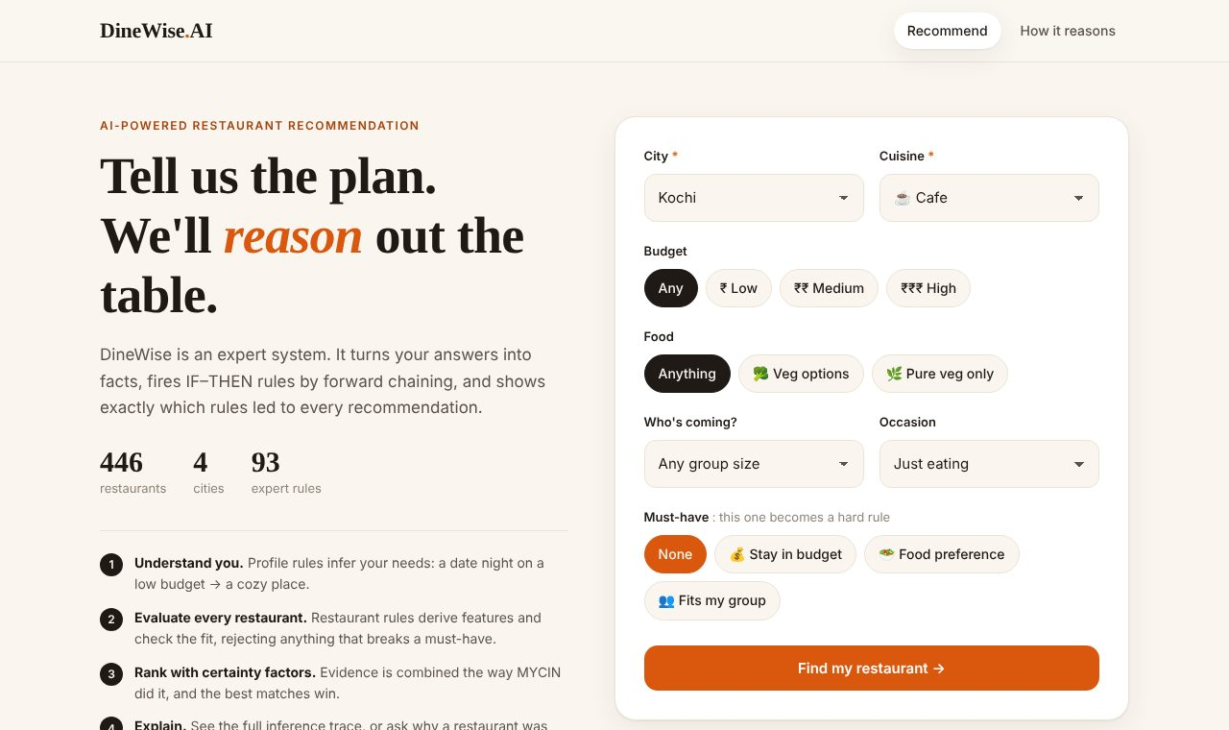
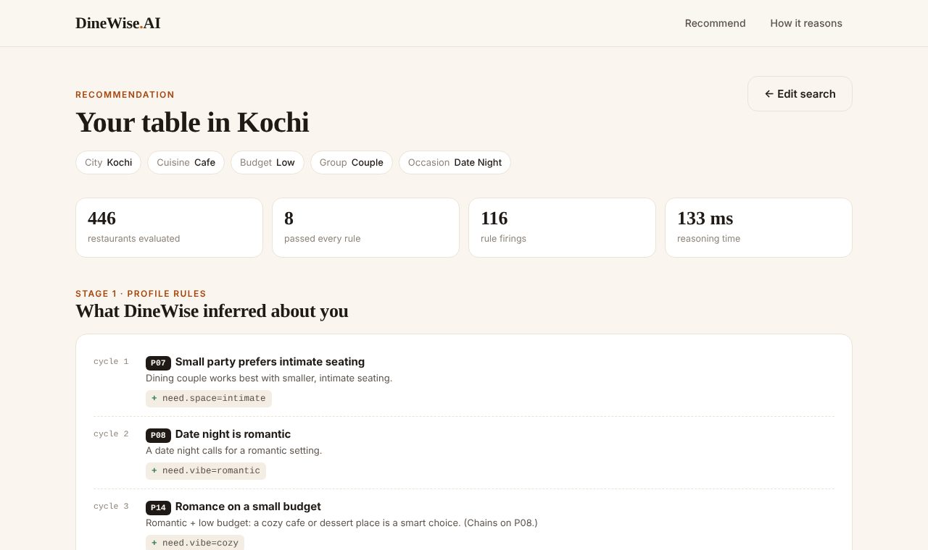
Output Screens
09 • OUTPUT SCREENS
Home: diner preferences
Stage 1: profile inferences
City, cuisine, budget, food, group, occasion and the must-have choice.
Rules fired for the diner, e.g. date night → romantic → cozy.
RAJALAKSHMI ENGINEERING COLLEGE • CSE (CYBER SECURITY)
10

Slide 11
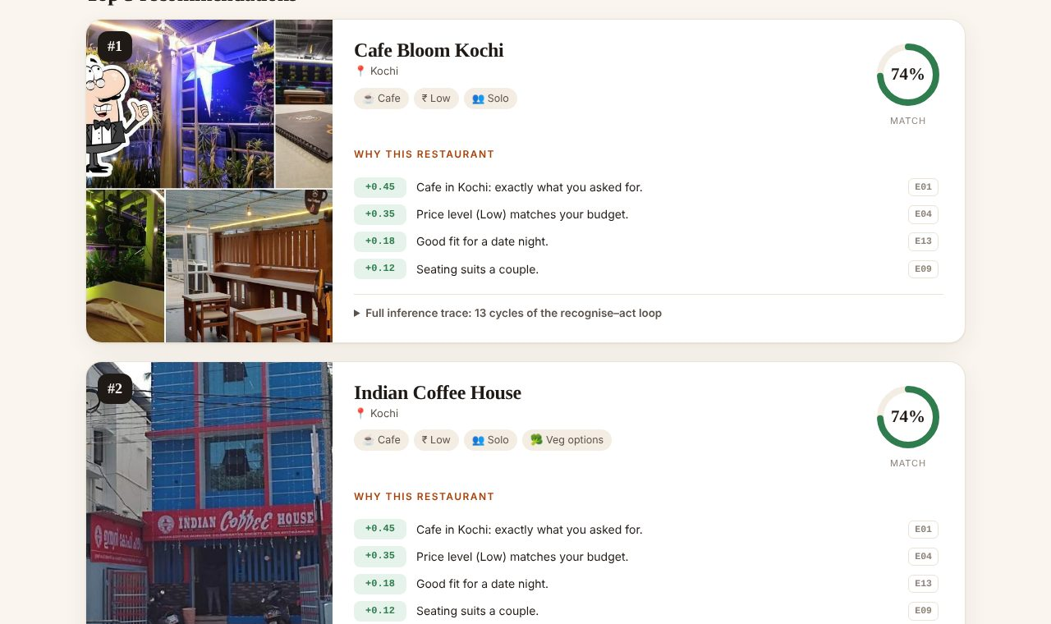
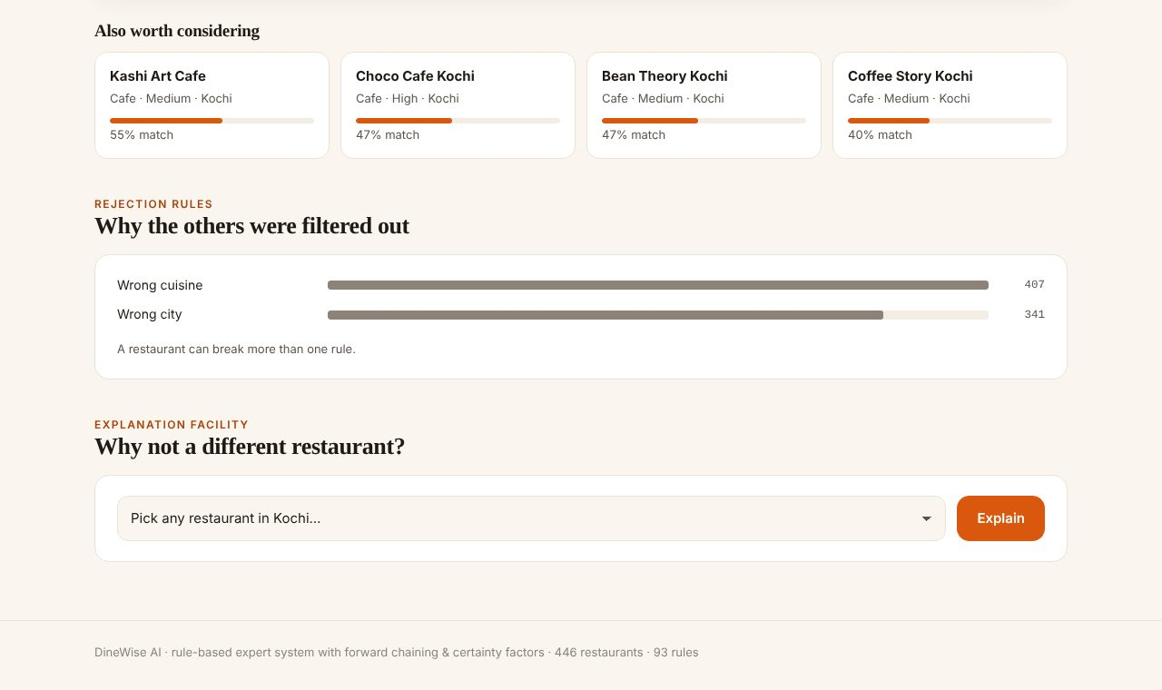
Output Screens
09 • OUTPUT SCREENS (CONTD.)
Top 3 recommendations
Why the others were filtered out
Each card shows the % match and the evidence rules behind it.
Rejection statistics and the “Why not a different restaurant?” tool.
RAJALAKSHMI ENGINEERING COLLEGE • CSE (CYBER SECURITY)
11

Slide 12
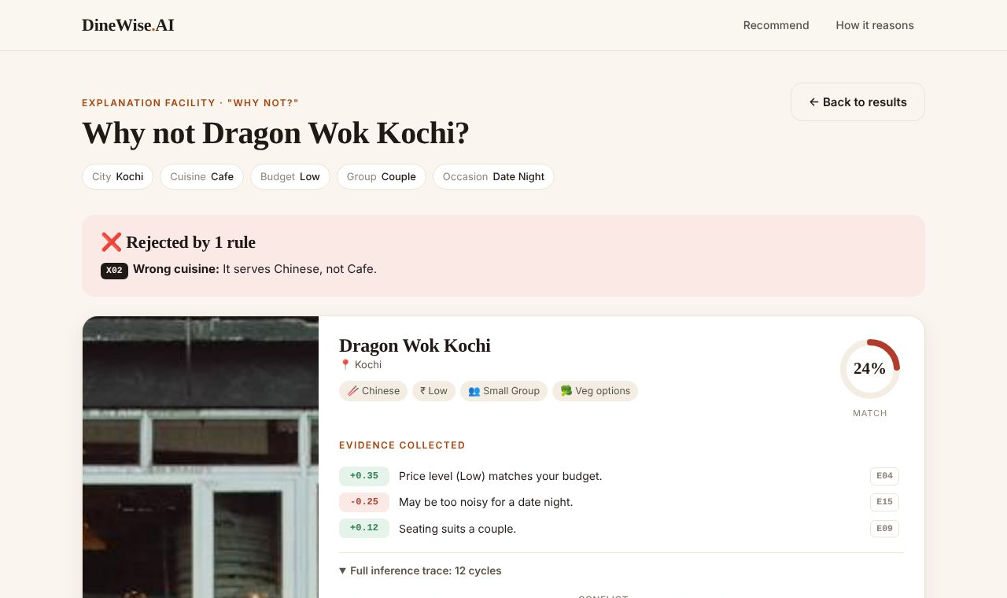
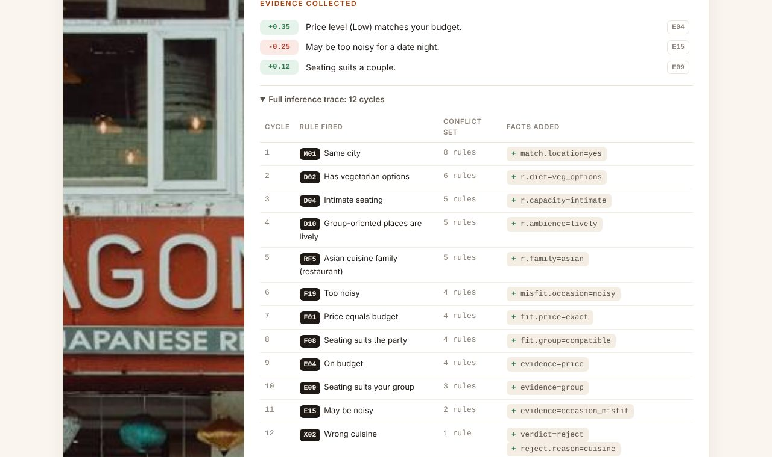
Output Screens
09 • OUTPUT SCREENS (CONTD.)
“Why not?” verdict
Inference trace
Dragon Wok Kochi is rejected by rule X02: wrong cuisine.
Each cycle lists the rule fired, the conflict set and the facts added.
RAJALAKSHMI ENGINEERING COLLEGE • CSE (CYBER SECURITY)
12

Slide 13
Testing & Validation
10 • QUALITY CHECKS
14 / 14 TESTS PASSED
✓
Forward chaining
✓
Conflict resolution
Chained facts are derived; each rule fires once.
Salience first, then the more specific rule.
✓
Certainty factors
✓
Pure-veg constraint
MYCIN combination gives the right % match.
No mixed kitchen is ever recommended.
✓
Relaxation & ranking
✓
Why not & web pages
Results ranked by CF; relaxation explained.
Rejecting rule reported; all pages render.
Run with: python -m pytest -q → 14 passed. Tests cover the engine, the recommender and the Flask web app.
RAJALAKSHMI ENGINEERING COLLEGE • CSE (CYBER SECURITY)
13

Slide 14
Limitations & Future Enhancements
11 • NEXT STEPS
CURRENT LIMITATIONS
FUTURE ENHANCEMENTS
• Rule certainty factors are set by hand
• No real ratings, opening hours or distance
• Rules can only be edited in the code
• Covers 4 cities and 446 restaurants
• Learn rule CFs from user feedback (👍 / 👎)
• Add ratings, opening hours and distance
• A rule editor in the browser
• Compare with a content-based ML recommender
• Expand to more cities with live data
The proposed enhancements describe future scope, not features claimed as already implemented.
RAJALAKSHMI ENGINEERING COLLEGE • CSE (CYBER SECURITY)
14

Slide 15
CONCLUSION
DineWise AI shows how a forward-chaining expert system with certainty factors can recommend restaurants and explain every choice.
THANK YOU
Questions & Discussion
DineWise AI • Project Review
KEY TAKEAWAYS
• Knowledge kept separate from the engine
• Certainty factors turn evidence into % match
• Explanations make every result transparent
Presented by [Your Name] | Reg. No. [Reg. No.]
Rajalakshmi Engineering College

