Slide 1
Heart Disease Prediction
Using Effective Machine Learning Techniques
 | BY
M VINAY KUMAR | (16RJ1A05C8)
M ANJANEYULU RAJU | (16RJ1A05F0)
M LOKANAND | (16RJ1A05F3)
Under guidance of
N.PAVAN

Slide 2
ABSTRACT
  Heart disease is a common problem which can be very severe in old ages and also in people not having a healthy lifestyle.
  The main objective of this project is to try and reduce the number of occurrences of the heart diseases in patients. The medical data such as age, sex, Blood pressure, cigarette smoked per day and so on is taken as input and then these features are modelled for prediction.
  The algorithms like K- nearest neighbor , Naïve Bayes and decision tree are used.

Slide 3
EXISTING SYSTEM
Diagnosis of the condition solely depends upon the Doctor's intuition.
DISADVANTAGES:
Detection is not possible at an earlier stage.
In the existing system is time consuming .

Slide 4
PROPOSED SYSTEM
In proposed system we don’t depend upon doctor but we use algorithms to predict heart disease through machine learning.
We use algorithms like K- nearest neighbor , Naïve Bayes and decision tree to increase accuracy of result.
  ADVANTAGES:
Very less time taking and accurate result.
Detection is possible at an earlier stage.

Slide 5
HARDWARE REQUIREMENTS
PROCESSOR | : PENTIUM AND ABOVE
SPEED | : 1.1GHz AND ABOVE
RAM | : 2GB AND ABOVE
HARD DISK | : 512GB AND ABOVE

Slide 6
SOFTWARE REQUIREMENTS
OS | : WINDOWS 10
IDE | : ANACONDA (JUPITER)
TECHNOLOGY | : PYTHON
DATA FILE TYPE | : CSV

Slide 7
Algorithms:
1.KNN(K-Nearest Neighbours)
2.Naive Bayes
3.Decision tree
4.Random Forest

Slide 8
K– Nearest Neighbour:
1.In 1951, Hodges et al. introduced a nonparametric technique for pattern classification which is popularly known the K-Nearest Neighbour.
2.K-Nearest Neighbour technique is one of the most elementary but very effective classification techniques.
3.It makes no assumptions about the data and is generally be used for classification tasks when there is very less or no prior knowledge about the data distribution.

Slide 9
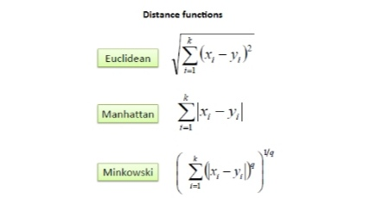

4.This algorithm involves finding the k nearest data points in the training set to the data point for which a target value is unavailable and assigning the average value of the found data points to it.
5.It uses following equations.

Slide 10
Naïve Bayes
1.Naive Bayes is a simple but an effective classification technique
which is based on the Bayes Theorem.
2. It assumes independence among predictors, i.e., the attributes or features should be not correlated to one another or should not, in anyway, be related to each other.
3.Even if there is dependency, still all these features or attributes independently contribute to the probability and that is why it is called Naïve.

Slide 11
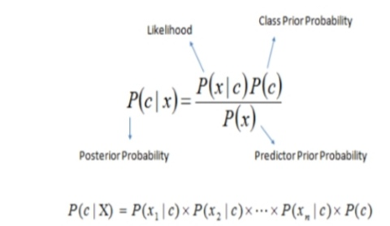
4.we use following Bayes Theorem formula.

Slide 12
Decision Tree:
1.Decision Tree Decision tree is a of supervised learning algorithm.
2.This technique is mostly used in classification problems.
3.It performs effortlessly with continuous and categorical attributes.
4.This algorithm divides the population into two or more similar sets based on the most significant predictors.
5.Decision Tree algorithm, first calculates the entropy of each and every attribute. Then the dataset is split with the help of the variables or predictors with maximum information gain or minimum entropy. These two steps are performed recursively with the remaining attributes.

Slide 13
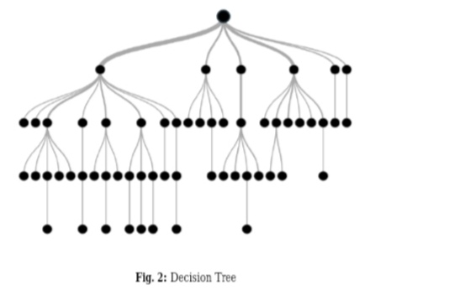

Slide 14
Random Forest:
1. Random Forest is also a popular supervised machine learning algorithm.
2.This technique can be used for both regression and classification tasks but generally performs better in classification tasks. As the name suggests, Random Forest technique considers multiple decision trees before giving an output.
3. So, it is basically an ensemble of decision trees. This technique is based on the belief that more number of trees would converge to the right decision.
4 For classification, it uses a voting system and then decides the class whereas in regression it takes the mean of all the outputs of each of the decision trees. It works well with large datasets with high dimensionality.

Slide 15
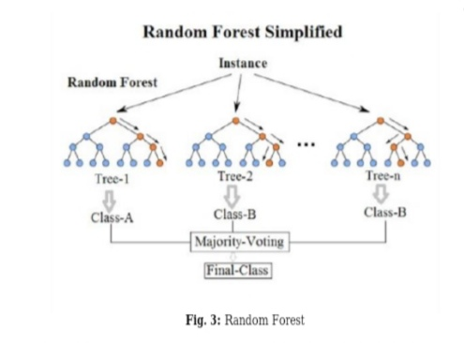
Fig4:Random forest

Slide 16
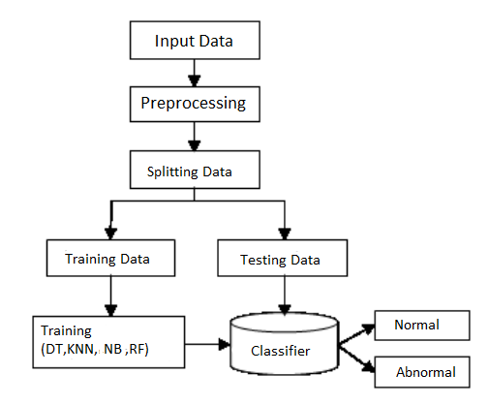
System Architecture

Slide 17
Input Data
First the data set is read for further process. This source is a comma separated file (CSV).
Preprocessing
The database contains NaN values. The NaN values cannot process by the programming hence these values need to convert into numerical values. In this approach mean of the column is calculated and NaN values are replaced by the mean.
Splitting Data
The whole database is split into training and testing database. The 80% data is taken for training while remaining 20% data is used for testing.
Training Data
This data is used to train the model.

Slide 18
Testing Data
This data is used to test the trained model for checking accuracy of output.
Training
The model is trained for prediction purpose.
Classification
The training data is trained by using four different machine learning algorithms i.e. Decision Tree, KNN, Random forest.

Slide 19
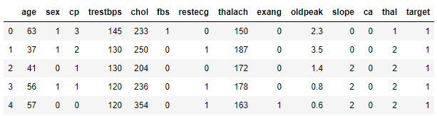
Data Set Sample

Slide 20
RESULT
Algorithm | Accuracy
KNN | 80-85%
Naïve Bayes | 80-85%
Decision Tree | 75-90%
Random Forest | 80-95%

Slide 21
CONCLUSION
This work will be useful in identifying the possible patients who may suffer from heart disease in the next 10 years. This may help in taking preventive measures and hence try to avoid the possibility of heart disease for the patient. So when a patient is predicted as positive for heart disease, then the medical data for the patient can be closely analysed by the doctors.

Slide 22
THANK YOU

