Slide 1
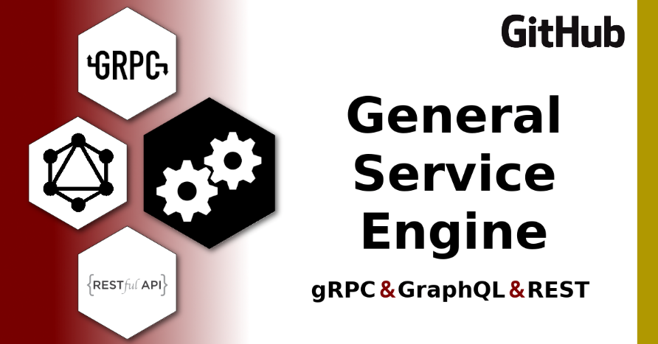
# OVERVIEW \
intro to service-engine
c
Generalized service engine that auto provisions REST, GraphQL & gRPC services that support CRUD operations with full validation to tables, views and materialized views of several popular databases
## Multiple Implementations:
service-engine
SRC for NPM package
service-engine-docker
Implements NPM package
SRC for Generic Docker Image
service-engine-template
Implements Generic Docker Image
Ideal for bootstrapping new projects
## Key Features
Auto provision of server resources to support CRUD in REST, GraphQL & gRPC with minimal configuration
Validation at the source
Support DB Schema migration
Auto Generate API Documentation (openapi3 docs, GraphQL Playground, .proto file)
Provide a hook for intercepting the query before execution in order to append extra data (specifically to support partition keys)
1
2
3
JOE WINGARD | 2021 OCTOBER 15 | SLIDES: tinyurl.com/conf42-service-engine .

Slide 2
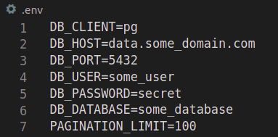
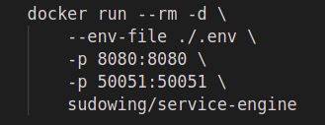

# HOW IT WORKS \
startup sequence
2
Run DB Migrations
Autodetects DB resources via DB Survey
Builds JOI validators for all DB resources
Publishes REST, GraphQL & gRPC services
3
1
PostgreSQL
MySQL
SQLite
Oracle
Redshift
SQL Server
SE
:8080 REST
## Key REST Endpoints
Health Check Route
http://localhost:8080/healthz
OpenAPI3 Definitions
http://localhost:8080/openapi
.proto
http://localhost:8080/proto
GraphQL Playground
http://localhost:8080/some-app-service/graphql/
4
:8080 GraphQL
:50051 gRPC

Slide 3
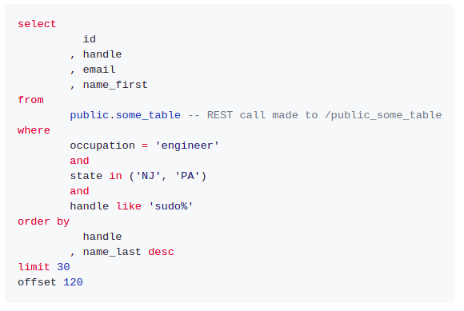
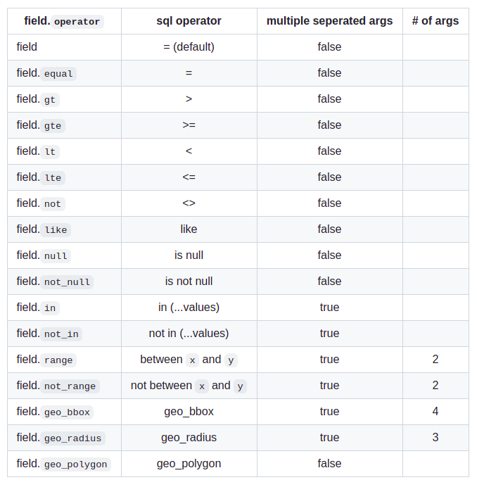
# KEY CONCEPT \
service call → structured query language
c
5
## SQL Operators
c
1
2
http://localhost:8080/sample-app-name/service/${schema}_${table}/
? occupation = engineer
& state.in = NJ|PA
& handle.like = sudo%
& |page = 5
& |limit = 30
& |orderBy = handle,name_last:desc
& |fields = id,handle,email,name_first
& |seperator = |
3
## REST API Endpoint Patterns
action | method | endpoint pattern | note
CREATE | POST | /service/:resource | 1 or many
READ | GET | /service/:resource/record?field_a=alpha&field_b=bravo | if resource is keyed
UPDATE | PUT | /service/:resource/record?field_a=alpha&field_b=bravo | if resource is keyed
DELETE | DELETE | /service/:resource/record?field_a=alpha&field_b=bravo | if resource is keyed
READ | GET | /service/:resource | many supported operators
6
## Additional Query Context
4
## REST API Headers
key | description
|page | Pagination Page
|limit | Pagination Limit
|fields | Fields to return from the SQL query
|orderBy | Fields to order results by. (field_a:desc,field_b,field_c:desc)
|seperator | Separator used to separate values submitted in request
req header key | req header value | resp header key | resp header value description
 |  | x-request-id | UUID assigned to request for injection into log
x-get-sql | truthy | x-sql | SQL built by service
x-get-count | truthy | x-count | unpaginated count for submitted query

Slide 4
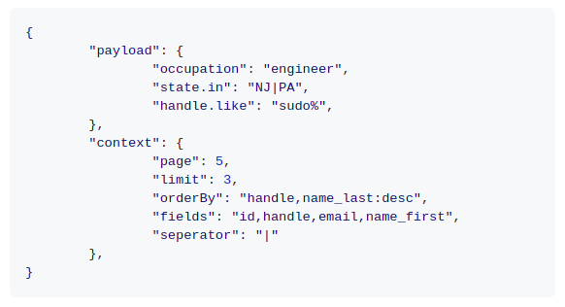
# SYSTEM DESIGN \
normalize → validate → build SQL
c
1
http://localhost:8080/sample-app-name/service/${schema}_${table}/
? occupation = engineer
& state.in = NJ|PA
& handle.like = sudo%
& |page = 5
& |limit = 30
& |orderBy = handle,name_last:desc
& |fields = id,handle,email,name_first
& |seperator = |
REST
view
GraphQL
resolver
gRPC
method
3
2
service call normalizer
4
query validation
6
5
query builder
7
database

Slide 5
# DOCUMENTATION \
video feature overviews & requirements
## Application Considerations
### Unsupported Characters in GraphQL
All DB schema names, resource names and field names must adhere to GraphQL Schema Definition Language (SDL)
### DB Permissions
Migration support is optional -- however if you want to use it you'll need to ensure the service account being used by the app has appropriate permissions to create objects and write records.
### Returning Fields on CREATE & UPDATE
Not all DBs support returning fields on INSERT & UPDATE statements.
Postgres does and it's the recommended engine for new projects implemented this library.
For example, MySQL & Sqlite3 return 201s with no-body in REST and other payloads in GraphQL & gRPC.
c
1
## Feature Overview Videos
Quick Start
Key REST Endpoints
Insomnia Import
CRUD Operations
SQL Operators
Query Context
API Response Metadata
Debug Mode
Permissions
DB Schema Migrations
GraphQL Playground and Geoqueries
gRPC Service (CRUD & Geoqueries)
Complex Resources (subqueries & aggregate queries)
Middleware & Redactions

Slide 6


# CLOSING NOTES \ feedback, closing thought & contact info
Joe Wingard
github @sudowing
keybase @sudowing
linkedIn @joewingard
PostgreSQL
geo
data
SE
1
:8080 REST
:8080 GraphQL
:50051 gRPC
## Project Feedback
Feedback and Recommendations are best received as Pull-Requests & GitHub Issues.
## Closing Thought
I hope this project is useful to you and your team. If you find it valuable, please send me a note!
MySQL
user
data
SE
2
:8080 REST
:8080 GraphQL
:50051 gRPC
api.domain.com
/v1/geography
/v1/user
/v2/prediction
/v1/inventory
/v1/partner
SQLite
prediction
data
SE
3
:8080 REST
:8080 GraphQL
:50051 gRPC
SQL Server
inventory
data
SE
4
:8080 REST
:8080 GraphQL
:50051 gRPC
Oracle
partner
data
SE
5
:8080 REST
:8080 GraphQL
:50051 gRPC
6

