Slide 1
Intro to Flask
Sudarshan Muralidhar

Slide 2
Minimal Web Framework
Build a webserver using Python
Doesn’t enforce lots of structure (use your own classes, databases, whatever)
Super easy debugging
All Python packages are available!
Great community and documentation

Slide 3
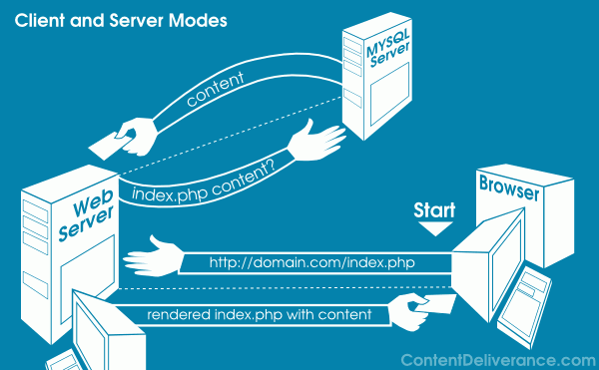
What’s a server?
Flask lets you handle incoming requests, and serve back responses (html, json, text, whatever) to the client
Useful websites, APIs

Slide 4
2 Major Use-Cases
Websites
HTML and JS is great, but can’t handle login forms, storing users, etc
APIs
Lightweight tools for other people (or you!) to use
Automatic updates for applications
App asks server if it should update; server returns download url
Built a program and want to let others use it from their apps
They send a request with parameters to server, server sends back processed result

Slide 5
Intro
Basic App
Debugger

Slide 6
POST vs GET requests
GET - Requests data from a specified resource
Can send some parameters, but these are public
https://www.youtube.com/watch?v=blahblah&t=100
Can be bookmarked and cached; stored in history
Browser’s default request type.
POST - Submits data to be processed to a specified resource
Parameters are hidden
Browsers ask for confirmation before resending
No restriction on length or type of data

Slide 7
Website
Goal:
Homepage says hi
Login asks for name and password
/user/name says “hi name” and lists all people who have logged in
Static Page
Templated Page
Handling request parameters
Template inheritance

Slide 8
More Tutorial
http://flask.pocoo.org/docs/0.10/quickstart/

Slide 9
Hosting On Server
http://alex.nisnevich.com/blog/2014/10/01/setting_up_flask_on_ec2.html
https://www.digitalocean.com/community/tutorials/how-to-deploy-a-flask-application-on-an-ubuntu-vps

