Slide 1
The role of Informatics in Patient Safety
Dr. Sukhen Dey
Indianan University Southeast

Slide 2
Let’s Define Patient Safety and Informatics
Patient safety is “the environment, infrastructure and technology emphasizing the reporting, analysis and prevention of medical error and adverse events that might case a patient ‘harm’ “.
Informatics is “the application of computing technology, network protocols, telecommunication mechanism and software algorithms applied towards improving the quality of a “Human Service” process”

Slide 3
Patient Safety might Encompass:
Patient fall
Medication errors
Identification errors
Suicide
Infection
Patient protection from bodily harm
Post / op complications
Treatment delays
Adverse drug effects
Many others coming out every day

Slide 4
Basic Statistics
Projected from a report from the Institute of Medicine in 1999 I estimate (using some statistical inferences) that as many as 140,000 people die in U.S. hospitals each year as the result of lapses in patient safety.
Over past 5 years over 125,000 medication errors have been reported to FDA (Just one agency )
Imagine, how many might have not been reported?
Imagine, how many might have not been reported because non-identification of errors?

Slide 5
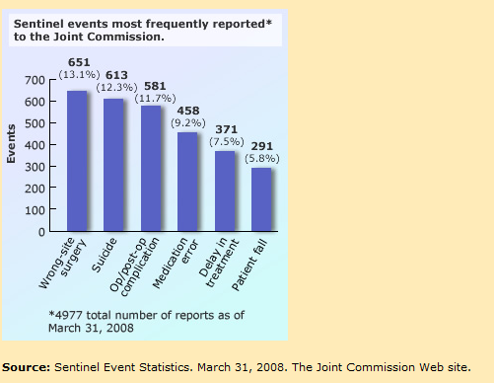
Some joint Commission Statistics

Slide 6
How Application of Informatics can help?
Three Basic Classification of Informatics Application in Patient Safety:
Hardware oriented
Software oriented
Predictive model oriented (BI)

Slide 7
Hardware to ensure patient safety-Examples
Patient bracelet
Lightweight, wireless devices which enable nurses to perform safety checks and safely administer bedside medications.
The Hardware, DB and network backbone that distribute real-time access to patient-specific data and evidence-based medical knowledge–so one can make the right decision at the right time.
Bedside dispensing cabinet systems with digital technology to keep track of medication, administration and safety.
The XXX Type Bandage is ideal for controlling arterial bleeding and severe external hemorrhage.
In Near Future – Gentleman we have the technology (Dr. Dey)
Global Network with synchronous treatment protocols (VOIP)
Holographic Image Transportation within and Outside Hospitals
Global Nursing Stations – Outsourced to different countries like India
Automated ergonomic based Motion-Beds to prevent bed sores

Slide 8
Software to ensure patient safety-Examples
Patient response monitoring systems
Risk Monitoring software in gathering data on nursing-sensitive indicators required for submission to any Agency database.
Intelligent Incident Reporting software – Not just for reporting but Decision Support
Software reporting PSIs (Patent safety Indicators ) as proposed by AHRQ (Agency for Healthcare Research and Quality)
In Near Future – (Dr. Dey)
Intelligent – Bilingual – Response Monitoring System – with ‘No response’ message distribution to the next expert station – collaborative healthcare
On-line real-time risk monitoring software producing “leading indicators” for ensuring patient safety – proactive not reactive

Slide 9
Predictive models to ensure patient safety-Examples
Correlations of environmental variables with patient safety violation incidences – 3^{rd,} 6th and 12th Floors
Regression analysis to predict what independent variables can explain the variances in patient safety violations – Language, age, Disease Type, English instructions to non-English speaking patients, primary physicians etc.
Predictive analysis based on patient demographics so that we can be more careful to “High risk” patients (multivariate and data mining ).
Pattern Recognition Algorithms to recognize “leading Indicators” of safety.
Structural equation modeling, sometimes called path analysis, to gain additional insight into causes of “Safety Violations” – if you know the cause you can prevent it.

Slide 10
An (on-line) Course in Patient Safety and Informatics at IUS
I am in a process to design an On-line Course at Indiana University which can be offered to Students and Clinical Professional
Benefits of an on-line course:
“Patient Safety and Informatics” are relatively theoretical topics and well suitable for distance learning
Convenient to offer to a large body of students
Various research projects can be assigned and managed
Has world-wide potential
Important “Discussion Forums” using today’s technology with participants from interdisciplinary areas
If interested contact me at sdey@ius.edu

Slide 11
In Conclusion
Beyond all technologies, at the end of the day:
One must approach Patient Safety as “Mission Critical”
One must preserve physical, emotional and intellectual rights of Patients
One must consider Patient Safety as a means to improve overall “Public Health and Safety”

Slide 12
Some questions to consider:
Q: Patient safety is “the environment, infrastructure and technology emphasizing the reporting, analysis and prevention of ______and adverse events that might case a patient ‘___’ “.
A: Patient safety is “the environment, infrastructure and technology emphasizing the reporting, analysis and prevention of medical error and adverse events that might case a patient ‘harm’ “.

Slide 13
Some questions to consider:
Q:Informatics is “the application of computing technology, network protocols, telecommunication mechanism and software algorithms applied towards improving the quality of a “________” process”
A: Informatics is “the application of computing technology, network protocols, telecommunication mechanism and software algorithms applied towards improving the quality of a “Human Service” process”

Slide 14
Some questions to consider:
Q: Which of the following incidences may be threats to patient Safety:
Patient fall
Medication errors
Suicide
1 & 2
1, 2 & 3
A: 1,2 & 3

Slide 15
Some questions to consider:
Q. Over past 5 years over 125,000 medication errors have been reported to FDA (Just one agency ) T F
A. T

Slide 16
Some questions to consider:
Q. Based on my lecture (Dr. Dey) what are the typical categories of informatics applications in Patient Safety?
Hardware
Software
Networks
Predictive models
1, 2 & 4
A: 1,2 & 4

Slide 17
The role of Informatics in Patient Safety
Dr. Sukhen Dey
Indianan University Southeast

