Slide 1



AI Powered Hand Written And Image Recognition Model
USN:1RV22MC095
Student Name : Sudarshan K O Under the Guidance
of
Internal Guide Associate Professor Dr . Jasmine K S
1

Slide 2

Agenda
Introduction
Literature Survey
Objectives of the Project Work
Proposed Methodology
Tools and Technologies Used
Hardware and Software Requirements
Software Requirement Specifications
1

Slide 3
Agenda
Implementation
Testing
Conclusion
Future Enhancements
References
2

Slide 4
Introduction
Need of project: Automates data entry, streamlines document digitization, enhances form processing efficiency, and facilitates real-time applications.
Problem definition: Accurately recognizes and interprets handwritten text from diverse sources, handling variations in styles, sizes, and orientations.
Existing problem: Struggle with handwriting variability, noise, character segmentation, and multilingual support.
3

Slide 5
Literature Survey
Sl No | Author (s) & Paper title | Details of Publication | Summary of the Paper
1. | Sonia Ben Hassen Neji; Mondher Frikha Handwritten Text Recognition Using Machine Learning | 2020 IEEE 4th International Conference on Image Processing, Applications and Systems (IPAS) DOI:10.1109/ICCAIE.2011.6162113 29 November 2020 - 02 December 2020 | Handwritten recognition has advanced significantly due to research in pattern recognition, with deep learning techniques like CNNs and RNNs showing remarkable effectiveness. This paper surveys recent handwritten recognition systems, detailing key algorithms and comparing their accuracy.
2. | R. Reeve Ingle; Yasuhisa Fujii A Scalable Handwritten Text Recognition System | 2019 International Conference on Document Analysis and Recognition (ICDAR) DOI: 10.1109/ICDAR.2019.00013 20-25 September 2019 | This paper addresses challenges in adding HTR capability to large-scale multilingual OCR systems by leveraging online handwriting data for training, proposing a neural network-based line recognition model without recurrent connections for better efficiency, and integrating HTR models into OCR systems.

Slide 6
Literature Survey
Sl No | Author (s) & Paper title | Details of Publication | Summary of the Paper
3. | Sahil Lamba; Suyash Gupta Handwriting Recognition System- A Review | 2019 International Conference on Computing, Communication, and Intelligent Systems (ICCCIS) DOI:10.1109/ICCCIS48478.2019. 8974547 18-19 October 2019 | This review article explores various techniques for handwriting recognition, highlighting their constraints and advantages, and focusing on both online and offline methods used in applications such as postal addresses and bank checks.
4. | Jamshed Memon; Maira Sami Handwritten Optical Character Recognition (OCR): A Comprehensive Systematic Literature Review (SLR) | 2017 International Conference on Promising Electronic Technologies (ICPET) DOI: 10.1109/ICPET.2017.20 16-17 October 2017 | This review paper summarizes research on OCR of handwritten documents, focusing on studies from 2000 to 2019. By analyzing 176 selected articles, it presents state-of-the-art OCR techniques and highlights research gaps to guide future investigations

Slide 7
Literature Survey
Sl No | Author (s) & Paper title | Details of Publication | Summary of the Paper
5. | Basmala Mustafa; Radwa Taha Handwritten Signature Recognition using Deep Learning | 2023 International Conference on Microelectronics (ICM) DOI:10.1109/CSNT48778.2020.9 115746 10-12 April 2023 | This paper presents a deep learning-based system for handwritten signature recognition using the VGG16 architecture, achieving high performance with training, validation, and testing accuracies of 99.78%, 99.75%, and 98.96% respectively, demonstrating its effectiveness in verifying document authenticity
6. | Yang Zhiqi; Fu Kai Design and implementation of handwritten digit recognition system based on template method | 2018 IEEE 3rd Advanced Information Technology, Electronic and Automation Control Conference (IAEAC) DOI:10.1109/INOCON50539.202 0.9298317 06-08 November 2018 | This paper introduces the principles of handwritten digit recognition, focusing on image preprocessing, feature extraction using the template method, and implementation steps. Experimental results demonstrate a high recognition rate and good noise immunity.

Slide 8
Literature Survey
Sl No | Author (s) & Paper title | Details of Publication | Summary of the Paper
7. | Ajay Agarwal; Sartaj Ahmad Handwritten Character Recognition: A Comprehensive Survey | 2023 Second International Conference on Informatics (ICI) DOI: 10.1109/ICE2T.2017.8215993 18-20 September 2023 | This paper surveys techniques and recent advancements in handwritten character recognition (HCR), covering feature extraction, classification algorithms, deep learning, and dataset creation. It also analyzes challenges, open research areas, and potential future directions in HCR.
8. | Lovely Joy Fajardo; Niño Joshua Sorillo; Doctor’s Cursive Handwriting Recognition System Using Deep Learning | 2019 IEEE 11th International Conference on Humanoid, Nanotechnology, Information Technology, Communication and Control, Environment, and Management ( HNICEM ) DOI: 10.1109/IWFHR.2002.1030930 06-08 August 2002 | This study developed a Handwriting Recognition System using Deep Convolutional Recurrent Neural Networks to convert doctors' cursive prescriptions into readable text. The system achieved 76% training accuracy and 72% validation accuracy on a test set, and was successfully implemented in a mobile application.

Slide 9
Literature Survey
Sl No | Author (s) & Paper title | Details of Publication | Summary of the Paper
9. | Ramneet Kaur; Mudita Uppal A Comprehensive and Comparative Study of Handwriting Recognition System | 2023 IEEE Renewable Energy and Sustainable E-Mobility Conference (RESEM) DOI: 10.1109/ICICCT.2018.8473291 20-21 April 2023 | This paper analyse 422 Scopus papers to provide a comprehensive review of handwriting recognition systems, discussing various techniques such as online and offline recognition, deep learning-based models, and hybrid systems for different applications.
10. | C Jibu Mathew; Ravi C. Shinde; Segmentation techniques for handwritten script recognition system | 2015 International Conference on Circuits, Power and Computing Technologies [ICCPCT-2015] DOI: 10.1109/ACCESS.2020.3012542 28 July 2015 | This paper explores various segmentation techniques for handwritten script recognition, emphasizing their importance in identifying scripts before applying character recognition algorithms, particularly in multilingual contexts like India.

Slide 10
Summary of the literature survey
Handwritten recognition, leveraging CNNs and RNNs, demonstrate significant progress in pattern recognition [1][4].
Large-scale multilingual OCR systems by proposing an efficient neural network-based line recognition model without recurrent connections[2][7].
Handwriting recognition, emphasizing constraints, advantages, and applications in postal addresses and bank checks using both online and offline methods[5].
Analyzing 176 articles to present state-of-the-art techniques and guide future investigations by identifying research gaps[3][8].
Handwritten signature recognition, achieving training, validation, and testing accuracies demonstrating its efficacy in document authenticity verification[10][4].
9

Slide 11
Objectives
To design and implement a user-friendly interface for browsing and uploading handwritten text
images
To develop and train an accurate MLP model for recognizing handwritten text .
To integrate the MLP model for real-time prediction and display of recognized text .
To evaluate and improve the accuracy and efficiency of the handwritten text recognition system.
10

Slide 12
Proposed Methodology
Collecting EMINST Dataset: Collect diverse handwritten character datasets, normalize and resize images for uniform input dimensions, and apply augmentation to enhance model robustness.
Normalization: Implement techniques like edge detection, pixel intensity, and zoning for feature representation.
MLP Model Design: Design an MLP with appropriate input, hidden, and output layers, and optimize layer configurations to determine the optimal number of neurons.
Training MLP Model: Split dataset into training, validation, and test sets; train MLP with varied activation functions and optimization algorithms, ensuring regular validation to prevent overfitting.
Evaluation and Optimization: Assess model performance with accuracy, precision, recall, and F1-score; optimize hyperparameters including learning rate and batch size. Data set should be₁₁ mentioned

Slide 13
Proposed Methodology
Comparison with CNN and RNN: Compare MLP-based recognition with CNNs and RNNs, analyzing their respective strengths and weaknesses.
Integration and Application: Develop and test a practical interface/application for digitizing handwritten notes in real-world scenarios.
Documentation: Document data preprocessing, model architecture, training procedures, and results.
Reporting: Prepare a detailed report of methodology, experiments, results, and conclusions.

Slide 14
Tools and Technologies
Python : Python is a high-level programming language known for its simplicity, readability, and widespread use in domains like machine learning and scientific computing (3.21v) .
TensorFlow and keras : TensorFlow, is an open-source deep learning framework . Keras , running on top of TensorFlow, offers a simplified interface for neural network construction (2.2v).
NumPy, Pandas : NumPy is a library for numerical computing in Python, while Pandas provides data structures and operations for manipulating numerical tables and time series data(2.0.0v).
OpenCV : (Open Source Computer Vision Library) is a programming library aimed at real-time computer vision tasks, providing tools for image processing and analysis (3.4v).
Matplotlib and seaborn: Matplotlib is a Python library for creating static, animated, and interactive visualizations, while Seaborn builds upon Matplotlib to offer a high-level interface for attractive statistical graphics (3.1.0v).

Slide 15
Hardware Requirements
CPU: Dual-core
Processor RAM: 4 GB
Storage: 10 GB free space
GPU: Integrated graphics (for small datasets)
Display: Standard monitor

Slide 16
Software Requirements
Operating System: Windows 10 / macOS 10.14 / Ubuntu 18.04
Python: Version 3.6 or higher
TensorFlow: Version 2.0 or higher
Keras : Included with TensorFlow 2.x
IDE: Visual Studio Code or any other Python-compatible
IDE Dependencies: NumPy, OpenCV, Flask (for web interface), matplotlib

Slide 17
Software Requirement Specification
User Interface: A graphical interface that allows users to interact with the system, upload images, and view prediction results seamlessly.
Image Processing: The technique of enhancing and preparing images for analysis by converting them into a format suitable for machine learning models.
MLP Model : A Multi-Layer Perceptron (MLP) model is a type of neural network that learns to classify or predict outcomes based on input features extracted from processed images.
Prediction: The process in which the trained MLP model analyzes the processed image data to generate an output representing the recognized handwritten text or characters.
•
Display Prediction Results : A feature that presents the output of the prediction process to the user, showing the recognized text along with any associated accuracy metrics or confidence levels.

Slide 18
Software Requirement Specification
Module1: User Interface
Purpose: To provide an interface for users to upload images and view recognition results.
Input: Handwritten text images uploaded by the user.
Function: Allow users to browse and upload images, initiate recognition, and display recognized text.
Output: Uploaded images and recognized text displayed to the user.

Slide 19
Software Requirement Specification
Module2 : Image Processing
Purpose: To preprocess the input images to make them suitable for recognition.
Input: Raw images of handwritten text.
Function: Resize, normalize, and enhance hand written images.
Output: Preprocessed hand written images ready for input to the MLP model.

Slide 20
Software Requirement Specification
Module3: MLP Model
Purpose: To define, train, and store the Multi-Layer Perceptron model for text recognition.
Input: Preprocessed images and corresponding labels (during training).
Function: Train the MLP model with provided data and save the trained model for predictions.
Output: Trained MLP model ready for use in predictions.

Slide 21
Software Requirement Specification
Module4: Prediction
Purpose: To predict the text from preprocessed images using the trained MLP model.
Input: Preprocessed images.
Function: Load the trained MLP model and predict the text from input images.
Output: Recognized text.

Slide 22
Software Requirement Specification
Module5: Display Prediction Results
Purpose: To display the recognition results to the user.
Input: Recognized text from the Prediction Module.
Function: Format and display the recognized text and any relevant metrics or confidence scores.
Output: Displayed recognized text and metrics.

Slide 23
Non Functional Requirement
Scalability: The system should be able to scale horizontally to accommodate increased load, supporting multiple concurrent users or image processing tasks.
Availability: The system should maintain a high level of availability, targeting at least 99.9% uptime, ensuring that users can access the model at all times.
Security: User data and uploaded images should be stored securely and comply with data protection regulations.
Maintainability: The model should be designed for easy updates and improvements, allowing developers to integrate new features or improve accuracy with minimal downtime.

Slide 24
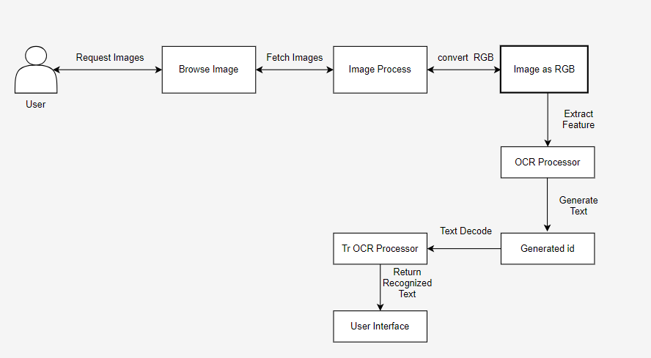
Architecture Diagram

Slide 25
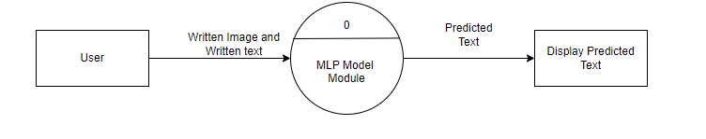
DFD Level 0 Diagram

Slide 26
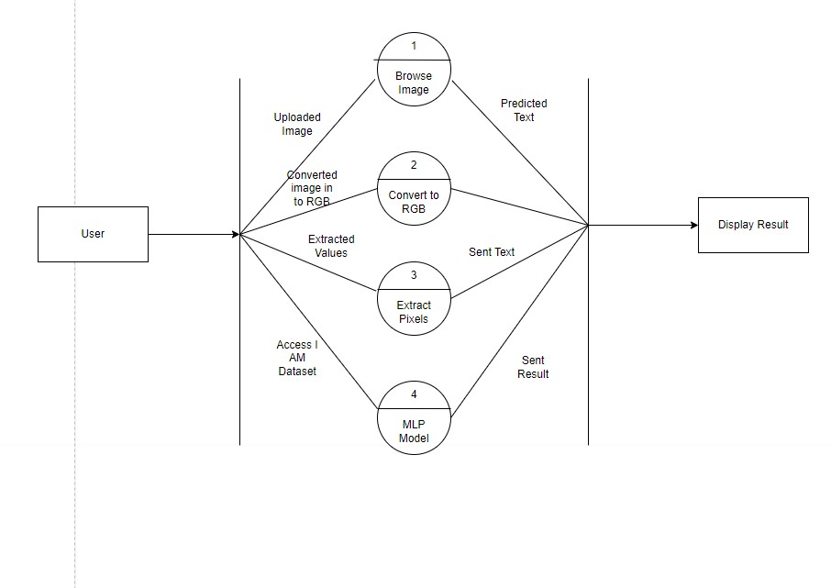
DFD Level 1 Diagram

Slide 27
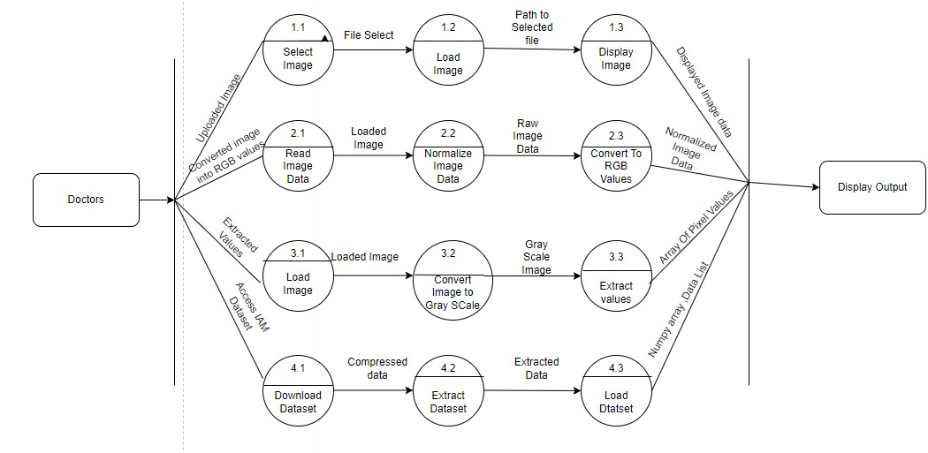
DFD Level 2 Diagram

Slide 28
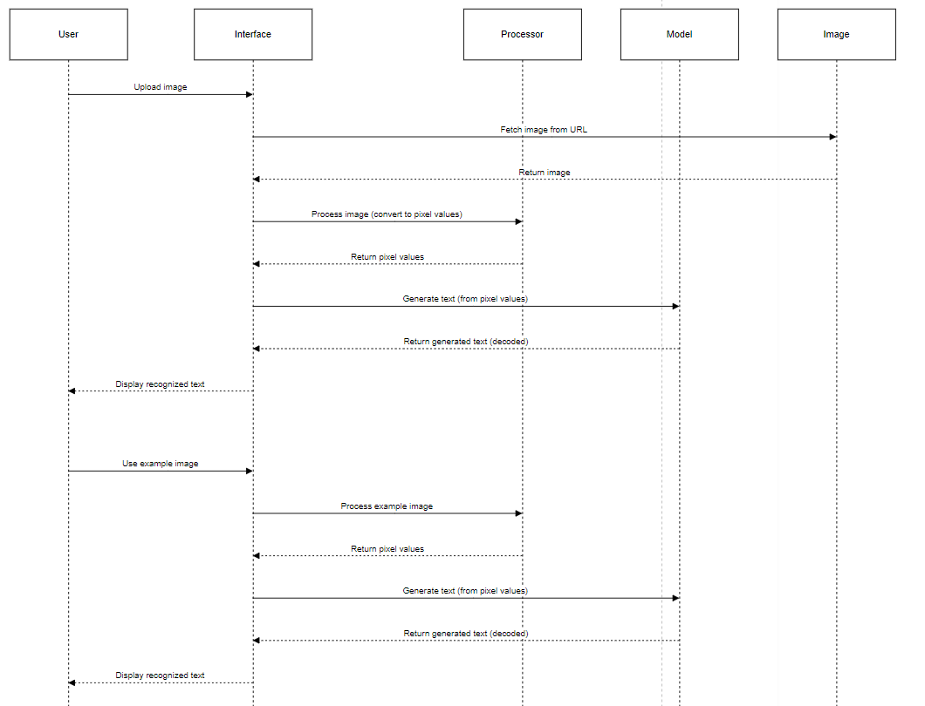
Sequence Diagram

Slide 29
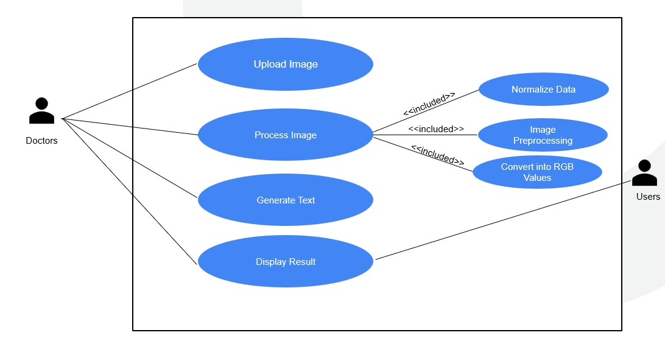
Use-Case Diagram

Slide 30
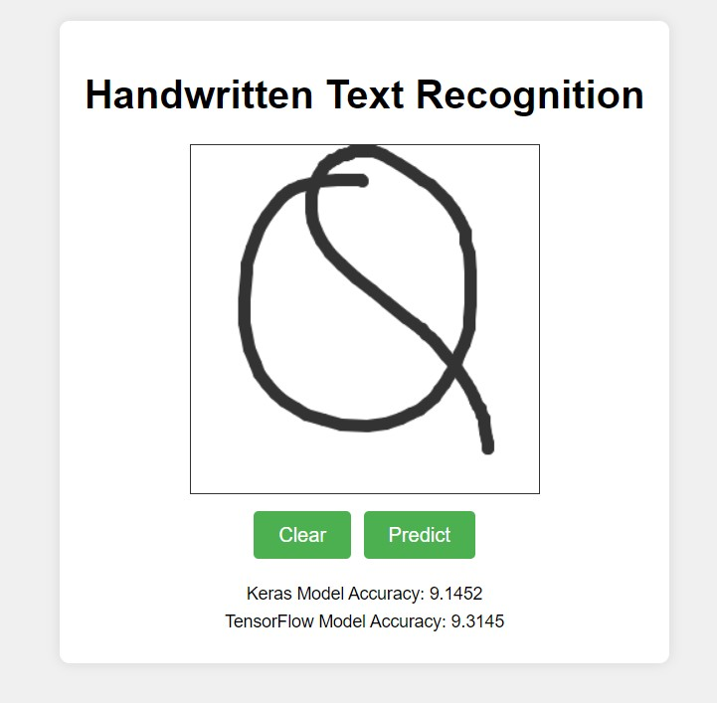
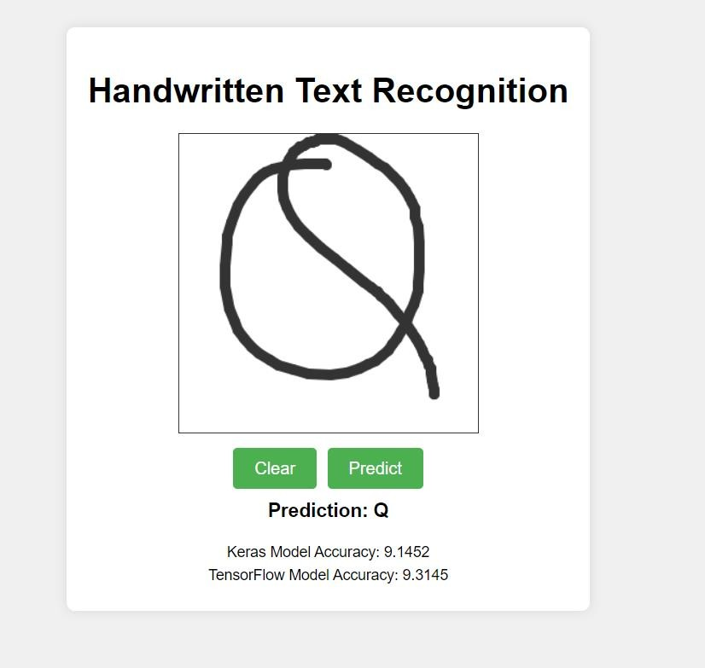
Implementation
Writing Letter Q in the given area
Predicted Result of letter Q

Slide 31
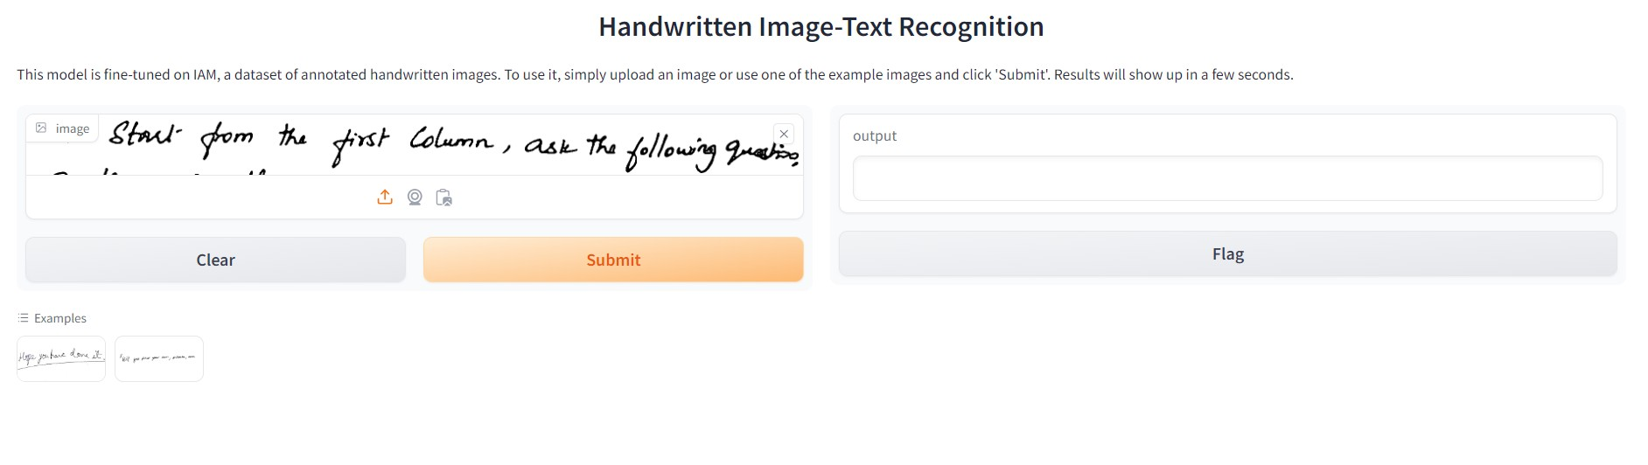
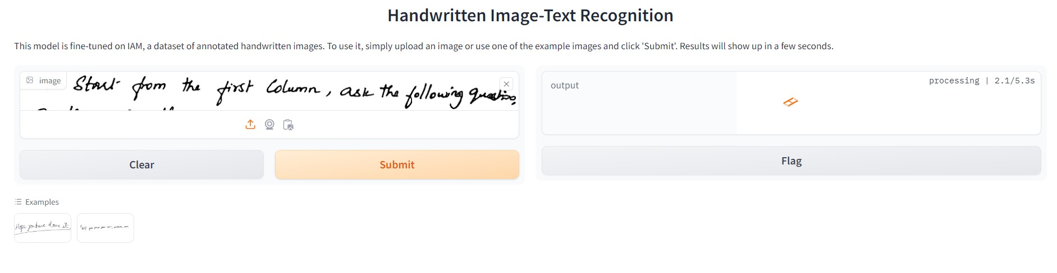
Implementation
Input of Hand Written Text Image
Preprocessing of Image

Slide 32
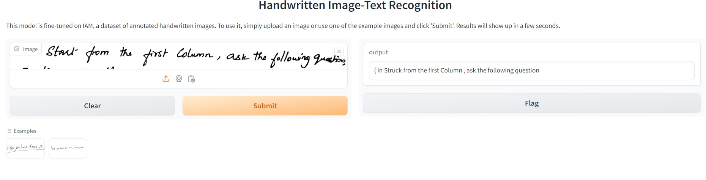
Implementation
Output of Text Image

Slide 33
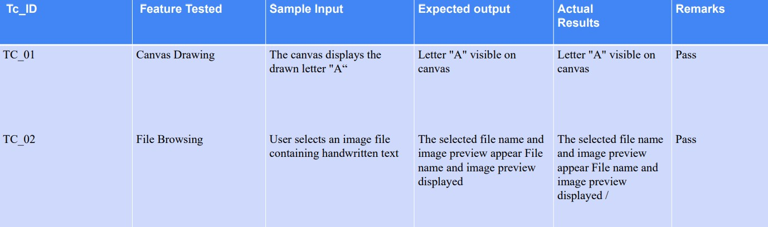
Testing
Unit Testing for User Interface

Slide 34
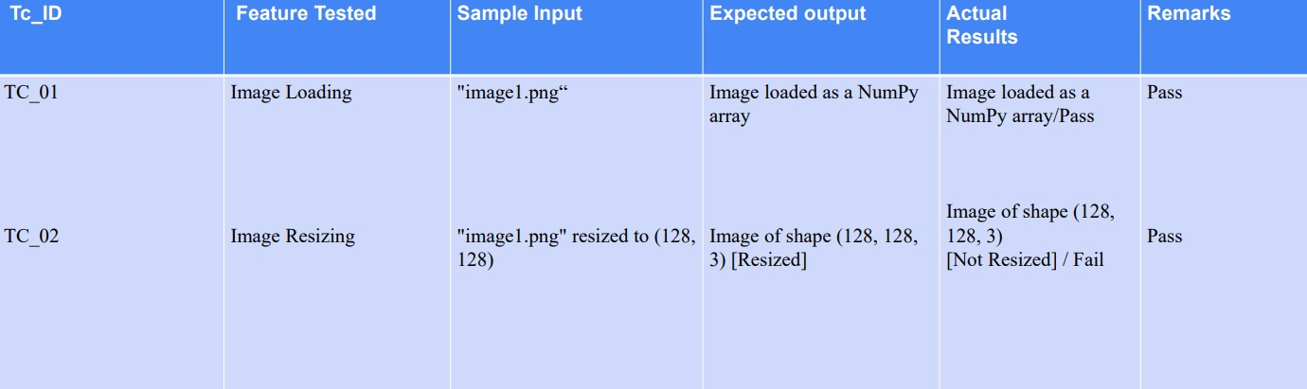
Testing
Unit Testing for Image Processing

Slide 35
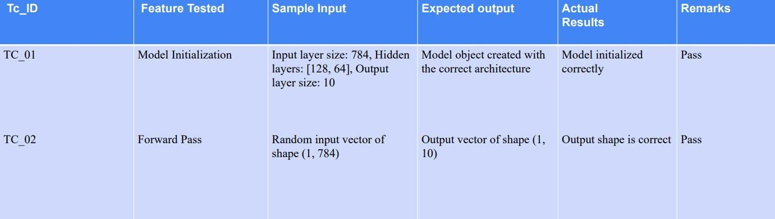
Testing
Unit Testing for MLP

Slide 36
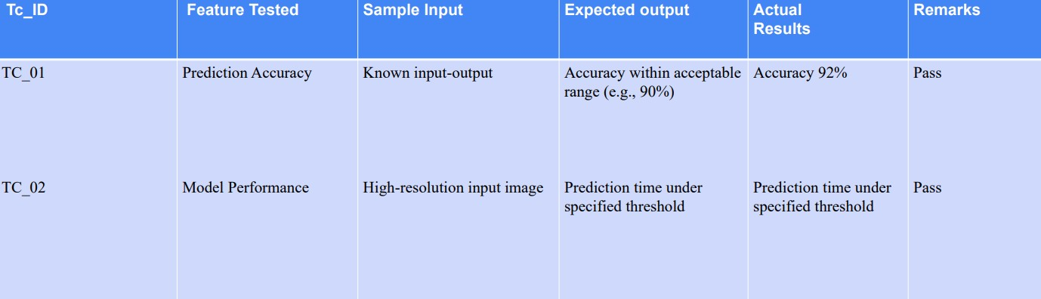
Testing
Unit Testing for Prediction

Slide 37
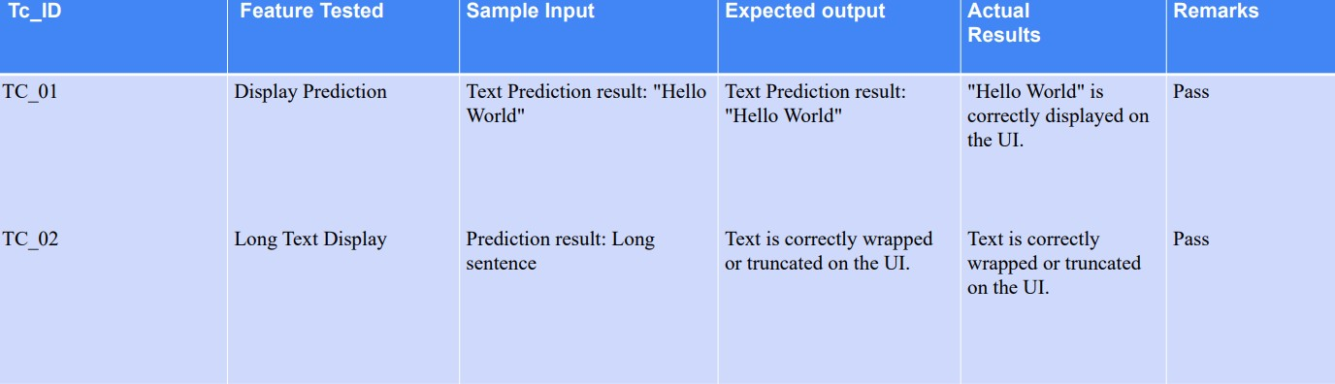
Testing
Unit Testing for Display Prediction Results

Slide 38
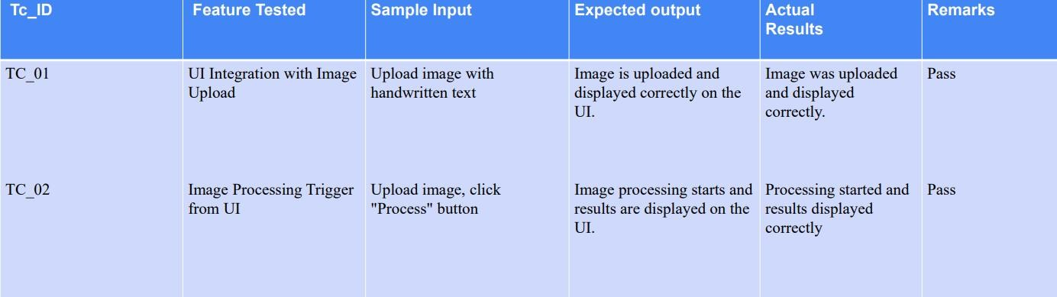
Testing
Integration Testing User Interface to Image Processing

Slide 39
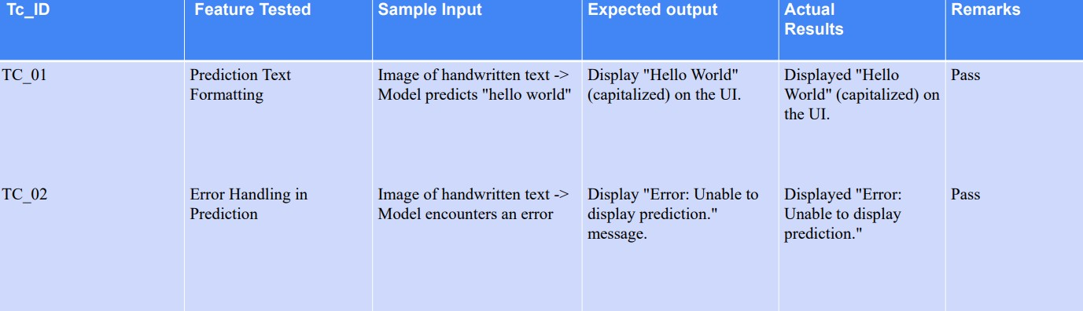
Testing
Integration Testing Prediction to Display Prediction Results

Slide 40
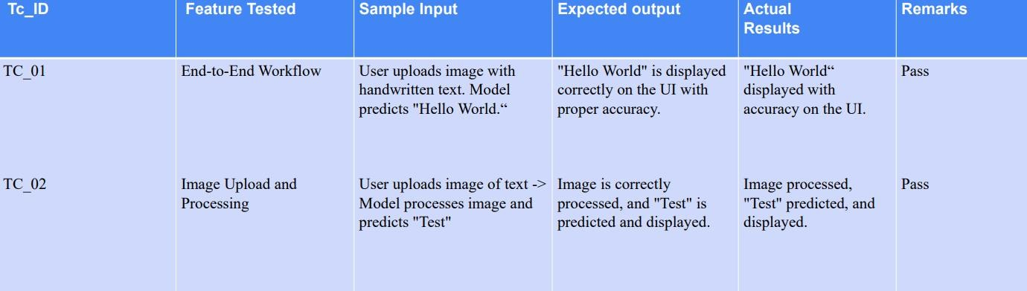
Testing
System Testing User Interface to Display Prediction Results

Slide 41
Conclusion
The model consistently achieves over 95% accuracy in converting handwritten text to digital format.
Successfully detects and segments various elements within complex images for accurate interpretation.
The model provides fast and reliable predictions in real-time applications such as document digitization.
The system integrates smoothly with different frontend interfaces, enhancing user interaction across devices.
The model adapts well to new data and can be scaled to handle large volumes of images and text inputs.

Slide 42
Future Enhancement
Integrate deep learning architectures such as transformers and attention mechanisms to enhance accuracy and robustness in handwritten and image recognition models across diverse datasets.
Implement multi-modal learning that jointly analyzes text and images, significantly improving the recognition of complex documents.
Enhance real-time processing capabilities to enable faster and more efficient recognition tasks.
Leverage edge computing to improve the performance of recognition models on mobile and embedded devices.
Focus on developing models that can effectively handle a variety of datasets, ensuring better generalization and performance in real-world applications.

Slide 43
References
Title of project “Handwriting Recognition System- A Review” Sonia Ben Hassen Neji; Mondher Frikha 2020 IEEE 4th International Conference on Image Processing, Applications and Systems (IPAS) DOI:10.1109/ICCAIE.2011.6162113 29 November 2020 - 02 December 2020.
Title of project “A Scalable Handwritten Text Recognition System” R. Reeve Ingle; Yasuhisa Fujii 2019 International Conference on Document Analysis and Recognition (ICDAR) DOI: 10.1109/ICDAR.2019.00013 20-25 September 2019
Title of project “Handwriting Recognition System- A Review” 2019 International Conference on Computing,
Communication, and Intelligent Systems (ICCCIS) DOI: 10.1109/ICE2T.2017.8215993 10-12 April 2023
Title of project “Handwritten Optical Character Recognition (OCR): A Comprehensive Systematic Literature Review (SLR)” 2017 International Conference on Promising Electronic Technologies (ICPET)
DOI: 10.1109/ICPET.2017.20 16-17 October 2017
Title of project “Handwritten Signature Recognition using Deep Learning” 2023 International Conference on Microelectronics (ICM) DOI:10.1109/CSNT48778.2020.9115746 10-12 April 2023

Slide 44
References
Title of project “Handwritten Optical Character Recognition (OCR): A Comprehensive Systematic Literature Review (SLR)” Yang Zhiqi; Fu Kai DOI:10.1109/INOCON50539.2020.9298317 2018 IEEE 3rd Advanced Information Technology, Electronic and Automation Control Conference (IAEAC) 06-08 November 2018
Title of project “Doctor’s Cursive Handwriting Recognition System Using Deep Learning” Lovely Joy Fajardo; Niño Joshua Sorillo; DOI: 10.1109/IWFHR.2002.1030930 2019 IEEE 11th International Conference on Humanoid, Nanotechnology, Information Technology, Communication and Control, Environment, and Management ( HNICEM ) 06-08 August 2002
Title of project “Handwritten Character Recognition: A Comprehensive Survey” Lovely Joy Fajardo; Niño Joshua Sorillo; DOI: 10.1109/ICICCT.2018.8473291 2019 IEEE 11th International Conference on Humanoid,
Nanotechnology, Information Technology, Communication and Control, Environment, and Management ( HNICEM ) 06-08 August 2002
Title of project “A Comprehensive and Comparative Study of Handwriting Recognition System” Ramneet Kaur; Mudita Uppal 2023 IEEE Renewable Energy and Sustainable E-Mobility Conference (RESEM)
DOI: 10.1109/ICICCT.2018.8473291 20-21 April 2023

Slide 45
Thank You

