Slide 1
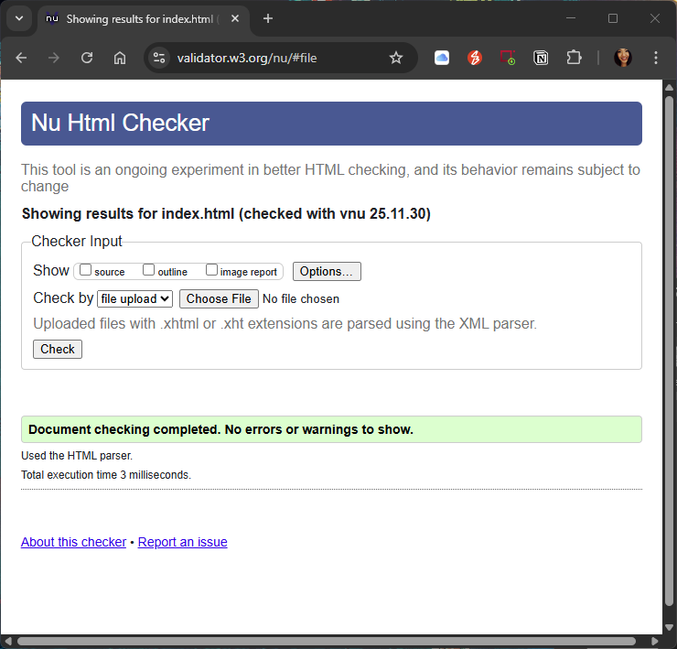
Validations
Homepage

Slide 2

Validations
Contact

Slide 3

Validations
About

Slide 4

Validations
Resume

Slide 5
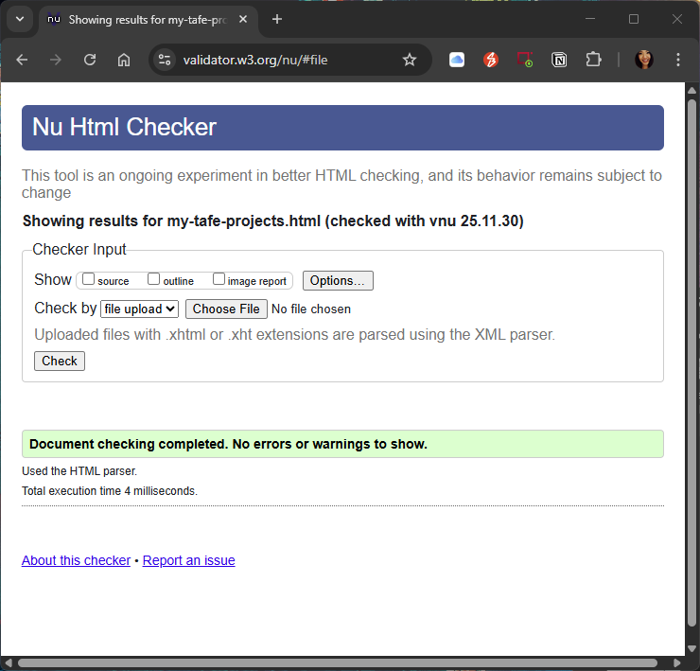
Validations
Tafe Projects Samples

Slide 6
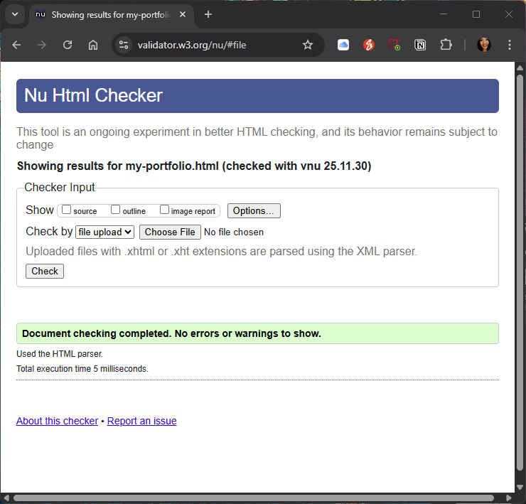
Validations
My Portfolio

Slide 7

Validations
Copyright

Slide 8
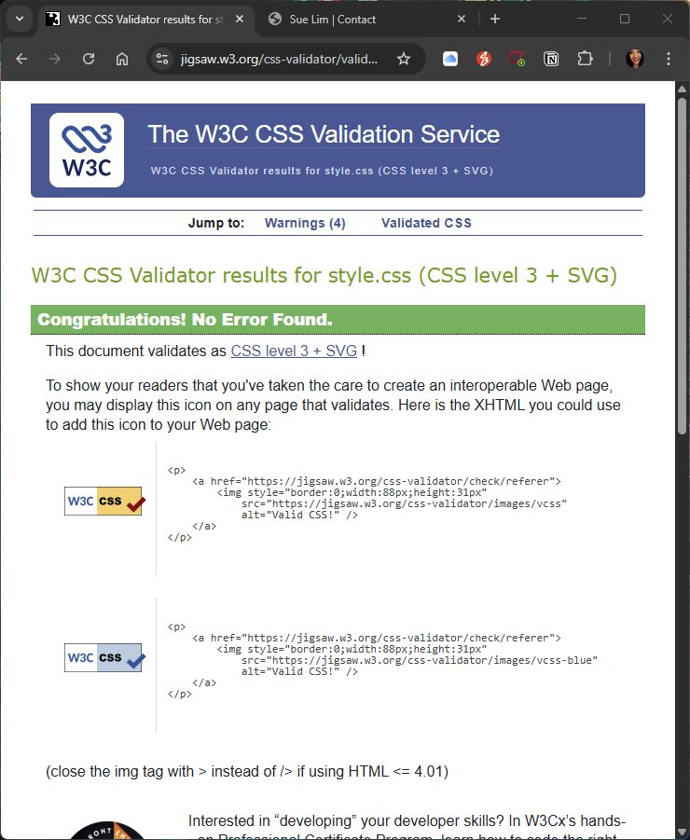
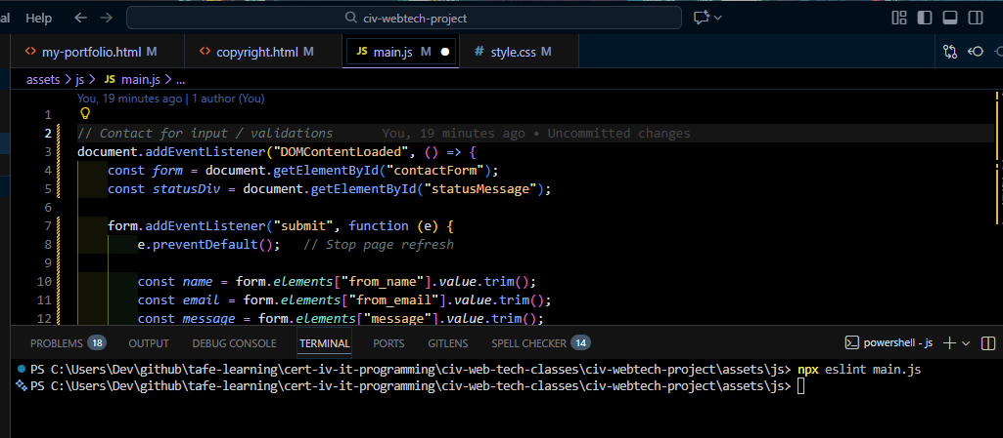
Validations
CSS & JS

