Slide 1
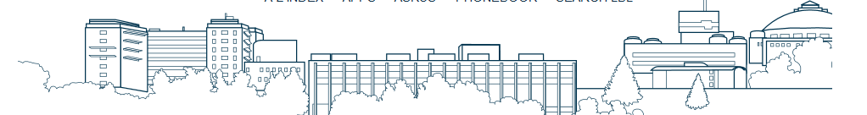

EHS 304 Laser Alignment Training
Laser Safety Program
2018

Slide 3
Exercise # 1. Wedge Window Alignment
Maximum time for completing the exercise: 30 minutes
Overview
The alignment and setup of wedge window assembly presents high potential for laser eye injury and uncontrolled secondary back reflection as a wedge consist of two reflective surfaces and can potentially be oriented in such a way to expose directly the back reflection upward or towards an undesired path. The users will learn how to safely mount and setup a wedge window.
The wedge window used in this exercise is:
  LW3-1037C, Fused Silica, Uncoated, 3º wedge
Tools
Laser protective eyewear for 638 nm
Beam blocks
Fluorescent cards

Slide 4
Wedge Window Alignment
MIRROR 1
OPTICAL LAYOUT
Diode Laser
BEAM BLOCK
TARGET
1.4 mW, 638 nm
BEAM BLOCK
MIRROR 2
IRISES
WEDGE WINDOW
BEAM BLOCK
TASKS:
Start with the laser beam blocked or disabled. Put on the appropriate laser protection goggles.
Position a beam block between the mirrors. Enable the red laser and open the beam.
Align so the beam is on the first mirror. Block the beam at the laser aperture.
Place a beam block between the second mirror and the first iris. Open the beam. Align so the beam is on the second mirror.
Block the beam. Close both irises and place beam block behind the first one. Open the beam.
Align such as the beam is centered on the closed first iris. Block the beam. Move the beam block behind the second iris.
Unblock the laser and open the first iris to allow the beam to reach the second iris. Align so the beam is centered on the second iris.
Iterate these steps until both irises are correct. Verify for stray reflections with a card.
Block the laser. Move the beam blocks around the wedge window. Open the second iris.
Holding a card at front of the window, adjust the window mount so the beam enters the window aperture.
Check for front and back surface reflections. Be careful, if positioned incorrectly, the reflected beam may be upward.
Rotate the window inside the mount or the mount itself so that reflected beam would be on the target or horizontal. Find the back reflection beam and either align it on target or block it. Use gloves if touching the optics.
Perform two point unique alignment, to verify that the beam is in horizontal plane. Iterate these steps until both targets are correct.
Verify that all beams, including reflected or stray beams, are contained.
Block the laser or turn it off.

Slide 5
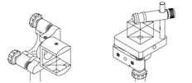
Exercise # 2. Beam Splitter Cube Alignment
Maximum time for completing the exercise: 15 minutes
Overview
The alignment and setup of polarizing beam splitter cube presents high potential for laser eye injury and/or uncontrolled reflections as a polarizing cube consist of two polarized orthogonal reflections coming from two orthogonal surfaces. Typical mounting of such optic allows for 360º rotation, therefore presenting high risks for upward and unsafe beam path.
The students will learn how to safely mount a non-polarizing beam splitter cube:
Broadband Dielectric Non-Polarizing Beamsplitter Cube
  12.7 mm, 400-700 nm
  50/50 splitting for un-polarized light
  Multilayer broadband dielectric coating
  CW and low-energy pulsed laser applications
Tools
Laser protective eyewear for 638 nm
Beam blocks
Fluorescent cards

Slide 6
Beam Splitter Cube Alignment
OPTICAL LAYOUT
MIRROR 1
Diode Laser
1.4 mW, 638 nm
REFLECTED BEAM TARGET
BEAM BLOCK
MIRROR 2
IRISES
BEAM SPLITTER CUBE
BEAM BLOCK
TASKS:
Start with the laser beam blocked or disabled. Remove (or leave in) the wedge window mount.
Repeat tasks 2 thru 8 from Exercise # 1 if not completed already.
Block the laser. Place a beam block at front of the cube. Open the second iris.
Unblock the beam.
Adjust the mount so the beam enters the cube aperture. Rotate/adjust the beamsplitter mount so that reflected beam would be in horizontal plane and on the target.
Check for stray beam at all sides.
Verify all beams, including reflected or stray beams, are contained.
Block the laser or turn it off.

Slide 7
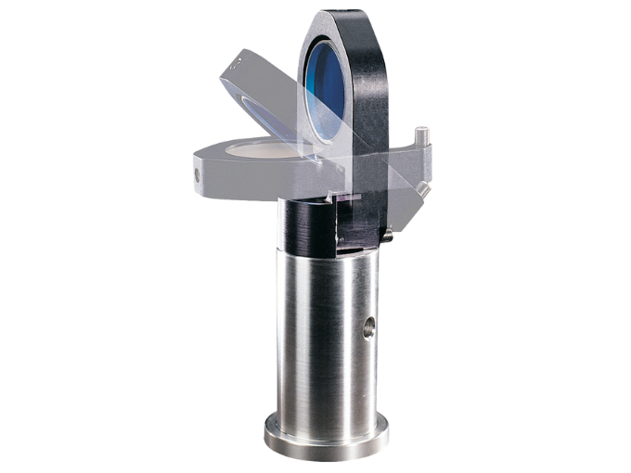
Exercise # 3. IR Beams and Flipper Mirror Setup
The following experimental setups are designed to teach one specific skill related to laser hazard commonly encountered in laser laboratories and setups.
Maximum time for completing the exercise: 15 minutes
Overview
The alignment and setup of a flipper mirror assembly presents high potential for laser eye injury as it can be set improperly and provide a risk to redirect a laser beam at a multitude of upward angles during the flipping motion.
Always mount the flip mirror to flip downwards!
Tools
Laser protective eyewear for 852 nm
Beam blocks
Fluorescent cards

Slide 8
IR Beams and Flipper Mirror Setup
OPTICAL LAYOUT
BEAM BLOCK
IRIS
IRIS
MIRROR 2
MIRROR 1
FLIPPER MIRROR ASSEMBLY
IR Diode Laser
BEAM BLOCK
MIRROR 3
3.8 mW, 850 nm
TASKS:
Start with the laser beam blocked or disabled. Remove the flipper mirror and the lenses mounts if in place.
Position a beam block at front of the first lens. Close the irises.
Put on the appropriate laser protection goggles.
Enable the IR laser. Holding a card on top of the mirror, adjust the laser such as the beam is on the Mirror 1. Remove the card. Block the beam at the laser, place beam blocks behind the first and second irises.
Open the beam, align it to be centered on the closed first iris.
Block the beam. Open the first iris, open the beam and center the beam on the second iris.
Proceed aligning the beam to Mirror 2 and Mirror 3 to final target on beam block using the safety skills learned in previously such as walking the beam from optic to optic with a card. Now you have the beam aligned.
Block the beam. Insert the flipper mirror in its mount. Place a beam block behind it.
Open the beam and align the beam so the beam reflection is redirected toward the beam block by the perimeter guard..
Always flip the mirror when the beam is blocked!
With the goggles on, use the IR viewer and verify all beams, including reflected or stray beams, are contained.
Block the laser or turn it off.

Slide 9
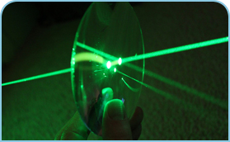
Exercise # 4. IR Beams and Telescope Alignment
Maximum time for completing the exercise: 15 minutes
Overview
The alignment and manipulation of IR beams pose a practical and safety problem due to the fact that the beam is invisible to the human eye. Therefore, any unexpected beams or scattered light cannot be detected visually. It requires additional laser tools that students will get familiar with. Additionally, introduction of lenses into the beam path may pose safety concerns as it generates diverging and converging beams that need to be considered and controlled.
The lenses used in this exercise are:
  LC1582-B, -75 mm, 1”, N-BK7, Plano Concave
  LA1986-B, +125 mm, 1”, N-BK7, Plano Convex
Tools
Laser protective eyewear for 850 nm
Beam blocks
IR and Fluorescent cards
IR viewer

Slide 10
IR Beams and Telescope Alignment
OPTICAL LAYOUT
BEAM BLOCK
IRIS
IRIS
MIRROR 2
MIRROR 1
-75 mm LENS
+125 mm LENS
IR Diode Laser
BEAM BLOCK
MIRROR 3
3.8 mW, 850 nm
TASKS:
Start with the laser beam blocked or disabled. Remove (or flip down) the flipper mirror and the lenses mounts if in place if not done already.
Repeat steps 2 thru 7 from Exercise # 3.
Position the lenses in their mounts.
Using the safety skills learned in previously (such as walking the beam from optic to optic with a card), align the beam thru the lenses. Check beam collimation. Observe motion of beam on beam block behind the +125 mm lens.
Optional task: you can change the distance between the lenses, place them at some angle, or rotate them to observe different optical effects such as telescope adjustment for beam collimation, telescope adjustment to focus at desired plane, telescope adjustment for astigmatism, filter strength and reflections.
With the goggles on, use the IR viewer and verify all beams, including reflected or stray beams, are contained.
Block the laser or turn it off.

Slide 11
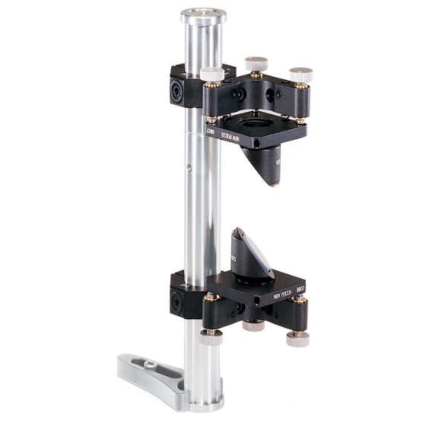
Exercise # 5. Periscope Alignment
Mandatory exercise, Maximum time for completing: 30 minutes
Overview
The alignment of a periscope of any type (up (down)-and-over or plane-vertical) present high potential for laser eye injury as it re-directs the beam in both the horizontal and vertical plane. A careful alignment process is required to ensure that all reflections are considered and controlled at all time. Additional safety measures are also suggested in this exercise as good practice to avoid scattered or direct exposures.
Tools needed
Laser protective eyewear for 532 nm
Beam blocks
Fluorescent cards

Slide 12
Periscope Alignment
BEAM BLOCK
OPTICAL LAYOUT
IRISES
PERISCOPE ASSEMBLY
Diode Laser
5mW, 532 nm
TARGET
TASKS:
Start with the laser beam blocked or disabled. Remove the polarizing beam ND filter if present.
Close both irises and place beam blocks behind the first and second isis.
Put on the appropriate laser protection goggles.
Enable the green laser and remove the beam block if present.
Adjust the laser such as the beam is centered on the closed first iris. Block the beam.
Unblock the beam and open the first iris to allow the beam to reach the second iris.
Align so the beam is centered on the second iris. Verify for stray reflections with a card.
Block the laser. Open the second iris.
Covering the upper mirror with a card, unblock the laser. Adjust the upper mirror so that the beam enters the mirror aperture. Align the mirror until the beam is pointing vertically down.
Move the card to cover the lower mirror, when beam is correct on the mirror, align the beam toward the target.
Perform two point unique alignment, to verify that the beam is in horizontal plane (optional).
Verify that there are no stray beams and all beams are contained.
Block the laser or turn it off.

Slide 13
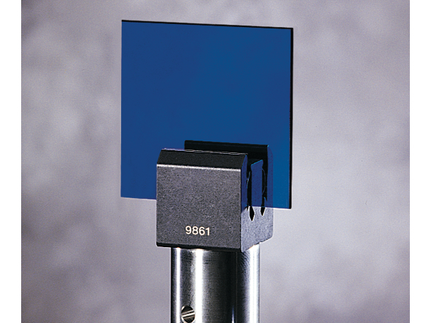
Exercise # 6. Attenuation Filters
Maximum time for completing the exercise: 15 minutes
Overview
The introduction of attenuator or other filters (such as band pass filters) into the beam path may pose safety concerns as it generates back reflections that need to be controlled at all time.
The neutral density filter used in this exercise is:
  NE203B, 50.8mm Square Absorptive ND Filter, ND=0.3
Tools
Laser protective eyewear for 532 nm
Beam blocks
Fluorescent cards

Slide 14
Attenuation Filters
BEAM BLOCK
OPTICAL LAYOUT
PERISCOPE ASSEMBLY
Diode Laser
5mW, 532 nm
ND FILTER
IRISES
TARGET
BEAM BLOCK
TASKS:
Start with the laser beam blocked or disabled. Use the already aligned beam in Exercise #5.
Place a beam block at front of the periscope.
Insert the ND filter intentionally offset. Hold the detector card close to the filter in the way you know the reflection will go before unblocking.
Open the beam. If practiced correctly, the beam is always on the card. Rotate the filter to the right position while holding the card. This way the reflected beam is never uncontrolled.
Once the filter is in the final position, block the reflected beam.
If desired, remove the beam block behind the ND filter and continue aligning the beam as in previous exercise.
Verify that there are no stray beams and all beams are contained.
Block the laser or turn it off.

