Slide 1
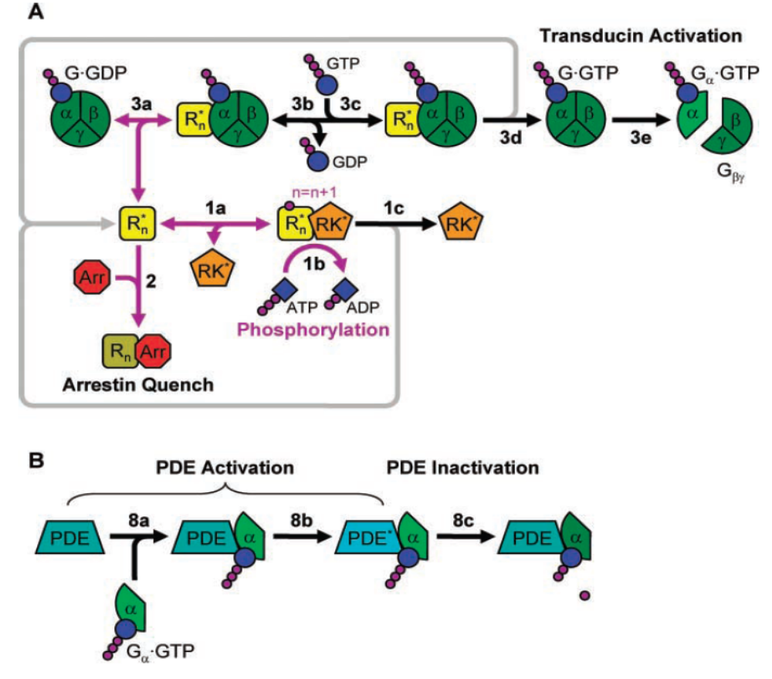
The System to be Modeled:
Photo Transduction in Rod Cells
The example shown in the following is adapted for this tutorial

Slide 2
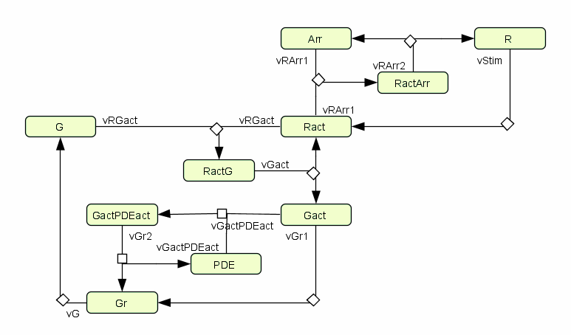
1) Model Network Structure
Components
Interactions
Stoichiometry
Adding mathematics in graphical tools is often a pain

Slide 3
2) Kinetic Rate Laws
Export graphical model to SBML => Import to IQR Tools
Add kinetic rate expressions in the IQRmodel
  We start simple, by assuming mass action kinetics
  Only in a single reaction we assume Michaelis Menten kinetics
Initialize parameters with guessed values
  Nothing known about the parameters => we set all to „1“

Slide 4
3) Initial Conditions
In this example we assume that:
Carefully undertaken experiments showed that the number of molecules of the involved species (WT) in the inactive state (thus their total amount) is as follows:
R = 500
G = 3000
Arr = 5
The number of PDE molecules is unknown but believed to be somewhere between 10 and 1000
All remaining species have an initial amount of 0

Slide 5
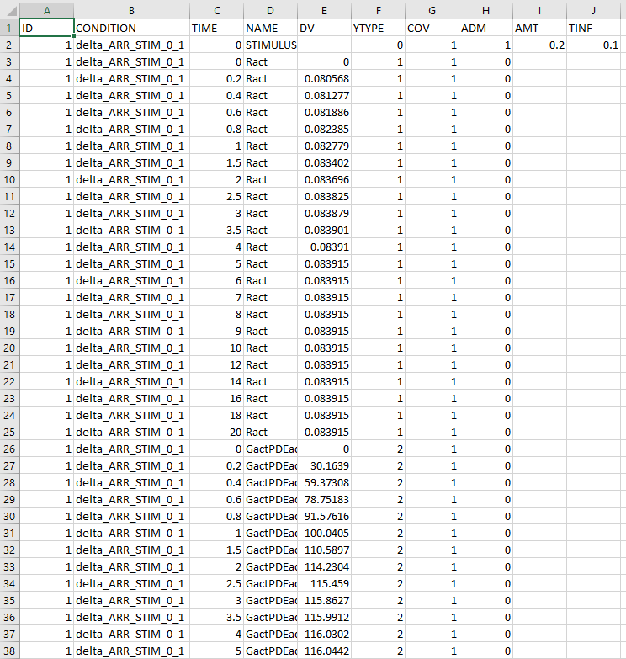
4) Measurement Data
The experimentalists gave us 4 documented CSV data files
  Time-series measurement data
  of Ract and GactPDEact
  Information about the biological
  experiments that have been performed
  to obtain the data
  The information in the documentation
  is the base for the specification of the
  experiment descriptions
  The data already is formated as CSV dataset for import_IQRsysData()

Slide 6
Experiments and Measurements
Time-series data measured
different
stimuli
measured
single knock-outs

