Slide 1
Analysing the Severity of Car Accidents
Using Python to Analyse the Data

Slide 2
The Problem
Analysing Accident Severity
SEVERITYCODE:
3 - fatality
2b - serious injury
2 - injury
1 - prop damage
0 - unknown
Looking at impact of Weather, Road Condition and Light Condition

Slide 3
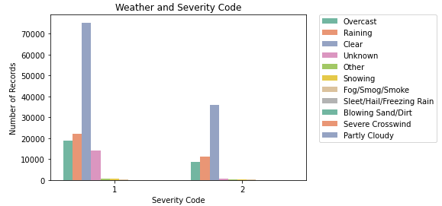
Weather and Severity Code

Slide 4
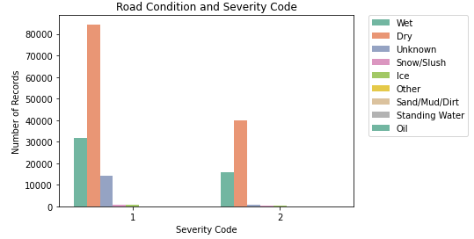
Road Condition and Severity Code

Slide 5
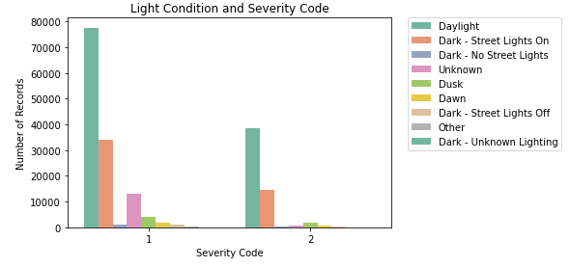
Light Condition and Severity Code

Slide 6
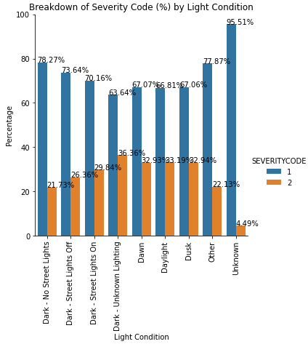
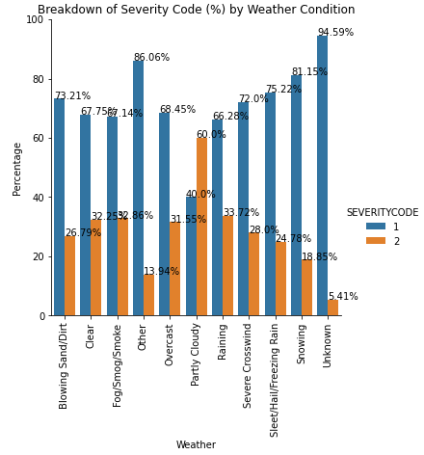
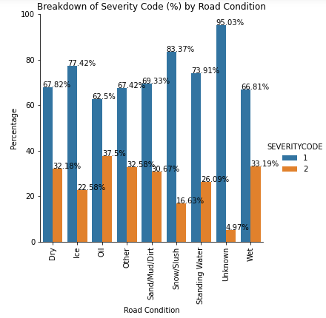
Percentages of Severity Code

Slide 7
Chi Square Results
Weather Chi Square
Null hypothesis 1: Weather does not affect Severity Code
Alternate hypothesis 1: Weather does affect Severity Code
Road Condition Chi Square
Null hypothesis 2: Road condition does not affect Severity Code
Alternate hypothesis 2: Road condition does affect Severity Code
Light Condition Chi Square
Null hypothesis 3: Light condition does not affect Severity Code
Alternate hypothesis 3: Light Condition does affect Severity Code

Slide 8
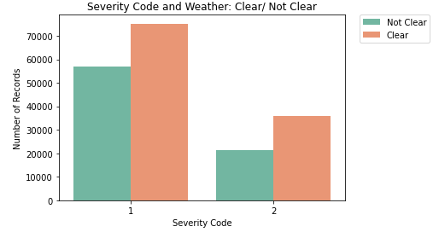
Weather – Clear / Not Clear

Slide 9
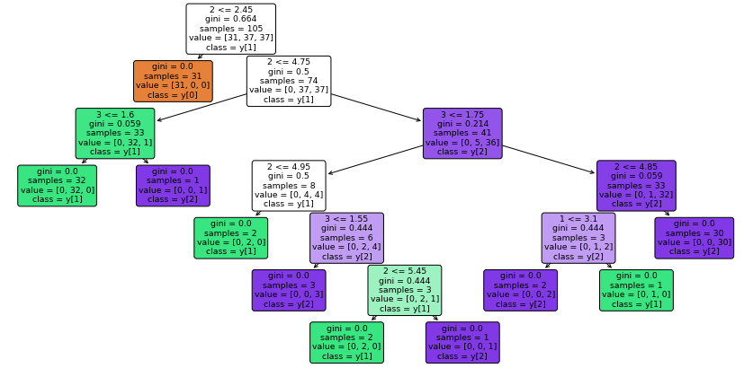
Decision Tree

