Slide 1

Web Scraping / Regression
Ersin Süer
Istanbul DataScience Academy
2nd Project
20 December, 2022

Slide 2

Goal
The goal is trying to make a numerical prediction for the laptop prices on the website called “Trendyol”.
For this goal we’ve used mathematical and statistical models with python and python libraries.

Slide 3




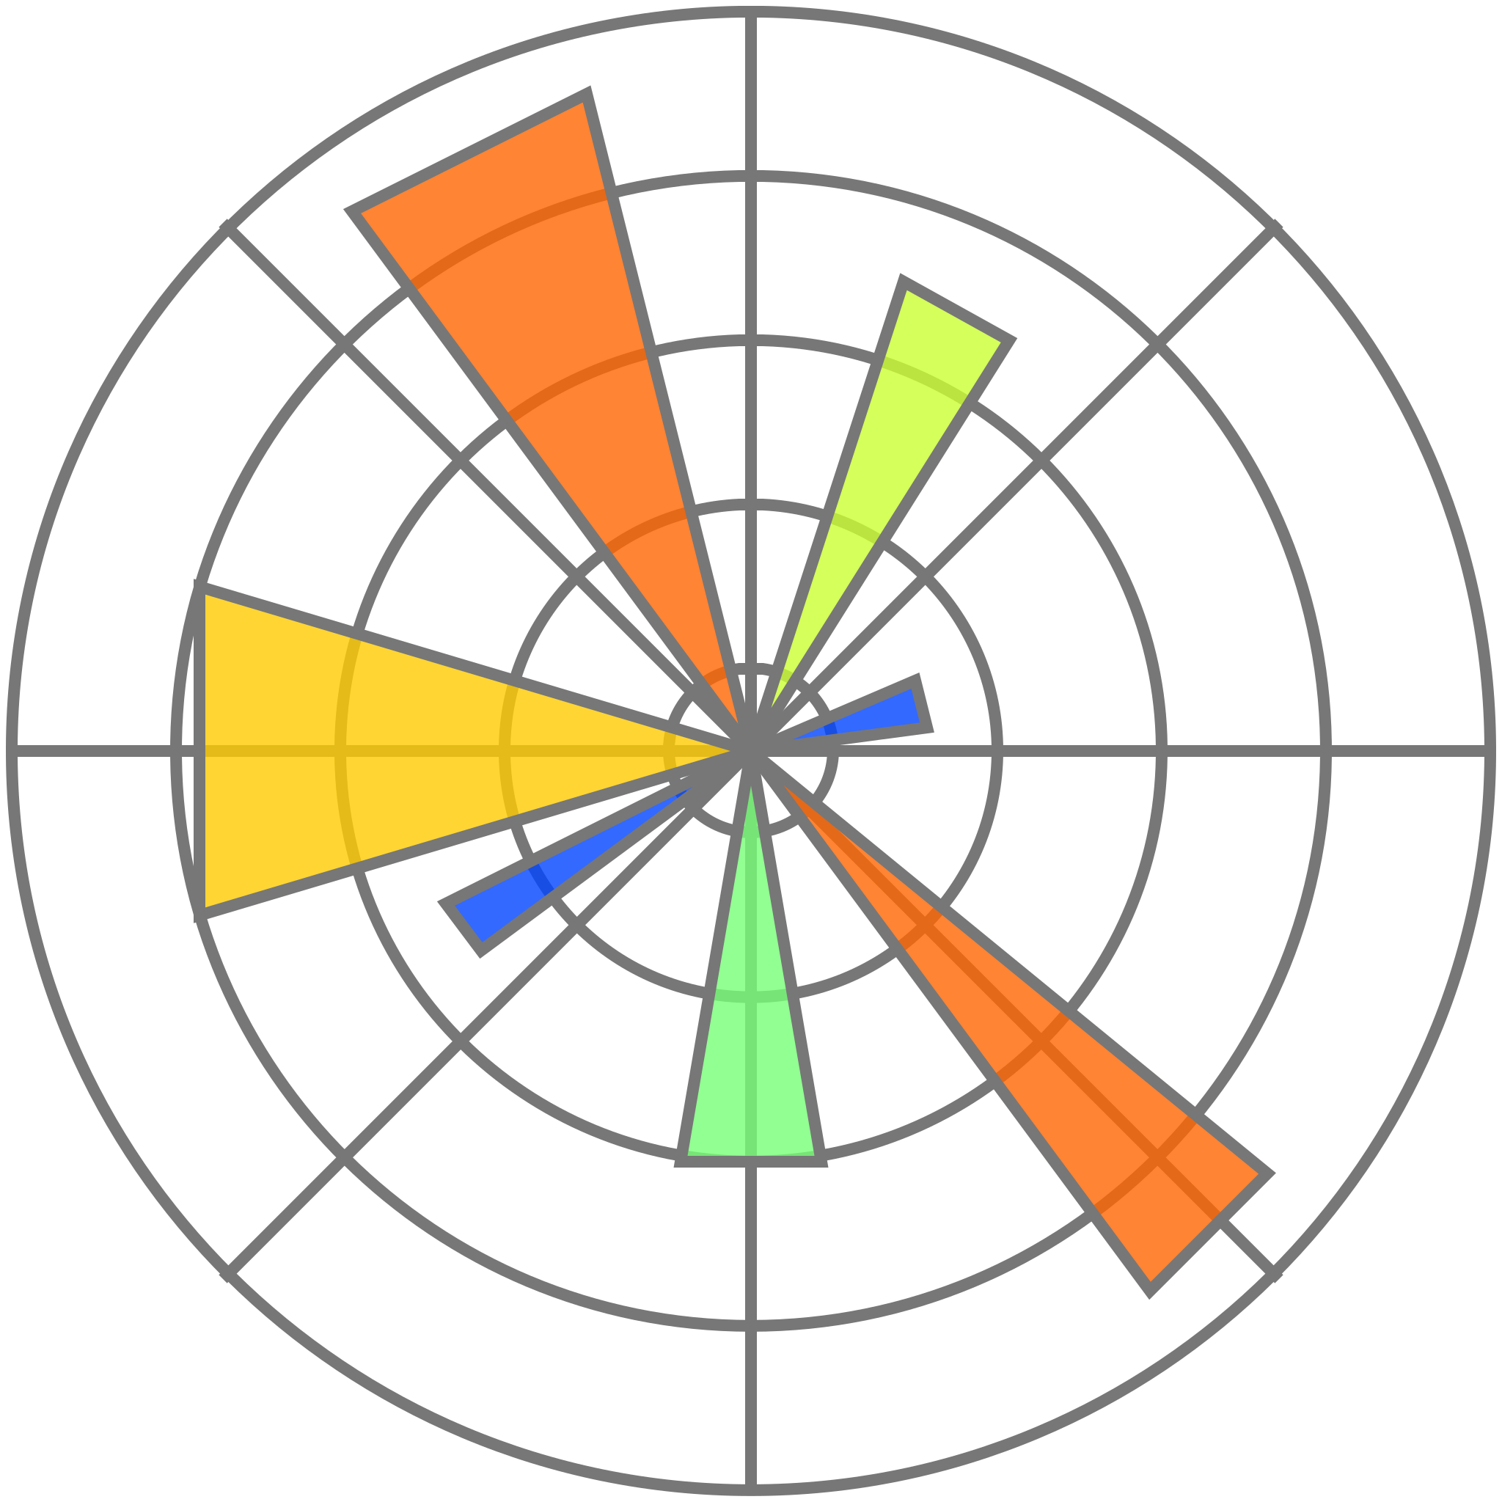

Numpy
Pandas
Trendyol
Selenium
Matplotlib
Seaborn
Scikit Learn

Slide 4
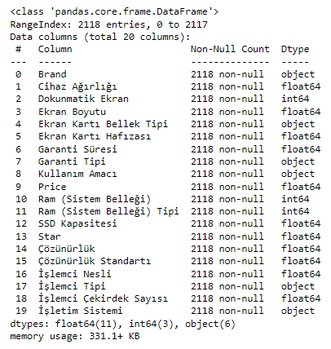
EDA
4934 rows /
43 columns
Categorisation
Label Encoding
Removing
Noneffective Columns
Drop NaN
2118 Rows / 20 Columns
Weight
TouchScreen
Resolution
Screen Size
GPU Memory
Guarantee Duration
Guarantee Type
HDD
RAM
CPU
GPU
GPU Type
GPU Refresh Rate
Keyboard
Optical Harddrive
Colour
CPU Model
Title

Slide 5








Lineer Regression
Basic Regression on Numeric Data
Get Dummies to Non Numeric Data
Checking on P Value and Heatmap
Standart Scaler for Cond. Number
Target : Price
Target : Price_Log

Slide 6
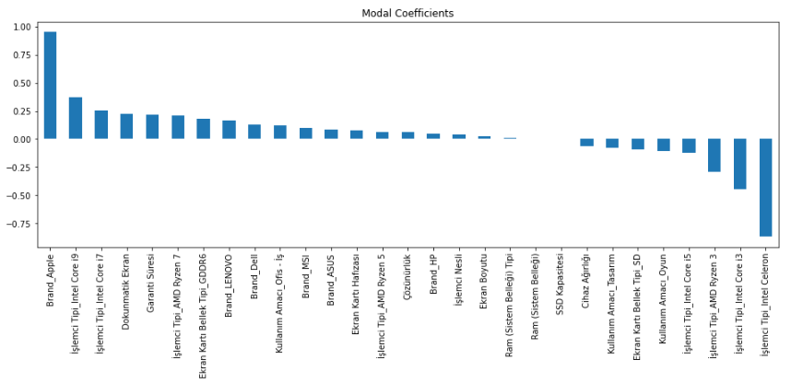
Modal Coefficients

Slide 7
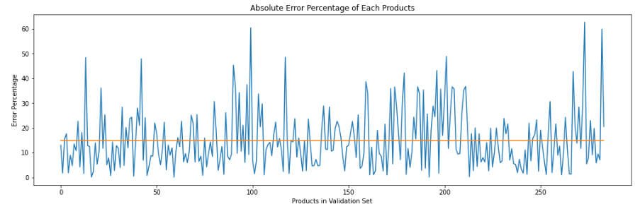
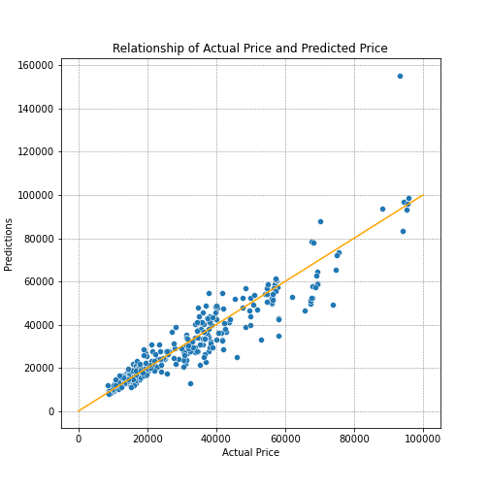
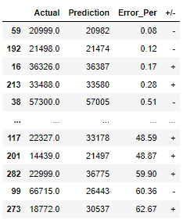
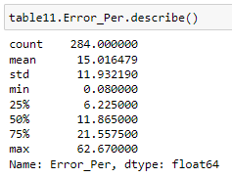
%15.22 %14.65 %11.86 %17.20 %11.64

Slide 8
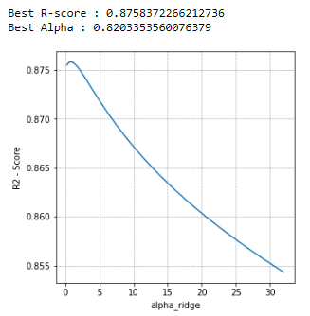
Cross Validation

Slide 9

If we had more time…
First of all we could get definitely more data about laptops.
We could also do further cross validation.

Slide 10
Any Questions?

Slide 11
Thank you for listening!
Ersin Süer
Güven Fazlı
Merve Makbule Semizer

