Slide 1


TPM in ESD
Motivation of TPM setup
Roles of TPM
Responsibilities / key tasks of TPM
TPM setup in ESD
TPM = Technical Project Manager
Diesel Systems
Internal | RBCD/ESD | 2016/01/06 | Pres16_003 | © Robert Bosch GmbH 2015. All rights reserved, also regarding any disposal, exploitation, reproduction, editing, distribution, as well as in the event of applications for industrial property rights.

Slide 2
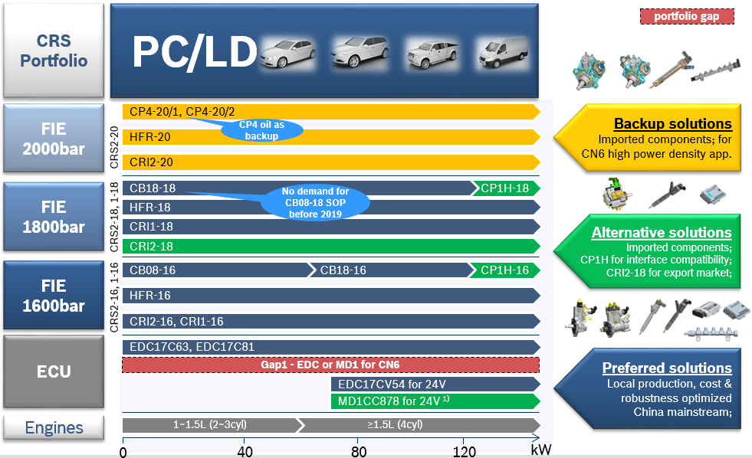
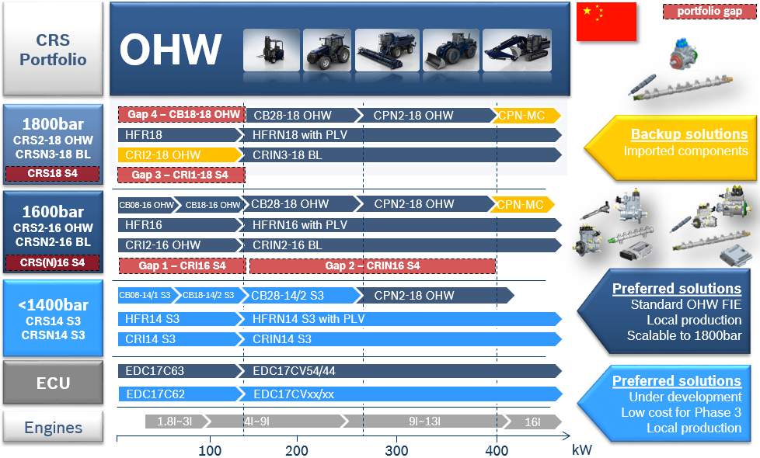
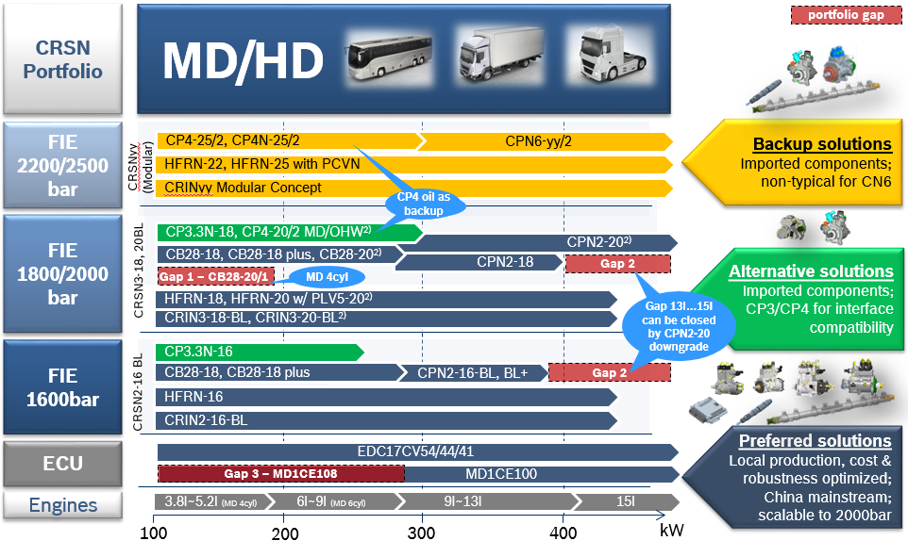
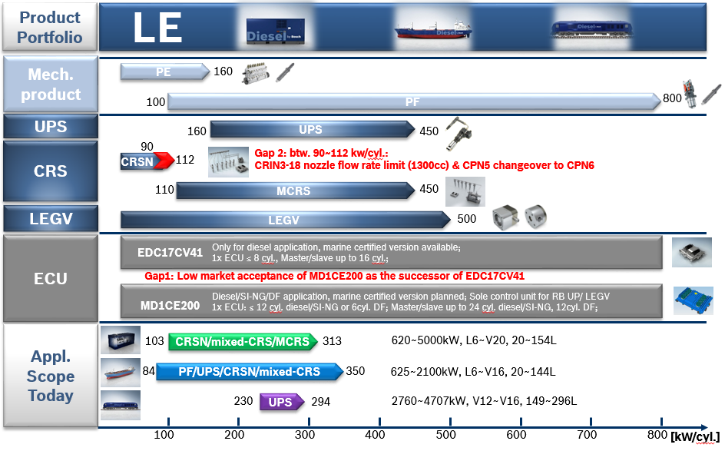
Motivation of TPM setup
TPM in ESD
Complex FIE product portfolios for wide application range (incl. PC, LD, MD, HD, OHW, LE, NG…) require an effective and efficient FIE system-level technical leader in segment-wises
New platform development of FIE systems and components require system engineering from requirement to validation
TPM = Technical Project Manager
Diesel Systems
Internal | RBCD/ESD | 2016/01/06 | Pres16_003 | © Robert Bosch GmbH 2015. All rights reserved, also regarding any disposal, exploitation, reproduction, editing, distribution, as well as in the event of applications for industrial property rights.

Slide 3
Roles of TPM
TPM in ESD
Steering committee, e.g. TSR, PRB…
RBCD
PRM Champion in
DS PRM
System platform review
Product strategy alignment
Acquisition support
TPM in ESD
Tech. support
Sales
ESD1/2/3 system engineers
Requirement alignment
Define / track sys. requirement
Info. Exch.
Region inputs
PT, EMS stakeholders
Components development (incl. validation)
System-IDN
DS FIE handbook / TSP
TPM as FIE system-level technical leader and local CRS(N) system platform PjM for assigned segment
TPM = Technical Project Manager
Diesel Systems
Internal | RBCD/ESD | 2016/01/06 | Pres16_003 | © Robert Bosch GmbH 2015. All rights reserved, also regarding any disposal, exploitation, reproduction, editing, distribution, as well as in the event of applications for industrial property rights.

Slide 4
Responsibilities / key tasks of TPM
TPM in ESD
General
In case of CRS platform sub-PM
Window person for PRM-SSP in DS, RBCD PRM champion and platform development activities in System-IDN
Support PRM for system platform development
Support project acquisition
Project Management for special and strategic tasks in technical area with regular reporting and monitoring the project progress
Work closely with PRM and DM to transfer the plan into reality
TSP KPI owner and region input to FIE handbook for responsible segments
CRS platform system engineering from requirement to validation:
Define & track requirements for new platform development of system & components
Plan and track capacity and cost in related development
Report progress of the project to management inside of the review committee (e.g. TSR, PRB…)
Maintain current platform in term of requirements / product description update, and integrate necessary new components in existing systems
TPM = Technical Project Manager
Diesel Systems
Internal | RBCD/ESD | 2016/01/06 | Pres16_003 | © Robert Bosch GmbH 2015. All rights reserved, also regarding any disposal, exploitation, reproduction, editing, distribution, as well as in the event of applications for industrial property rights.

Slide 5














TPM setup in ESD
TPM in ESD
Segment | TPM
PC/LD Incl. Sub-PM of CRS1-18 | ESD-NN
MD/HD Incl. Sub-PM of CRSN3-20-BL | ESD-Tang Yonghua
OHW Incl. Sub-PM of CRS(N)14 S3 | ESD-Lin Chao
Large Engine (LE) | ESD-Zhu Song
xxx
TPMs installed in ESD for segment-wises incl. sub-PM for new CRS platform development
TPM = Technical Project Manager
Diesel Systems
Internal | RBCD/ESD | 2016/01/06 | Pres16_003 | © Robert Bosch GmbH 2015. All rights reserved, also regarding any disposal, exploitation, reproduction, editing, distribution, as well as in the event of applications for industrial property rights.

Slide 6
TPM in ESD
Backup
Diesel Systems
Internal | RBCD/ESD | 2016/01/06 | Pres16_003 | © Robert Bosch GmbH 2015. All rights reserved, also regarding any disposal, exploitation, reproduction, editing, distribution, as well as in the event of applications for industrial property rights.

Slide 7
Task sharing between TPM and System engineer
OHW workshop
Technical Project Manager
Support PRM for system platform development
Project Management for special task and strategic task in technical area with regular reporting, and monitoring the project progress.
Work closely with PRM and DM to transfer the plan into reality.
System engineer
Manage the customer project on time, on cost and on specification according to Bosch PEP
Customer Project status monitoring, reporting and Internal & external communication
Documentation of the project management
Implement customer project task list…
Customer project communication and strategy
Diesel Systems
Internal | ESD | 2016/01/06 | Pres16_003 | © Robert Bosch GmbH 2015. All rights reserved, also regarding any disposal, exploitation, reproduction, editing, distribution, as well as in the event of applications for industrial property rights.

Slide 8
Communication
OHW workshop
Component PRM
DM
ESD2
Coordinator
Li Hongmiao
ESD2
section
System PRM
TPM
ESD3
Coordinator
Gong Xuejun
ESD3
section
Inner communication
(e.g. strategy, specific topic)
External communication
(e.g. customer project)
SM and DM
System PRM
Customer
TPM
System engineer
Project leader
Component PRM
Component
department
TPM:
1. Support PRM to transfer platform strategy into customer project
2. Platform guideline and hints
PM:
1. Responsible for customer Project and project strategy
2. Manage customer Project according to PEP
3. Project documentation and customer communication
4. Report project status to manager
Diesel Systems
Internal | ESD | 2016/01/06 | Pres16_003 | © Robert Bosch GmbH 2015. All rights reserved, also regarding any disposal, exploitation, reproduction, editing, distribution, as well as in the event of applications for industrial property rights.

Slide 9
Task sharing between TPM and System engineer
Technical Project Manager
Support PRM for system platform development
Support gas project acquisition
Overall project Management for special task and strategic task in technical area with regular reporting, and monitoring the project progress
BOT/PRC/PET?
Work closely with PRM-LE/DM/IDN-LE to transfer the plan into reality.
System engineer
Manage the customer project on time, on cost and on specification according to Bosch PEP
Customer Project status monitoring, reporting and Internal & external communication
Documentation of the project management
Implement customer project task list…
Customer project communication and strategy
Support diesel project acquisition
Diesel Systems
Internal | ESD | 2016/01/06 | Pres16_003 | © Robert Bosch GmbH 2015. All rights reserved, also regarding any disposal, exploitation, reproduction, editing, distribution, as well as in the event of applications for industrial property rights.

Slide 10
Communication
LE workshop
DS-B2/PRM-LE
ESD
DS-B2/ENL-IDN &ELS
TPM
System engineer
ESD2
section
LE sales
for strategy alignment
ENG departments
coordination
IDN function
(e.g. strategy, specific topic)
Project function
(e.g. customer project)
ESD2
DS-B2/PRM-LE
Customer
coaching
Sales
TPM
System engineer
Project leader
Project status update
Component
department
TPM:
1. Support PRM to transfer platform strategy into customer project
2. Platform guideline and hints
3. Report overall project/ engineering status to ESD/ENG
PM:
1. Responsible for customer Project and project strategy
2. Manage customer Project according to PEP
3. Project documentation and customer communication
4. Report project status to manager
Diesel Systems
Internal | ESD | 2016/01/06 | Pres16_003 | © Robert Bosch GmbH 2015. All rights reserved, also regarding any disposal, exploitation, reproduction, editing, distribution, as well as in the event of applications for industrial property rights.

