Slide 1

Enhance Amazon’s Product Recommendation, Search, and Reviews
Sue Lim
January 16, 2023

Slide 2
Project OVERVIEW

Slide 3
Overview
Product Recommendation
Product Search
Product Reviews
Enhance Amazon Product Recommendation, Search, and Reviews
Product Recommendation
Model-based algorithms
Product Search
Identify similar groups of products & expand search
Product Reviews
Identify key sentences in positive/negative reviews which would be useful to customers

Slide 4
I. Product recommendation

Slide 5
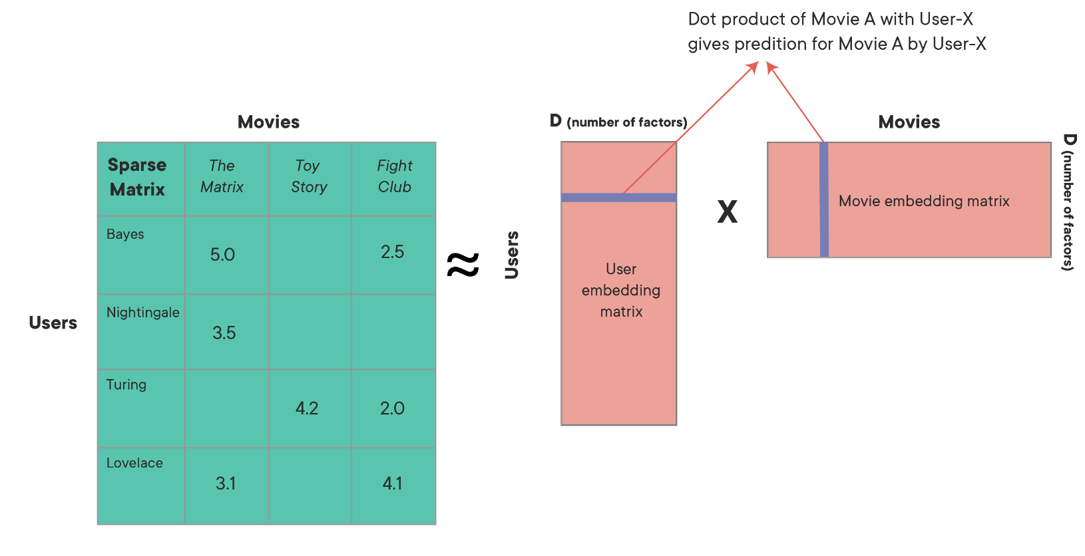
Overview
Product Recommendation
Product Search
Product Reviews
Enhance Product Recommendation
Recommend products based on existing ratings
Method: Model-based approaches
Notes:
Scalability
Cold Start Mitigation

Slide 6
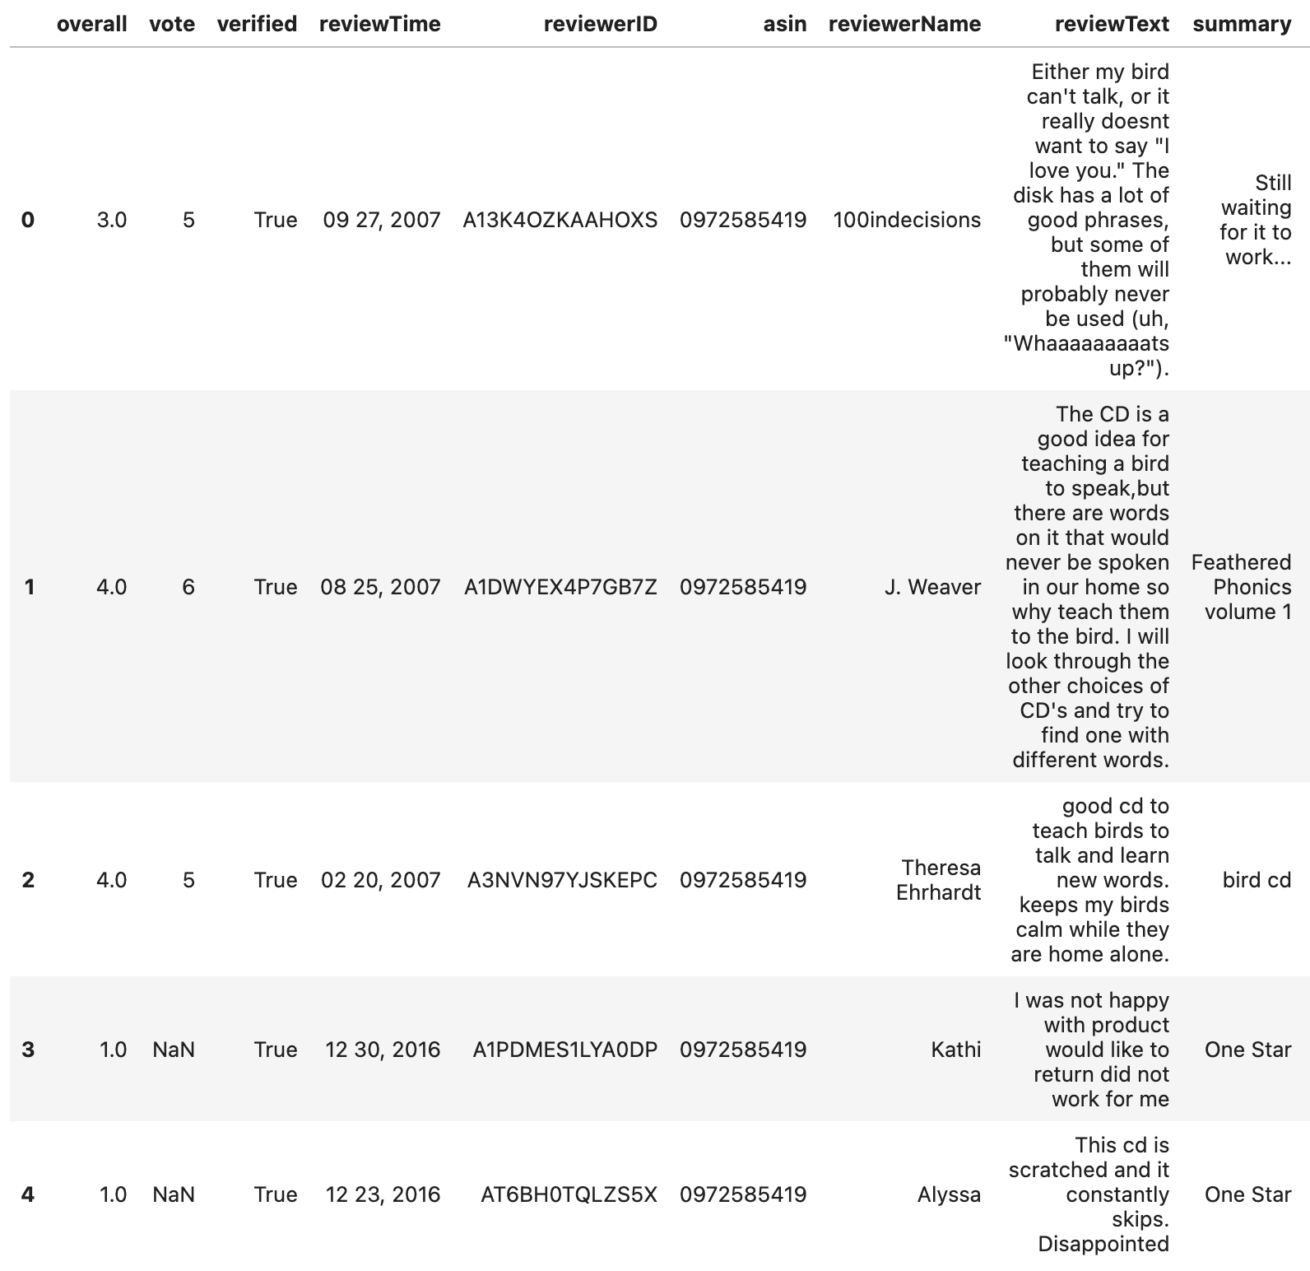
Overview
Product Recommendation
Product Search
Product Reviews
Data: Amazon Product Reviews from UCSD
Reviews for pet supplies
in years 2013 – 2018
Average rating is 4 stars

Slide 7
Overview
Product Recommendation
Product Search
Product Reviews
Training & Testing
Trained using SVD, ALS, and Neural Networks
Metrics Using ALS
 | RMSE | MAE
Train Data | 0.29 | 0.08
Test Data | 1.20 | 0.79
* SVD: Singular Value Decomposition
* ALS: Alternating Least Squares
* RMSE: Root Mean Squared Error
* MAE: Mean Average Error

Slide 8
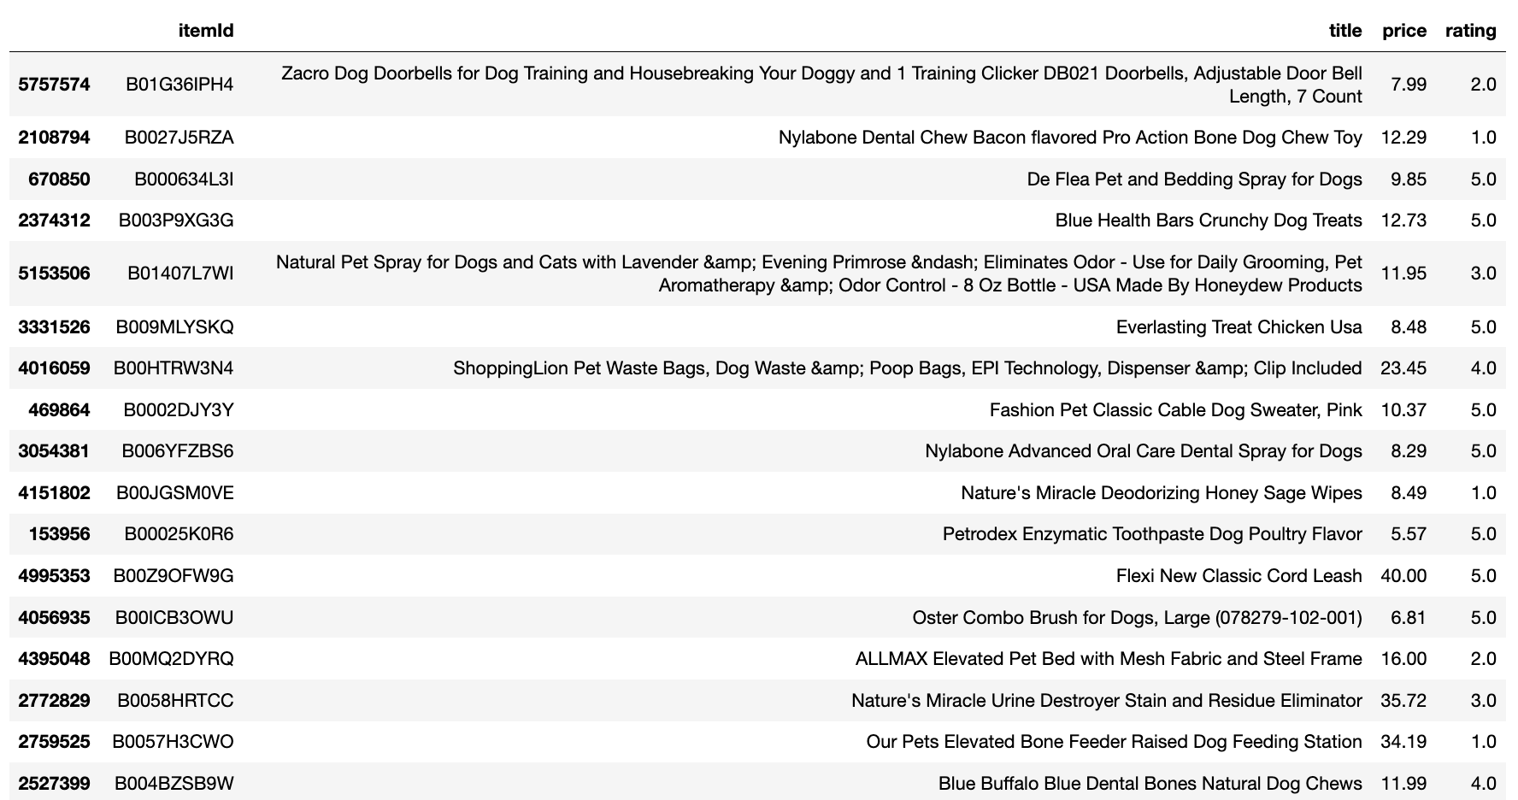
Overview
Product Recommendation
Product Search
Product Reviews
Example: User Ratings for Training

Slide 9
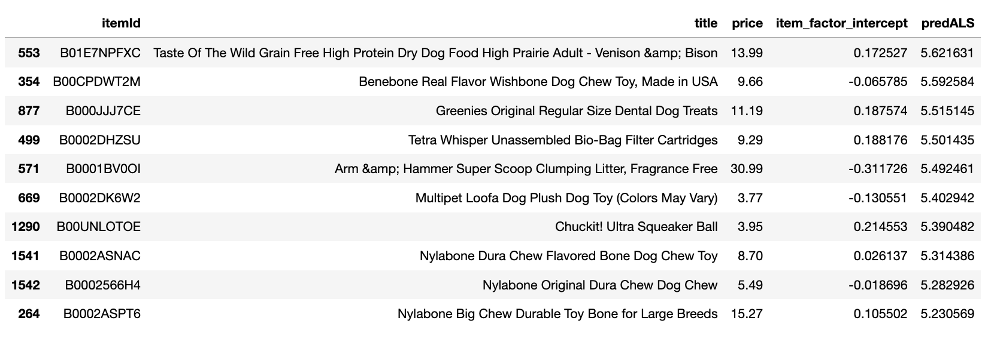
Overview
Product Recommendation
Product Search
Product Reviews
Example: Top 10 Recommendations for the User

Slide 10
Ii. Product search

Slide 11

Overview
Product Recommendation
Product Search
Product Reviews
Enhance Product Search
Identify similar groups of products & enable expanded search based on the categories.
Method: Multi-label classification neural network
Step 1) Generate categories using keywords sellers post
Step 2) Use product images to predict categories
Categories
Modern sofa
Ivory sofa

Slide 12
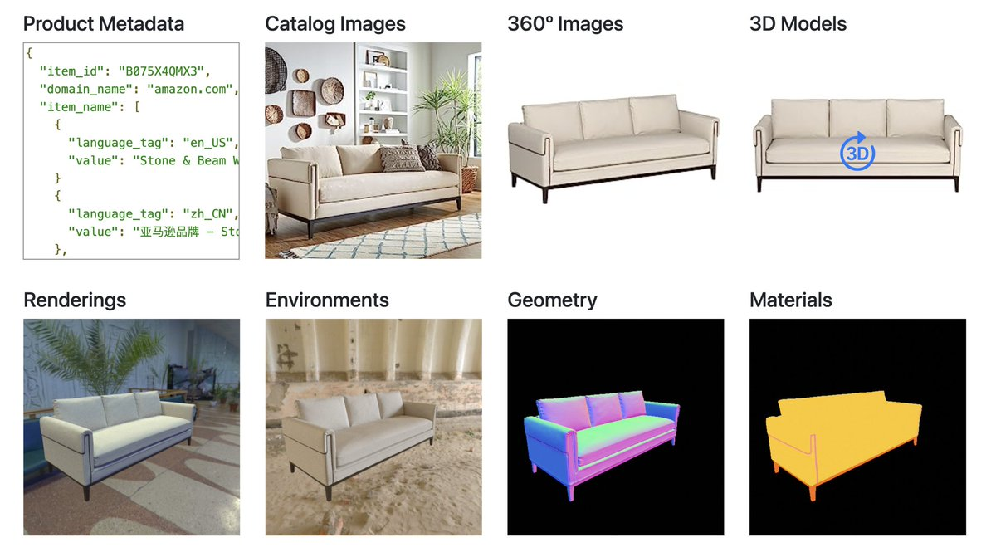
Overview
Product Recommendation
Product Search
Product Reviews
Data: Amazon Berkeley Objects ("ABO") data
The data contains images, tags, and other information for various product categories
This project focuses on the category “Shoes”

Slide 13
Overview
Product Recommendation
Product Search
Product Reviews
Training & Testing
Trained using multi-label classification neural networks (allowed to have more than one target label)
Accuracy Ratios
Train Data: 0.99
Test Data: 0.96

Slide 14



Overview
Product Recommendation
Product Search
Product Reviews
Example: Keyword “Formal Shoes”
4 categories containing formal
formal shoes for men black
formal shoes for mens leather
leather shoes for men formal branded
shoes for men formal

Slide 15
III. Product reviews

Slide 16
Overview
Product Recommendation
Product Search
Product Reviews
Product Reviews
Identify key sentences from most popular reviews
Method: Term Frequency-Inverse Document Frequency (TF-IDF)
Step 1) Identify keywords from positive/negative reviews
Step 2) Extract sentences containing such keywords from most popular reviews

Slide 17
Overview
Product Recommendation
Product Search
Product Reviews
Data: Amazon Product Reviews from UCSD
Reviews for pet supplies
in years 2013 – 2018
Average rating is 4 stars

Slide 18
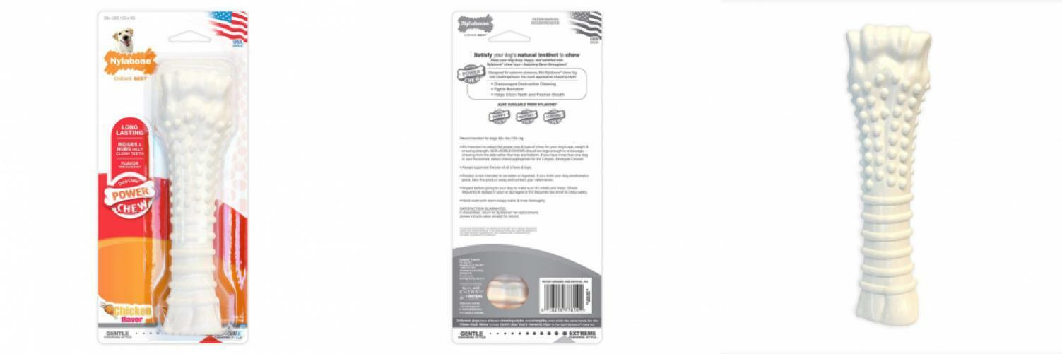
Overview
Product Recommendation
Product Search
Product Reviews
Example: “Nylabone Dura Chew Textured Dog Chew, X-Large”

Slide 19
Overview
Product Recommendation
Product Search
Product Reviews
Example: Top 5 Positive Reviews
“( 2560+ lbs)\nIt's really cute to walk along the aisle and see contented dogs happily holding their chew bones in their paws and gnawing away.”
“I am so glad I got it and I suspect they are even happier!”
“My 60 pound boxer pit mix is a fan.”
“Yummy & Healthy & Fun ...”
“Wears slowly.”

Slide 20
Overview
Product Recommendation
Product Search
Product Reviews
Example: Top 5 Negative Reviews
“Like I handed her a brick.”
“I was told that if we got her something like this, she would not tear up anything, like my Bible, anymore.”
“Price is very high than local store, you may able to buy it from Marshall or other local store with better price, and my dog evening blooding after play a while with this product, after one time use, I just through it away.”
“so this is a big fat nope is our book of chew toys.”
“I bought this when I had 4 dogs in the house (our two, and two puppies we were fostering), out of 4 dogs NONE of them wanted this!”

