Slide 1

Enhance Amazon’s Product Recommendation, Search, and Reviews
Sue Lim
December 27, 2023

Slide 2
I. Project OVERVIEW

Slide 3
Overview
Product Recommendation
Product Search
Product Reviews
Enhance Amazon Product Recommendation, Search, and Reviews
Product Recommendation
Product Search
Identify similar groups of products
Product Reviews
Identify key sentences in positive/negative reviews

Slide 4
Ii. Product recommendation

Slide 5
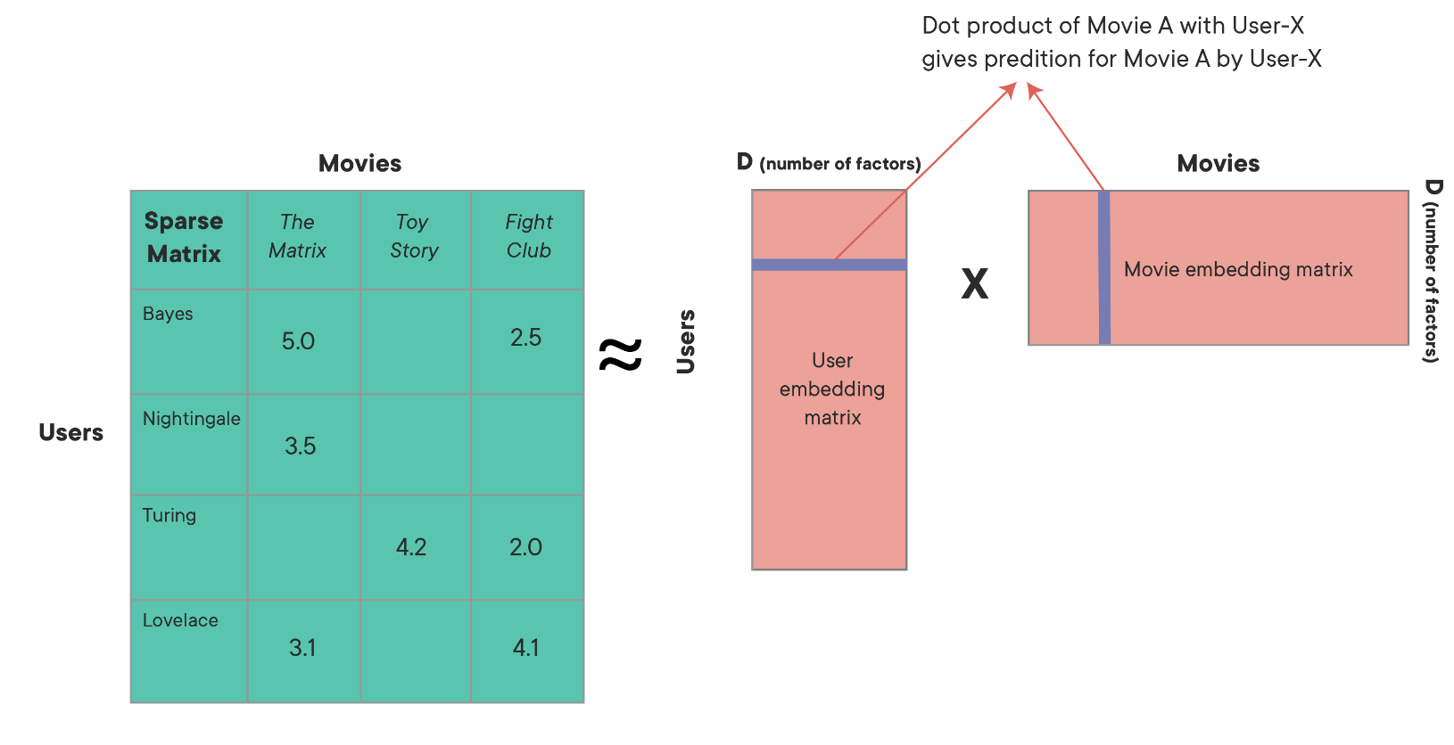
Overview
Product Recommendation
Product Search
Product Reviews
Enhance Product Recommendation
Recommend products based on existing ratings
Model-based approaches

Slide 6
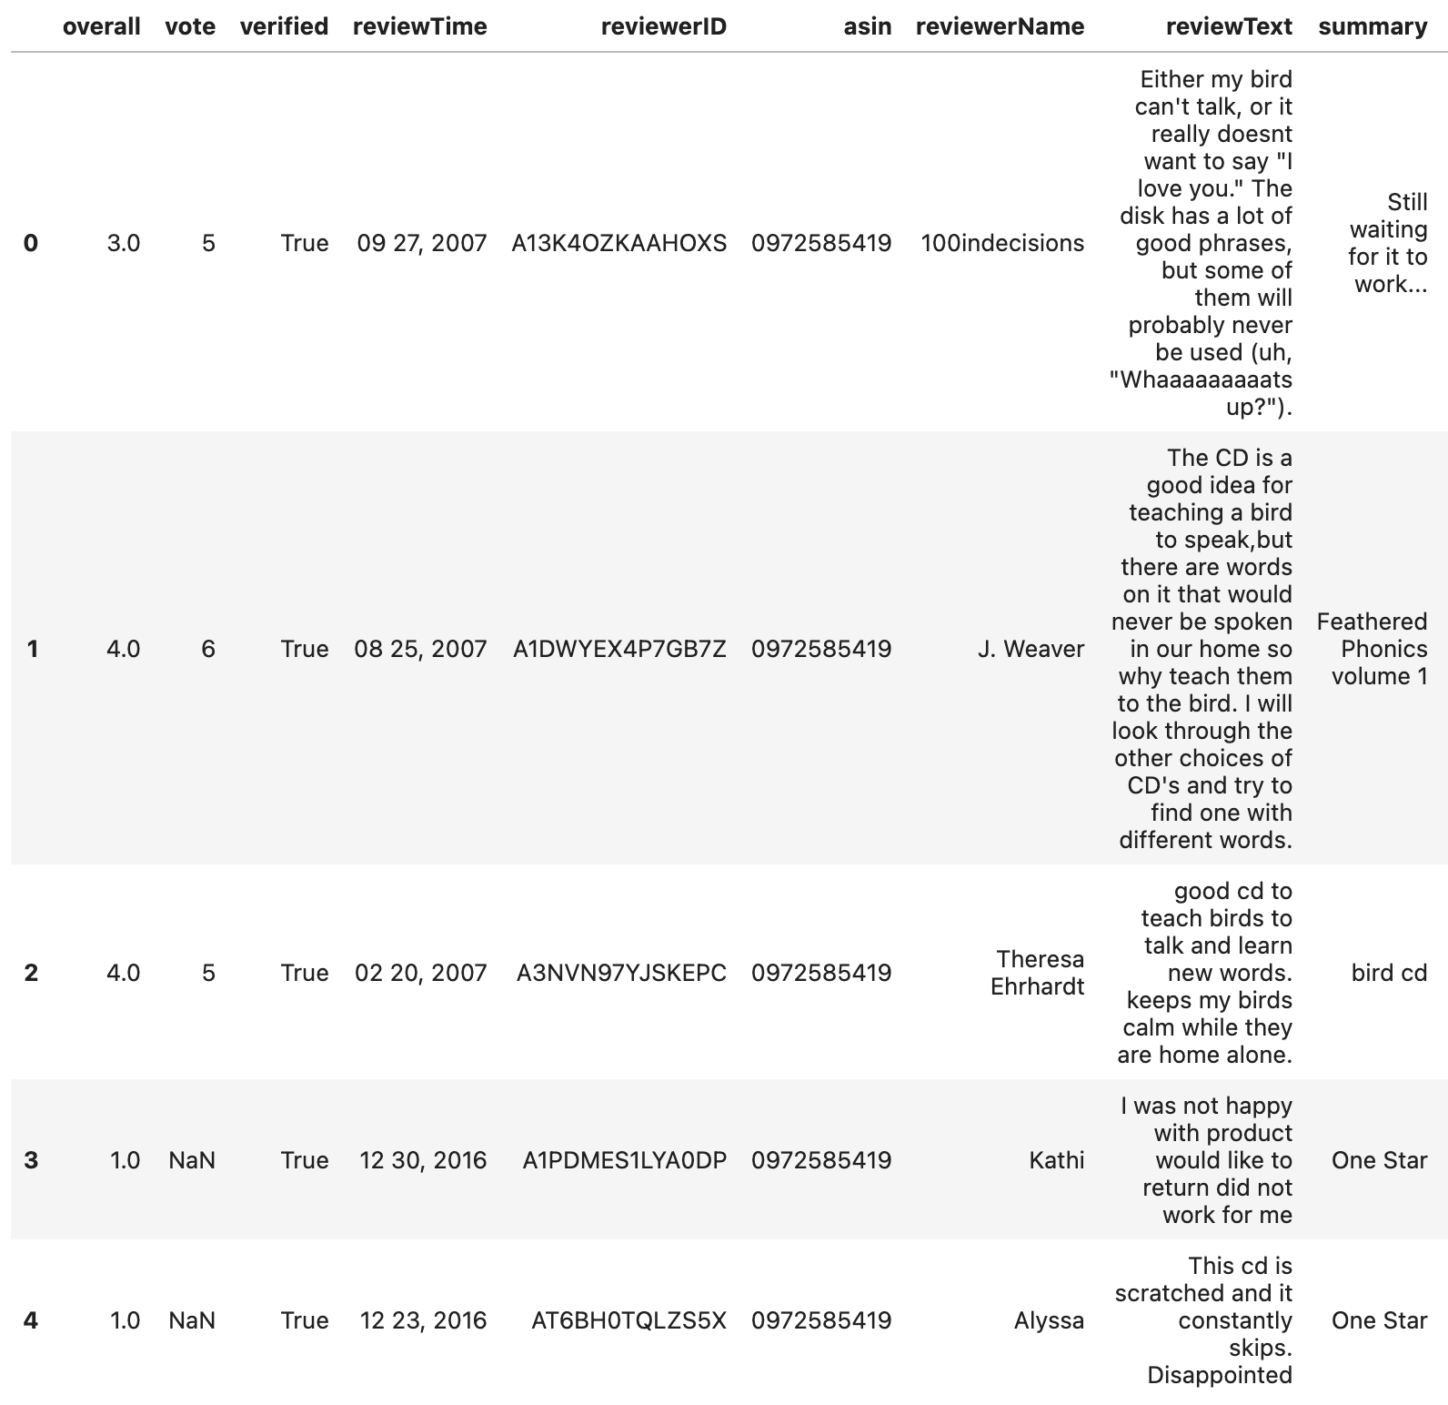
Overview
Product Recommendation
Product Search
Product Reviews
Data: Amazon Product Reviews from UCSD
Reviews for pet supplies
Years 2013 – 2018
Average rating is 4 stars

Slide 7
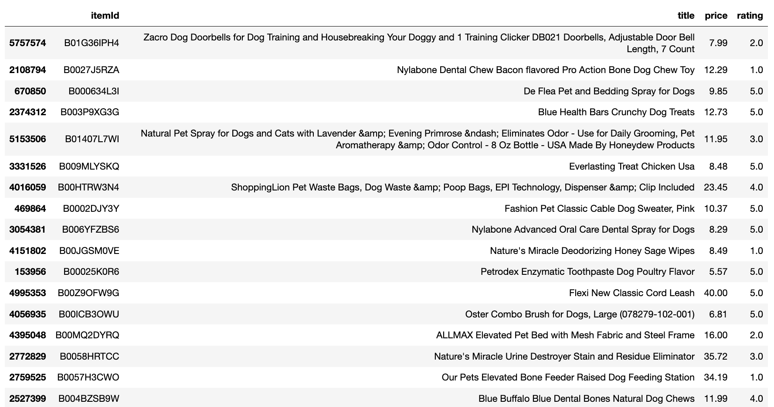
Overview
Product Recommendation
Product Search
Product Reviews
Example: User Ratings for Training

Slide 8
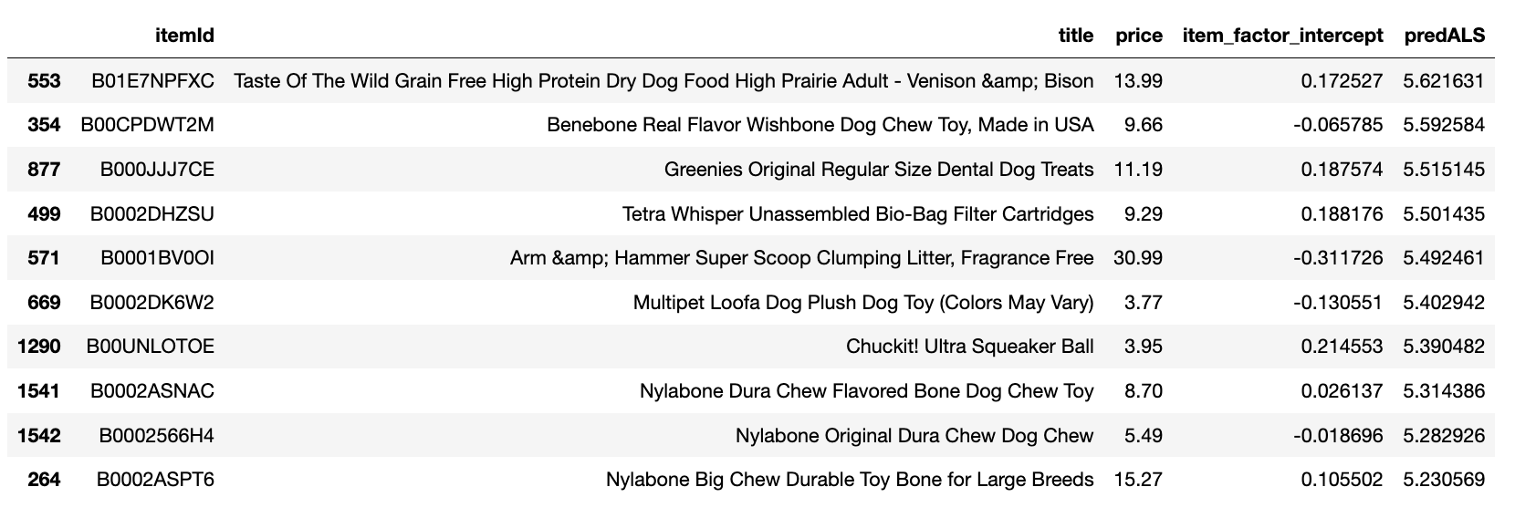
Overview
Product Recommendation
Product Search
Product Reviews
Example: Top 10 Recommendations for the User

Slide 9
IiI. Product search

Slide 10
Overview
Product Recommendation
Product Search
Product Reviews
Enhance Product Search
Uses product images to predict categories through multi-label classification neural network
Enables expanded searches based on common categories

Slide 11
Overview
Product Recommendation
Product Search
Product Reviews
Data: Amazon Berkeley Objects ("ABO") data
The data contains images, tags, and other information for various product categories
This project focuses on the category “Shoes”

Slide 12



Overview
Product Recommendation
Product Search
Product Reviews
Example: Keyword “Formal Shoes”
4 categories containing formal
formal shoes for men black
formal shoes for mens leather
leather shoes for men formal branded
shoes for men formal

Slide 13
IV. Product reviews

Slide 14
Overview
Product Recommendation
Product Search
Product Reviews
Product Reviews
Identify keywords from positive/negative reviews
Extract sentences containing the identified keywords from most popular reviews

Slide 15
Overview
Product Recommendation
Product Search
Product Reviews
Data: Amazon Product Reviews from UCSD
Reviews for pet supplies
Years 2013 – 2018
Average rating is 4 stars

Slide 16
Overview
Product Recommendation
Product Search
Product Reviews
Example: Positive Reviews for “Nylabone Dura Chew Textured Dog Chew, X-Large”
“( 2560+ lbs)\nIt's really cute to walk along the aisle and see contented dogs happily holding their chew bones in their paws and gnawing away.”
“I am so glad I got it and I suspect they are even happier!”
“My 60 pound boxer pit mix is a fan.”
“Yummy & Healthy & Fun ...”
“Wears slowly.”

Slide 17
Overview
Product Recommendation
Product Search
Product Reviews
Example: Negative Reviews for “Nylabone Dura Chew Textured Dog Chew, X-Large”
“Like I handed her a brick.”
“I was told that if we got her something like this, she would not tear up anything, like my Bible, anymore.”
“Price is very high than local store, you may able to buy it from Marshall or other local store with better price, and my dog evening blooding after play a while with this product, after one time use, I just through it away.”
“so this is a big fat nope is our book of chew toys.”
“I bought this when I had 4 dogs in the house (our two, and two puppies we were fostering), out of 4 dogs NONE of them wanted this!”

