Slide 1

Enhance Amazon’s Product Recommendation, Search, and Reviews
Sue Lim
November 30, 2023

Slide 2
I. Project OVERVIEW

Slide 3
Overview
Product Recommendation
Product Search
Product Reviews
Enhance Amazon Product Recommendation, Search, and Reviews
Product Recommendation
Product Search
Identify similar groups of products
Product Reviews
Identify key sentences in positive/negative reviews

Slide 4
Ii. Product recommendation

Slide 5
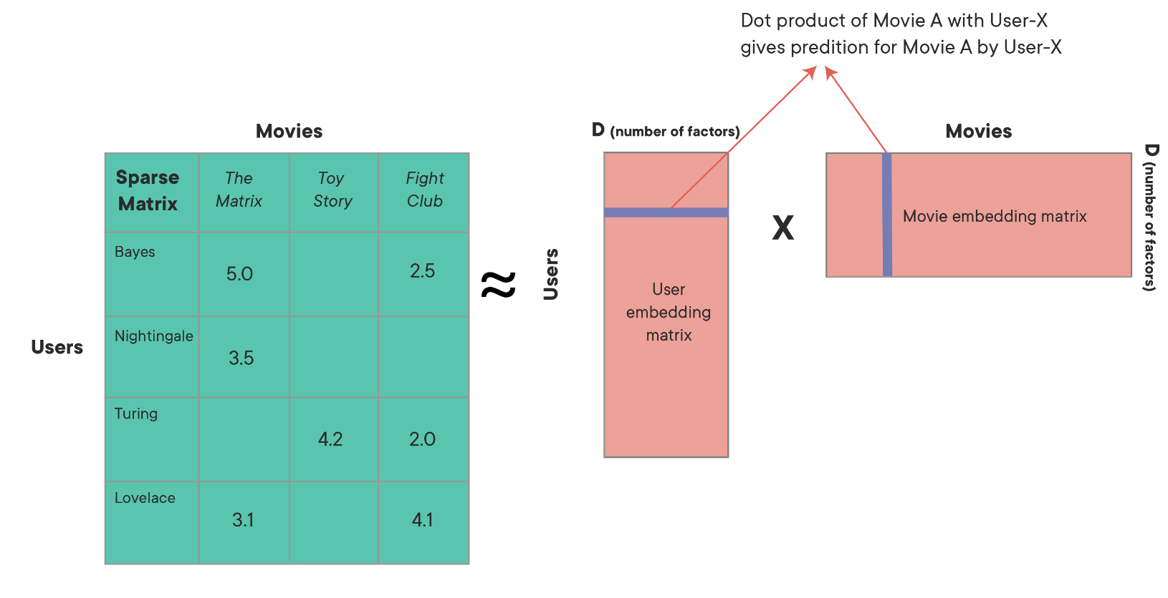
Overview
Product Recommendation
Product Search
Product Reviews
Product Recommendation
Recommend products based on existing ratings
Model-based approaches
Singular Vector Decomposition (“SVD”)
Alternating Least Squares (“ALS”)
Neural Networks

Slide 6
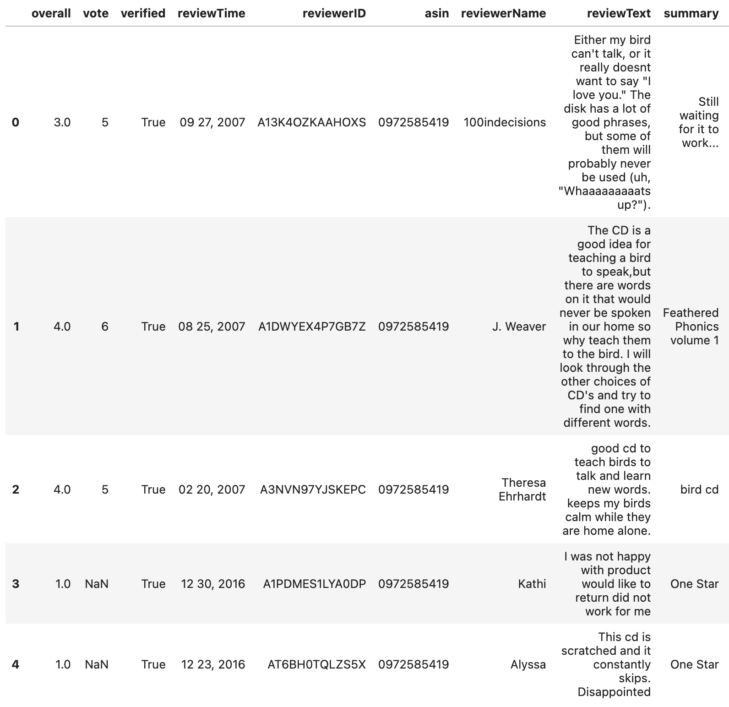
Overview
Product Recommendation
Product Search
Product Reviews
Data: Amazon Product Reviews from UCSD
Reviews for pet supplies
Years 2013 – 2018
Average rating is 4 stars

Slide 7
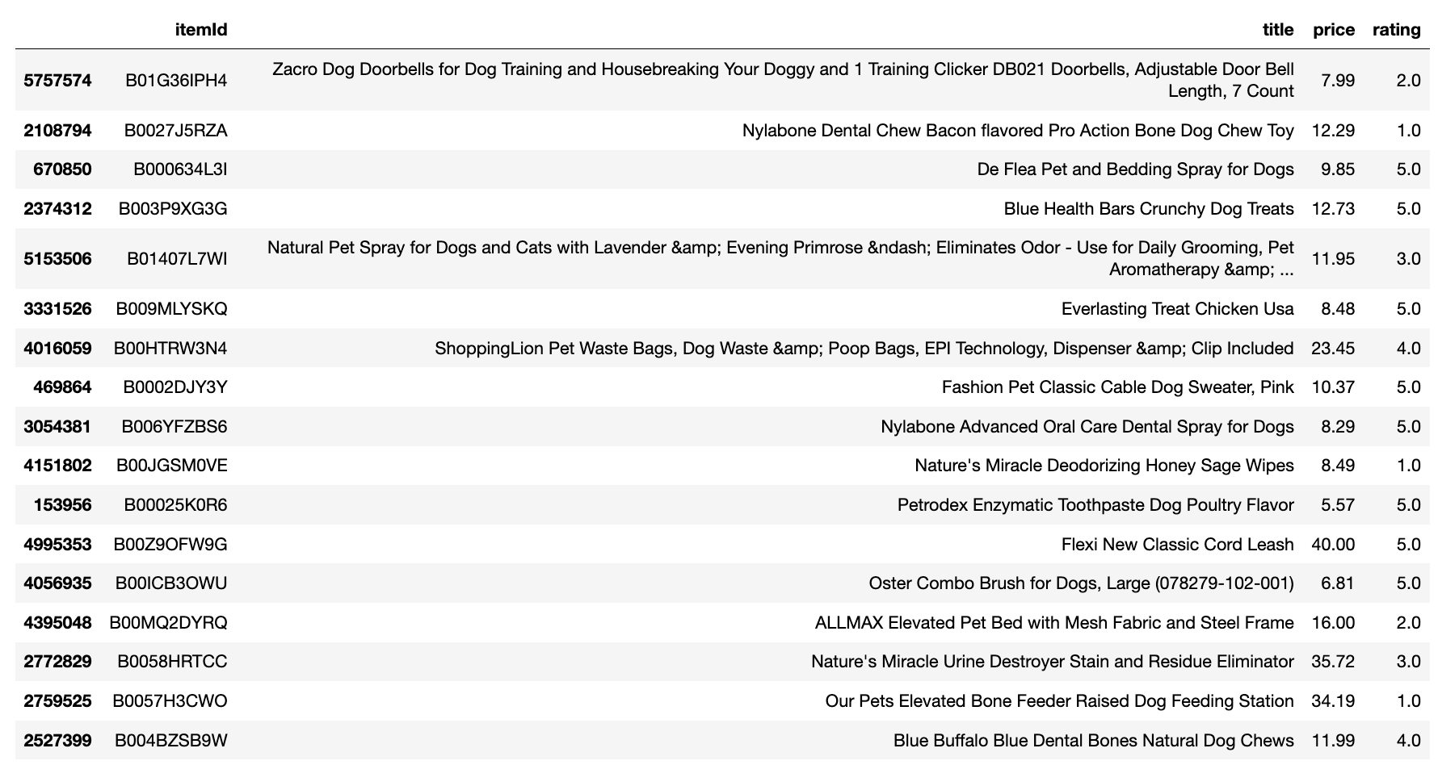
Overview
Product Recommendation
Product Search
Product Reviews
Demo: User Ratings for Training

Slide 8
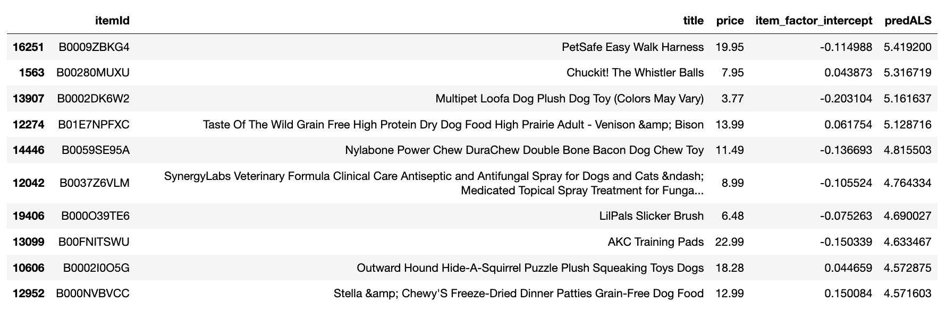
Overview
Product Recommendation
Product Search
Product Reviews
Demo: Top 10 Recommendations for the User

Slide 9
IiI. Product search

Slide 10
Overview
Product Recommendation
Product Search
Product Reviews
Product Search
Uses keywords sellers post about their products as target labels
Uses images to predict keywords through multi-label classification neural network
Enables

Slide 11
Overview
Product Recommendation
Product Search
Product Reviews
Data: Amazon Berkeley Objects ("ABO") data
The data contains images, tags, and other information for various product categories
This project focuses on the category “Shoes”

Slide 12
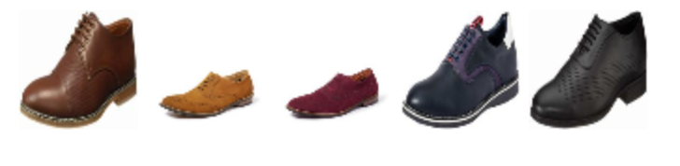
Overview
Product Recommendation
Product Search
Product Reviews
Demo: “Formal Shoes”
4 related labels returned:
formal shoes for men black
formal shoes for mens leather
leather shoes for men formal branded
shoes for men formal

Slide 13
IV. Product reviews

Slide 14
Overview
Product Recommendation
Product Search
Product Reviews
Product Reviews
Identify keywords from positive/negative reviews
Term Frequency – Inverse Document Frequency (“TF-IDF”) is used.
Extract sentences containing the identified keywords from most popular reviews

Slide 15
Overview
Product Recommendation
Product Search
Product Reviews
Data: Amazon Product Reviews from UCSD
Reviews for pet supplies
Years 2013 – 2018
Average rating is 4 stars

Slide 16
Overview
Product Recommendation
Product Search
Product Reviews
Demo: Positive Reviews for “LitterMaid LM500 Automated Litter Box”
“with 4 cats, i clean the entire unit about once every two weeks.”
“after years of digging and scratching around in litter\nboxes myself, it's a joy to own something that brings the process into the 21st Century.”
“i use a lot less litter, and spend almost no time dealing with the waste itself.”
“(I have my unit in a carpet covered wood box because I have a dog who likes litter boxes...especially when there's a cat in it, and I keep a plastic runner at the opening of the box...it works great and I just vaccuum or sweep the runner when nec.)”
“I originally bought this product to help elevate this issue but it has proven to be a blessing from the litter box gods.”

Slide 17
Overview
Product Recommendation
Product Search
Product Reviews
Demo: Negative Reviews for “LitterMaid LM500 Automated Litter Box”
“Therefore in conclusion, I do hope the next unit will be great since the cat seems to like it when it is "On Duty" and working, but when she is on Strike, it burns us all up and our pocketbooks from mailing them all the parts back they require and now burning our tempers that they now want to charge shipping fees for their "FREE" warranties that mean nothing really when they will only give u a problem when u point out there is no charges except the word "Free" regarding their Warranty and replacements on the Warranty information provided with the unit and on their site.”
“But the list of shortcomings is a long one, the most endearing of which was flinging urineladen clods of litter against the wall.”
“We used 3 types of premium clumping litter, yet end up cleaning the pan by hand frequently each day.”
“Second, less than 2 months again this time the unit starts having a huge crack from the outside of the motor assembly and along the outside of the unit all down the side of the connection where the ac dc unit is plugged in.”
“Finally, the little box at the end that is supposed to receive the litter is undersized for a multiple cat household, and are expen$ive to buy, so we started emptying the box and reusing it.”

