Slide 1
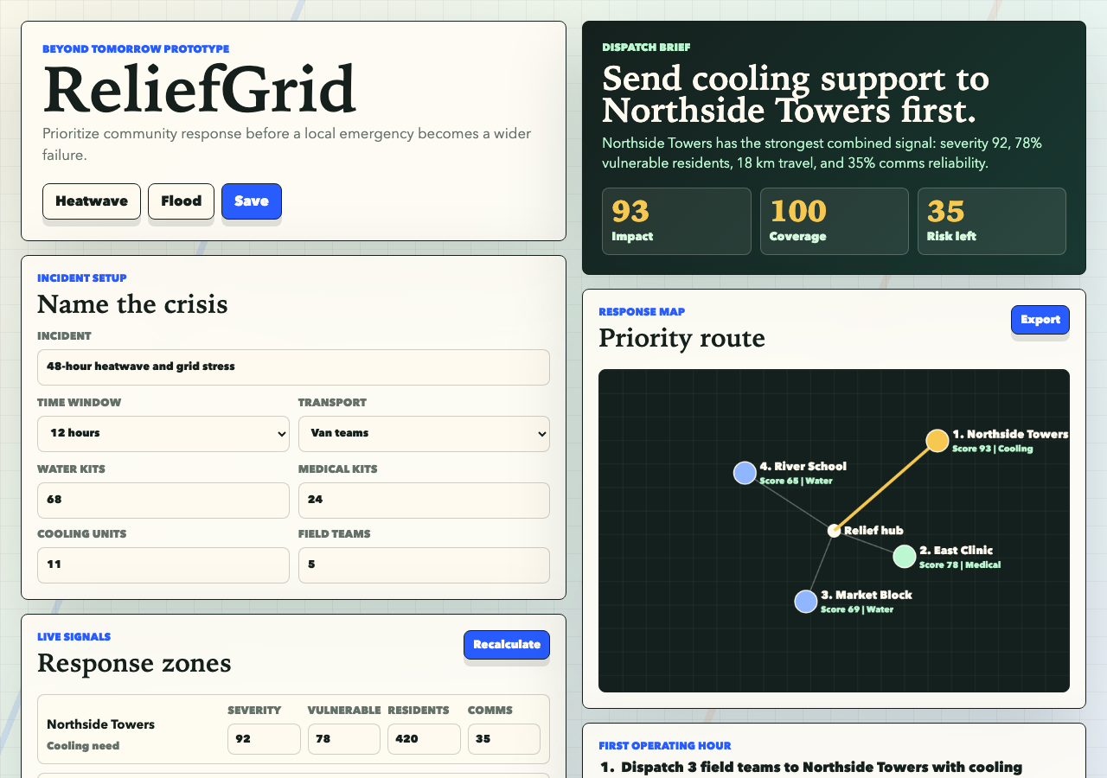
BEYOND TOMORROW SUMMIT
ReliefGrid
Prioritize response before the crisis spreads.
A working local-first app for community response teams that turns noisy field reports into a ranked dispatch brief.
93
4
1 hr
Top-zone dispatch score
Inputs ranked per zone
Plan generated for field teams
Deliverables ready: working app, demo video, screenshots, pitch deck, Devpost field copy.
ReliefGrid / Beyond Tomorrow Summit / 01

Slide 2
PROBLEM
Emergency teams lose time when every zone looks urgent.
Design target
A responder should understand why the top zone wins without opening a model explanation page.
The product is intentionally narrow: make the first prioritization call explainable, shareable, and fast.
Resident reports
High volume, uneven confidence, hard to compare.
signal
Supply limits
Water, transport, and volunteers run out before need does.
constraint
Fragile comms
A perfect cloud dashboard fails when field teams are offline.
failure mode
Submission fit
Impact, implementation, UX, and innovation are each explicit in the prototype.
ReliefGrid / Beyond Tomorrow Summit / 02

Slide 3
WORKFLOW
ReliefGrid compresses a messy incident into one dispatch decision.
The app is built around the moment before action: rank, justify, export.
1
2
3
4
Incident setup
Zone scoring
Response map
Dispatch brief
Adjust supply, comms, transport, and crew constraints.
Rank need, vulnerability, access, and confidence.
See the priority pattern and bottleneck type.
Export a concrete first-hour action plan.
Outcome
A ranked zone, a reason code, resource guidance, and a brief that can be handed off without an account.
ReliefGrid / Beyond Tomorrow Summit / 03

Slide 4
PROTOTYPE
The working build favors visible reasoning over hidden automation.
Every score can be inspected through the same UI judges will use in the demo.
Editable constraints
Supply and transport pressure visibly change ranking priorities.
Ranked zones
Each zone shows need, vulnerability, access, confidence, score, and action.
Brief export
The top-zone recommendation becomes a screenshot-ready dispatch receipt.
ReliefGrid / Beyond Tomorrow Summit / 04

Slide 5
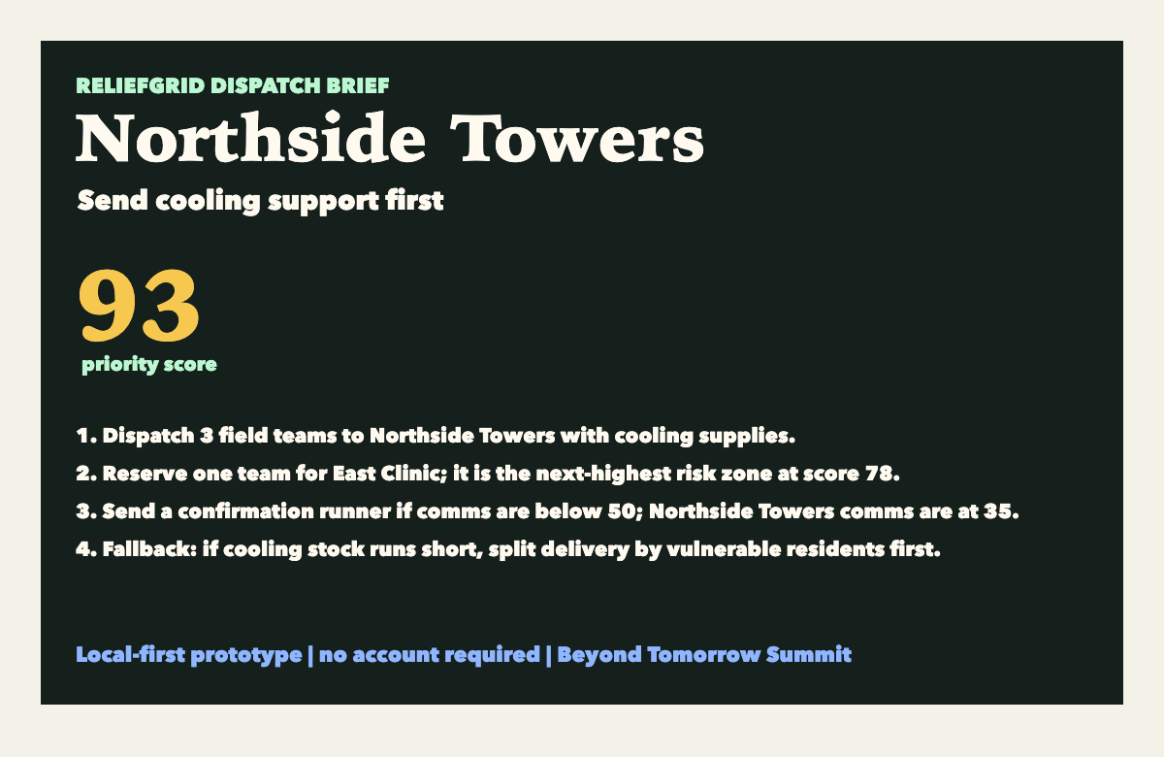
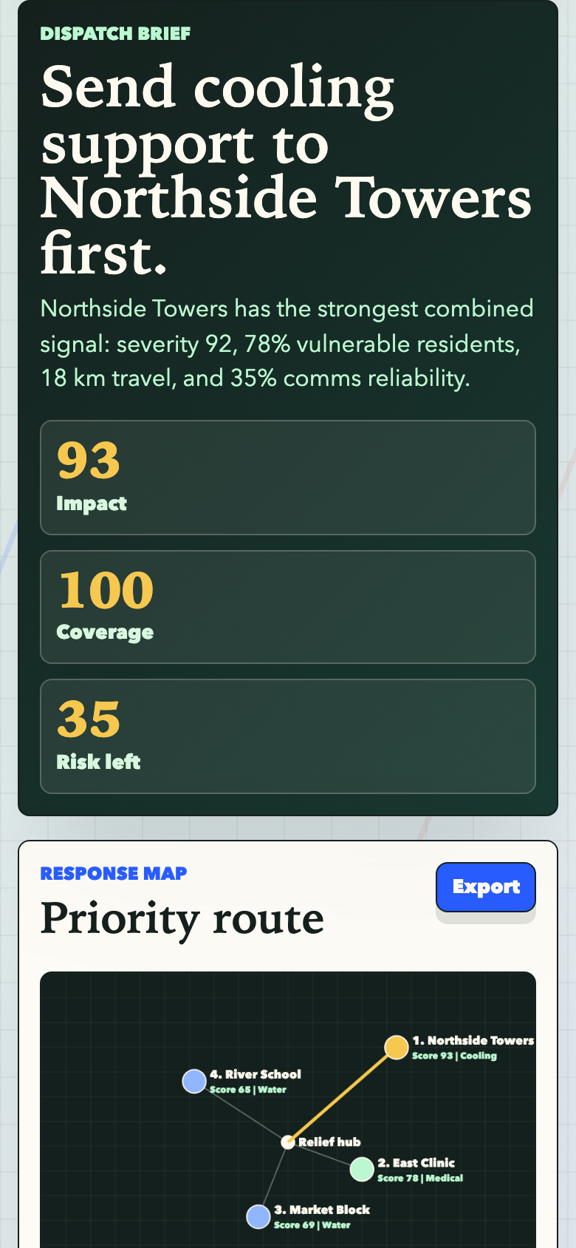
IMPACT
The first version is small enough to use, but broad enough to scale.
ReliefGrid avoids a fragile all-in-one emergency platform and starts with a repeatable decision unit.
Heatwave welfare checks
Flood response triage
Rank apartment blocks by vulnerability and access.
Prioritize zones with isolating roads and supply gaps.
Clinic outage routing
Campus safety ops
Send generator, water, and transport to the best first site.
Coordinate volunteers without exposing sensitive data.
Why it can grow
1. Static deploy today, data connectors later. 2. Scoring remains transparent enough for local trust. 3. Exports work even when the receiving team has no app login.
ReliefGrid / Beyond Tomorrow Summit / 05

Slide 6
BUILD PLAN
The submission is complete enough for judges to run and inspect.
No backend dependency is required for the prototype, which keeps the demo stable under deadline pressure.
Static app
Scoring engine
Visual proof
Persistence
HTML/CSS/JS entry point
Need, risk, access, confidence
Canvas map and receipt export
LocalStorage scenario state
Now
Next
Later
Trust
Working prototype + package
GitHub repo + hosted demo
SMS intake + city data feeds
Audit trail + incident templates
Submission checklist
App, WebM demo, screenshots, pitch deck, field copy, runbook, and final QA are packaged locally.
ReliefGrid / Beyond Tomorrow Summit / 06

