Slide 1


AI-Powered Emergency Healthcare Connector & Smart Ambulance Dispatch
Name: Suffiya Shanawaj Inamdar
Branch: CSE – Data Science
Year: TY
Roll No: P59
Subject: DBMS

Slide 2
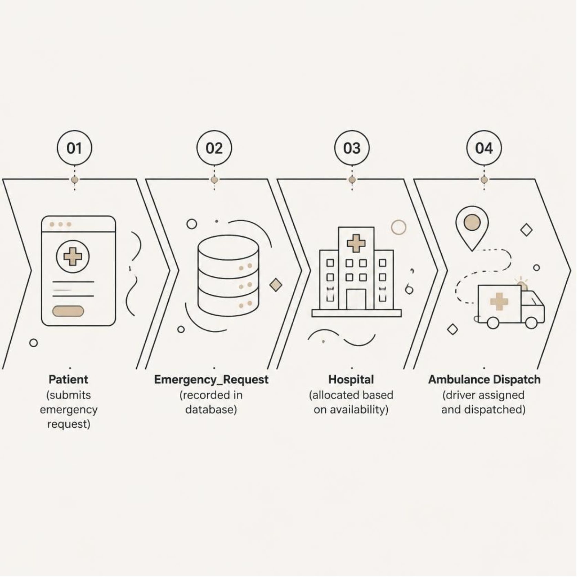

Project Overview
MySQL-based relational database system
Manages emergency healthcare information
Connects patients, hospitals, doctors, and ambulance services
Stores emergency requests and dispatch records
Tracks ICU beds, blood bank, and pharmacy data
Designed using a normalized relational structure
The project organizes emergency healthcare data using relational database concepts — structured storage and SQL-based retrieval of operational information.

Slide 3
Database Used
11 Relational Tables
1. Patient | 7. Dispatch
2. Hospital | 8. ICU_Bed
3. Doctor | 9. Blood_Bank
4. Ambulance | 10. Pharmacy
5. Driver | 11. Emergency_Contact
6. Emergency_Request
Database Configuration
DBMS: MySQL
Database Name: EmergencyHealthcareDB
Relational database model
Tables connected via Primary Keys and Foreign Keys
Normalized relational design

Slide 4
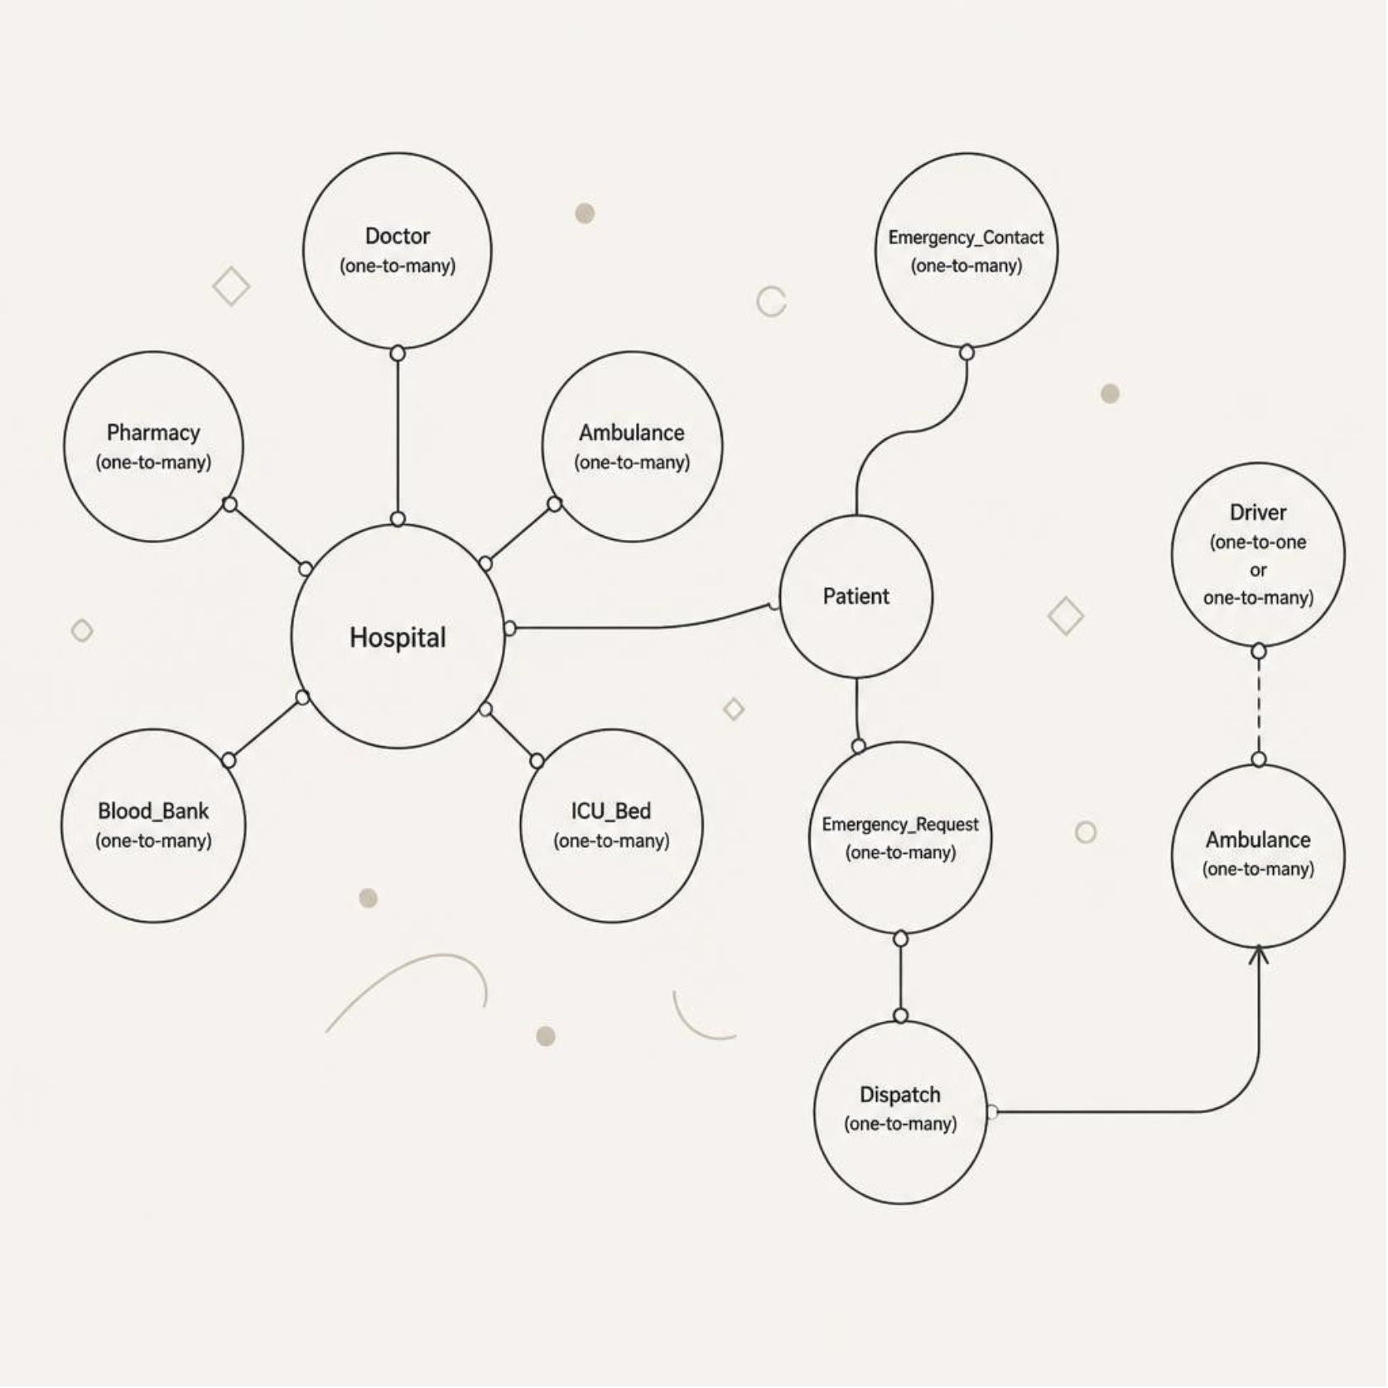

Key Relationships
Relationship Rules
Primary Key: Uniquely identifies each record in a table
Foreign Key: Links related tables together
Relationships enforce referential integrity
Ensures data consistency across the schema
Every foreign key references a valid primary key —
orphaned records are prevented by design.

Slide 5
SQL Commands Used
DDL
DML
CREATE DATABASE
CREATE TABLE
ALTER TABLE
INSERT
UPDATE
DELETE
DQL / Query Ops
Advanced
SELECT, WHERE
GROUP BY, HAVING
ORDER BY
JOIN
Subqueries
Aggregate Functions

Slide 6
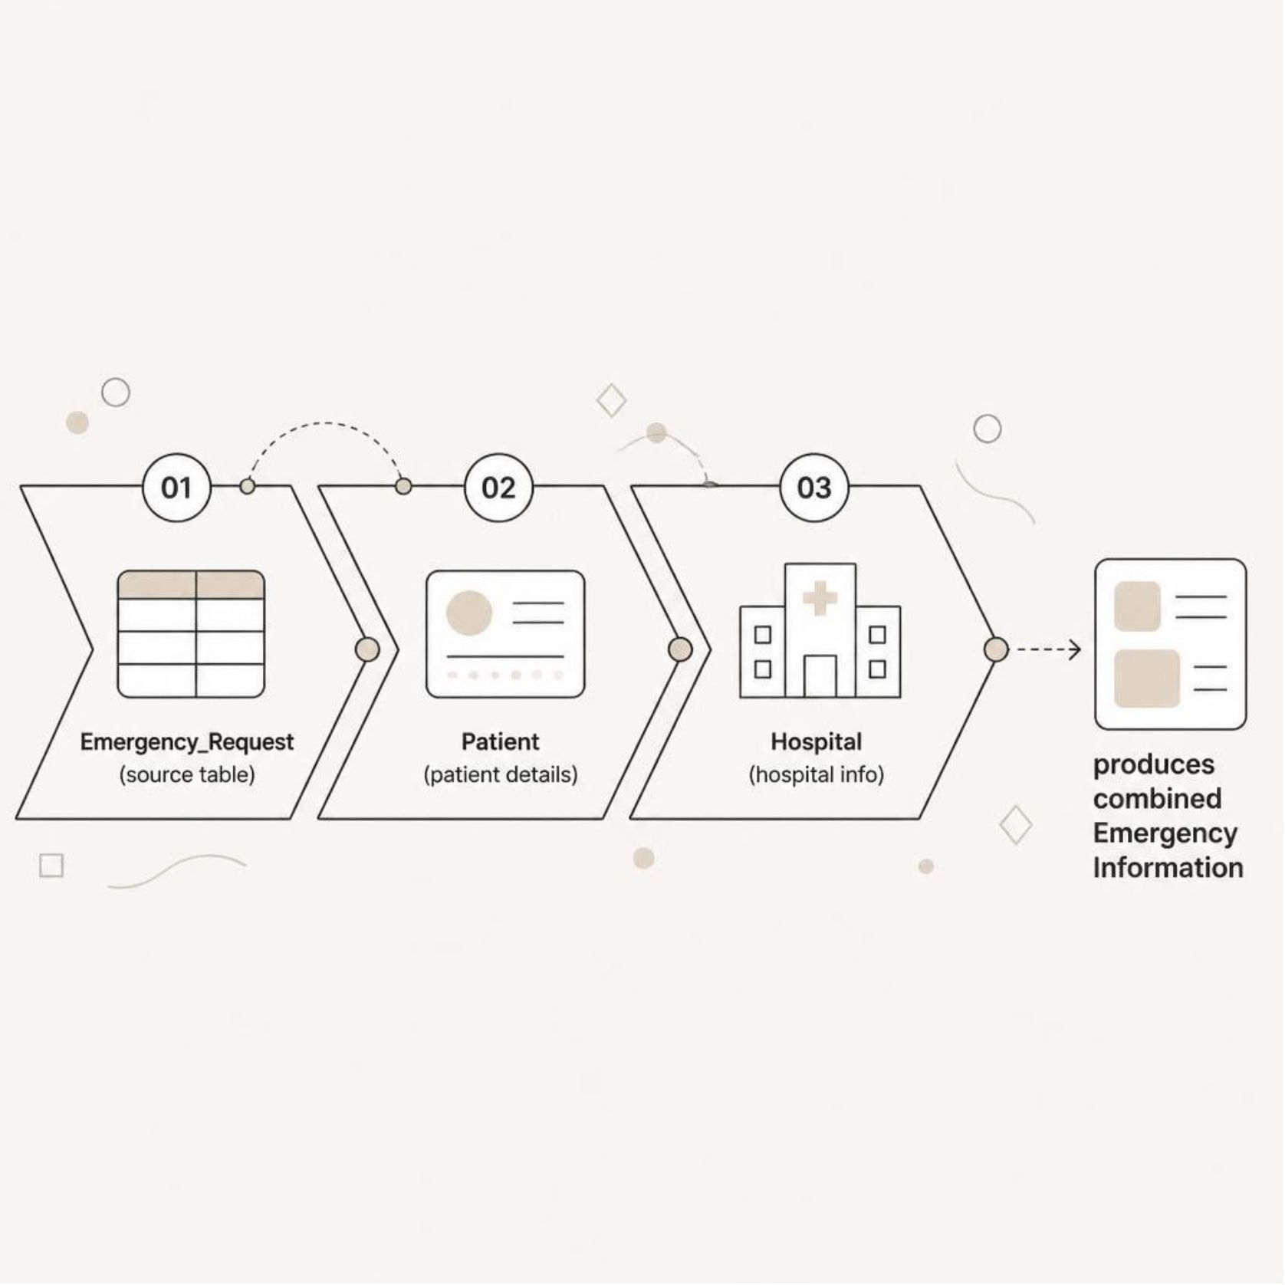
Advanced SQL Queries
Join & Query Operations
INNER JOIN – matches records across related tables
LEFT JOIN – retains all rows from the left table
SELF JOIN – compares rows within the same table
Multi-table JOIN – combines multiple related tables
GROUP BY – groups records for aggregation
HAVING – filters grouped results
Aggregate functions – COUNT(), SUM(), AVG()
Subqueries – nested query inside another
Correlated subquery – compares values with related rows

Slide 7
Database Features
Views
Stored Procedure
Trigger
Emergency_Request_View – combined emergency request report
Ambulance_Dispatch_View – dispatch and ambulance information
Purpose: Reusable reporting without rewriting queries
GetRequestsByPriority()
Accepts priority as a parameter
Returns matching emergency requests
Purpose: Reusable parameterized query
trg_dispatch_ambulance_status
Automatically updates ambulance status to "On Duty" after dispatch
Purpose: Automatic database action on event

Slide 8
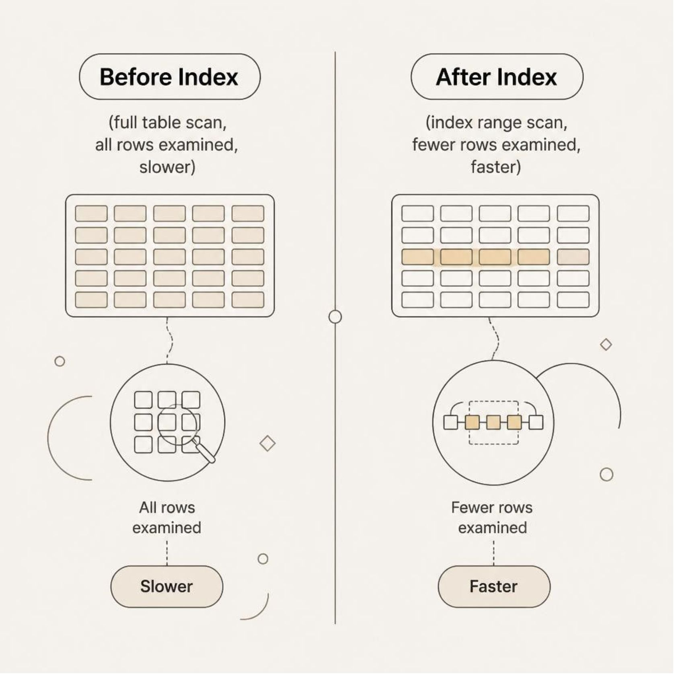
Performance & Optimization
Indexing Strategy
EXPLAIN used to inspect query execution plans
Indexes created on frequently filtered and joined columns
Composite indexes for multi-condition queries
Indexes Created
Emergency_Request — Hospital_ID, Priority_Level, Request_Time
Ambulance — Status
Dispatch — Ambulance_ID, Dispatch_Time
Indexes help MySQL locate required records more efficiently
and reduce unnecessary row scanning.

Slide 9
Database Concepts Applied
Constraints
ACID Properties
PRIMARY KEY – unique row identifier
FOREIGN KEY – enforces table relationships
NOT NULL – field must have a value
UNIQUE – no duplicate values allowed
CHECK – validates data against a condition
Atomicity
Consistency
Transaction completes fully or rolls back
Database remains in a valid state
Referential Actions
Isolation
Durability
Concurrent transactions are controlled
Committed changes are preserved
ON DELETE CASCADE – deletes child records automatically
ON UPDATE CASCADE – propagates key updates

Slide 10
Conclusion
Implemented a MySQL relational database for emergency healthcare.
Structured data using relationships, constraints, and normalization.
Implemented joins, aggregate queries, subqueries, and views.
Applied indexing and EXPLAIN for query optimization.
Implemented a stored procedure and trigger for automation.
Provides a structured foundation for emergency healthcare and ambulance dispatch data management.

