Slide 1



World Book Day 2016
Can you answer the following 20 questions and be a
World Book Day Champion?

Slide 2

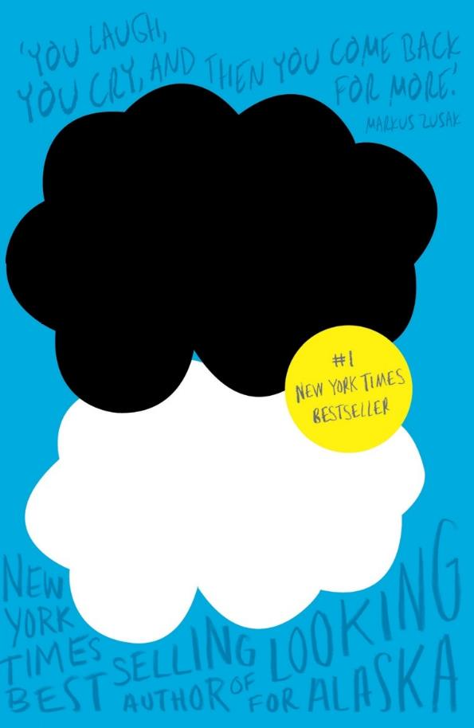



Round 1 - Blanked Out Books
Can you guess the book title and author from our cleverly disguised covers?

Slide 3
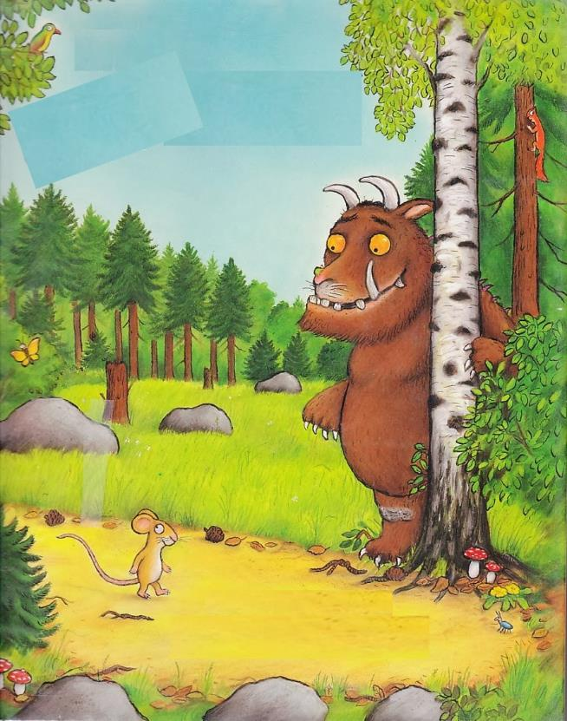
Guess the book title (1 point) and author (1 point)
Question: 1

Slide 4
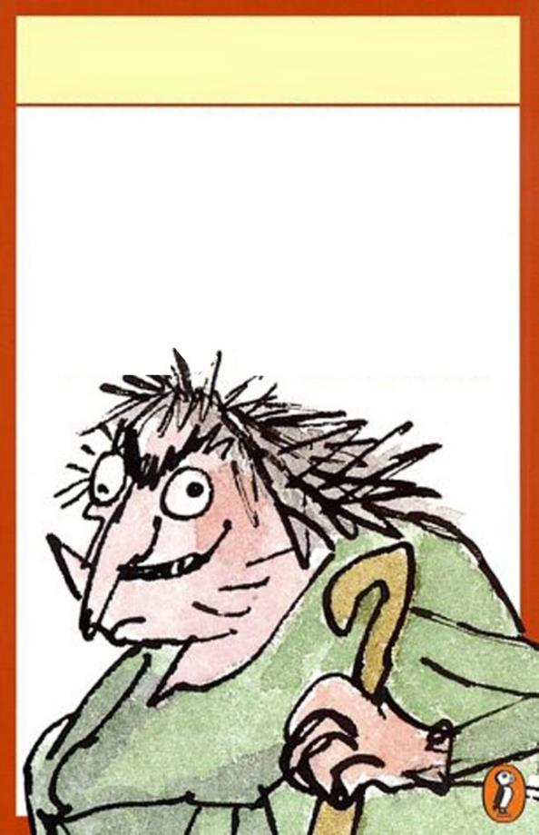
Guess the book title (1 point) and author (1 point)
Question: 2

Slide 5
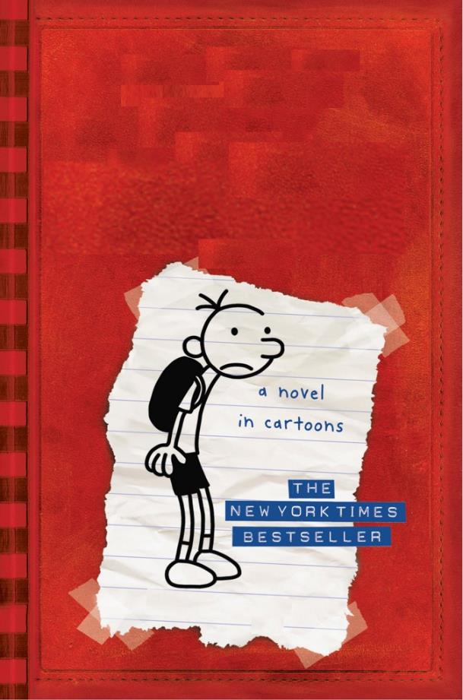
Guess the book title (1 point) and author (1 point)
Question: 3

Slide 6

Guess the book title (1 point) and author (1 point)
Question: 4

Slide 7
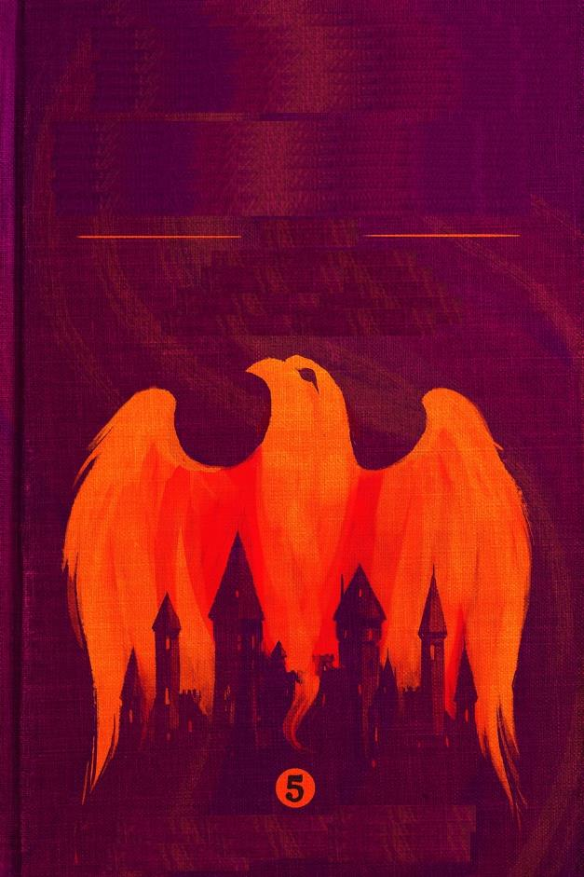
Guess the book title (1 point) and author (1 point)
Question: 5

Slide 8

Guess the book title (1 point) and author (1 point)
Question: 6

Slide 9
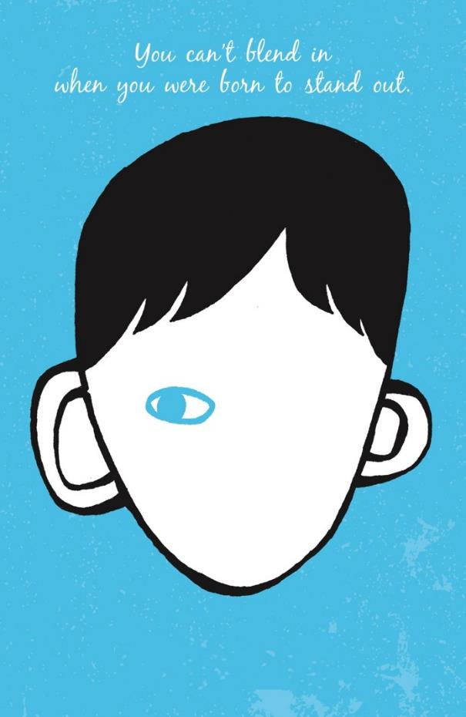
Guess the book title (1 point) and author (1 point)
Question: 7

Slide 10
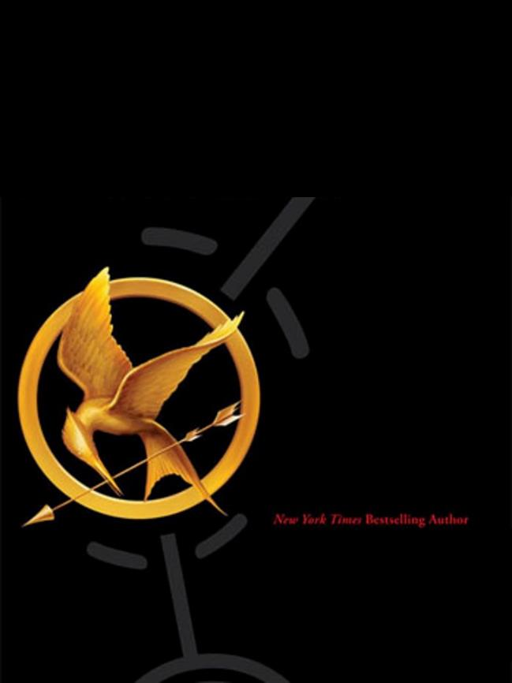
Guess the book title (1 point) and author (1 point)
Question: 8

Slide 11
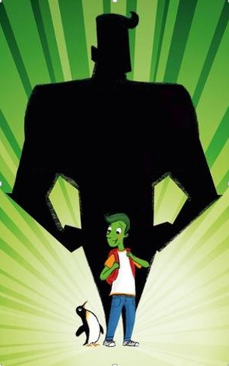
Guess the book title (1 point) and author (1 point)
Question: 9

Slide 12

Guess the book title (1 point) and author (1 point)
Question: 10

Slide 13
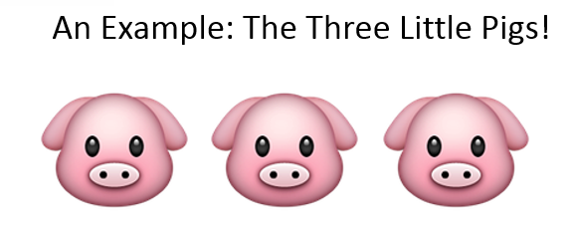
Round 2 - Emoji Book Titles
Look at the following slides and guess the title of the book!

Slide 14

Guess the book title from the emoji (1 point) and author (1 point)
Question: 11

Slide 15


Guess the book title from the emoji (1 point) and author (1 point)
Question: 12

Slide 16



Guess the book title from the emoji (1 point) and author (1 point)
Question: 13

Slide 17


Guess the book title from the emoji (1 point) and author (1 point)
Question: 14

Slide 18

Guess the book title from the emoji (1 point) and author (1 point)
Question: 15

Slide 19



Guess the book title from the emoji (1 point) and author (1 point)
Question: 16

Slide 20


Guess the book title from the emoji (1 point) and author (1 point)
Question: 17

Slide 21


Guess the book title from the emoji (1 point) and author (1 point)
Question: 18

Slide 22



Guess the book title from the emoji (1 point) and author (1 point)
Question: 19

Slide 23


Guess the book title from the emoji (1 point) and author (1 point)
Question: 20

Slide 24


How did you do?
Or
Time to check your answers!

Slide 25
Time for the answers!
Round 1 – Blanked Out Books
1. The Gruffalo by Julia Donaldson
2. The Twits by Roald Dahl
3. Diary of a Wimpy Kid by Jeff Kinney
4. Alice in Wonderland by Lewis Caroll
5. The Order of the Phoenix by J.K. Rowling
6. The Witches by Roald Dahl
7. Wonder by R.J. Palacio
8. The Hunger Games by Suzanne Collins
9. The Astounding Broccoli Boy by Frank Cottrell Boyce
10. The Hobbit by J.R.R. Tolkien

Slide 26
Time for the answers!
Round 2 – Emoji Book Titles
11. Holes by Louis Sachar
12. The Very Hungry Caterpillar by Eric Carle
13. The Boy in the Dress by David Walliams
14. Noughts and Crosses by Malorie Blackman
15. The Hunger Games by Suzanne Collins
16. Fantastic Mr Fox by Roald
17. Lord of the Rings by J.R.R. Tolkien
18. Of Mice and Men by John Steinbeck
19. How to Train your Dragon by Cressida Cowell
20. The Curious Incident of the Dog in the Night-Time by Mark Haddon

