Slide 1
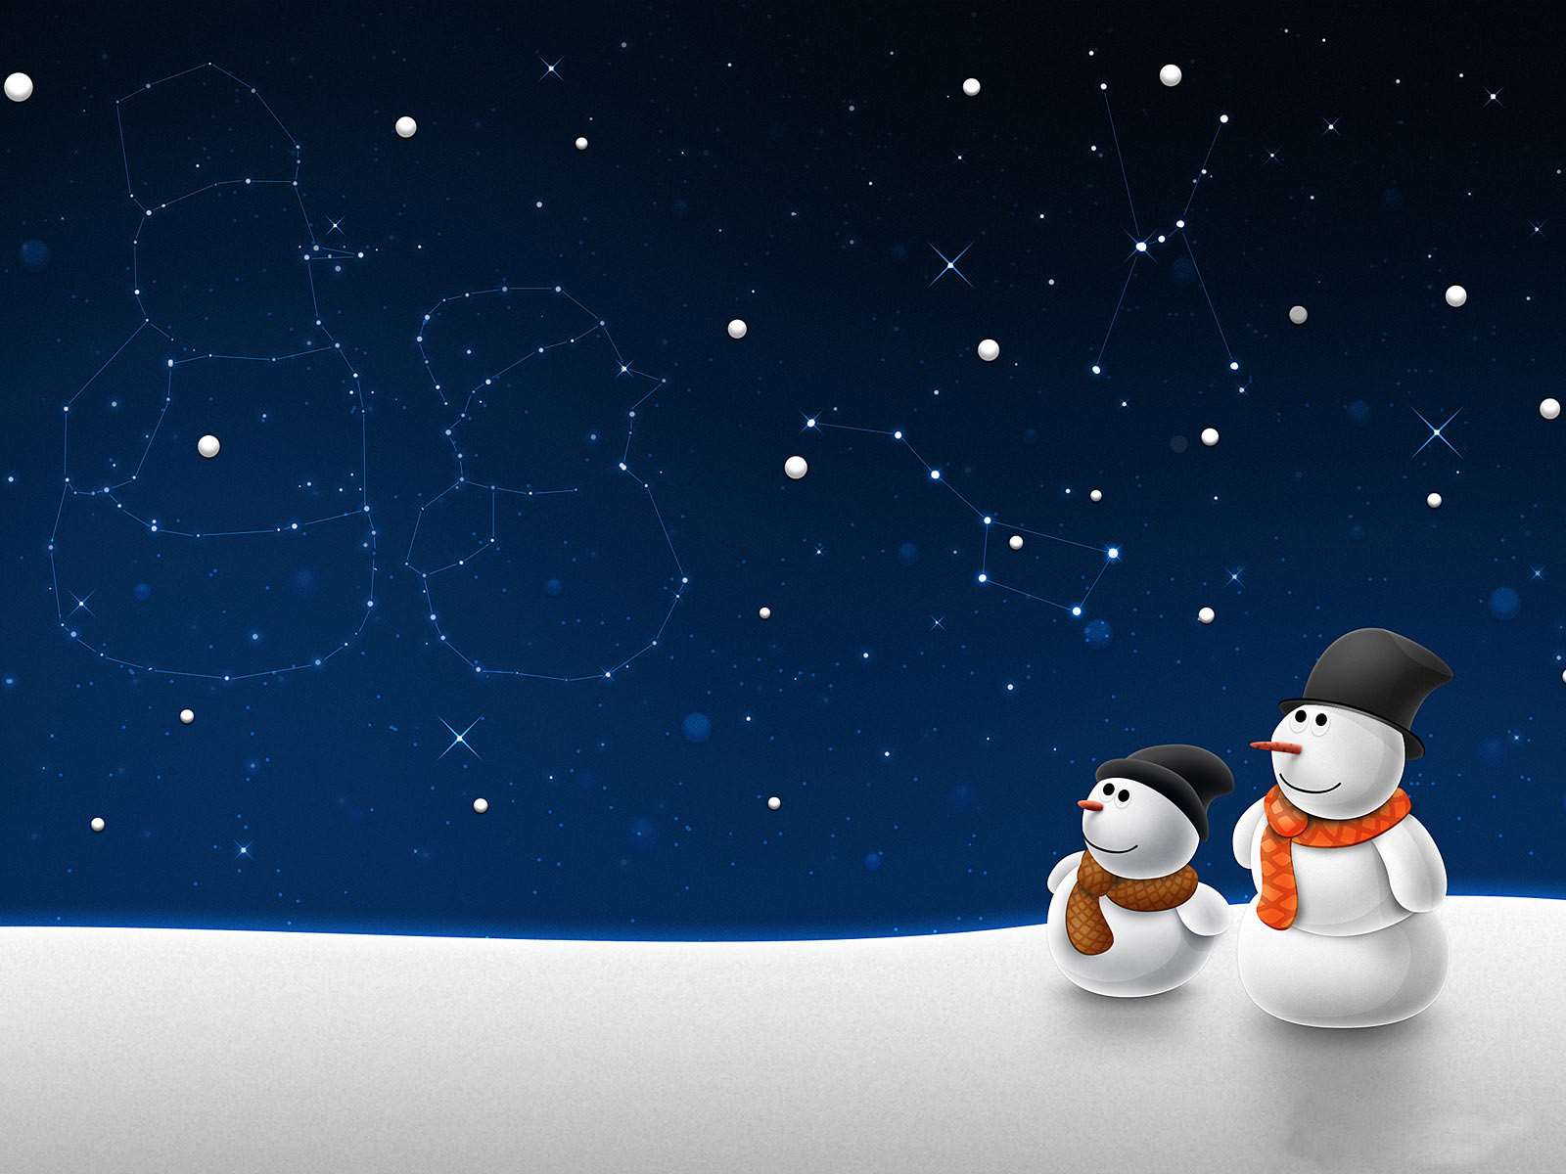


Welcome to the ‘Beyond the Book’ Christmas quiz!
15 questions to test your festive knowledge.
Any cheating and we will put you on the naughty list!
(The number of points available for each answer is in brackets)

Slide 2
Q1: In the movie ‘Elf’ - how do the citizens of New York help Santa to fly? (1)

Slide 3
Q2: ‘Feliz Navidad’ is ‘Merry Christmas’ in what language? (1)

Slide 4
Q3: The North Pole, said to be Santa's home, is located in which ocean? (1)

Slide 5
Q4: Which long running TV series features a character called Santa's Little Helper? (1)

Slide 6
Q5: The Christmas tree in Trafalgar Square, London, is an annual gift from which European country? (1)

Slide 7
Q6: What nickname do the two burglars in ‘Home Alone’ give themselves? (1)

Slide 8
Q7: If you were born on Christmas Day what zodiac sign would you be? (1)

Slide 9
Q8: What are the names of the three wise men? (3)

Slide 10
Q9: By what common name do we know the vegetable Brassica Oleracea? (1)

Slide 11
Q10: What is myrrh? (1)

Slide 12
Q11: Can you name the four ghosts who appear in
‘A Christmas Carol’ by Charles Dickens? (4)

Slide 13
Q12: Who was crowned King of England on December 25th 1066? (1)

Slide 14
Q13: 'Nadolig Llawen' is ‘Merry Christmas’ in what language? (1)

Slide 15
Q14: What are the names of Santa's reindeer? (9)

Slide 16
Q15: If a person was given all the gifts mentioned in the song ’The Twelve Days of Christmas’, how many gifts in total would they receive? (5)

Slide 17
For the answers visit www.suffolklibraries.co.uk/beyond-the-book

