Slide 1

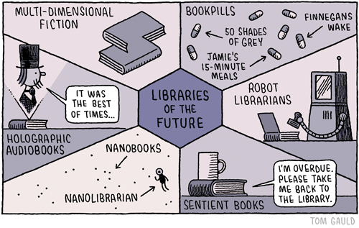


Activity 3 – Can YOU design the library of the future?
Notes:
Discuss Thunk No. 3 – Do you always learn something when you open a book?

Slide 2
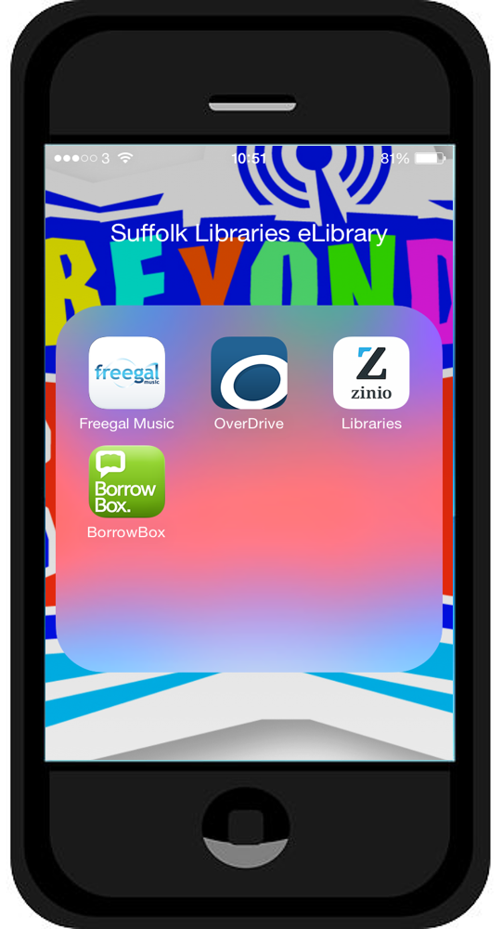
There’s more to Suffolk Libraries than just books!
As soon as you activate your new ‘Beyond the Book’ library card you can download music, books, magazines and more from Suffolk Libraries
– all for free!
Notes:
Encourage pupils to register their new library cards by visiting their local branch of Suffolk Libraries.
They will receive a pin number needed to log in to the apps.

Slide 3
Download these apps and you have a mini-library in your pocket!
Freegal – (Music) unlimited streaming. You can also download music and videos
Zinio– (eMagazines) Download and read the latest PS4, fashion, football and other magazines
Overdrive– (eBooks) Download books to read on your phone, tablet etc.
Linked to the Accelerated Reader programme
Borrow Box– (eAudio) Download and listen to audio books wherever you are

Slide 4

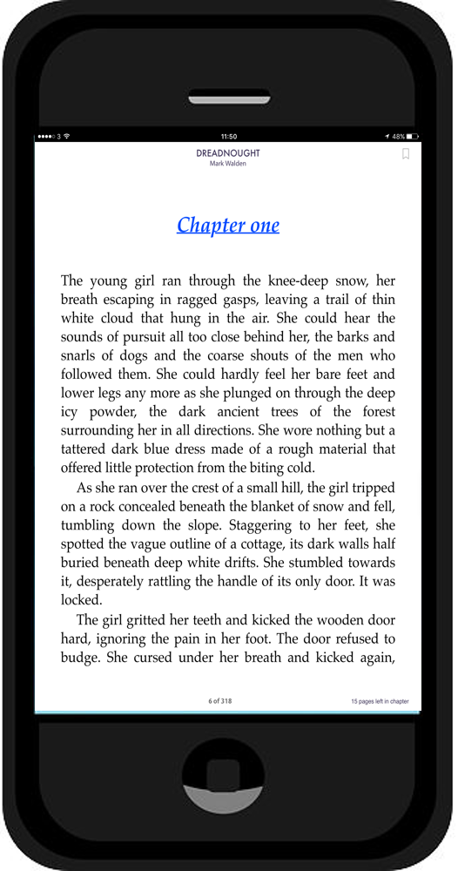
Paper books vs Electronic text
Which is better?
How are they similar?
What makes them different?
Notes:
Starter: eLibrary discussion points:
paper vs electronic
Divide the class into two groups – one group should come up with reasons why the printed book is better than the electronic version and the other half do the opposite. Share ideas afterwards.

Slide 5

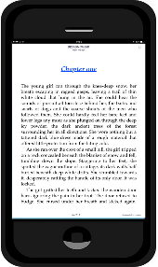
Paper vs Electronic – our ideas
Benefits of paper books
More titles available than eBooks
Does not require batteries to read
Last for a long time (13 leather bound books found in Nag Hammad in Egypt are an estimated 1,693 years old)
Can be dropped without damage
Can be read in the bath
Can be passed on to other people
Benefits of electronic books
Available 24/7
Easy, fast and cheap to send across the world
Able to store many books in a small space
Can adjust the size of text
Can be downloaded at home
Text can be translated quickly
Greater access to books in remote areas of the world
Does not use up a natural resources (wood)
Notes:
We came up with the following ideas: we would love to hear what pupils have to say.

Slide 6
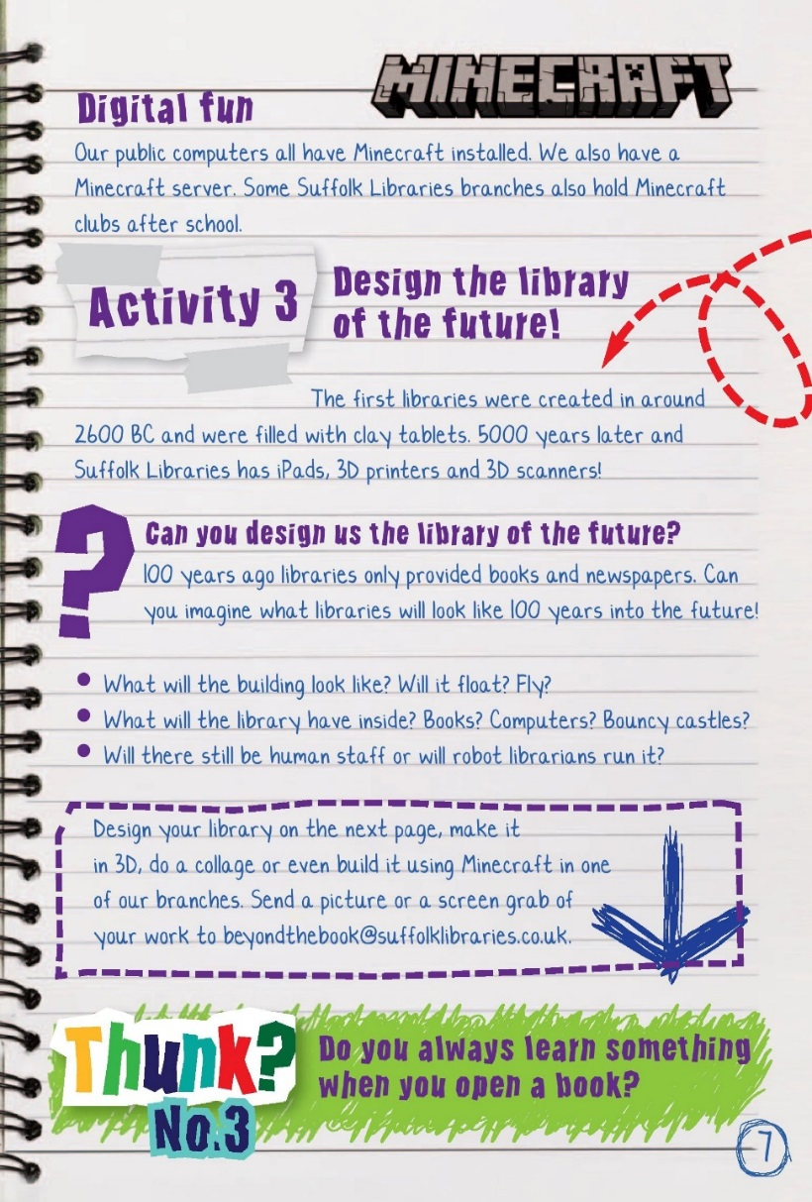
Activity 3 – Can YOU design the library of the future?
The next 3 slides give a very brief 5000 year history of libraries
How have they changed?
What has stayed the same?

Slide 7
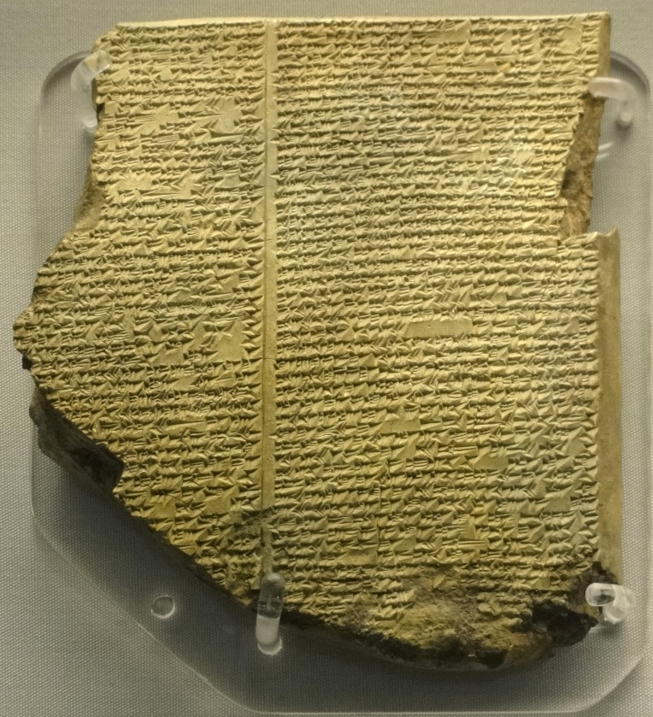
The history of libraries in 3 slides
2600 BC – 300 BC – 2016 AD
The first ‘libraries’ were started around 2600BC in what is now modern day Iraq.
They were filled with clay tablets recording transactions between traders.
You were not allowed to borrow the tablets.
It was probably a bit boring

Slide 8
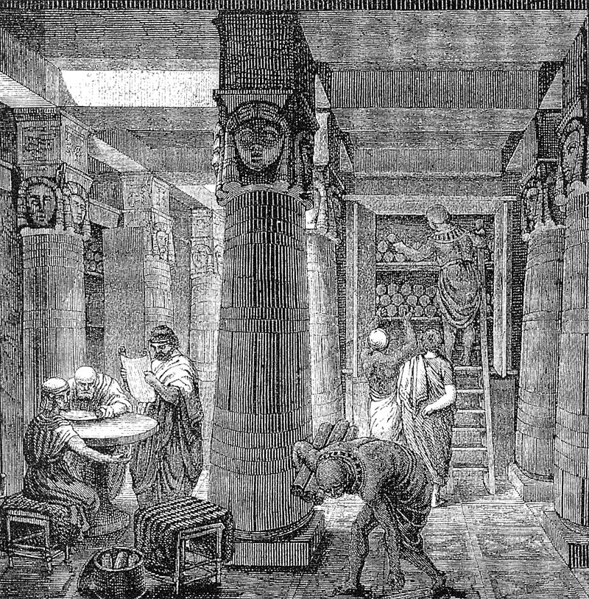
The history of libraries in 3 slides
2600 BC – 300 BC – 2016 AD
In 300 BC the Ancient Library of Alexandria was built in Egypt.
The pharaohs would confiscate stories written on scrolls and store them in the library. No one knows how many they had, but it could have been as many as 400,000!
You were allowed to go into the library and read the scrolls, but not take them home.
Still sounds a bit boring to be honest!

Slide 9
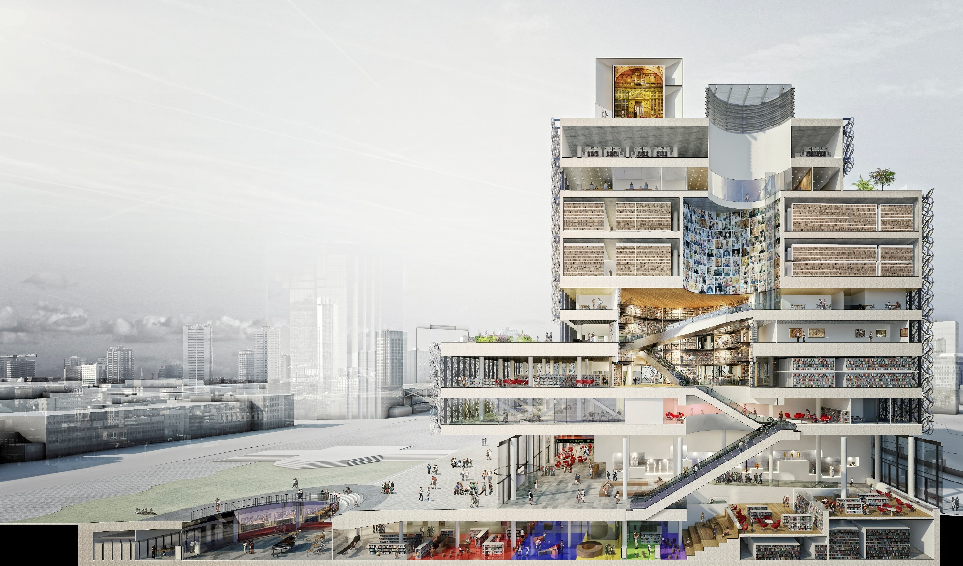
The history of libraries in 3 slides
2600 BC – 300 BC – 2016 AD
In 2016 the Library of Birmingham is the biggest cultural space open to the public in Europe.
It has 800,000 books, a café, music, film, computers, photographs, free Wi-Fi, ping pong tables, a language centre, a Google Digital Garage and much more.

Slide 10
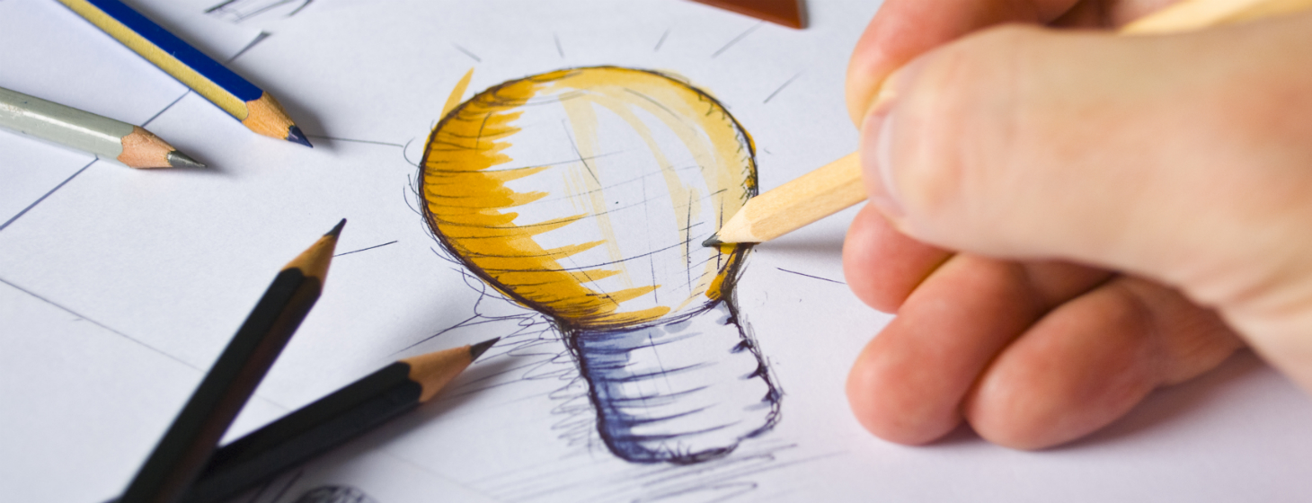
Activity 3 – Can YOU design the library of the future?
What will libraries look like in the future?
Will they still have books in?
Design us the library of the future using pen and paper, using CAD on a computer, a collage, in 3d, or even on Minecraft!
Send your ideas to beyondthebook@suffolklibraries.co.uk
For ideas visit: http://suffolklibraries.co.uk/tag/beyond-the-book
and see what famous authors predict the world of reading will be like a hundred years from now!
Notes:
This activity can be completed using pens and paper, using CAD on a computer, a collage, in 3d, or even on Minecraft.
Pupils can include anything they like in their libraries as long as they can justify their decisions: There are no wrong answers.
It may be useful to discuss these two non-negotiables about libraries.
• Accessible for everyone in society
• Free to use
Please send pictures, screen grabs etc of the work to beyondthebook@suffolklibraries.co.uk

