Slide 1



Welcome to Beyond the Book!
This is your personal
‘Beyond the Book’ activity booklet.
We hope you enjoy taking part in the activities and can’t wait to see examples of your work!
Please write your new library card number on your booklet

Slide 2

Welcome to Beyond the Book!
This is your brand new Suffolk Libraries library card!
Year 7 pupils are the only pupils who have this card.
The card is unique to you!
Sign the back of your card now.
To activate the card you need to take it to your local library (with the completed membership form)
Notes:
Page 2 – Introduction to ‘Beyond the Book’.
To register/activate their new card:
• Pupils need to complete the joining form, have it signed by their parent/carer and take it to their local library to activate it.
• This is a brand new card only available to this year 7 group – no one else! Please emphasise this point.
• If pupils think they are already registered – ask them to still complete the form and take it to their local library.

Slide 3
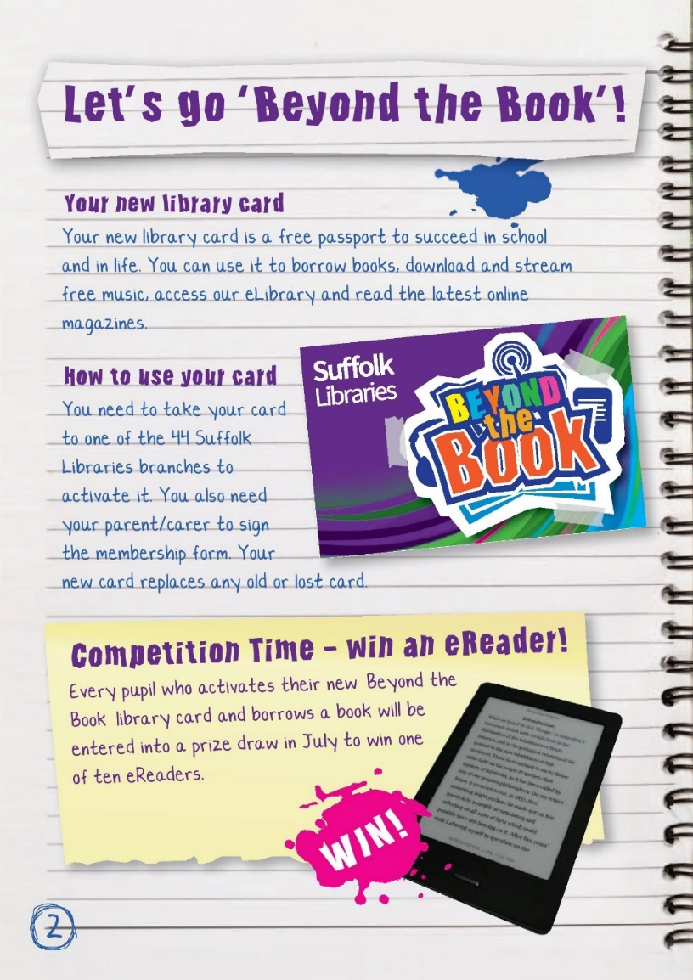
Welcome to Beyond the Book!
You need your new card to borrow books and to access our digital services.
This will allow you to download eBooks, audio books and even download free music!
Everyone who activates their new card will be entered into a prize draw to win their very own eReader!
Notes:
eReader competiton
Any pupil in year 7 who registers at their local library during this academic year will be entered into a prize draw to win one of 10 eReaders.

Slide 4
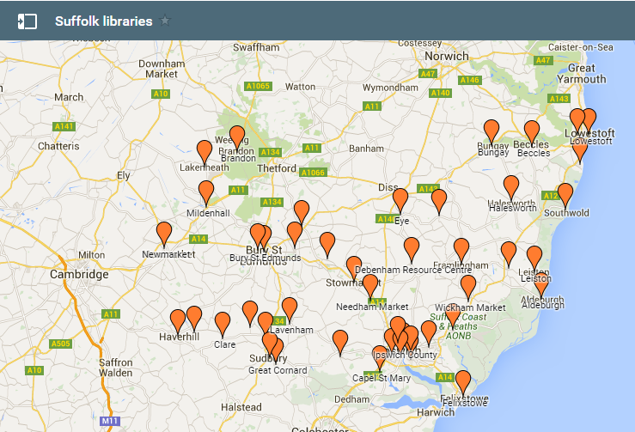
Your Local Suffolk Libraries Branch
• There are 44 branches of Suffolk Libraries in Suffolk!
• You can borrow a book from any Suffolk Library – not just the closest!
• You can also return books to any Suffolk Library!
• Many branches are open 7 days a week and after school!
Where is your closest local library?
Visit http://www.findalibrary.org.uk/
Enter your postcode and find out!
Notes:
Points to get across:
• There are 44 bricks and mortar branches of Suffolk Libraries in Suffolk pupils can access.
• You can borrow a book from any Suffolk Library – not just the closest.
• You can also return books to any Suffolk Library.
• You can request a book to be sent from one branch of Suffolk Libraries to another for you to pick up.
• There are also 6 mobile library routes that can be accessed here
http://suffolklibraries.co.uk/community-services/mobile-libraries/

Slide 5

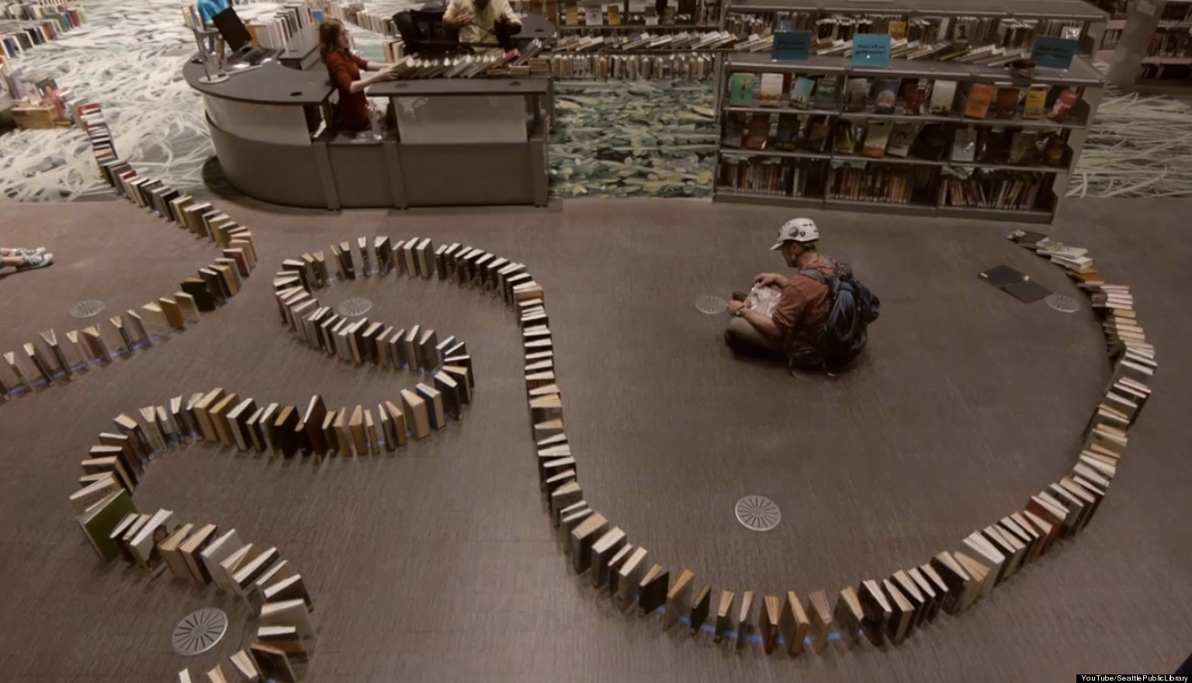
Did You Know?
Suffolk Libraries adds over 2 miles of books to its shelves each year!
If we put all the new books in a row it would take Mo Farah 8 minutes and 3 seconds run from the first book to the last!

Slide 6



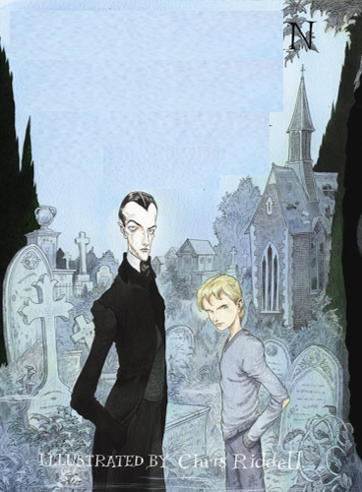
Are you ready to Thunk?!
A thunk is a simple-looking question about everyday things. No two answers are the same!
Thunk No. 1 - Can you judge a book by its cover?
We have removed the title and author from these books – would you read any?
Discuss the Thunk with the person next to you, then feedback to the class.
Notes:
Activities to introduce Thunk No. 1
Ask pupils if they recognise any of the book covers
Has anyone read the books?
Conduct a class vote to find out which cover appeals to pupils the most
Ask pupils to discuss Thunk No. 1 - Can you judge a book by its cover? In pairs and feedback as a class
Answers (from left to right) – A Monster Calls by Patrick Ness, The Astounding Broccoli Boy by Frank Cottrell Boyce, Flour Babies by Anne Fine, The Graveyard Book by Neil Gaiman. A longer version of this activity id available at the Beyond the Book blog.

Slide 7
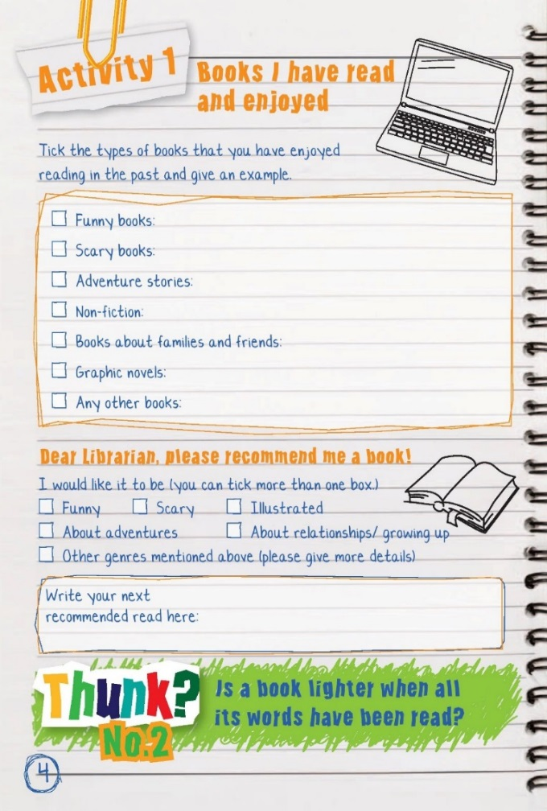
Activity 1 -
Prior reading
• Tick the genres of books you have read in the past and enjoyed
• Provide an example
What would you like to read next?
Will you stick to a genre you have previously enjoyed or try something new?
Notes:
Discussion points to introduce the activity. Talk about
• Introduce the word ‘genre’ – (a specific type of music, film, or writing)
• Share with the class what books you enjoyed as a child
• The books your own children enjoy (if applicable)
• The books you enjoy as an adult
• How you discover the books you read
• Emphasise the expert knowledge librarians have in recommending books.

Slide 8

Activity 1 – Your recommendation
Take your completed activity to your school library or to any Suffolk Library and ask the librarian to suggest a book you might like to enjoy!
Notes:
Plenary
• To find out who has chosen what ask for a show of hands as you read out the genres mentioned in part 2 (funny, scary, relationships/growing up, adventures, illustrated, other). What do you notice about what pupils would like to read (most/least popular)?
• Ask one pupil to read out their selections - can anyone in the class recommend a book for this pupil?
• Remind pupils that they can take this to a school librarian for a recommendation. The school librarian could then deliver the recommended books to the class the following week. They can also take it to any branch of Suffolk Libraries.

