Slide 1

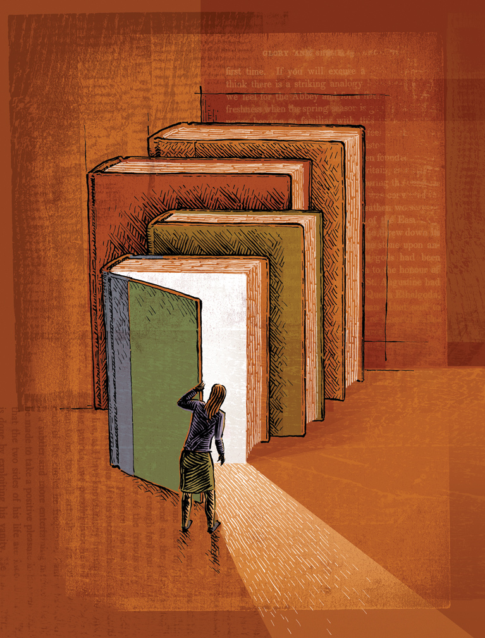


Activity 4 – Going ‘Beyond the Book’
Go beyond the book and into a world of imagination
Notes:
Discuss Thunk No. 4 – If you borrow all the books from a library, is it still a library?

Slide 2
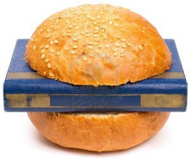
A Story Sandwich
Imagine you are creating a story sandwich – The bread acts as the beginning and the end of the story. What do you need to act as the filling?
1.
2.
3.
4.
5.
Characters (Who does what)
Setting (Where does it happen)
Plot (What happens)
Conflict (people who have different views about something)
Resolution (How everything comes together in the end)
Notes:
Starter: What are the ingredients for a great story?
As pupils to imagine they are creating a story sandwich – The bread acts as the beginning and the end of the story. What do you need to act as the filling?
Ask them to discuss what they think are the five things every story needs. Feedback to the class.
You could show them answer 1 as part of the introduction.
• Characters
• Setting
• Plot
• Conflict
• Resolution
Discuss these as a class to ensure understanding. Can pupils decide which the most important ingredient is? Are characters more important than where the story is set?

Slide 3
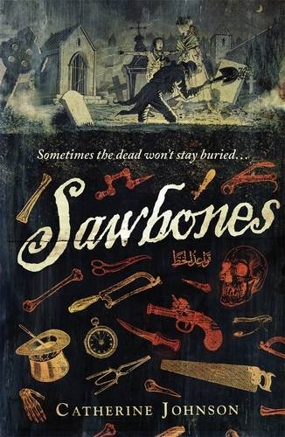
A Sawbones Story Sandwich
We loved Sawbones by Catherine Long. How does her story sandwich look?
• Characters: Ezra (a former child slave who now is a surgeon’s apprentice), Loveday Finch (child circus performer and wannabe detective), the resurrection men (men who sell dead bodies to surgeons to practice on), various nasty hoodlums.
• Setting: 18th Century London (dangerous, dirty, lawless, cold, bleak)
• Plot: Some precious gems are missing. Is this why Loveday’s father was poisoned and Ezra’s boss shot and killed? Who are the mysterious men looking for a body with no tongue and is the small beggar boy really a powerful prince?
• Conflict: Will Ezra and Loveday solve the murders and get to the jewels before the murderer does?
• Resolution: A magic show that is not what it seems and a rooftop chase across London that ends in death – but for whom?
Notes:
Discuss the slide outlining the Sawbones Story Sandwich demonstrating the five ingredients.

Slide 4


Activity 4 – Going ‘Beyond the Book’
What would you do if you could travel inside your favourite book!
Meet Hermione and cast a spell on Harry?
Go through the wardrobe to visit Narnia?
Steal the golden ticket from Charlie to win the chocolate factory!
Notes:
What else would pupils like to do?

Slide 5
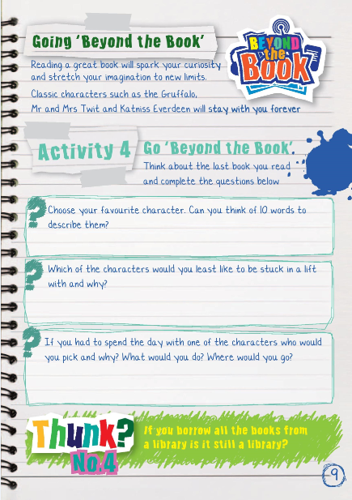
Activity 4 – Going ‘Beyond the Book’
Now look at Activity 4 in your booklet and go ‘Beyond the Book’ by interacting with the last book you read!
(you could also do your favourite book)
Notes:
Booklet Activity 4: Go ‘Beyond the Book’.
Ask pupils to think about the book they are reading and work through the questions.
Each of the questions could be expanded into fun activities such as
• Pupils read out their 10 describing words for others to guess the character
• Illustrating the pupil and character stuck in a lift
• Acting out being transported into the setting of the book and describing what each of the senses encounters
• Emailing or tweeting the questions to the author
Extension:
We also interview authors on our blog and ask them the same final question about sending a book to Mars.
Visit the link below and see what books they would send.
Do any authors pick the same book or author?
What reasons do they give for their choice?
http://suffolklibraries.co.uk/tag/beyond-the-book

