Slide 1
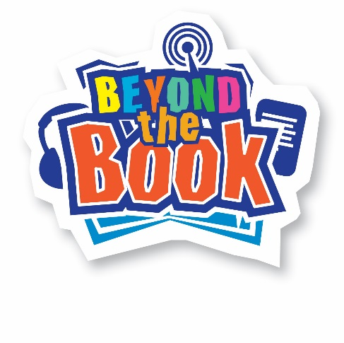
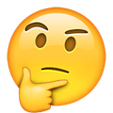

Emoji Book Quiz
Look at the following slides and guess the title of the book!

Slide 2
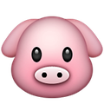
Emoji Book Quiz
An Example: The Three Little Pigs!

Slide 3


Emoji Book Quiz
Emoji #1
Answer: The Very Hungry Caterpillar by Eric Carle

Slide 4
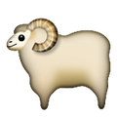
Emoji Book Quiz
Emoji #2
Answer: The Sheep-Pig by Dick King-Smith

Slide 5

Emoji Book Quiz
Emoji #3
Answer: Holes by Louis Sachar

Slide 6
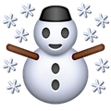
Emoji Book Quiz
Emoji #4
Answer: The Snowman by Raymond Briggs

Slide 7
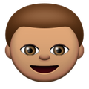

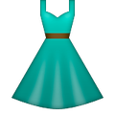
Emoji Book Quiz
Emoji #5
Answer: The Boy in the Dress by David Walliams

Slide 8

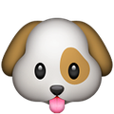

Emoji Book Quiz
Emoji #6
Answer: The Hundred and One Dalmatians by Dodie Smith

Slide 9


Emoji Book Quiz
Emoji #7
Answer: Noughts and Crosses by Malorie Blackman

Slide 10
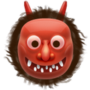
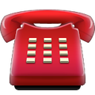
Emoji Book Quiz
Emoji #8
Answer: A Monster Calls by Patrick Ness

Slide 11

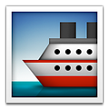

Emoji Book Quiz (Click next for the solution)
Emoji #9
Answer: Watership Down by Richard Adams

Slide 12
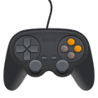
Emoji Book Quiz
Emoji #10
Answer: The Hunger Games by Suzanne Collins

Slide 13

Emoji Book Quiz
Emoji #11
Answer: Curious Incident Of The Dog In The Nighttime by Mark Haddon

Slide 14



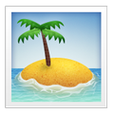
Emoji Book Quiz
Emoji #12
Answer: Five on a Treasure Island by Enid Blyton

Slide 15
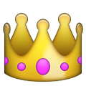
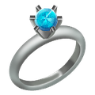
Emoji Book Quiz
Emoji #13
Answer: Lord of the Rings by J. R. R. Tolkien

Slide 16
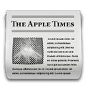

Emoji Book Quiz
Emoji #13
Answer: Paper Towns by John Green

Slide 17

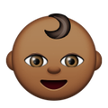
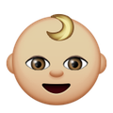
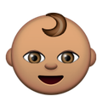
Emoji Book Quiz
Emoji #14
Answer: Flour Babies by Anne Fine

Slide 18

Emoji Book Quiz
Emoji #15
Answer: Pig Heart Boy by Malorie Blackman

Slide 19

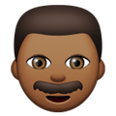

Emoji Book Quiz
Emoji #16
Answer: Fantastic Mr Fox by Roald Dahl

Slide 20
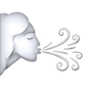


Emoji Book Quiz
Emoji #17
Answer: Winnie the Pooh by A. A. Milne

Slide 21
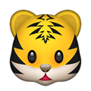


Emoji Book Quiz
Emoji #18
Answer: The Tiger Who Came To Tea by Judith Kerr

Slide 22

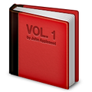

Emoji Book Quiz
Emoji #19
Answer: Hitch Hikers Guide to the Galaxy by Douglas Adams

Slide 23
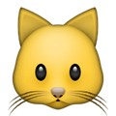

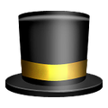
Emoji Book Quiz
Emoji #20
Answer: The Cat in the Hat by Dr Seuss

Slide 24
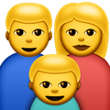
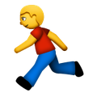

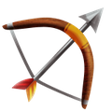
Emoji Book Quiz
Emoji #21
Answer: We’re Going on a Bear Hunt by Michael Rosen

Slide 25
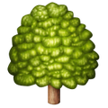
Emoji Book Quiz
Emoji #22
Answer: The Wind in the Willows by Kenneth Grahame

Slide 26
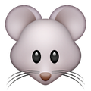
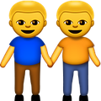
Emoji Book Quiz
Emoji #23
Answer: Of Mice and Men by John Steinbeck

Slide 27
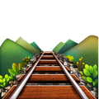
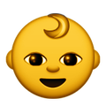
Emoji Book Quiz
Emoji #24
Answer: The Railway Children by Edith Nesbi

Slide 28
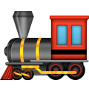
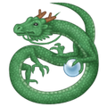
Emoji Book Quiz
Emoji #25
Answer: How To Train Your Dragon by Cressida Cowell

Slide 29

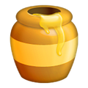


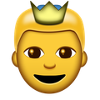
Emoji Book Quiz
Emoji #26
Answer: Harry Potter and the Half Blood Prince by J. K. Rowling

Slide 30
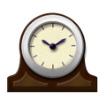
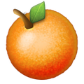
Emoji Book Quiz
Emoji #27
Answer: A Clockwork Orange by Anthony Burgess

Slide 31
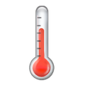



Emoji Book Quiz
Emoji #28
Answer: Fahrenheit 451 by Ray Bradbury

Slide 32

Emoji Book Quiz
Emoji #29
Answer: The Silence of the Lambs by Thomas Harris

Slide 33
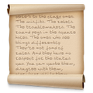
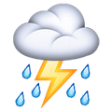
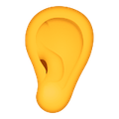

Emoji Book Quiz
Emoji #30 (last one and the toughest!)
Answer: Roll Of Thunder, Hear My Cry by Mildred D. Taylor

Slide 34
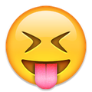
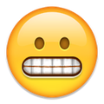
Emoji Book Quiz
How did you do?
Or

