Slide 1

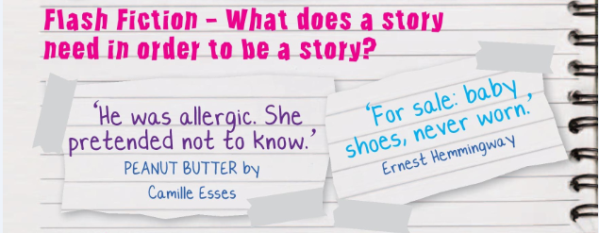

Activity 5 – Writing Flash Fiction and Flash Summaries
Is it possible to tell a story in less than 10 words?
Do they have the 5 components of a story sandwich?
Characters, Setting, Plot, Conflict, Resolution
Notes:
This next section draws upon the work done in the last activity and is designed to get those creative juices flowing!
Starter: Discussion Points
Read the two very short stories out loud to the class.
• Ask the class to vote on whether they are indeed stories.
• Can one or two sentences tell a story?
• Do they have all of the ingredients for a successful story discussed in the previous activity- character, setting, plot, conflict, resolution?
• If not, does it matter? Are they interesting or fun?

Slide 2
Activity 5 – Writing Flash Fiction and Flash Summaries
Think about the following and write some ideas down
• What questions do these stories leave you with?
• What do you think is happening beneath the surface of so few words?
• What genres would flash fiction be good for?
Characters, Setting, Plot, Conflict, Resolution
Notes:
Ideas for delivering in the classroom
Divide the class into groups and designate each group to answer one of the flash fiction questions below. Feedback as a whole class.
Think about the following and write some ideas down
• What questions do these stories leave you with?
• What do you think is happening beneath the surface of so few words?
• What genres would flash fiction be good for?

Slide 3


Activity 5.1 – Writing Flash Fiction
Use this box to write your own flash fiction. Remember:
Characters, Setting, Plot, Conflict, Resolution
If you need a theme/idea to get you started try these:
An embarrassing moment, a chance encounter, love is in the air, opening a trap door, the haunted classroom, losing the match, escaping from death…
Tweet your stories to @SuffolkLibrary
Notes:
Pupils can use the box to write their own flash fiction.
You could
• Hold a flash fiction competition – use governors as a judging panel
• Create illustrated posters of their flash fiction stories
• Make them into promotional bookmarks

Slide 4
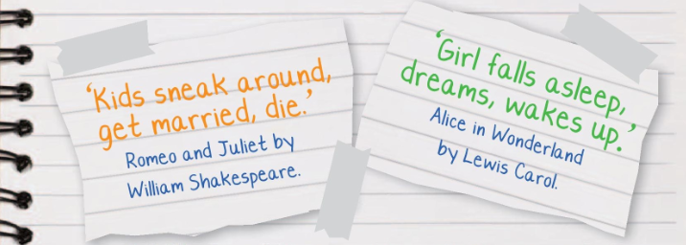
Activity 5.2 – Flash Summaries
Can you shrink the plot of a story down into 10 words or less?
William Shakespeare wrote 46,175 words to tell his tale of ‘two star crossed lovers’ – he could have managed with 6!
Alice in Wonderland is 55,296 words long – but what actually happens in the real world?
Test your book knowledge by identifying the examples on the next slide! Can you beat your teacher!
Notes:
Activity – Write a micro summary
Pupils summarise the plot of a novel into less than 10 words – giving enough information to allow readers to correctly guess the title of the book. These could then be used for a class competition.
Teachers could suggest titles for pupils to do such as James and the Giant Peach, Wimpy Kid, Gangsta Granny etc.

Slide 5
Activity 5.2 – Flash Summaries
Can you guess the which book is summarised below?
1. Boy starts new school, looks in mirror, saves the day.
2. Cunning mouse tricks other animals whilst walking in the forest
3. Boys talk through a fence before one borrows some nightwear.
4. Hairy footed chaps take a walk to return some jewellery
5. A garage dwelling, takeaway loving creature saves little Joy
Notes:
Can pupils and staff work out which book these flash summaries are about (answers on next slide).

Slide 6
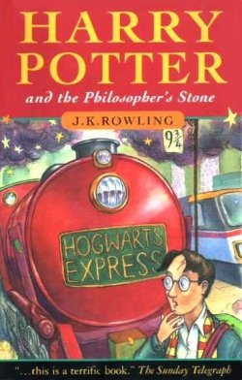
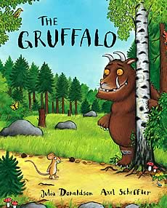
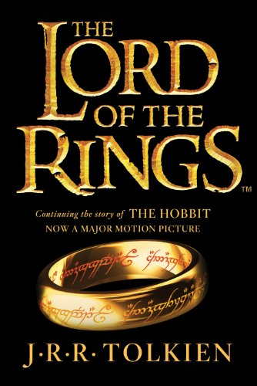
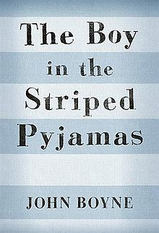
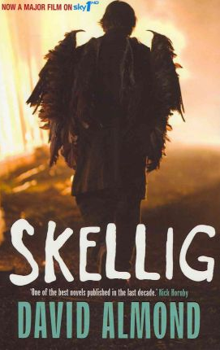
Activity 5.2 – Flash Summaries
Did you guess correctly?
2. Cunning mouse tricks other animals whilst walking in the forest
1. Boy starts new school, looks in mirror, saves the day.
4. Hairy footed chaps take a walk to return some jewellery
3. Boys talk through a fence before one borrows some nightwear.
5. A garage dwelling, takeaway loving creature saves little Joy
Notes:
The answers!
1 – Harry Potter and the Philosopher’s Stone
2 – The Gruffalo
3 – The Boy in the Striped Pyjamas
4 – Lord of the Rings
5 - Skellig

Slide 7
Activity 5.2 – Writing a Flash Summary
If you have space, use the box to write your own flash summary. Remember: You only have 10 words!
Some suggestions to get you started:
James and the Giant Peach, Wimpy Kid, Gangsta Granny, The BFG, Watership Down, Holes, The Cat in the Hat, Room on the Broom.
Tweet your summaries to @SuffolkLibrary
Notes:
Activity – Write a micro summary
Pupils summarise the plot of a novel into less than 10 words – giving enough information to allow readers to correctly guess the title of the book.
These could then be used for a class competition/stuck onto the correct book in the library

