Slide 1
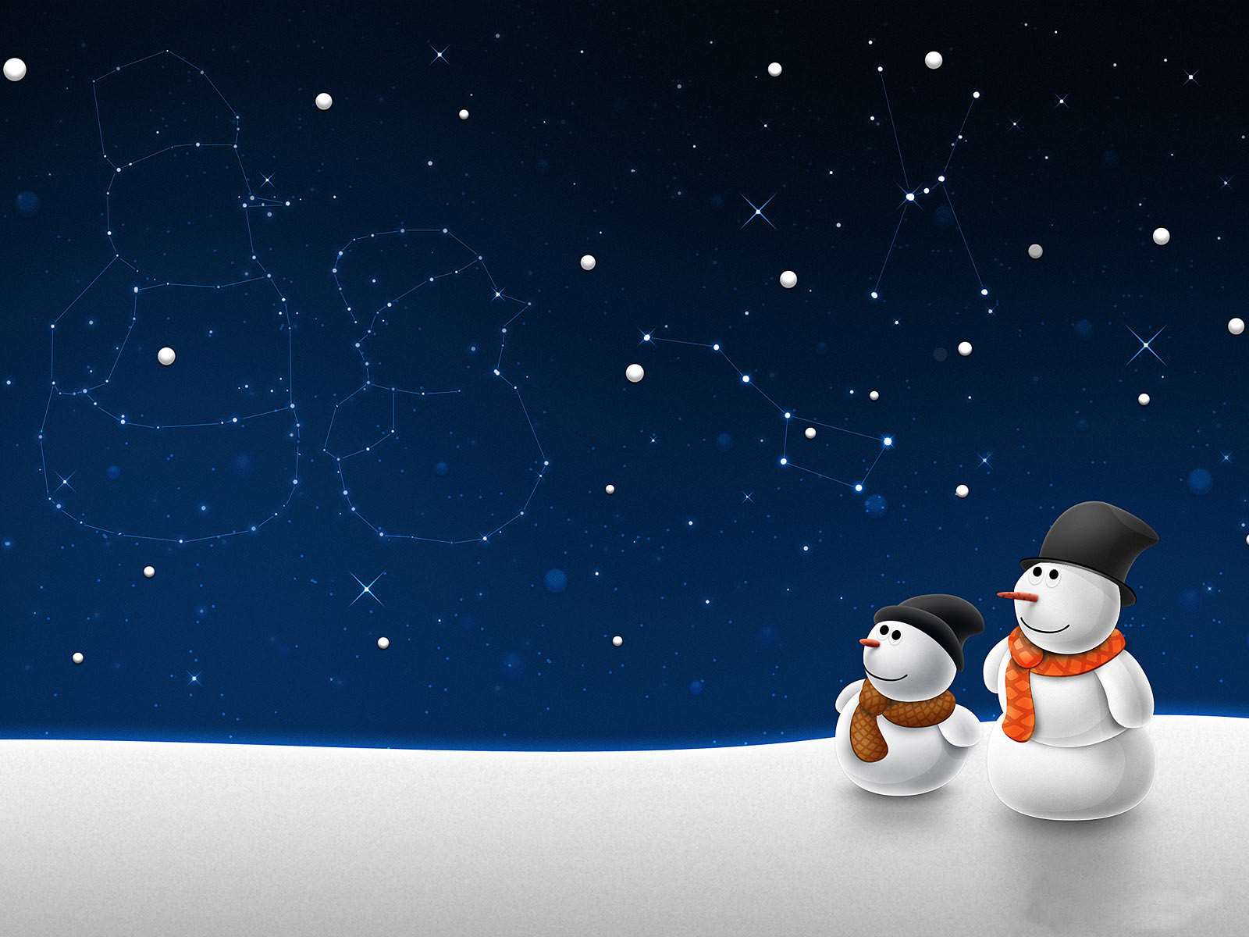


Here are the answers to the
‘Beyond the Book’ Christmas quiz!
(The number of points is signified in brackets)

Slide 2
Q1: In the movie Elf - how do the citizens of New York help Santa to fly?
Answer: They sing Christmas carols (1)

Slide 3
Q2: ‘Feliz Navidad’ is ‘Merry Christmas’ in what language?
Answer: Spanish (1)

Slide 4
Q3: The North Pole, said to be Santa's home, is located in which ocean?
Answer: Arctic Ocean (1)

Slide 5
Q4: Which long running TV series features a character called Santa's Little Helper?
Answer: The Simpsons (1)

Slide 6
Q5: The Christmas tree in Trafalgar Square, London, is an annual gift from which European country?
Answer: Norway (1)

Slide 7
Q6: What nickname do the two burglars in ‘Home Alone’ give themselves?
Answer: The Wet Bandits (1)

Slide 8
Q7: If you were born on Christmas Day what zodiac sign would you be?
Answer: Capricorn (1)

Slide 9
Q8: What are the names of the three wise men?
Answer: Balthasar, Melchior and Caspar. (3)

Slide 10
Q9: By what common name do we know the vegetable Brassica Oleracea?
Answer: The Brussel Sprout! (1)

Slide 11
Q10: What is myrrh?
Answer: An aromatic tree resin often used as incense or perfume. (1)

Slide 12
Q11: Can you name the four ghosts who appear in
‘A Christmas Carol’ by Charles Dickens?
Answer: Christmas Past, Christmas Present, Christmas Yet to Come, and Jacob Marley (4)

Slide 13
Q12: Who was crowned King of England on December 25th 1066?
Answer: William I (1)

Slide 14
Q13: 'Nadolig Llawen' is ‘Merry Christmas’ in what language?
Answer: Welsh (1)

Slide 15
Q14: What are the names of Santa's reindeer?
Answer: Dasher, Dancer, Prancer, Vixen, Comet, Cupid, Donner, Blitzen and Rudolph. (9)

Slide 16
Q15: If a person was given all the gifts mentioned in the song ’The Twelve Days of Christmas’, how many gifts in total would they receive?
Answer: 364 (5). Find out why here - http://www.intmath.com/blog/mathematics/the-twelve-days-of-christmas-how-many-presents-1686

Slide 17
How did you do?
32 points: Super Santa!
20-31 points: Excellent Elf!
10-20 points: Defrosted Snowman!
5-9 points: Brussel Sprout Face!
Less than 5: On the naughty list!

