Slide 1

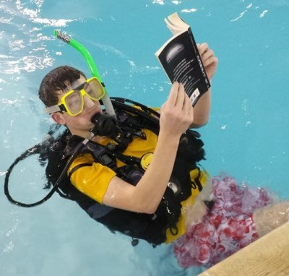


Activity 2 – Get Caught Reading!
Notes:
Discuss Thunk No. 2 – Is a book lighter when all its words have been read?
(Can you consume words?)

Slide 2
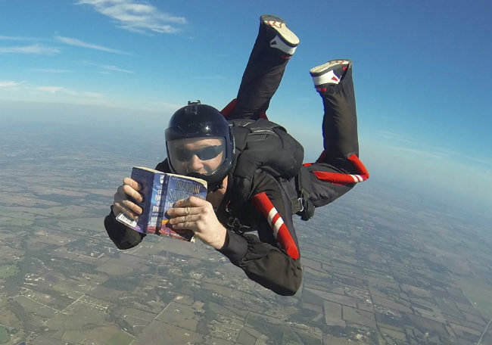
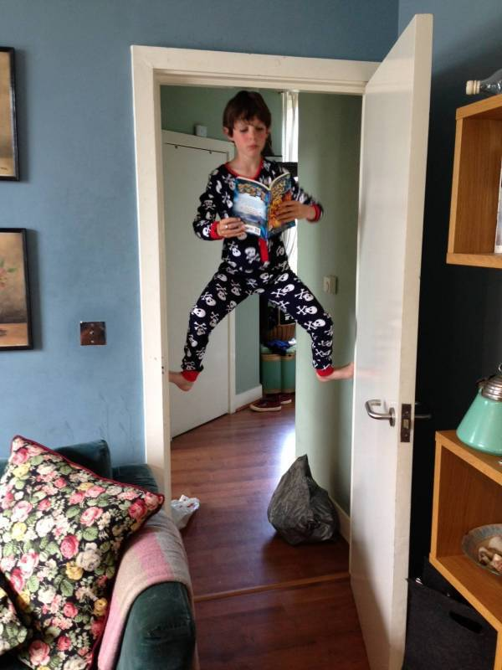
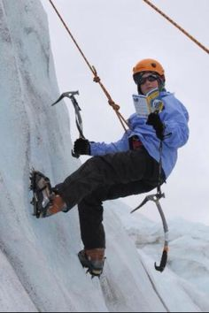
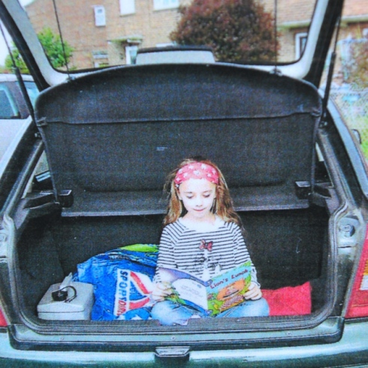
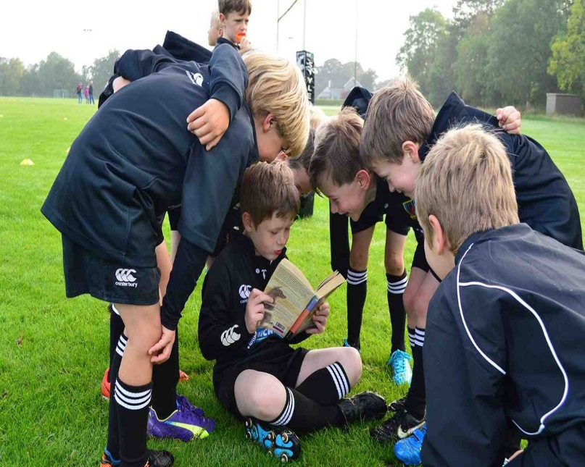
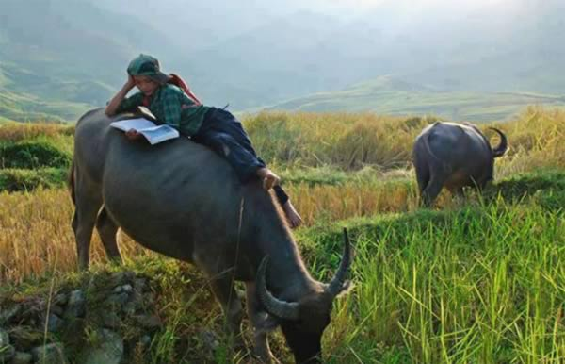
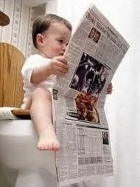
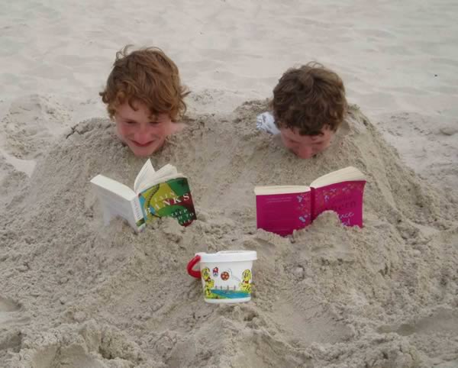
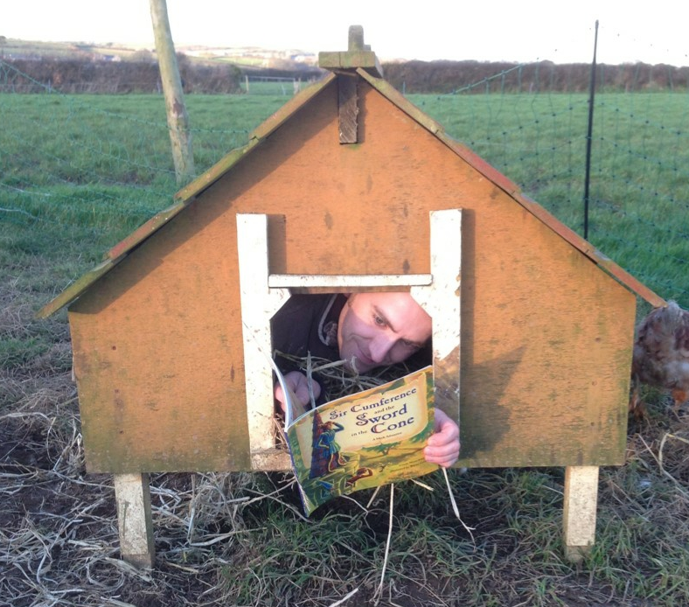
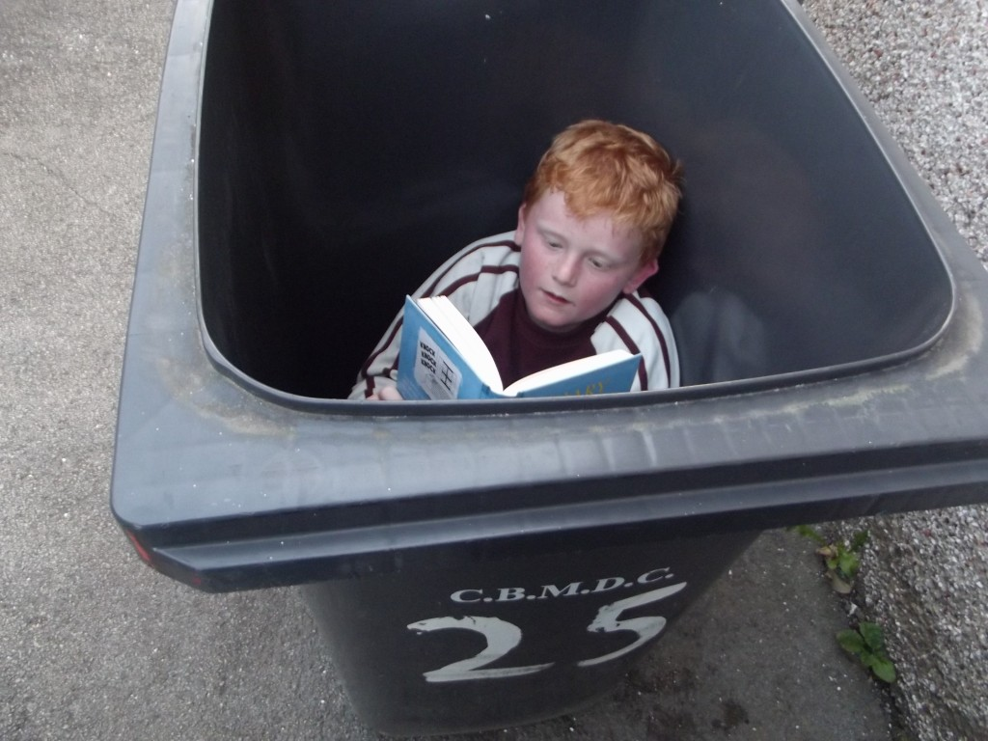
Activity 2 – Get Caught Reading!
One of the great things about books is that you can read them almost anywhere!
Notes:
A selection of people reading in strange places!

Slide 3
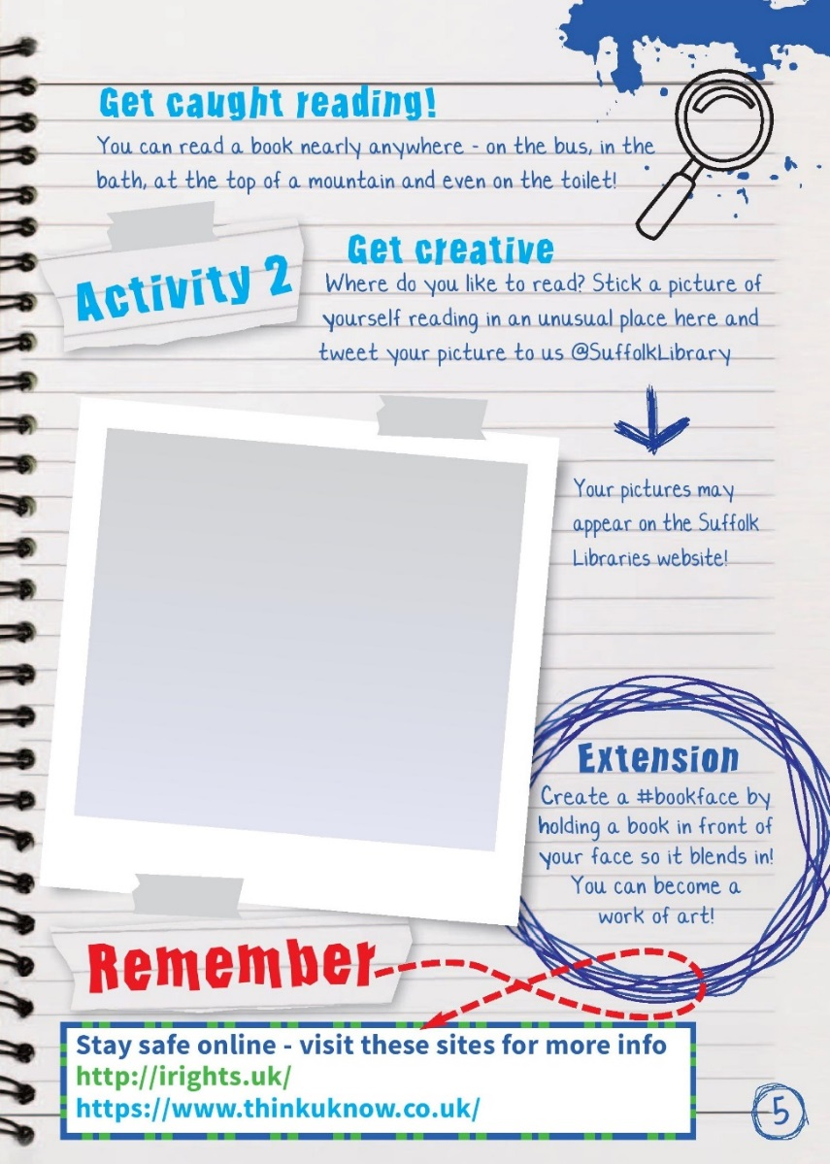

Activity 2 – Get Caught Reading!
Make a list of all the different places you have read in the past
Share the results with your class
Think of a new place/situation you could ‘Get Caught Reading’!
Take a picture, stick it in your activity book and send it to us on twitter @SuffolkLibrary
Notes:
Starter
• Ask pupils to mind map/list locations they have read a book or have seen others reading (these may include to read, at home, in bed, on public transport, in the bath).
• As a class discuss the results – you could write them on the board and keep a tally to explore your class results.
Booklet Activity 2 – Get Caught Reading
The idea is for pupils to take a picture of themselves reading in an unusual place. It would be very powerful for staff to do the same to normalise reading for pupils (and fun!). This could be set as a homework or as part of a lesson if pupils are allowed to move around school
These pictures can be used in the following ways
• stuck into the activity books
• tweet picture to us @suffolklibrary (either by pupils or through the school twitter account)
• used as a display in the reception area of your school
• competition held for the most inventive
Things to consider
• This should be a fun task, pupils are not supposed to put themselves at risk.
• The activity booklet has links to eSafety resources that pupils should be made aware of if they are online using social media.

Slide 4
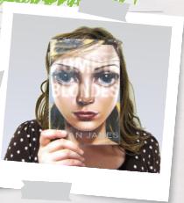
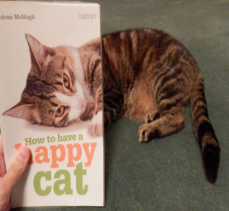
Activity 2: Extension – #bookface
Extension activity - create a ‘book face’
Inventive social media people have been positioning book covers in front of their own faces and taking a picture.
If done well, the results can be spectacular!
Have a look through some books for covers with faces, arms etc and get creative!
Use #bookface on twitter to share your book face!
Notes:
This is a great way for pupils to experience new books and browse– ask your school librarian to check stock for books with faces and other body parts on for pupils to look through then create their own pictures.
Creating a book face might appeal to shy pupils unwilling to take part in ‘get caught reading’ if their face is covered by a book.

