Slide 1

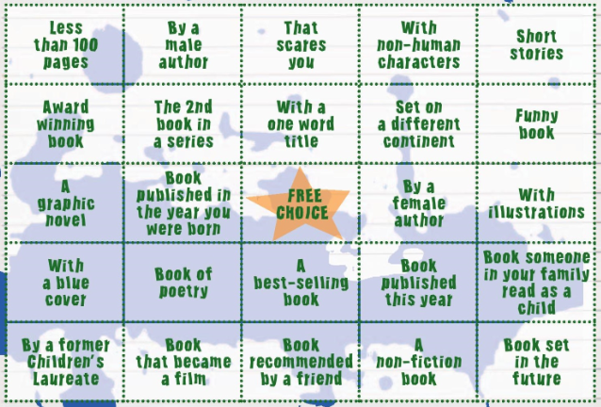

Activity 6 – ‘Beyond the Book’ Bingo
The bingo sheet has 25 different squares
Each square has a different genre of book for you to read and cross off.
Cross off all 25 and become a ‘Beyond the Book’ champion!
Notes:
Suggested classroom activities
• Assign each square to different individuals/groups to collate a list of books (one group looks for 10 books with a blue cover, another looks for books with less than 100 pages etc).
• OPAC library search – teach pupils how to search for books using the Suffolk Libraries online catalogue https://suffolk.spydus.co.uk (your own school library catalogue may also be online and useful).
• Link the bingo in with any school wide rewards (Vivo etc)
For further suggestions go to our website, go to your local or school library or ask your friends and family for ideas.

Slide 2

Activity 6 – ‘Beyond the Book’ Bingo
Some ideas:
Award winning book: Try Carnegie Medal winner Tanya Landman or Patrick Ness
With illustrations: Something by Chris Riddell, Uncle Montague’s Tales of Terror or The World of Norm
A best-selling book: By… David Walliams, Judie Blume, Anne Fine, Malorie Blackman
A one word title: Holes, Forever, Junk, Millions, Checkmate, Dracula, Sawbones
Non-Human characters: Wind in the Willows, Redwall series, His Dark Materials series
Someone in your family read as a child: Ask Grandparents, Aunties and Uncles!
Visit your library and browse the shelves for ideas!
Notes:
Suggested classroom activities
• Assign each square to different individuals/groups to collate a list of books (one group looks for 10 books with a blue cover, another looks for books with less than 100 pages etc).
• OPAC library search – teach pupils how to search for books using the Suffolk Libraries online catalogue https://suffolk.spydus.co.uk (your own school library catalogue may also be online and useful).
• Link the bingo in with any school wide rewards (Vivo etc)
For further suggestions go to our website, go to your local or school library or ask your friends and family for ideas.

