Slide 1
DATA 608 / KNOWLEDGE & VISUAL ANALYTICS
How much do
we get paid?
The salary story changes with the job title — and the state.
Muhammad Suffyan Khan • CUNY School of Professional Studies • October 2026

Slide 2
THE QUESTION
Same field, different ways to get paid
A descriptive comparison of annual mean wages—not an individual salary prediction.
06
16
49
OCCUPATIONS
SELECTED STATES
JURISDICTIONS
Official BLS SOC categories; not exact matches for every industry job title.
Six-role comparisons across a deliberately selected subset of U.S. states.
Published Data Scientist wage observations in the source table.
Important: equal-state averages are not U.S. national means; nominal wages are not cost-of-living adjusted.
DATA 608 • STORY 4 | OEWS MAY 2025 • SELECTED-STATE DATA
02

Slide 3
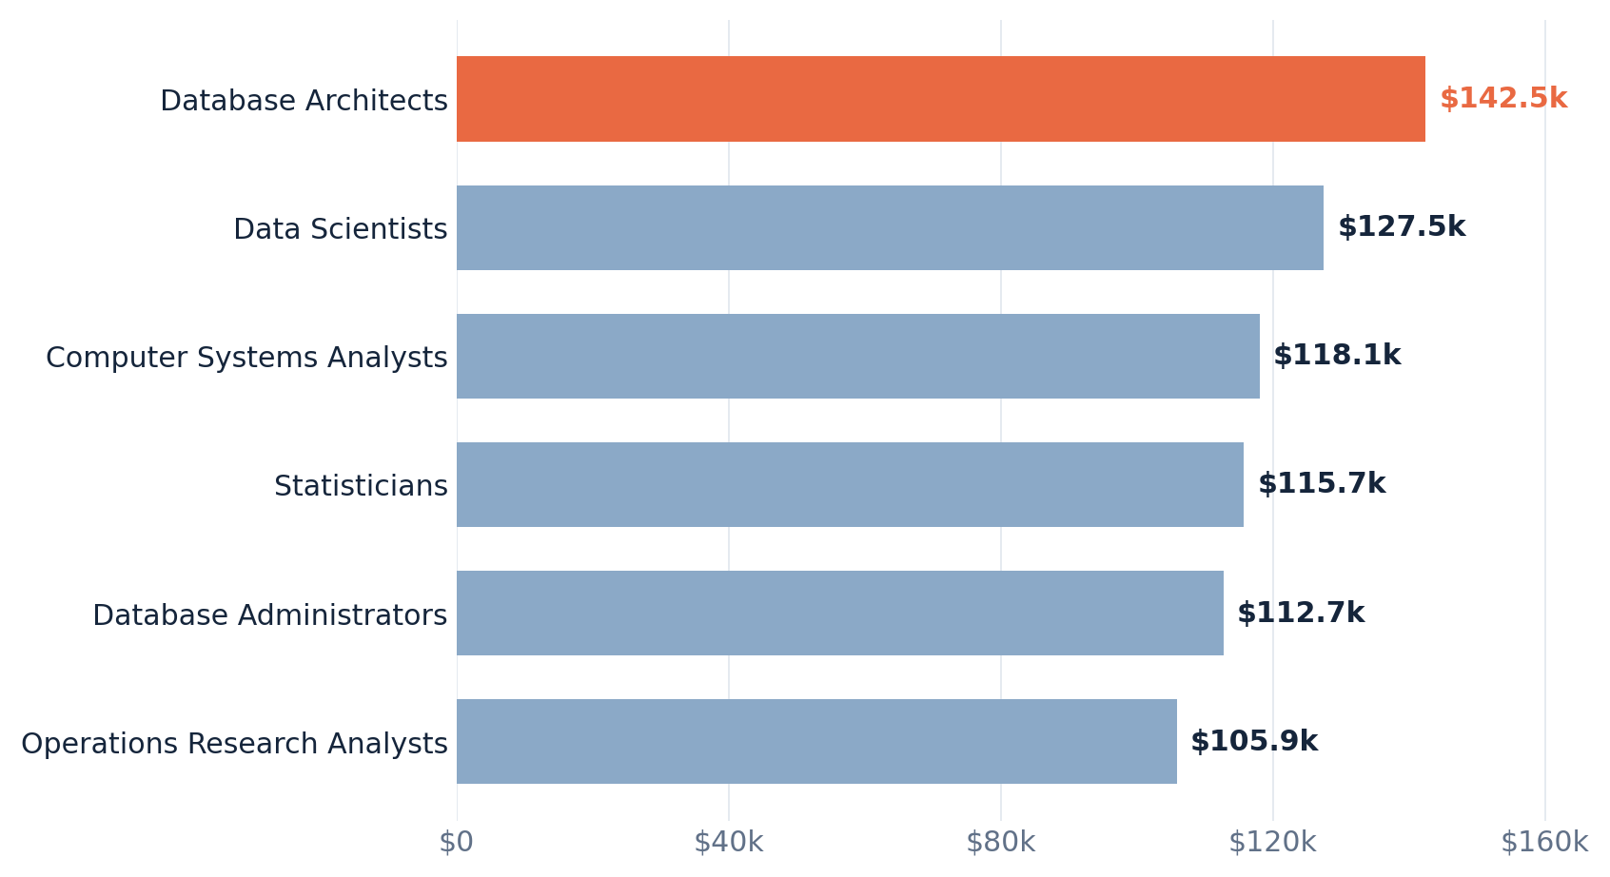
FINDING 01 · ROLE
Database Architects lead the six-role comparison
Equal-weight average of the 16 selected state mean wages, annual USD
$142.5k
Database Architects average $14.9k more than Data Scientists in this selected-state comparison.
These are averages of state means—not a worker-weighted U.S. estimate.
DATA 608 • STORY 4 | OEWS MAY 2025 • SELECTED-STATE DATA
03

Slide 4
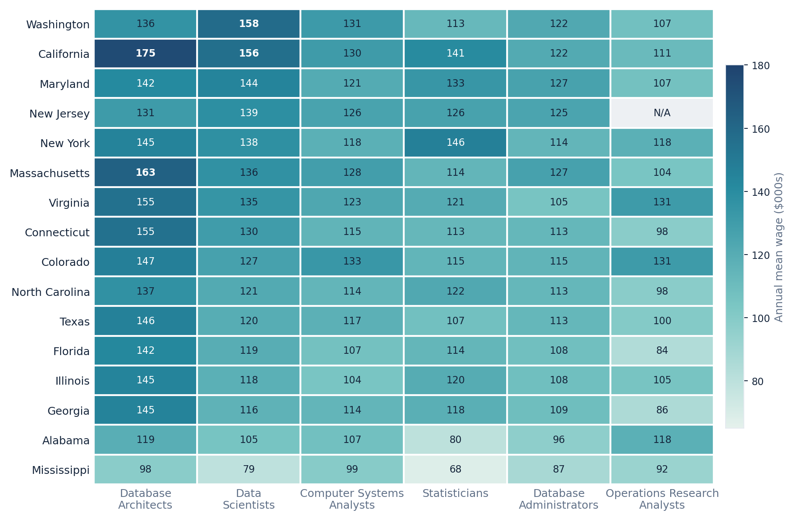
FINDING 02 · ROLE × STATE
There is no single salary ranking for every state
Darker cells indicate higher annual mean wages ($000s); gray means unavailable
Look across & down
Compare roles within a state (across a row), then compare states within a role (down a column).
California Database Architects: $175k; Mississippi Statisticians: about $68k.
DATA 608 • STORY 4 | OEWS MAY 2025 • SELECTED-STATE DATA
04

Slide 5
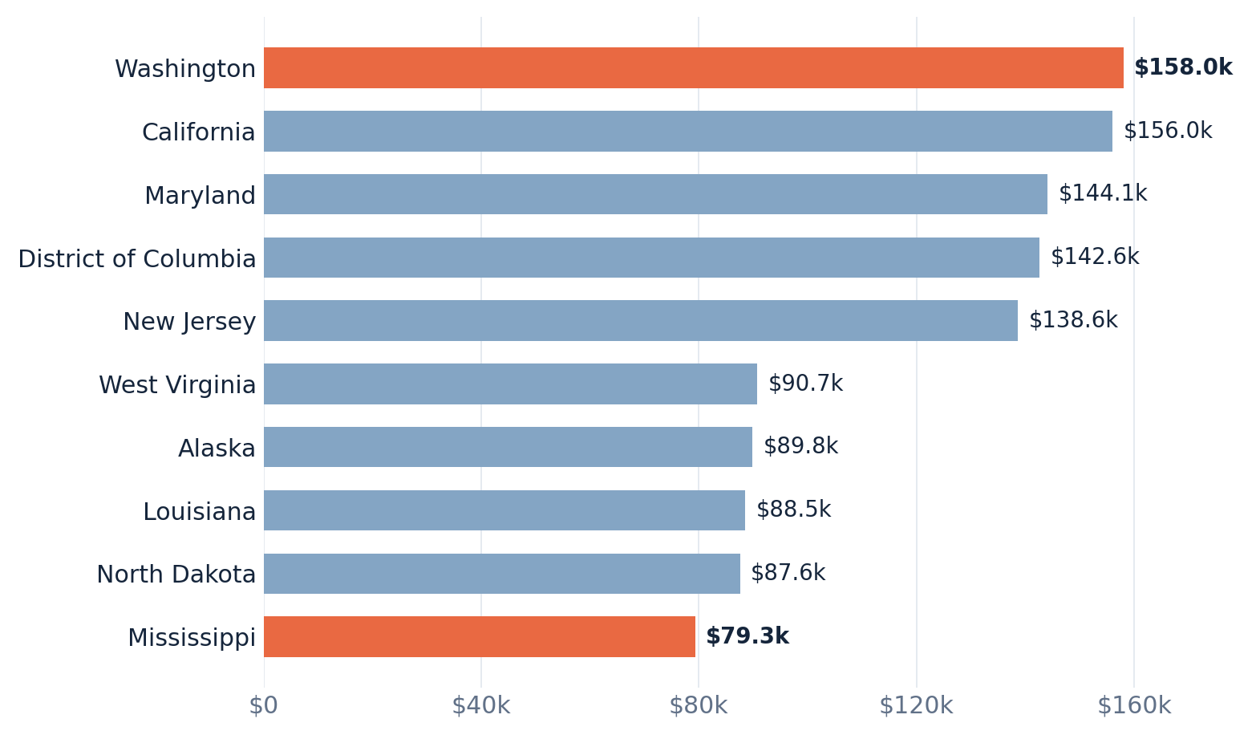
FINDING 03 · GEOGRAPHY
Data Scientist wages nearly double between extremes
Five highest and five lowest published jurisdictions, annual mean wages
$78,750 gap
Washington: $158,040
Mississippi: $79,290
The higher figure is about 1.99× the lower—not a measure of after-tax purchasing power.
DATA 608 • STORY 4 | OEWS MAY 2025 • SELECTED-STATE DATA
05

Slide 6
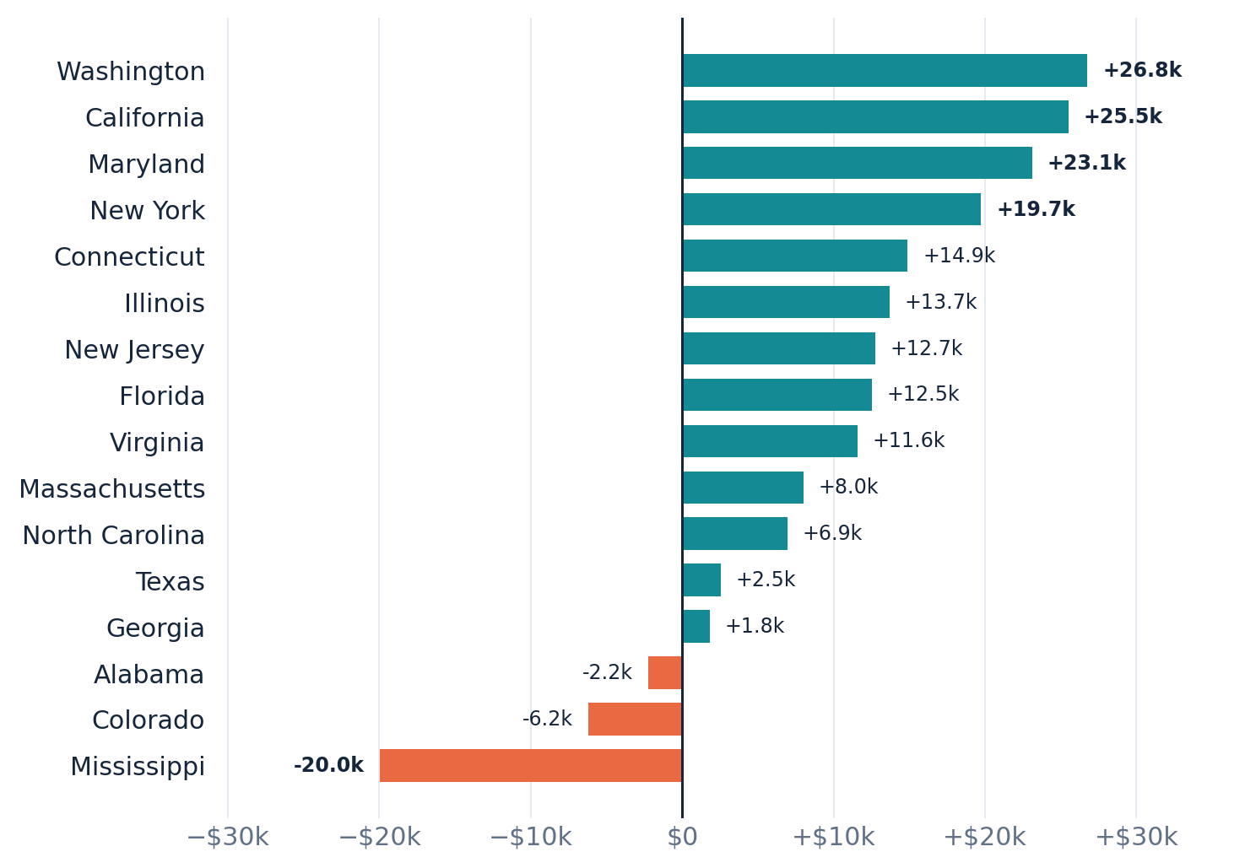
FINDING 04 · INTERACTION
The Data Scientist pay advantage is not universal
Data Scientist mean wage minus Computer Systems Analyst mean wage, 16 selected states
The sign flips
Washington: +$26.8k
Mississippi: −$20.0k
A positive difference favors Data Scientists. A negative difference favors Systems Analysts.
DATA 608 • STORY 4 | OEWS MAY 2025 • SELECTED-STATE DATA
06

Slide 7
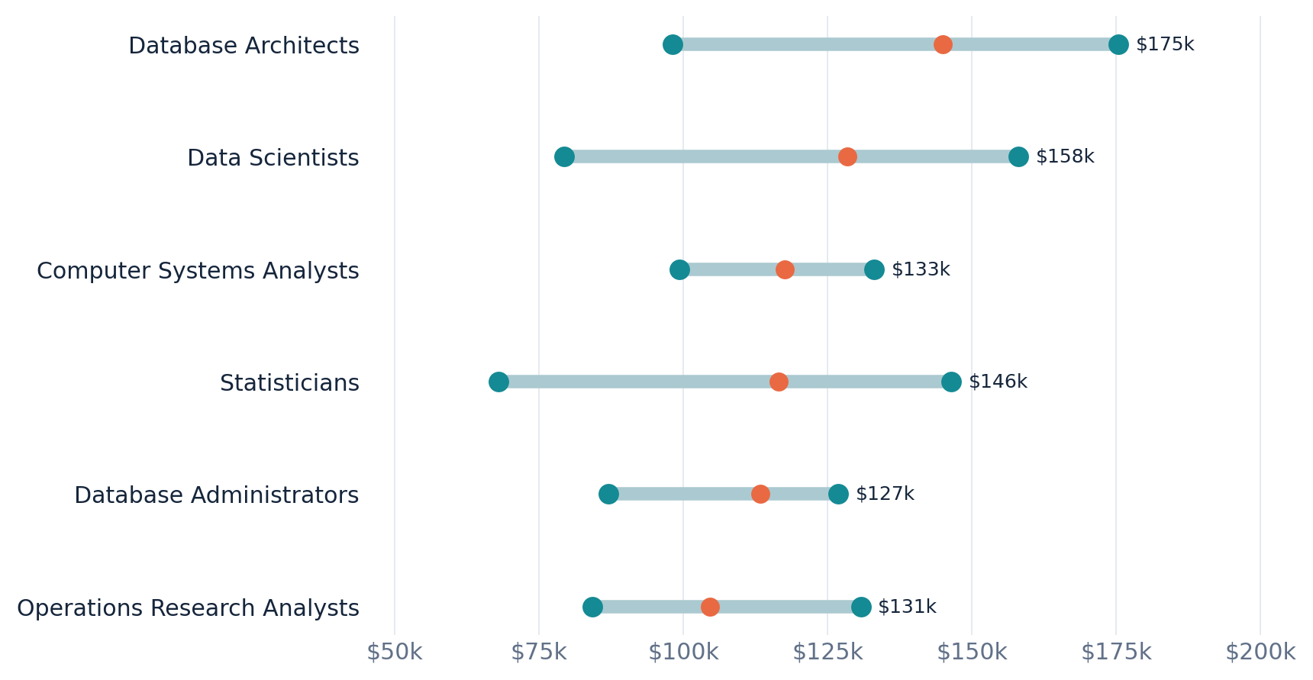
FINDING 05 · DISPERSION
A role can have a wide wage range across states
Endpoints show lowest and highest selected-state mean; orange dot = median state wage
Spread matters
The role ranking hides geographic variation.
A range plot reveals how far apart state mean wages can be within each occupation.
This uses the same selected 16 states.
DATA 608 • STORY 4 | OEWS MAY 2025 • SELECTED-STATE DATA
07

Slide 8
INTERPRETATION
What these comparisons can - and cannot - tell us
Read every salary figure in the context of its definition and coverage.
WAGE MEASURE
OCCUPATION MAPPING
Annual mean employee wage, not median, bonuses, benefits, or total pay.
Data Engineer / Data Analyst / Business Analyst are not one-to-one SOC categories.
GEOGRAPHIC SCOPE
CAUSALITY & VALUE
Six-role matrix covers 16 selected states; 49 entries for Data Scientists only.
These patterns do not explain why wages differ or compare purchasing power.
DATA 608 • STORY 4 | OEWS MAY 2025 • SELECTED-STATE DATA
08

Slide 9
CONCLUSION
How much do we get paid? It depends on both role and location.
Three key findings reveal how occupation and geography influence annual mean wages
01
02
03
ROLE
STATE
COMBINATION
Database Architects top the selected-state role ranking at about $142.5k.
Data Scientist mean wage spans $79.3k to $158.0k across published jurisdictions.
The Data Scientist vs. Systems Analyst pay gap switches sign in three of 16 states.
Bottom line: a single headline salary masks meaningful differences in both occupations and geography.
DATA 608 • STORY 4 | OEWS MAY 2025 • SELECTED-STATE DATA
09

Slide 10
SOURCES & METHODS
Transparent data provenance and reproducible code
Salary values: third-party BLS-attributed tables, not direct official BLS bulk downloads
DATA & OCCUPATIONAL DEFINITIONS
ANALYSIS & LIMITATIONS
BLS Occupational Employment and Wage Statistics (OEWS), May 2025.
Six detailed SOC occupations: 15-2051, 15-1243, 15-1242, 15-1211, 15-2031, and 15-2041.
Wage entries transcribed from SignalBleed BLS-attributed occupation tables.
Python notebook and local CSVs support all calculations.
Equal-state averaging; missing wages retained as missing.
16 states for joint role/state analysis, 49 jurisdictions for Data Scientists.
No geographic price adjustment or causal inference.
Official BLS tables: bls.gov/oes/tables.htm • Source mirror: signalbleed.com/jobs/
DATA 608 • STORY 4 | OEWS MAY 2025 • SELECTED-STATE DATA
10

