Slide 1
Infrastructure Investment and Jobs Act funding allocation
Population explains most differences in total funding, but per-resident allocations vary sharply
$196.0B
Muhammad Suffyan Khan
DATA 608: Knowledge and Visual Analytics
CUNY School of Professional Studies
Funding data as of March 2023
funding in the course dataset
Notes:
Source: Course-provided IIJA FUNDING AS OF MARCH 2023.xlsx.

Slide 2
Data and analytical scope
02
$196.0B
56
51
Total course-provided funding
Geographic jurisdictions
Election comparison jurisdictions
Equity benchmark
Population
A jurisdiction receives its population share of the geographic funding pool. The allocation ratio equals funding share divided by population share.
July 2022 Census estimates cover the states, District of Columbia, and Puerto Rico. Official 2020 Census counts cover four Island Areas.
Political comparison
Scope decision
Official FEC statewide 2020 results identify 26 Biden-won and 25 Trump-won jurisdictions. Territories do not enter this comparison.
The $3.0 billion Tribal Communities category remains separate because its population overlaps state and territorial populations.
Sources: Course dataset, U.S. Census Bureau, and Federal Election Commission
Notes:
Population: U.S. Census Bureau NST-EST2022-POP and 2020 Island Areas counts. Election results: Federal Election Commission, Federal Elections 2020.

Slide 3
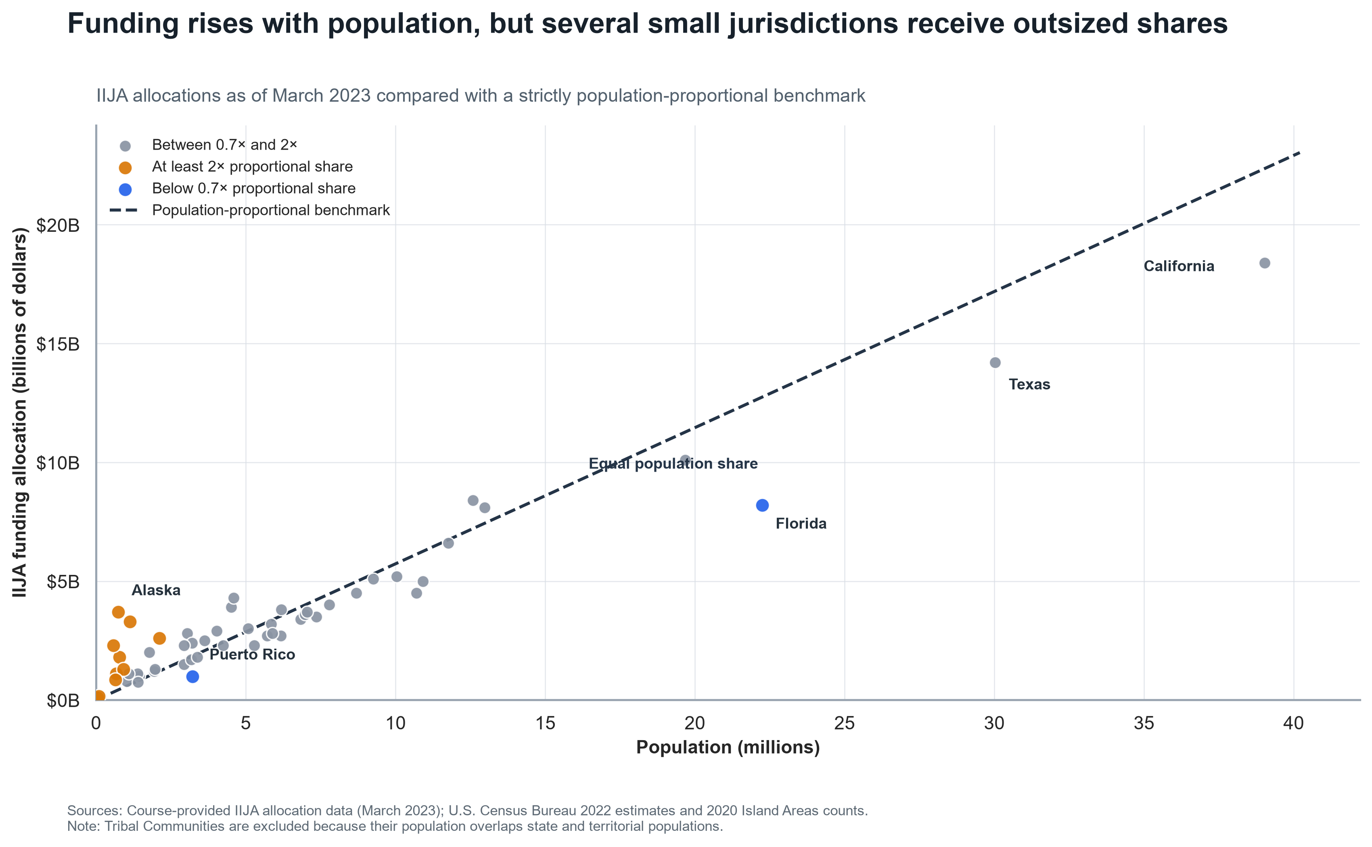
Population strongly tracks total funding
03
Pearson correlation: 0.966
Large jurisdictions receive more total funding. Several small jurisdictions still receive much more than their population-proportional share.
Interpretation
Population explains most of the total-dollar pattern. It does not explain the full distribution of dollars per resident.
Equity scope: 50 states, District of Columbia, and five territories; Tribal Communities excluded
Notes:
Sources: Course-provided IIJA allocations; U.S. Census Bureau 2022 estimates and 2020 Island Areas counts.

Slide 4
Per-resident funding ranges from $308 to $5,044
04
16.4x
Highest-to-lowest difference
The wide range confirms that the allocation is not strictly proportional to population.
Orange: eight highest values. Blue: eight lowest values. Common horizontal scale.
Notes:
Sources: Course-provided IIJA allocations; U.S. Census Bureau population estimates and Island Areas counts. Values rounded to nearest dollar.

Slide 5
The allocation does not favor Biden-won jurisdictions
05
13.4% higher
in Trump-won jurisdictions on a population-weighted basis
Mann-Whitney test
p = 0.172
Population-adjusted model
p = 0.341
Neither comparison reaches conventional statistical significance.
Scope: 50 states and District of Columbia; territories excluded from election comparison
Notes:
Sources: Course-provided IIJA allocations; U.S. Census Bureau population estimates; Federal Election Commission official 2020 results.

Slide 6
The evidence supports two conclusions
06
1
Allocation is not strictly population proportional
What this analysis cannot determine
Population strongly predicts total funding, yet per-resident allocations differ by more than sixteenfold across the observed jurisdictions.
Funding allocations do not equal completed spending.
1
2
Population does not capture infrastructure need or statutory funding minimums.
2
The data shows no preference for Biden-won jurisdictions
3
A statewide election winner is a simplified measure of political alignment.
Trump-won jurisdictions received more per resident. Neither the distributional test nor the population-adjusted model found a significant political difference.
4
The observational data cannot establish intent or causation.
Conclusion reflects the March 2023 allocation snapshot and cited population estimates
Notes:
Interpretation based on the descriptive, nonparametric, and population-adjusted analyses in the supporting notebook.

Slide 7
Sources and AI-use disclosure
07
Funding
AI-use disclosure
Course-provided IIJA FUNDING AS OF MARCH 2023.xlsx
Population
ChatGPT was used to assist with data-cleaning review, analysis, visualization refinement, and editorial review. I reviewed and validated all code, calculations, visualizations, interpretations, and final conclusions.
U.S. Census Bureau, NST-EST2022-POP
U.S. Census Bureau, 2020 Island Areas population counts
Election
Federal Election Commission, Federal Elections 2020
Supporting notebook and processed data are maintained in the private course repository.
Full source URLs and reproducible calculations appear in the supporting project files
Notes:
Population workbook: https://www2.census.gov/programs-surveys/popest/tables/2020-2022/state/totals/NST-EST2022-POP.xlsx
Island Areas: https://www.census.gov/newsroom/press-releases/2021/2020-population-us-island-areas.html
FEC: https://www.fec.gov/introduction-campaign-finance/election-results-and-voting-information/federal-elections-2020/

