Slide 1
Do stricter gun laws reduce
firearm deaths?
A 50-state comparison of 2024 law grades and mortality
Muhammad Suffyan Khan
DATA 608 · Knowledge and Visual Analytics
CUNY School of Professional Studies · Fall 2026
Stronger law grades coincide with lower mortality.
This comparison cannot establish a causal effect.
1
Notes:
Story 3, DATA 608. The audience is students and policy readers comparing state firearm mortality. The aim is to report the state-level pattern while keeping causal claims within the limits of the data. The analysis uses 50 states, 2024 law grades and 2024 annual age-adjusted firearm mortality retrieved with a CDC API.

Slide 2
The measures and five-level law scale
Mortality
Law strictness
CDC age-adjusted firearm deaths per 100,000
12 months ending 2024 Q4
All firearm deaths, including suicides
GIFFORDS 2024 letter grades
1 F = most lax · 2 D = lax · 3 C = middle
4 B = strict · 5 A = strictest
+ and − variants stay in the source table
50 states
Why these choices
50 explicit law assignments and API rates
Group sizes: 22, 3, 5, 7, and 13 states
A common year and age-adjusted rates improve
comparability. The five bins preserve the
source ordering without inventing state grades.
Sources: CDC NCHS open-data API (2024 Q4 annual age-adjusted rates); GIFFORDS 2024 scorecard.
2
Notes:
The CDC API request filters dataset 489q-934x for year_and_quarter=2024 Q4, time_period=12 months ending with quarter, cause_of_death=Firearm-related injury and rate_type=Age-adjusted. It returned one record with each state rate. The all-intents measure includes suicide, homicide and other firearm deaths. The dataset is designated provisional. All 50 states were joined by exact state names. The source GIFFORDS grades are an advocacy-group law index, not a survey. Collapsing plus/minus variants gives five ordered categories with uneven group sizes. The grade source concerns laws adopted during 2024, so no temporal causal sequence is established. Sources: https://data.cdc.gov/resource/489q-934x.json ; https://giffords.org/resources/scorecard2024/

Slide 3
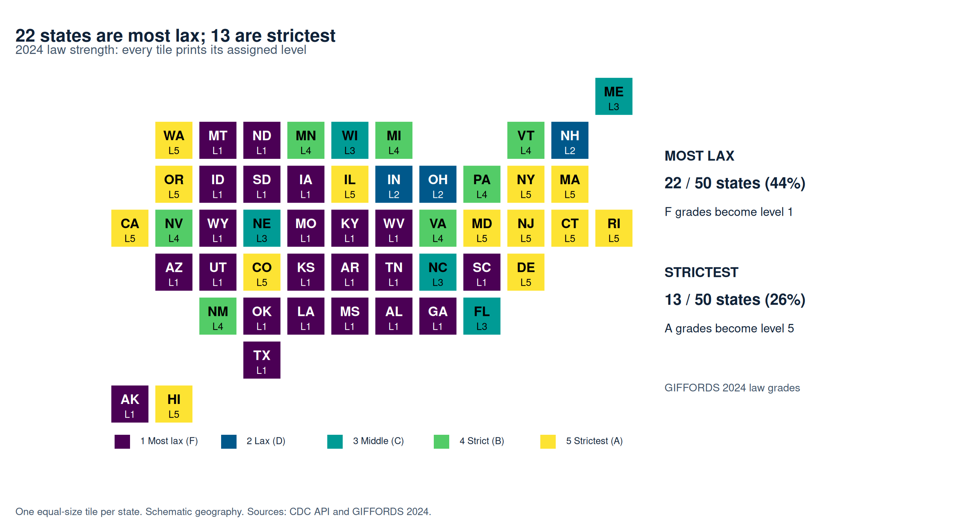
22 states are most lax; 13 are strictest
Equal tiles keep every state visible. Printed levels support the color legend.
3
Notes:
The five-grade map recodes F to 1, D to 2, C to 3, B to 4, and A to 5, dropping plus/minus signs only for the five-level category. Each state has a labeled equal-size tile so small states remain visible. This is a schematic tile heat map, not a physical-area choropleth. Colors use an ordered Viridis palette, and text provides a second way to identify states and their law levels. On-chart annotations print the extreme group counts and shares of the 50-state sample. Law category counts are 22, 3, 5, 7, 13. Sources: https://giffords.org/resources/scorecard2024/ ; scripts/create_heatmaps.R

Slide 4
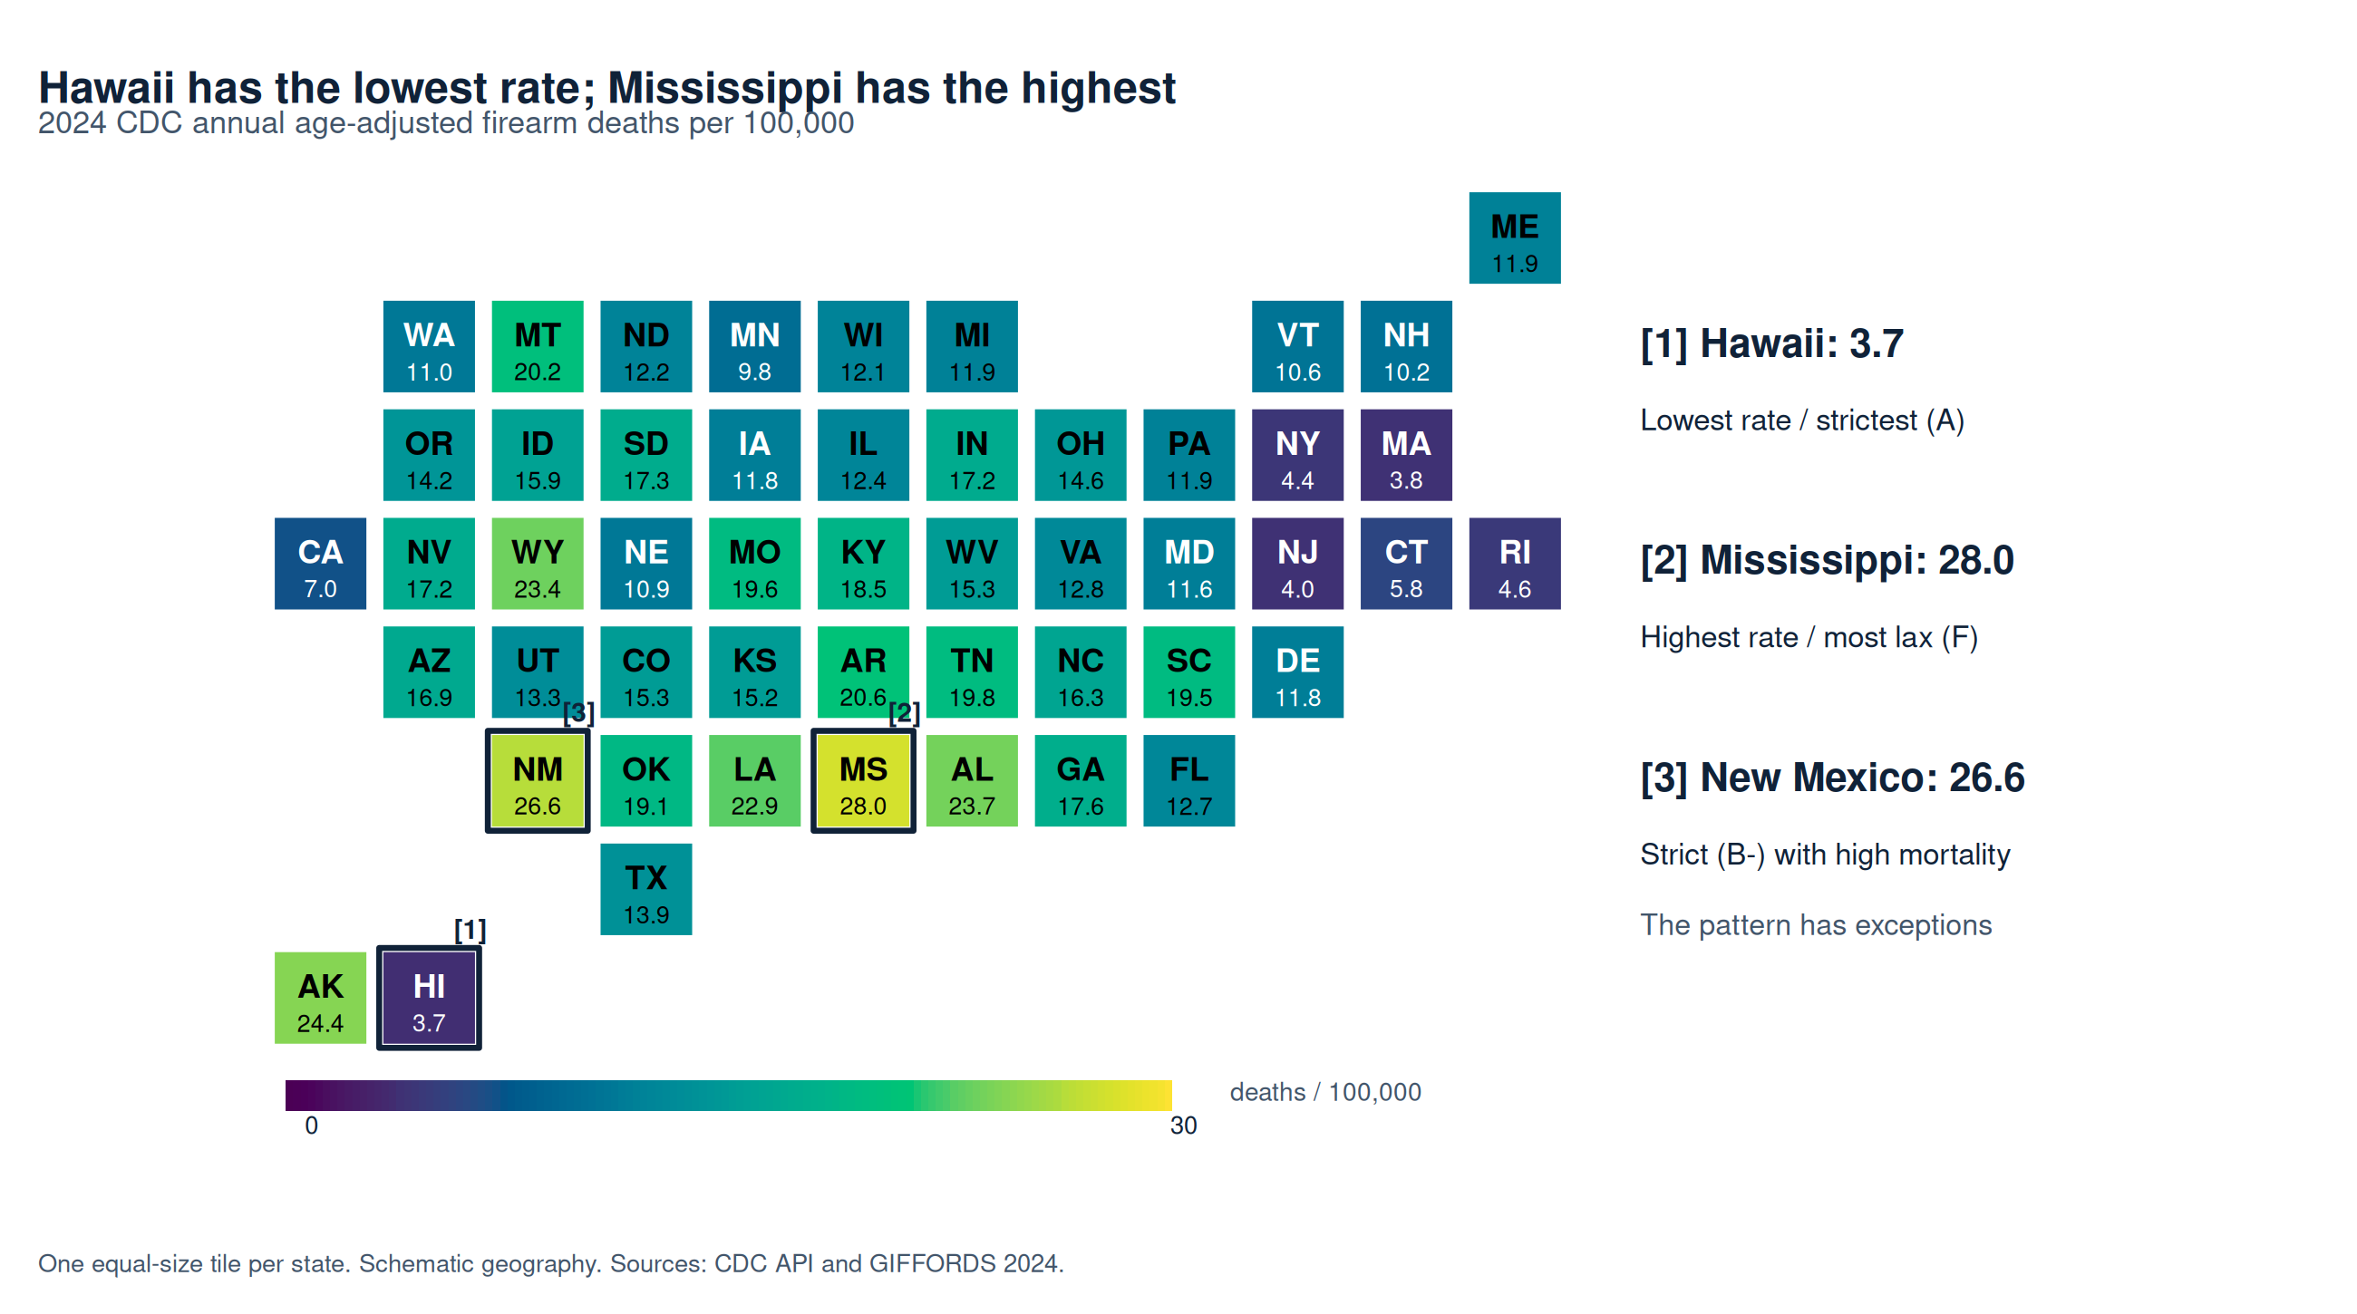
Mortality extremes fit the pattern, with exceptions
Numbered outlines connect the extremes and exception directly to their state tiles.
4
Notes:
The CDC annual age-adjusted firearm rates range from 3.7 per 100,000 in Hawaii to 28.0 in Mississippi. The map prints every state value and uses a fixed 0 to 30 scale. The identical tile positions let readers compare law strength and mortality without hiding small states. The numbered outlined tiles directly connect Hawaii, Mississippi and the New Mexico exception to the chart annotations. The rate refers to all firearm-related injury deaths. API data are provisional and subject to revision; checks of New York, Mississippi, California and Massachusetts match the current CDC final-data map at the published precision. Sources: https://www.cdc.gov/nchs/state-stats/deaths/firearms.html ; saved CDC API JSON in data/raw.

Slide 5
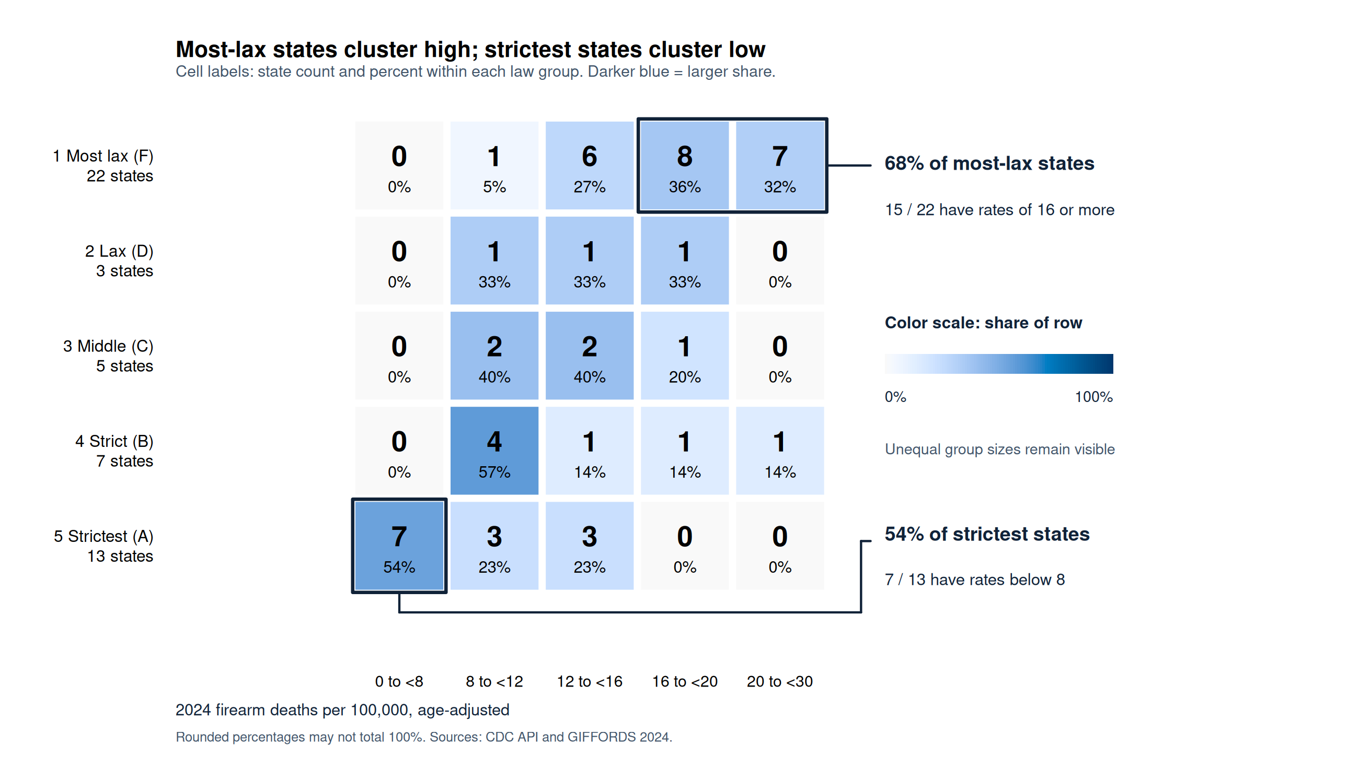
Most lax states cluster in higher mortality bands
Within-group percentages allow comparison despite unequal group sizes. Counts retain the evidence.
5
Notes:
The count heat map groups states by their five-level law category and rate intervals of 0 to less than 8, 8 to less than 12, 12 to less than 16, 16 to less than 20 and 20 to less than 30. Cells print counts and within-row percentages. Color encodes percentages from 0 to 100, so unequal group sizes do not distort the comparison. Black outlines and adjacent labels emphasize the F high-rate bands and A lowest-rate band. Among F-grade states, 15 of 22 fall in the 16 or higher bands. Seven of 13 A-grade states are below 8. No A-grade state is in the 16 or higher bands. Counts and percentages are descriptive. Rounded labels may not sum to exactly 100 percent. Row totals remain explicit. This heat map complements the two state maps and does not imply a causal pathway.

Slide 6
The strictest group averages 8.4 deaths versus 18.6
Law level
States
Mean rate
Median rate
1 · Most lax (F)
22
18.6
18.8
2 · Lax (D)
3
14.0
14.6
3 · Middle (C)
5
12.8
12.1
4 · Strict (B)
7
14.4
11.9
5 · Strictest (A)
13
8.4
7.0
Spearman correlation: −0.717
Rates: 2024 age-adjusted deaths per 100,000. Each state has equal weight.
New Mexico raises the B-group mean.
6
Notes:
The summaries are unweighted means and medians of state-level age-adjusted rates. They are not national rates or estimates of the effect of a law. The F-grade group mean is 18.595 and median 18.8; the A-grade group mean is 8.431 and median 7.0. Spearman correlation between law level and state mortality is -0.717. The B-grade mean 14.4 exceeds the C-grade mean 12.78, partly because New Mexico has 26.6; medians differ less (11.9 versus 12.1). Use the group table together with individual-state maps. Sources and calculations: data/processed/state_analysis_2024.csv and five_level_summary.csv.

Slide 7
The evidence supports an association
Observed answer
Stronger 2024 law grades tend to accompany
lower 2024 age-adjusted firearm mortality.
Limits that affect the conclusion
Other state characteristics and policy timing remain uncontrolled.
The law grades come from one advocacy organization.
All firearm deaths combine several intents with different causes.
A stronger causal test would track law changes and mortality across years
with suitable comparison states and controls.
7
Notes:
Answer the assignment directly: States with stronger 2024 law grades tended to have lower age-adjusted firearm mortality in 2024. This is consistent with a beneficial relationship, but a cross-sectional ecological comparison cannot establish that laws caused the mortality difference. The law index is one advocacy group’s classification. Gun ownership, economic conditions, geography, demographic factors, access to care, enforcement and neighboring laws were not controlled. The rate includes suicides as well as homicide, and these could respond differently to policies. Policies and deaths occur within the same year, so temporal ordering and delayed effects remain unresolved. A causal study would require repeated years, implementation dates and suitable comparison groups.

Slide 8
Sources, visual choices and reproducibility
CDC NCHS API
data.cdc.gov/resource/489q-934x.json
Annual 2024 age-adjusted firearm-related injury rates
GIFFORDS 2024 scorecard
giffords.org/resources/scorecard2024/
Law grades recoded to five ordered bins; original grades retained
R heat maps and complete supporting files
Labeled equal-size tiles and accessible palettes make the states comparable.
The package includes API evidence, source code, all 50 state assignments,
the notebook, PNG/PDF figures and written explanations.
AI assisted with coding, analysis and editorial review.
The accompanying disclosure documents this assistance.
8
Notes:
Full source details are in sources/SOURCES.md. The exact CDC API request, successful JSON response and schema are in data/raw. The law source HTML is archived; each state grade and five-level bin is in data/processed/law_scale_50_states.csv. R 4.3.3 actually generated all three heat maps from the joined CSV using base graphics. Python retrieves and prepares the data. R/RStudio is the new analysis and chart application; PowerPoint is the presentation delivery format. The schematic heat maps make all states visible, use readable labels and accessible palettes, and preserve separate legends for different scales. AI assistance included source checks, code drafting, analysis, presentation preparation and editorial review. The student must independently review the outputs and truthfully verify the disclosure before submission.

