Slide 1
Project Proposal
Freshwater Potability Assessment & Prediction
Team : 7
Hardi Raval
Bhanu Pandavula
Sufian Riza Mohammed

Slide 2
Agenda
Introduction
Research Questions?
Data Source
Data Pre-Processing [Missing values, Class imbalance, correlation, Outlier Removal]
Data Analysis [Confusion matrix & Algorithm selection]
Evaluation methods and metrics [Accuracy, Precision, Recall, F1-score]
QA

Slide 3
Introduction
Freshwater is essential because there's not much of it, but we need it for everything.
It's vital for drinking, cleaning, growing food, and making electricity.
Clean water keeps us healthy and supports all living things.
We use data to check if water is safe to use.
Protecting freshwater is crucial for us and the environment.

Slide 4
What are the Goals ?
Build
Build a model to reliably predict whether water is safe for drinking.
Understand
Identify the factors that affect water quality, including safety and portability.
Educate
Educate people about effects of different resources in water reservoir.

Slide 5
Research Questions?
What factors determine whether water is safe for drinking, and how do they interact?
Can we develop a reliable model to predict water safety based on key chemical composition?
How can predictive modeling complement existing regulatory frameworks?
How do things like pH, iron, and other substances affect whether water is safe to drink?

Slide 6

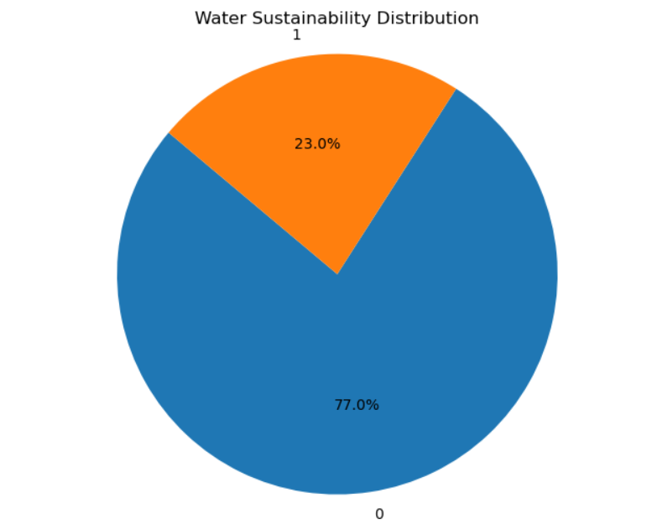
Data Source:
Water Quality Prediction Dataset:
https://www.kaggle.com/datasets/deepikaarikesavan/water-quality
Having clean water to drink is really important for staying healthy, and it's something everyone should have.
Dataset Details:
Number of Columns: 24
Numerical Data: 21
Categorical Data: 3
Number of Rows: 1048574
Water sustainability | No. of Records (out of 10,48,574)
Not sustainable (Target:0) | 8,07,841 (77.0%)
Sustainable (Target:1) | 2,40,734 (23.0%)

Slide 7
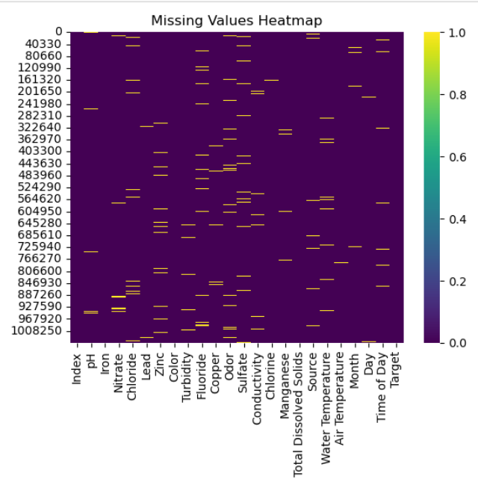
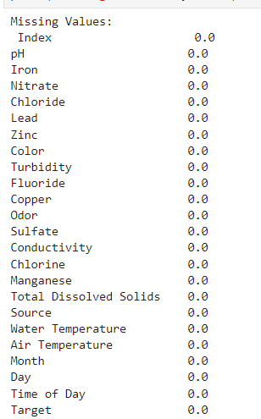
Handling Missing Values
Categorical Columns: Fill missing values with mode (most frequent category).
Quantitative Columns: Replace missing values with median.
Temporal Columns: Use specialized methods like interpolation or forward/backward filling.

Slide 8
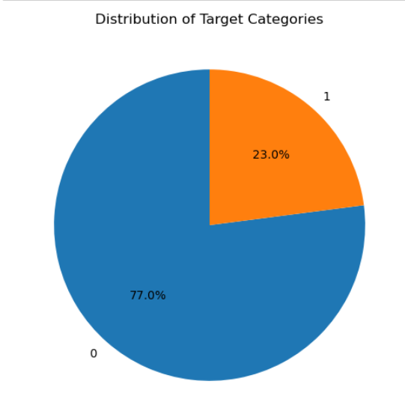
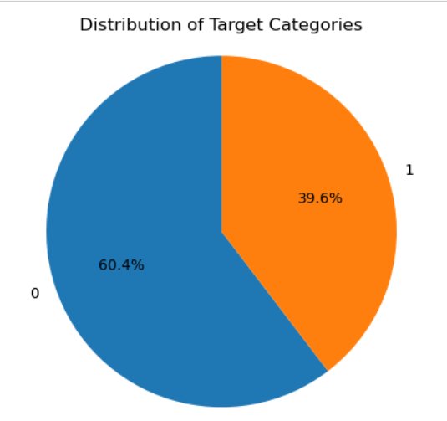
Class Imbalance
Original class distribution: 77% and 23%.
Implemented Down sampling to address class imbalance.
Down sampling involved reducing instances in the majority class.
After down sampling, class distribution became 60.4% and 39.6%.
This approach ensures a more balanced representation of classes.

Slide 9
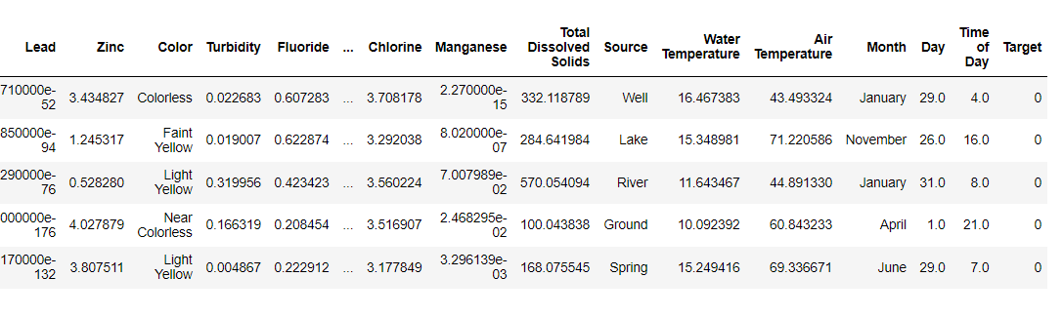
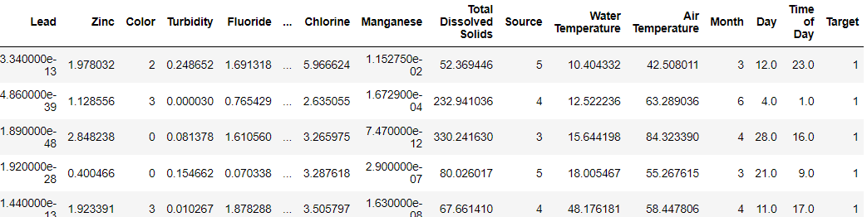
Label Encoding for Categorical Data
Converted 'Source', 'Color', and 'Month' values to numerical equivalents.
Utilized Label Encoding to assign unique numerical labels to categorical data.

Slide 10
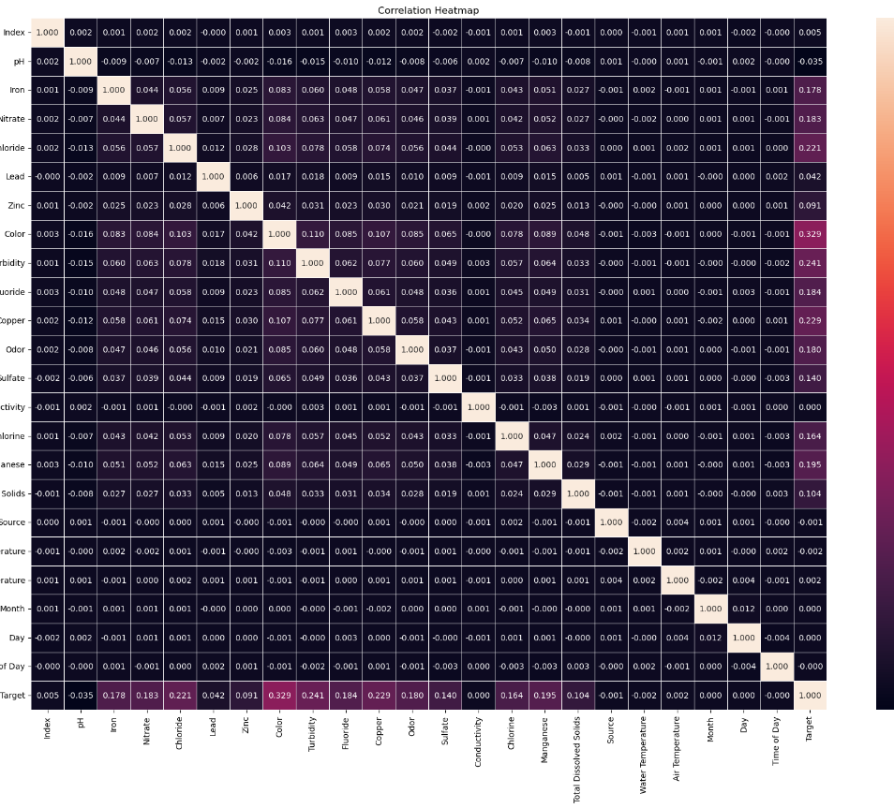
Correlation Heatmap
Correlation Analysis Results
No significant correlation between target label and features.
Highlights the need for further in-depth analysis.
Indicates potential hidden relationships requiring exploration.

Slide 11
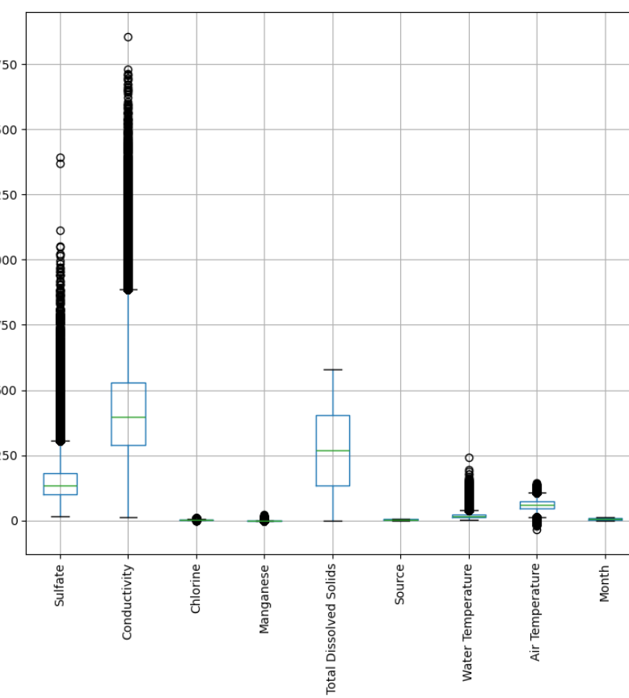
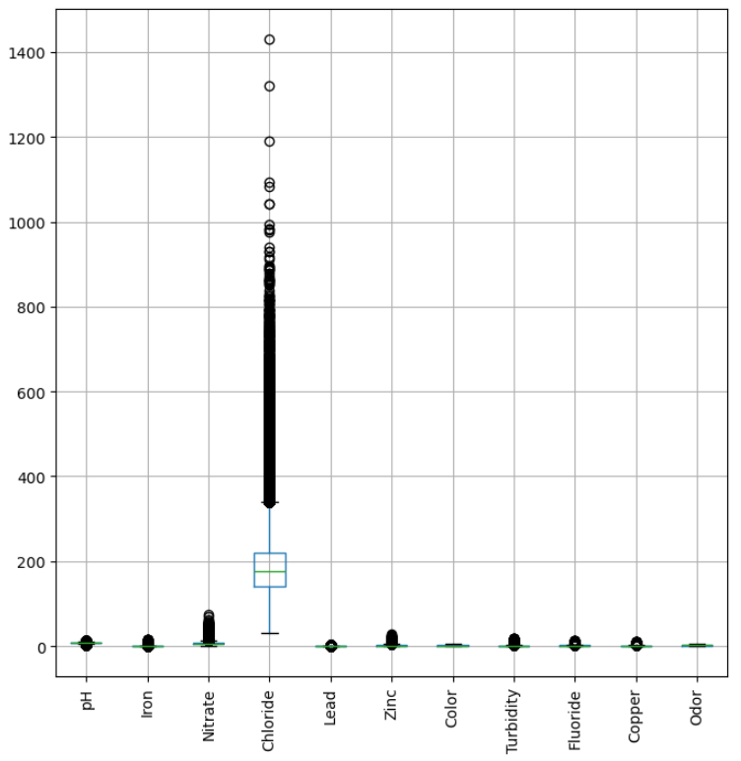
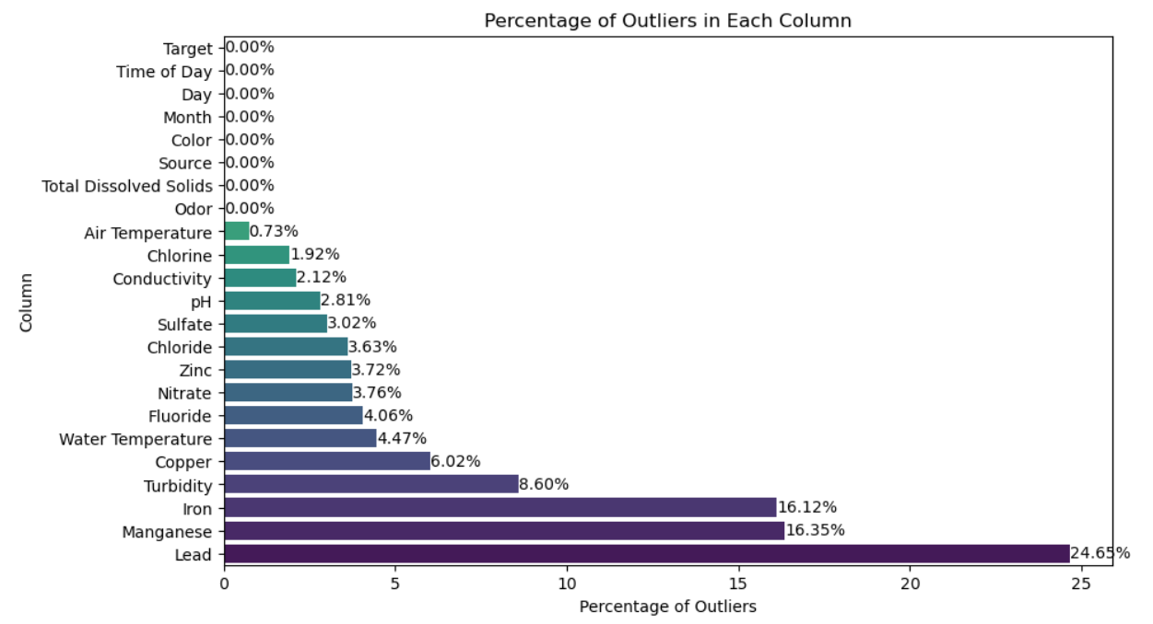
Outlier Detection and Analysis
Identified outliers using boxplot visualization.
Calculated percentage of outliers for each column.
"Lead" column exhibits the highest percentage of outliers.
Further investigation warranted to understand implications and potential data quality issues.

Slide 12
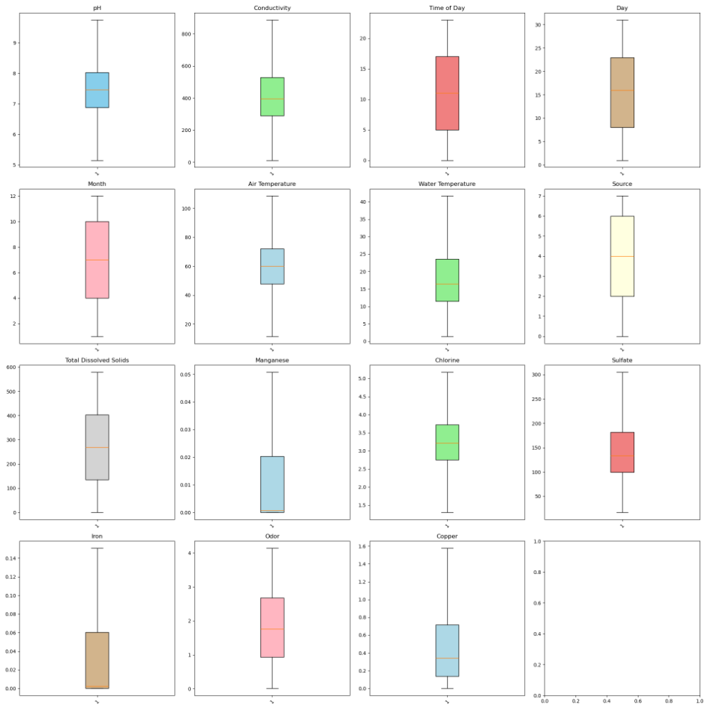
Outlier Removal
Excluded non-predictive columns.
Used Interquartile Range (IQR) method.
Clipped outliers within 1.5 times IQR.
Visualized top features' outlier removal

Slide 13
Data Preprocessing for Model Training
Feature Scaling:
Utilized StandardScaler from sklearn.preprocessing.
Applied feature scaling to training and testing sets.
Ensured uniform scale across features for improved model performance.
Data Splitting:
Used train_test_split function from sklearn.model_selection.
Split data into training and testing sets.
Allocated 70% of data for training and 30% for testing.
Shuffled data to ensure randomness.
Set random state for reproducibility.

Slide 14
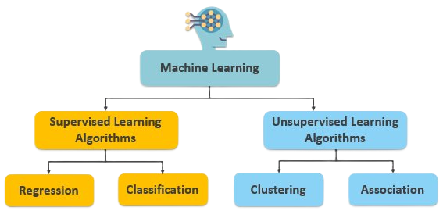
Algorithm selection
Since we have class label available , problem belongs to supervised learning.
Output of the target variable is either 0(not potable to drink) or 1(potable to drink):classification technique is used

Slide 15
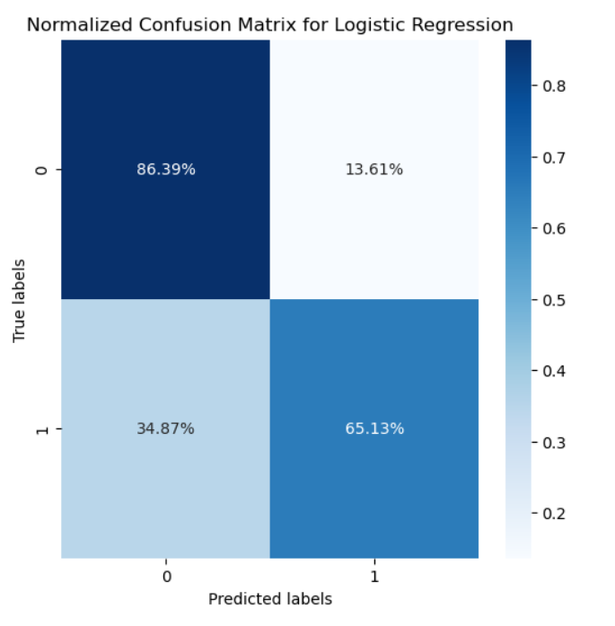
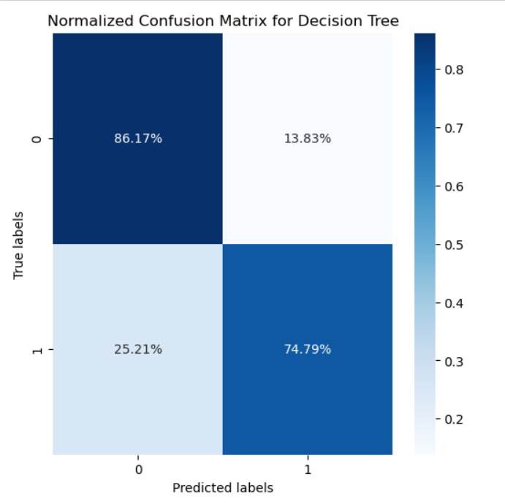
Confusion Matrix
After performing Logistic Regression, which exhibited significant misclassification, we switched to Decision Tree for further analysis. Here's what we observed:
True Negative: 86%
True Positive : 74%
Reduction in FN error from 34% to 25%
We also run other model to reduce the False Positive and False Nagative value.

Slide 16
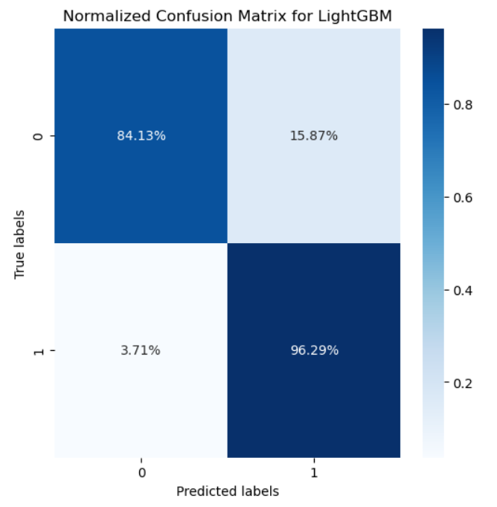
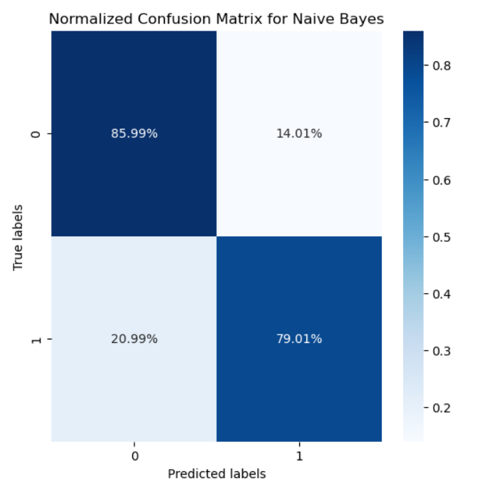
Confusion Matrix
Naive Bayes yielded a false negative error of 20% and false positive error of 14%.
LightGBM demonstrated superior performance, with a reduced false negative of 3.71% .
LightGBM's performance surpass Naive Bayes model, making it the preferred model due to its ability to significantly reduce false negatives and increase true positives..

Slide 17
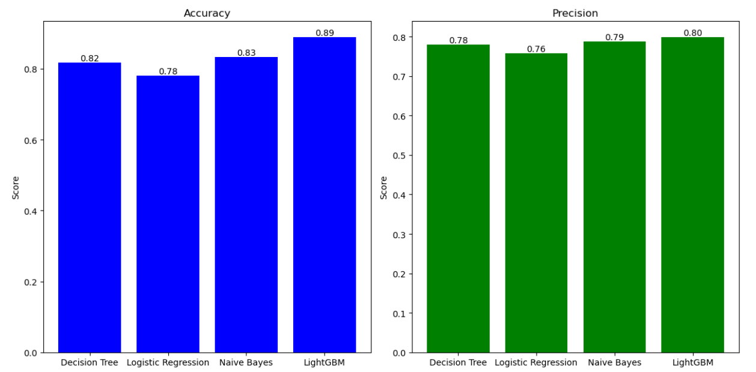
Model Comparison
We had done model training on Decision Tree, Logistic Regression, Naive Bayes, LightGBM

Slide 18
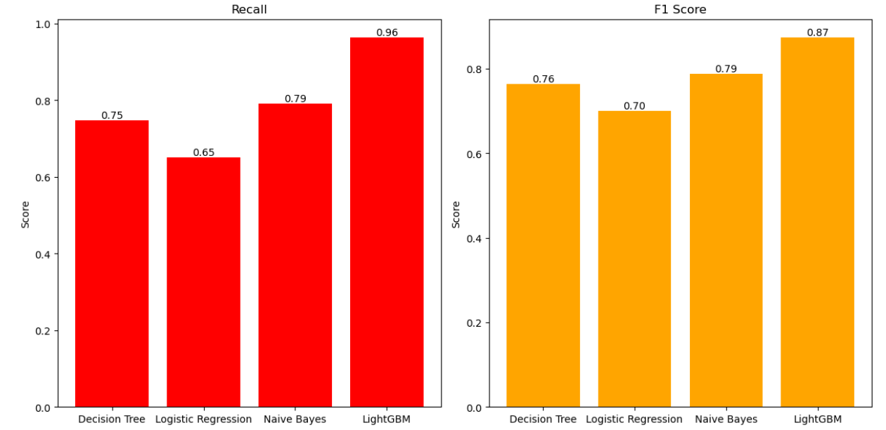
Model Comparison
We found that LightGBM achieved the highest recall score and an impressive F1 score of 0.87, demonstrating its superior performance compared to other models.

Slide 19
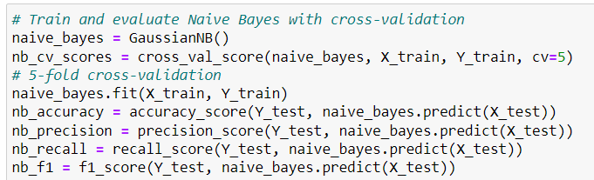
Cross validation
We used training data to generate multiple mini train-test split, to tune our model. Used cv=5

Slide 20
Model Selection
Even after performing cross validation on our chosen algorithms, we got highest accuracy with lightGBM.
LightGBM stands out with an accuracy of 0.89 and precision of 0.80, demonstrating superior performance compared to other models.
Therefore, we have chosen lightGBM as our final model to predict water potability

Slide 21
Future Work
Temporal Analysis: If time series data is available, exploring changes in water quality over time could yield insights into trends and seasonal variations.​
Geospatial analysis: If location data is available, we aim to perform geospatial analysis to identify water quality patters over different regions.

Slide 22


