Slide 1



INTRODUCTION TO SOFTWARE FUNCTIONAL TESTING

Slide 2
Content
The History of Software Testing
Why Software Testing is Important and What to Test
Soft Skills and Hard Skills of Software Tester
Basic Software Testing Terminology
Software Development Models and Testing
Software Testing Lifecycle
2

Slide 3
The History of Software Testing

Slide 4
20th Century: 50th-60th
Mathematical Approach
Exhaustive Testing
Debugging
This is not the “Testing”, this is just some sort of activity during
the Development
50th-60th
₇₀th
₈₀th
₉₀th
2000th
Now
4
Notes:
In the 1950s and 1960s, the testing process was very formalized, separated from the software development process and was “mathematised”. In fact, testing was more like debugging3 . The concept of exhaustive testing4 (checking all possible ways of code execution with all possible input data) was around. However, it soon became clear that exhaustive testing was impossible because the number of possible paths and input data was very large and it was difficult to find problems in the documentation with this approach.

Slide 5
20th Century: 80th
Lifecycle Integration
Error Prevention Approach
First Automation Attempts
Software Testing is recognized globally. A lot of methodologies, approaches, standards, etc. appears.
50th-60th
₇₀th
₈₀th
₉₀th
2000th
Now
5
Notes:
there was a key change in the place of testing in software development: instead of one of the final stages of project creation, testing was applied throughout the software lifecycle7 (see also the description of the iterative incremental software development model in “Software development models” {17} chapter), which allowed in a great number of cases not only to quickly detect and fix problems, but even to predict and prevent their occurrence. The same period also marked the rapid development and formalization of testing methodologies and the first basic attempts to automate testing

Slide 6
Modern Situation
Agile Testing
Testing as a part
of…
Testing as a basis
for…
Software Testing becomes a part of Development, DevOps and other activities. It becomes a basis for CI/CD/etc. approaches.
50th-60th
₇₀th
₈₀th
₉₀th
2000th
Now
6

Slide 7
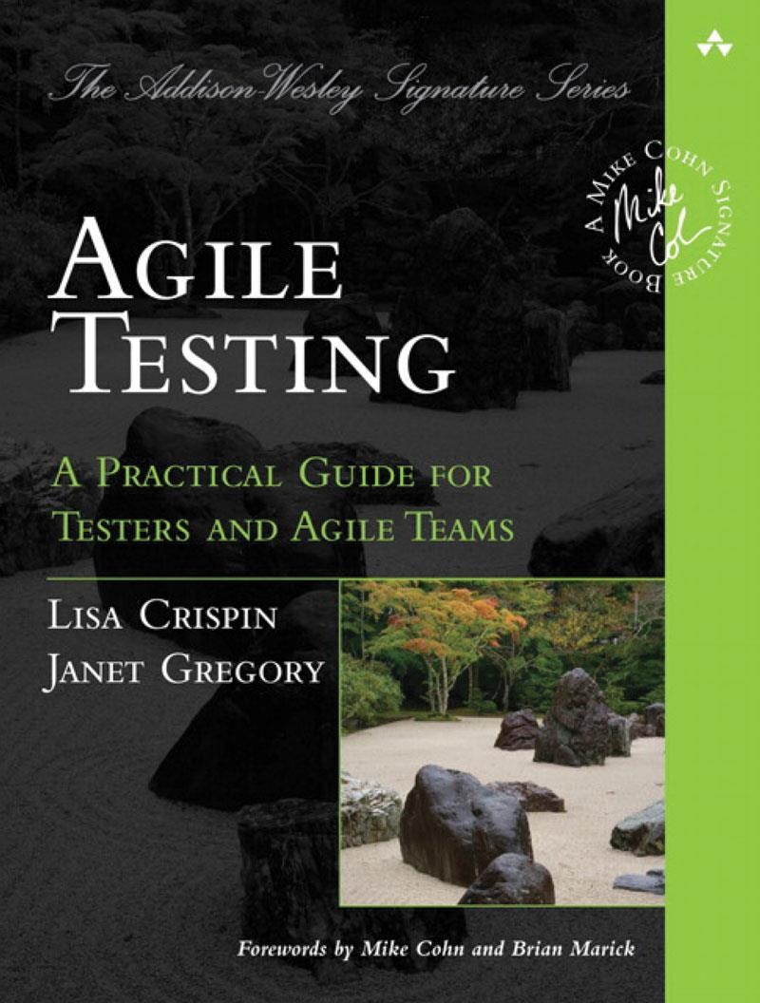
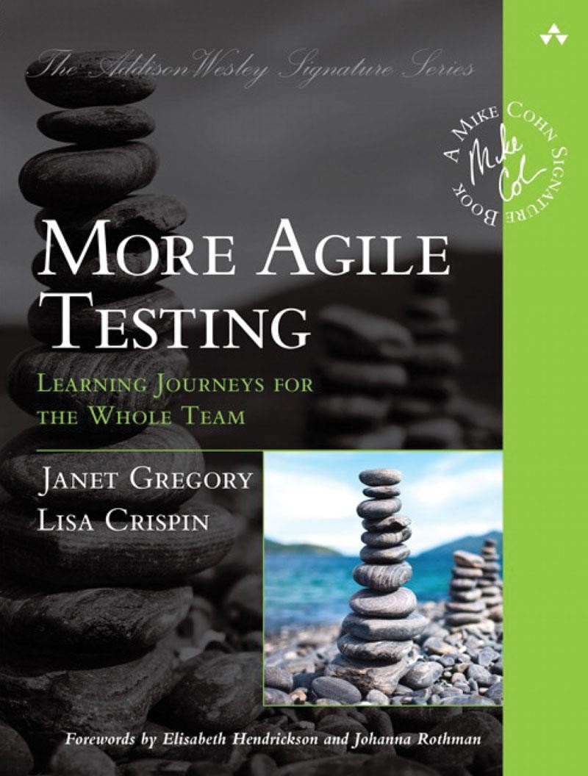
More About Our Days
7

Slide 8
Why Software Testing is Important and What to Test

Slide 9
Years ago
For Individual Users (and B2C Businesses)
Now
You want a Tool? Go write it yourself!
You want a Tool? Please, select from the following 100500 options.

Slide 10
Individual Users
For Enterprise (and B2B Businesses)
Enterprise Customers
Do like quality, but often fall victims of aggressive marketing.
They count. And count. And count again. And again. The quality affects this calculations essentially.

Slide 11
For Everyone
Trains, airplanes,
ships, etc…
Nuclear power
plants…
Medical
equipment…
Today software is literally EVERYWHERE. Smartphone failure is bad, but airplane crash is incomparable worse.

Slide 12
What to Test: Main Testing Areas
We can test…
Literally EVERYTHING

Slide 13
Soft Skills and Hard Skills of Software Tester

Slide 14

Soft Skills
Enhanced responsibility
Good communication skills
Performance and goal-oriented approach
Observation and attentiveness to details
Flexible thinking and ability to learn fast
Good abstract and analytical thinking

Slide 15
Hard Skills
Good English (B1+)
Programming basics
OS administration basics
Virtualization and cloud computing basics
Automated testing basics
General IT knowledge

Slide 16
Basic Software Testing Terminology

Slide 17
Quality
Testing and Quality
Testing
Quality Management
Quality Assurance
Quality Control

Slide 18
Testing and Quality by Example
Quality
Healthy Patient
 | Quality
 | Ma | nagement
Treatment
Quality Assurance
Quality Control
Medication and Procedures
Ongoing Diagnostics

Slide 19
Read and remember!
Testing and Quality
Testing – the process concerned with planning, preparation and evaluation of software products and related work products to determine that they satisfy specified requirements, to demonstrate that they are fit for purpose and to detect defects.
Quality – the degree to which a component, system or process meets specified requirements and/or user/customer needs and expectations.

Slide 20
Read and remember!
Testing and Quality
Quality management – Coordinated activities to direct and control an organization with regard to quality that include quality control and quality assurance improvement.
Quality assurance – part of quality management focused on providing confidence that quality requirements will be fulfilled.
Quality control – A set of activities designed to evaluate the quality of a component or system.

Slide 21
Defect, Expected Result, Actual Result
Expected result
Defect
Actual result

Slide 22
Read and remember!
Defect, Expected Result, Actual Result
Defect – an imperfection or deficiency in a work product where it does not meet its requirements or specifications.
Expected result – the predicted observable behavior of a component or system executing under specified conditions, based on its specification or another source.
Actual result – the behavior produced/observed when a component or system is tested.

Slide 23
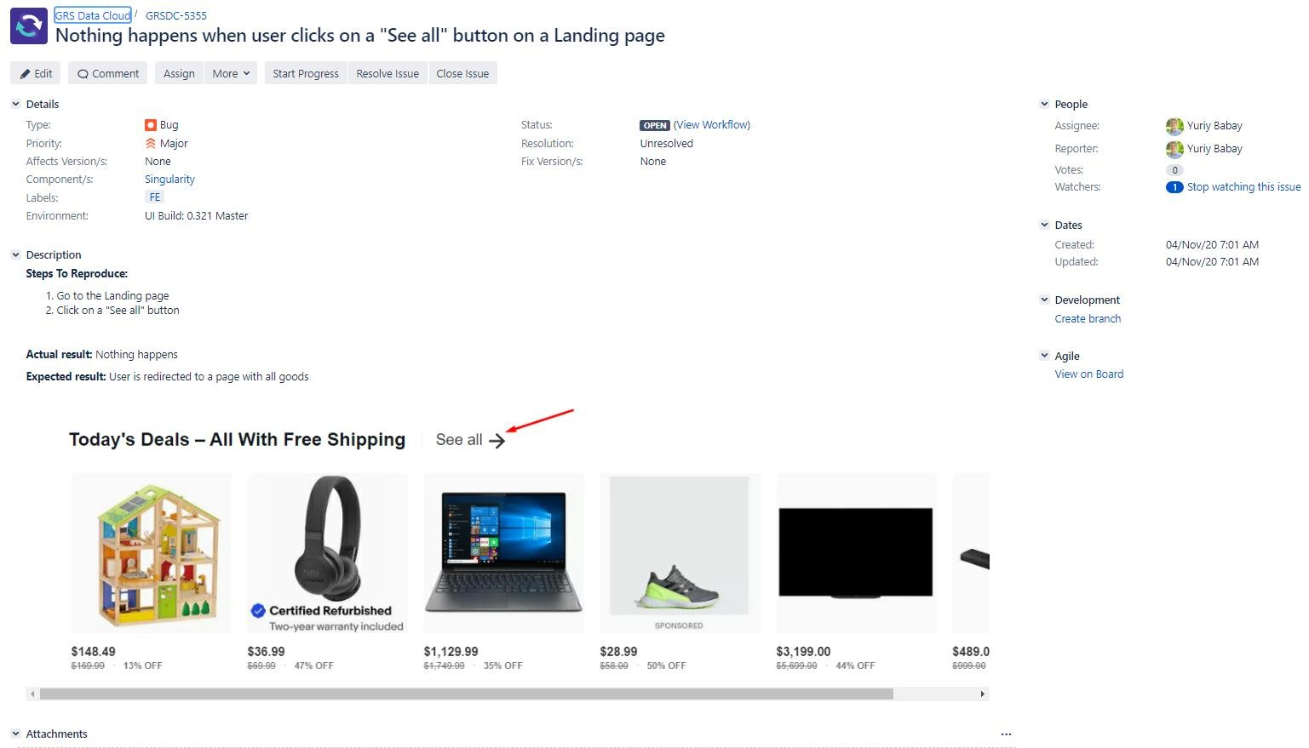
Defect Report: Sample

Slide 24
Checklist, Test Case, Test Suite
Checklist
Test Cases
Test Suites

Slide 25
Checklist, Test Case, Test Suite
Read and remember!
Checklist – a set of ideas.
Test case – a set of preconditions, inputs, actions (where applicable), expected results and postconditions, developed based on test conditions.
Test suite – a set of test cases or test procedures to be executed in a specific test cycle.

Slide 26
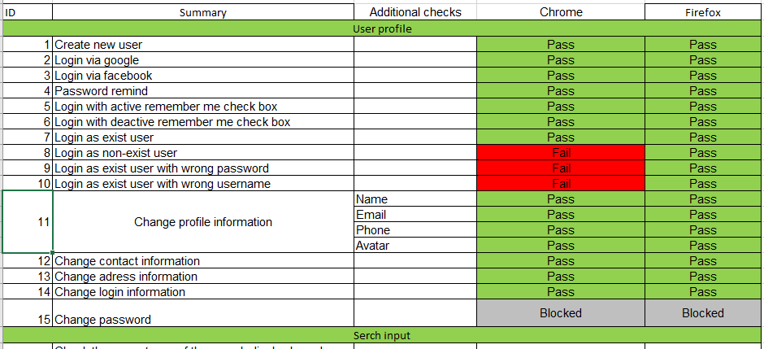
Checklist: Sample

Slide 27
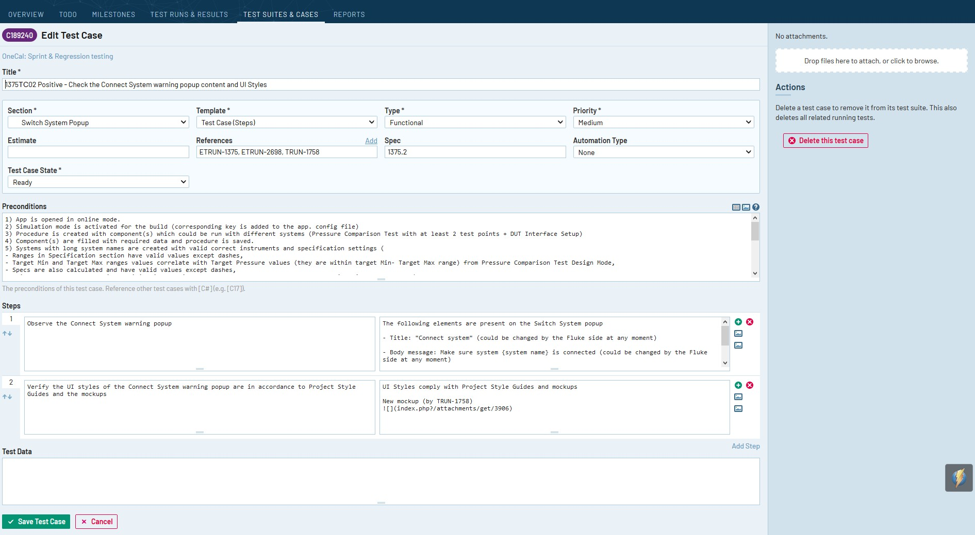
Test Case: Sample

Slide 28
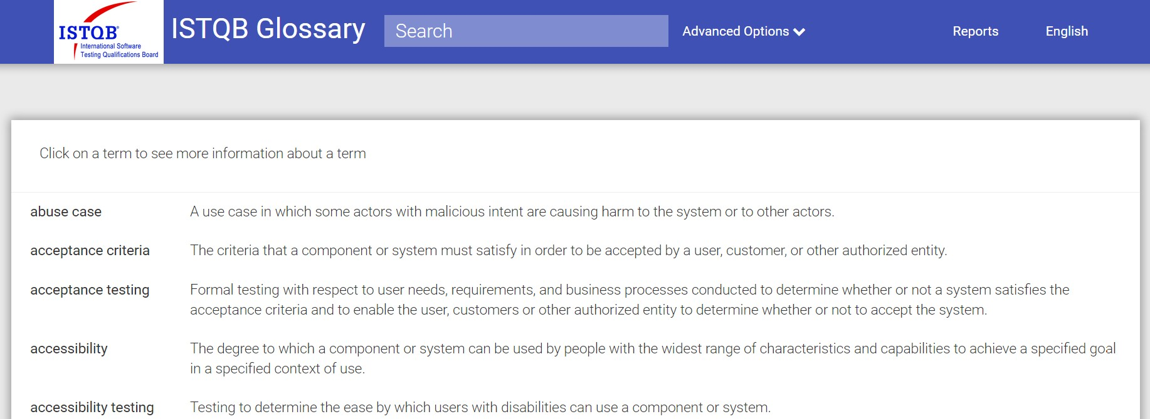
Please, visit this URL
https://glossary.istqb.org

Slide 29
Software Testing Lifecycle

Slide 30
General Overview
General planning and requirements analysis
1
Acceptance criteria establishment
Test results reporting
2
Test results analysis
8
Test strategy establishment
3
7
6
Defect reporting
4
5
Test cases creation
Test cases execution

Slide 31
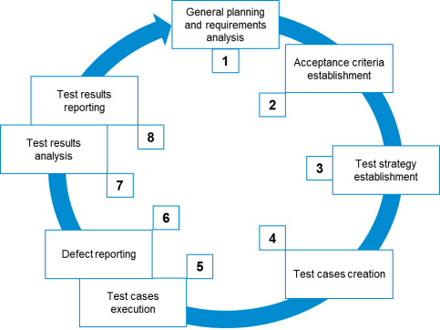
General planning and requirements analysis
General planning and requirements analysis
1. General planning and requirements analysis
Here we have to find out: what to test; how much work is ahead; what difficulties we may face; do we have all necessary resources; are requirements good enough.

Slide 32
Acceptance criteria establishment
Acceptance criteria establishment
2. Acceptance criteria establishment
Here we have to establish or adjust metrics and criteria for test process to start, pause, resume, complete or abort. We also have to know key quality criteria and goals for the current test cycle.

Slide 33
Test strategy establishment
Test strategy establishment
3. Test strategy establishment
Once again we return to planning to find out HOW shall we achieve all those goals and criteria from the previous step. Here we speak about approaches, tools, schedule, roles, responsibility and so on.

Slide 34
Test cases creation
Test cases creation
4. Test cases creation
Here we create, review, adjust, rework (and so on) checklists, test cases, test scenarios and other similar artifacts.

Slide 35
Test cases execution and defect reporting
Defect reporting
Test cases execution
Test cases execution
Defect reporting
These two stages are inseparable as we report defects during test cases execution and defects detection.

Slide 36
Test results analysis and reporting
Test results reporting
Test results analysis
Test results analysis
Test results reporting
Here we analyze if we managed to achieve the goals set during stages 1-3. The result of such analysis is presented in Test Result Report and used as the basis for the planning of the next test cycle.

Slide 37
Software Development Models and Testing

Slide 38
Disclaimer
This is NOT a detailed review or a comparison of Software Development Models. This is just a quick answer to “Where is the Testing in the … Model?”

Slide 39
Waterfall
General Planning
User Requirements
System Requirements
Technical Architecture
Detailed Design
Coding and Debugging
Testing (as we now understand it) comes to life barely in the middle of the project lifecycle. Testing reaches its maximum at the end of the project. Usually – too late.
Integration- and Unit-Testing
Installation Testing
System Testing
Acceptance Testing
Final Reporting

Slide 40




V-Model
Testing starts from the very beginning but it is concentrated mostly on the transition between stages.
Final Reporting
General Planning
User Requirements
Acceptance Testing
System Requirements
System Testing
Technical Architecture
Installation Testing
Detailed Design
Integration- and Unit-Testing
Coding and Debugging

Slide 41
Agile Model
With each and every cycle-based model Testing becomes “a part of every action” (although there are dedicated stages).
Iteration (24 h)
Project Backlog
Sprint Backlog
Sprint
(2-4 weeks)
Deliverable

Slide 42
And what about…
With non-iterative models Testing lies within dedicated stages and between stages.
RAD Model
Spiral Model
With iterative models Testing not only has dedicated stages, but fills any other activities like air or water.
Prototype Model
Any Other Model
With such approach Testing helps us to find defects ASAP or even to prevent them.

