Slide 1


TEST PLANNING AND CLASSIFICATION

Slide 2
Content
Test Planning: Tasks and Goals
Test Plan Sections
2

Slide 3

Test Planning: Tasks and Goals

Slide 4
Read and remember!
Main Definitions
Test planning – the activity of establishing or updating a test plan.
Test plan – documentation describing the test objectives to be achieved and the means and the schedule for achieving them, organized to coordinate testing activities.
4

Slide 5
Planning Tasks and Goals (part 1)
Planning Tasks and Goals
Estimation of work
scope and complexity
Designation of resources and ways to acquire them
Definition of schedule
and milestones
Risk mitigation and countermeasures definition
Distribution of duties
and responsibilities
Coordination of team- effort between teams/projects/groups
5

Slide 6
Why is Test Plan so important?
General planning and requirements analysis
Test Plan is the basis for all further activities, it is a map to the defined destination, a starting point to the reporting and so on and so
forth…
1
Acceptance criteria establishment
Test results reporting
2
Test results analysis
8
3
Test strategy establishment
7
6
Defect reporting
4
5
Test cases creation
Test cases execution
6

Slide 7
Planning Tasks and Goals (part 2)
Test Plan helps us to…
Get better results with
less effort
Optimize resources
usage, avoid waste
See the progress at any
given moment
Understand what to do
in any situation
Get better understanding between people
Cooperate better
7

Slide 8
Test Plan Sections

Slide 9
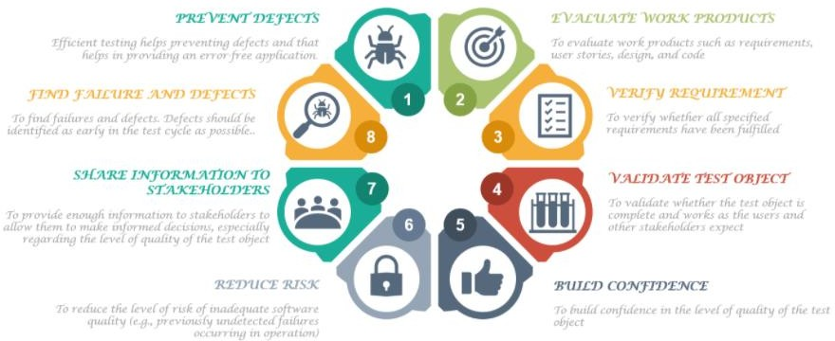
Read and remember!
Main Definition
Test plan – documentation describing the test objectives to be achieved and the means and the schedule for achieving them, organized to coordinate testing activities.
9

Slide 10
General Test Plan Sections Overview
Project scope and main goals
Schedule
Requirements to be tested
Roles and responsibilities
Requirements NOT to be tested
Risk evaluation
Test strategy and approach
Documentation
Criteria
Metrics
Resources
…
10

Slide 11
Read and remember!
Project scope and main goals
Project scope and main goals – a very brief description of the purpose of the application development.
E.g.:
Correct automated conversion of text documents in different source encodings to one destination encoding with performance significantly higher than human performance during the same actions.
11

Slide 12
Read and remember!
Requirements to be tested
Requirements to be tested – the list of functional and / or non- functional requirements to be tested.
E.g.:
UR-1.*: smoke test.
UR-2.*: smoke test, critical path test.
UR-3.*: critical path test.
BR-1.*: smoke test, critical path test.
QA-2.*: smoke test, critical path test
12

Slide 13
Read and remember!
Requirements NOT to be tested
Requirements NOT to be tested – the list of functional and / or non-functional requirements NOT to be tested.
E.g.:
SC-1: the application is a console one by design.
SC-2, L-1: the application is developed with proper PHP version.
QA-1.1: this performance characteristic is at the bottom border of typical operations performance for such applications.
13

Slide 14
Read and remember!
Test strategy and approach
Test strategy and approach – the description of the testing process in terms of the methods used, approaches, types of testing, technologies, tools, etc.
This description allows us to use the most effective and efficient way to achieve project goals in terms of quality.
E.g.:
Due to the team cross-functionality, a significant contribution to quality improvement can be expected from the code review combined with manual testing using the white box method. Unit-testing will not be applied due to extreme time limitations.
14

Slide 15

Test strategy as a standalone document
Scope of testing
Out of scope
Testing requirements
Acceptance criteria
Test types
Test types – implementation details
Test phases
Test automation
Test environments
Test data management
Test tools
Risks
15

Slide 16
Read and remember!
Criteria
Criteria – the list of miscellaneous testing criteria, such as acceptance criteria, entry criteria, suspension criteria, resumption criteria, exit criteria, etc.
E.g.:
Testing resumption criteria: more than 50% of bugs found during the previous iteration are fixed (see “Ongoing defects fixed percentage” metric).
16

Slide 17
Read and remember!
Resources
Resources – the list of miscellaneous project resources, such as software, hardware, staff, time, finance, etc.
E.g.:
Software: four virtual machines (two with Windows 10 Ent x64, two with Linux Ubuntu 18 LTS x64), two PHP Storm licenses (latest version available).
Hardware: two standard workstations (8GB RAM, i7 3GHz).
17

Slide 18
Read and remember!
Schedule
Schedule – in fact, this is a kind of calendar with milestones and periods marked on it.
E.g.:
25.05 – requirements testing and finalizing.
26.05 – test-cases and scripts for automated testing creation.
27.05-28.05 – main testing stage.
29.05 – testing finalization, reporting.
18

Slide 19
Read and remember!
Roles and responsibilities
Roles and responsibilities – the list of all key project roles (related to the testing process) with their key areas of responsibility.
E.g.:
Senior developer: participation in requirements testing and code review.
Tester: documentation creation, test-cases execution, participation in code-review.
19

Slide 20
Read and remember!
Risk evaluation
Risk evaluation – the list of risks that are likely to arise during the project. For each risk there is a probability evaluation and some options for resolving the situation.
E.g.:
Personnel (low probability): if any team member is inaccessible, we can contact the representatives of the “Cataloger” project to get a temporary replacement (the commitment from the “Cataloger” PM John Smith was received).
20

Slide 21
Read and remember!
Documentation
Documentation – the list of test documentation with details on who should prepare it, when, how, etc.
E.g.:
Requirements. Responsible person – tester, deadline – 25.05.
Test cases and defect reports. Responsible – tester, creation period –
26.05-28.05.
Test result report. Responsible person – tester, deadline – 29.05.
21

Slide 22
Read and remember!
Metrics
Metrics – the list of numerical characteristics of quality indicators, methods for their evaluation, formulas, etc.
E.g.:
Test cases success percentage:
𝑆𝑢𝑐𝑐𝑒𝑠𝑠
𝑇^{𝑆𝑃} = ^{𝑇} ∙ 100%, where
_{𝑇}𝑇𝑜𝑡𝑎𝑙
𝑇^{𝑆𝑃} – percentage of successfully passed test cases,
𝑇^{𝑆𝑢𝑐𝑐𝑒𝑠𝑠} – quantity of successfully passed test cases,
𝑇^{𝑇𝑜𝑡𝑎𝑙} – total quantity of executed test cases.
22

