Slide 1

SECURE KUBERNETES ON AZURE
How I designed, deployed, broke, diagnosed and fixed
a private AKS platform on real Azure infrastructure
DEV + PROD · BOTH VERIFIED LIVE
Presented by Sufyan Deen-Gabisi · github.com/sufideen/az-ent-sec-dashboard
Notes:
Thanks for having me. Over the next few minutes I'll walk you through a platform I designed and built myself: a private Kubernetes cluster on Azure, deployed through a pipeline with no stored passwords. I'll show you the design, and I'll also show you the day it broke, because that is where I learned the most.

Slide 2
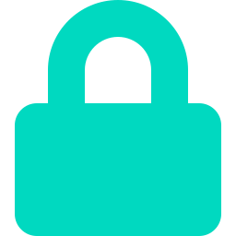
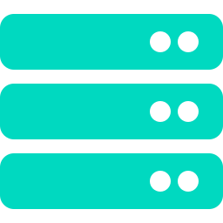

What I Built
I built a containerized web application on a private Azure Kubernetes Service cluster. It sits behind a WAF-enabled Application Gateway, pulls images from a private container registry, and is deployed by GitHub Actions using OIDC, so there are no long-lived credentials anywhere in the pipeline.
2
0
PRIVATE
5-LAYER
Independent
environments
Stored credentials
in the pipeline
API server —
no public IP
Real incident,
diagnosed live
I verified both environments end to end on 2026-09-18: real pods, real TLS, a real public IP and a real HTTP 200.
Secure Kubernetes on Azure — Portfolio Showcase
2
Notes:
In one sentence: it's a website running on Kubernetes that I locked down properly. Two environments, dev and prod. The API server has no public address, and nothing in the pipeline holds a password or key. I'll show you proof of both environments later, from the live Azure portal and the command line.

Slide 3


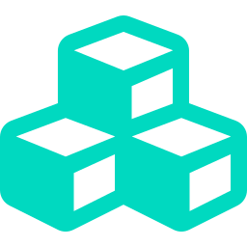
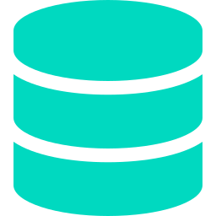
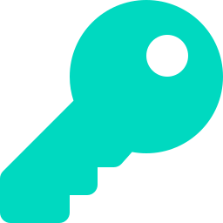
Architecture: how a request travels
Internet
Application Gateway (WAF_v2)
public IP · TLS termination · OWASP ruleset
AGIC watches Ingress objects, reconfigures the Gateway automatically
AKS CLUSTER — PRIVATE API SERVER (no public control-plane IP)
System node pool
User node pool (autoscaling)
mode=System · CriticalAddonsOnly taint
Add-ons only — no app workloads scheduled here
namespace: demo-web · Deployment, 2-5
replicas via HorizontalPodAutoscaler
Container Registry
Key Vault
Private endpoint · no admin user
AcrPull via kubelet identity only
RBAC-authorized · private endpoint
TLS cert synced via CSI driver identity
Secure Kubernetes on Azure — Portfolio Showcase
3
Notes:
Follow a visitor's request from the top. It arrives at the Application Gateway, where the WAF filters it and TLS ends. The Gateway forwards to pods in the AKS cluster. I split the cluster into a system pool that only runs Azure's own add-ons and a user pool for my app, which autoscales. Underneath sit two private services: the container registry that holds my images and Key Vault that holds the TLS certificate. Neither is reachable from the internet.

Slide 4

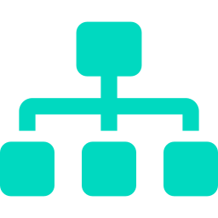
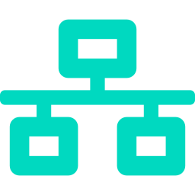



Inside the Cluster
The Kubernetes objects I deployed, and what each one does for me
Namespace
demo-web — isolates the app's objects, RBAC, and network policy
Deployment
2-5 replicas, non-root, read-only rootfs, all capabilities dropped
Service
Stable ClusterIP — what the Ingress and Gateway actually target
Ingress + AGIC
Declares routing intent; AGIC drives the real Application Gateway
HorizontalPodAutoscaler
Scales on CPU utilization (target 70%) with zero manual steps
NetworkPolicy (×3)
Default-deny; explicit allow only from the Gateway subnet + DNS
SecretProviderClass
Bridges the CSI driver to Key Vault — no cert material in Git
Secure Kubernetes on Azure — Portfolio Showcase
4
Notes:
If you're not a Kubernetes person, read this as a checklist of what I configured. The two I care about most are the default-deny network policy, which means pods can't talk to each other or out unless I say so, and the container settings: non-root, read-only filesystem, all Linux capabilities dropped.

Slide 5
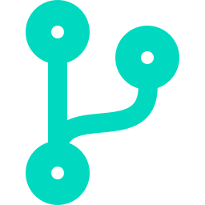

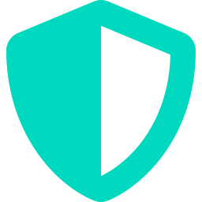
How I Locked It Down
Private API server
OIDC-only CI/CD
Azure RBAC + Entra ID
No public control-plane IP, anywhere
Federated tokens — zero stored Azure secrets in GitHub
Cluster access is group membership, not a static kubeconfig
Default-deny NetworkPolicy
Non-root everywhere
No embedded credentials
Explicit allow only from the Gateway; egress limited to DNS
Read-only rootfs, dropped capabilities, seccomp RuntimeDefault
ACR, Key Vault, and Gateway access all via managed identity
Secure Kubernetes on Azure — Portfolio Showcase
5
Notes:
Six decisions, all made up front rather than bolted on. The one people ask about most is the second: my pipeline logs into Azure with short-lived federated tokens, so there is no client secret in GitHub to steal or rotate. The same idea applies to the registry, Key Vault and the Gateway: they all use managed identities.

Slide 6

From git push to a running pod
1
2
3
4
5
Push
Build & Push
Bicep Deploy
kubectl apply
AGIC reconciles
What-If runs on
every PR, shows
the exact diff
OIDC login, image
built, tagged with
git SHA, pushed to ACR
Dev auto-deploys;
prod behind an
approval gate
Via az aks command
invoke — the only path
into a private API server
Gateway listener +
backend pool updated
to match the Ingress
Why I built it this way: a GitHub-hosted runner has no network route into a private cluster. So I use “az aks command invoke”, which runs kubectl through Azure itself. No VPN, no self-hosted runner and no Bastion host.
Secure Kubernetes on Azure — Portfolio Showcase
6
Notes:
This is the path from a code change to a running pod. The design problem I had to solve is that a private cluster can't be reached from a normal build runner. I used command invoke so the pipeline can still deploy without opening any network path. Dev deploys automatically, and prod waits for a human approval.

Slide 7

The Day Prod Broke
My prod app sat in ContainerCreating for over 24 hours and I hadn't noticed. Here is how I found it, five layers deep.
1
Invalid vault name: “REPLACE_WITH_KEY_VAULT_NAME”
Prod's overlay was missing a patch dev already had
2
ForbiddenByRbac
Admin identity lacked Key Vault Certificates Officer on that vault
3
ForbiddenByConnection
Vault is private by design — no VPN/Bastion path in, even for an authorized identity
4
SecretNotFound (404)
The TLS certificate simply didn't exist in prod's vault yet
5
InvalidImageName
A manual kustomize apply bypassed CI's image-substitution step mid-recovery
Full root-cause timeline: docs/webplat-architecture.md → “Incident: prod SecretProviderClass never patched”
Secure Kubernetes on Azure — Portfolio Showcase
7
Notes:
This is the slide I'm most glad to show. After I deployed prod, the pods were stuck and I didn't spot it for a day. Fixing it meant peeling back five separate problems, and each fix exposed the next. The first was a placeholder I forgot to patch in prod's config. The last was a manual step I took mid-recovery that skipped the pipeline's image substitution. What I took from it: put a check on pod readiness in the pipeline, and don't do manual applies during a recovery.

Slide 8
Kubernetes in Plain Language
The terms I'll use today, explained the way I use them in this project
Pod
Node
The smallest deployable unit — one or more containers sharing network/storage
A VM that runs pods — here, an Azure VM Scale Set instance
Deployment
ReplicaSet
Declares “I want N copies running” and reconciles reality toward that
The Deployment's mechanism — a new one on every pod-template change
Service
Ingress
A stable network identity for pods, even as pod IPs come and go
A declarative routing rule; needs a controller (AGIC) to act on it
HPA
CSI driver
Horizontal Pod Autoscaler — changes replica count based on live metrics
A plugin standard for mounting external storage/secrets into pods
Managed Identity
Private cluster
An Azure AD identity Azure manages the credential for — no key to leak
The Kubernetes API server has no public IP at all
Secure Kubernetes on Azure — Portfolio Showcase
8
Notes:
A quick glossary so nobody gets lost. If you only remember three: a pod is one running copy of the app, a Deployment keeps N pods alive, and an Ingress is a routing rule that the Application Gateway turns into real configuration.

Slide 9
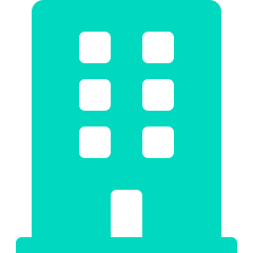
Where I'd Use This Pattern
Company websites with an SLA
Private line-of-business apps
Where “the site is down” is a business incident, not an inconvenience
Need network isolation but still a public-facing front door
Client engagement reference
Multi-environment platforms
Every piece answers a security-conscious procurement checklist
Each environment isolated at the network level, not just namespaced
Secure Kubernetes on Azure — Portfolio Showcase
9
Notes:
This isn't only a lab. I'd use this same pattern for a company website with an availability target, for internal line-of-business apps that need a public front door, and as a reference for clients whose procurement teams ask hard security questions.

Slide 10

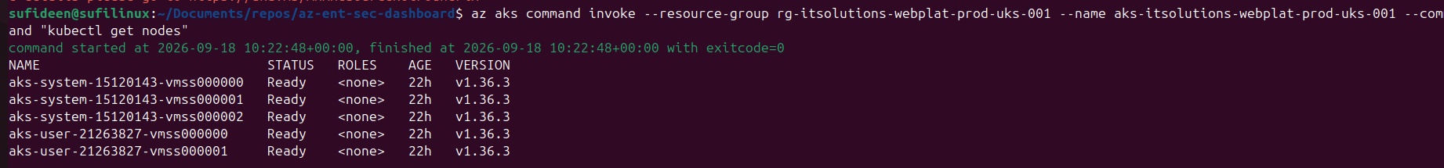
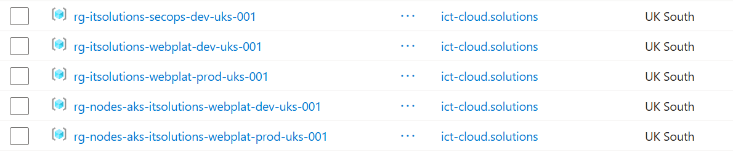
Proof, Not Just Claims
Everything below was captured from my own Azure tenant, not mocked up
curl — prod
kubectl get pods — prod
App Gateway backend health
HTTP/1.1 200 OK
Server: nginx/1.27.5
$ curl .../healthz
ok
demo-web-ccc969478-8cmfs
1/1 Running
demo-web-ccc969478-lmgm2
1/1 Running
10.31.0.103 Healthy
10.31.0.136 Healthy
(both environments)
What I'd point out
Both environments are live and separate. Twelve pieces of evidence are in the repo: node health, private DNS, pods, backend health, end-to-end curl and Defender inventory, for dev and prod.
kubectl get nodes on prod, run through az aks command invoke: 3 system and 2 user nodes, all Ready
Azure portal: dev and prod resource groups, plus the AKS-managed node groups
Secure Kubernetes on Azure — Portfolio Showcase
10
Notes:
I don't want you to take my word for it. On the left is the real output of kubectl get nodes against prod, run the way my pipeline runs it, through Azure and not over a VPN. Below it is the Azure portal showing the dev and prod resource groups. The full set of evidence is in the repository, and everything here has been cropped so no account details are shown.

Slide 11
Let's Talk
Private AKS + Azure networking design
Zero-secret CI/CD with OIDC federation
Live production incident diagnosis
Infrastructure as Code (Bicep) at scale
Sufyan Deen-Gabisi
github.com/sufideen/az-ent-sec-dashboard
The full write-up, evidence and runbook are in the docs/ folder of the repository
Notes:
To sum up: I can design a private, zero-secret Kubernetes platform on Azure, automate its delivery, and when it breaks in production, work through it methodically. The repository has everything, including the incident write-up. I'm happy to take questions, and to go deeper on any slide.

