Slide 1
The Cluster
Build | Image | Cluster-Deploy

Slide 2
Desired Deployment Attributes
{Autoscaling, Infastructure agnostic, distributed, Day-2 ops etc. }

Slide 3
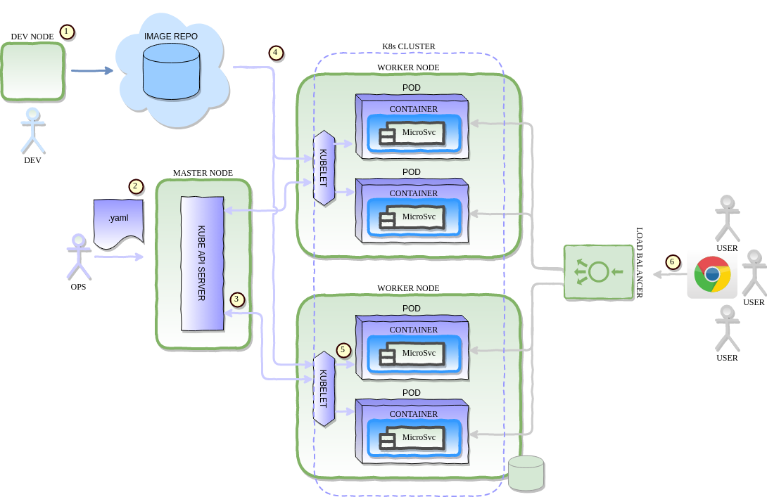
Cluster Basics

Slide 4
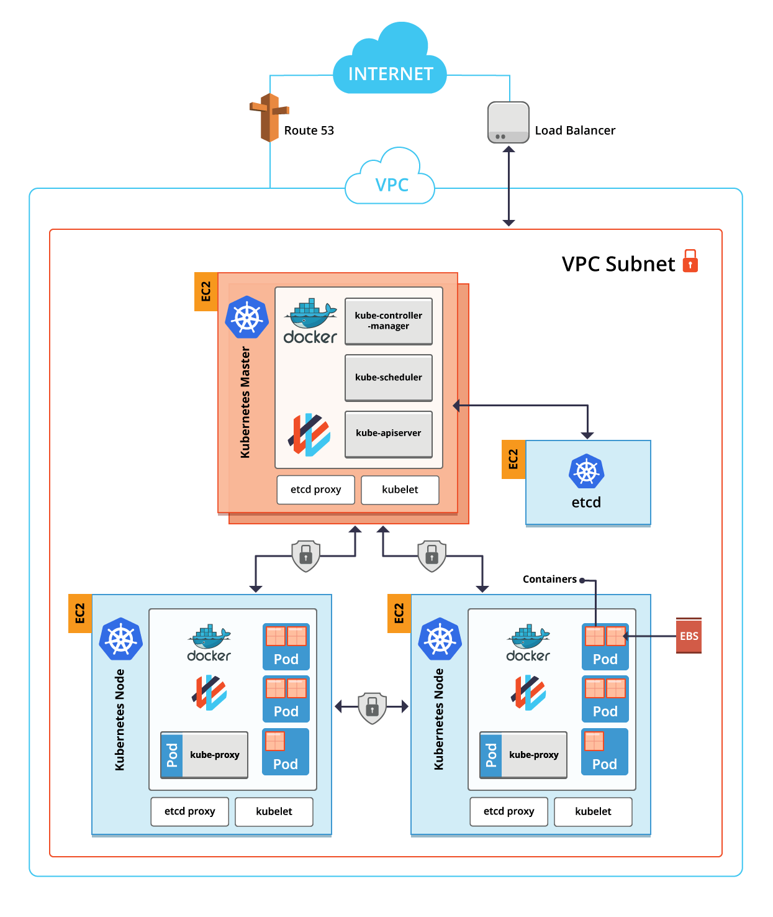
Sample AWS Cluster

Slide 5
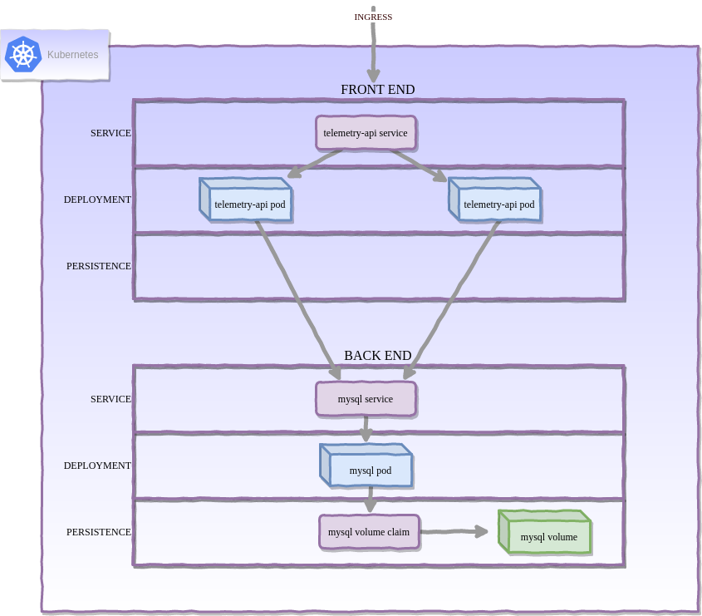
Example Deployment Configuration

