Slide 1
The Microservice
{ Develop | Build | Deploy }

Slide 2
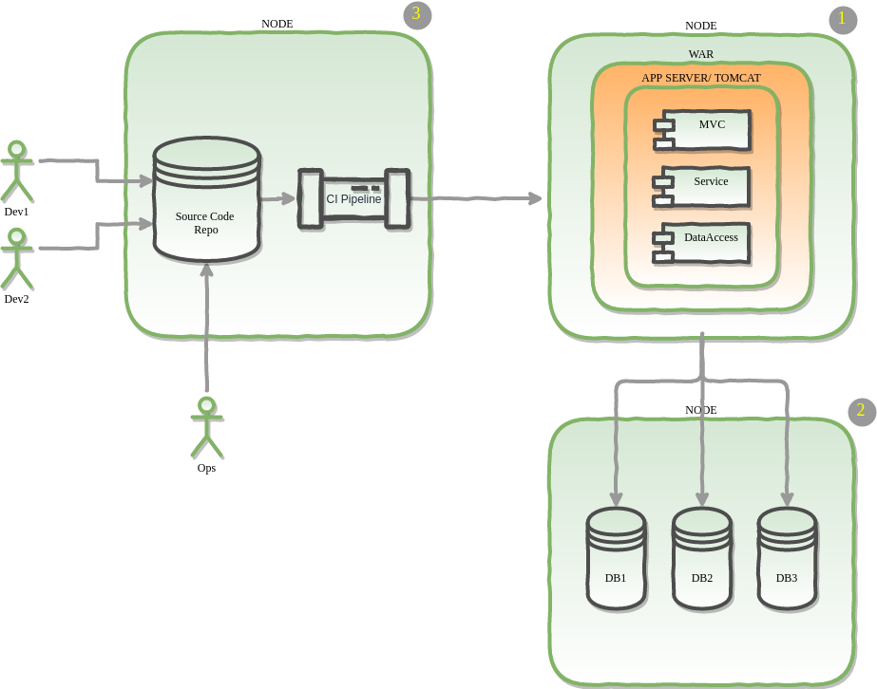
Classical Monolith Application

Slide 3
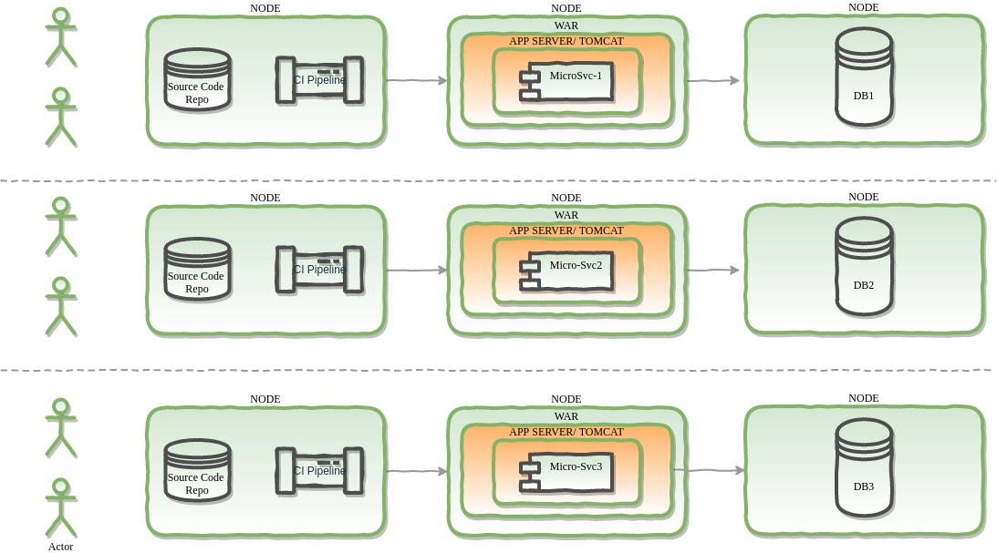
Micorservice Architecture

Slide 4
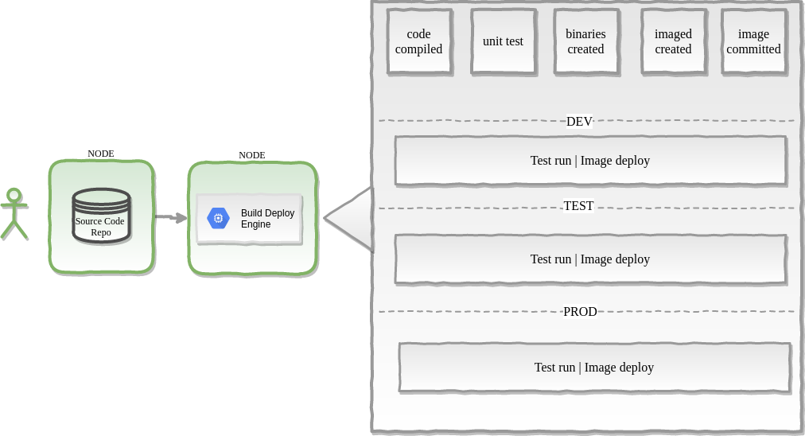
CI / CD Pipeline
Goals {
- devops_friction = LOW;
- infrastructure = IMMUTABLE;
- environment_drift = 0;
}

Slide 5
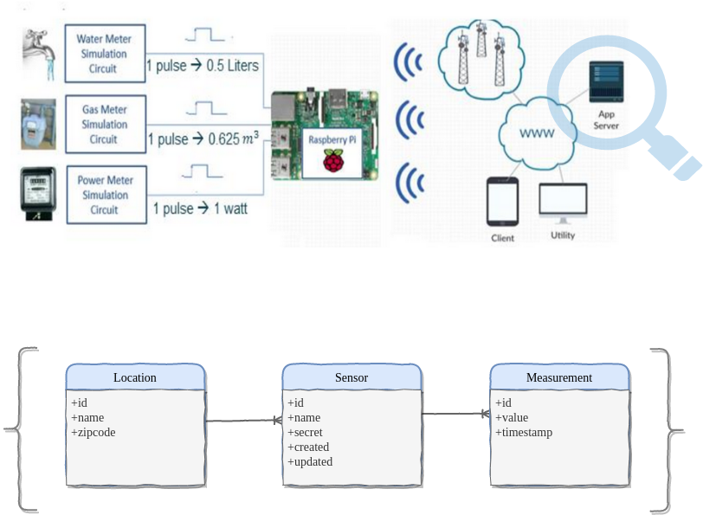
Telemetry Web API Application

