Slide 1
The Pipeline
{ Build | Deploy | Promote }

Slide 2
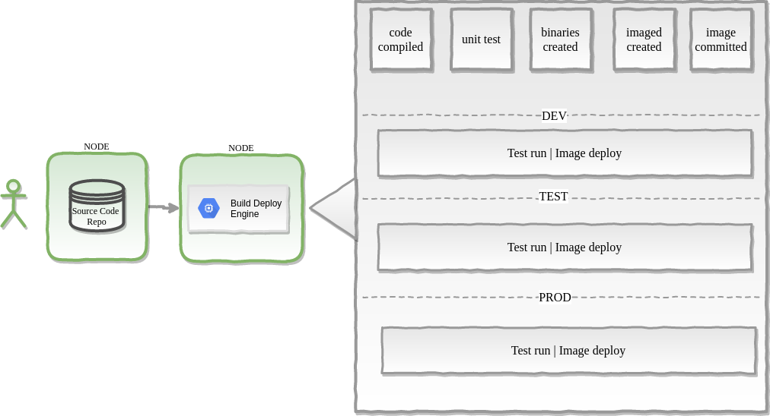
Dev-Sec-Ops Pipeline

Slide 3
Infrastructure-as-Code (IaC)
“Infrastructure as Code (IaC) is the management of infrastructure (networks, virtual machines, load balancers, and connection topology) in a descriptive model, using the same versioning as DevOps team uses for source code.”

Slide 4
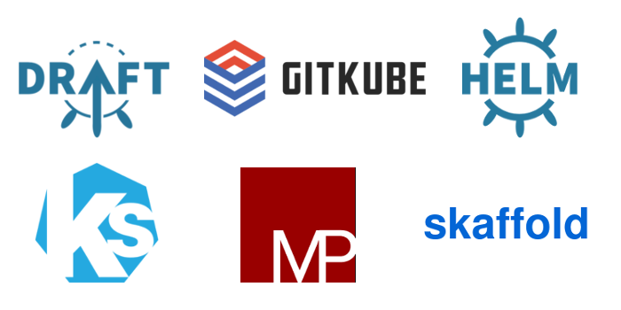

K8s IaC Tools Options
https://hasura.io/blog/draft-vs-gitkube-vs-helm-vs-ksonnet-vs-metaparticle-vs-skaffold-f5aa9561f948/

Slide 5
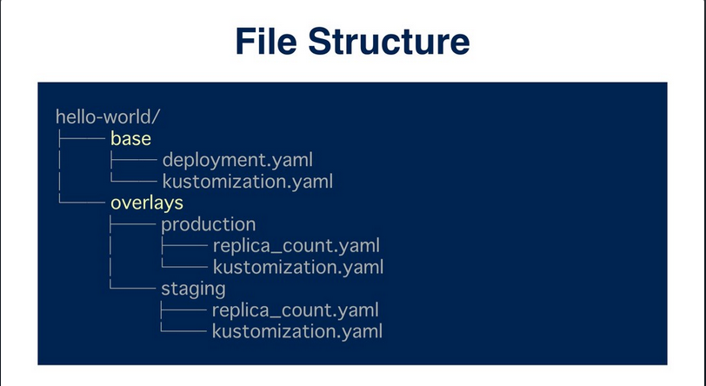
Kustomize
Simple | Declarative | Template-free | Autogenerated

Slide 6
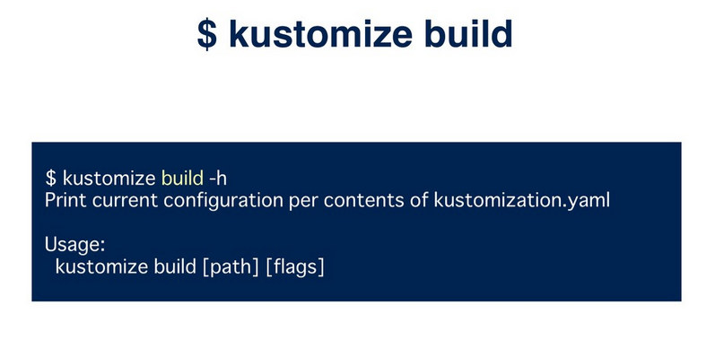

Kustomize

Slide 7
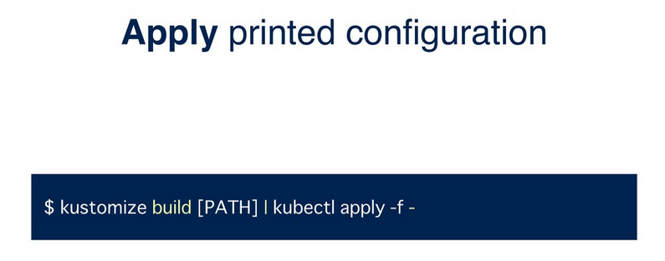
Kustomize
https://speakerdeck.com/spesnova/introduction-to-kustomize

