Slide 1
The Container
{ Build | Containerize | Deploy }

Slide 2
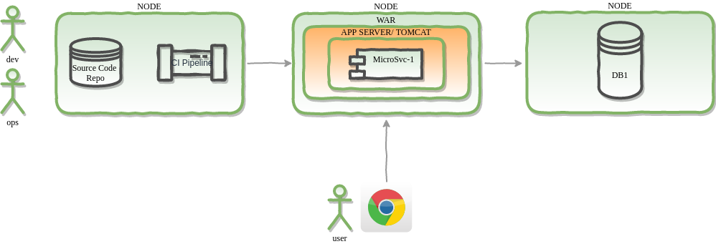
Classical Application Deployment

Slide 3
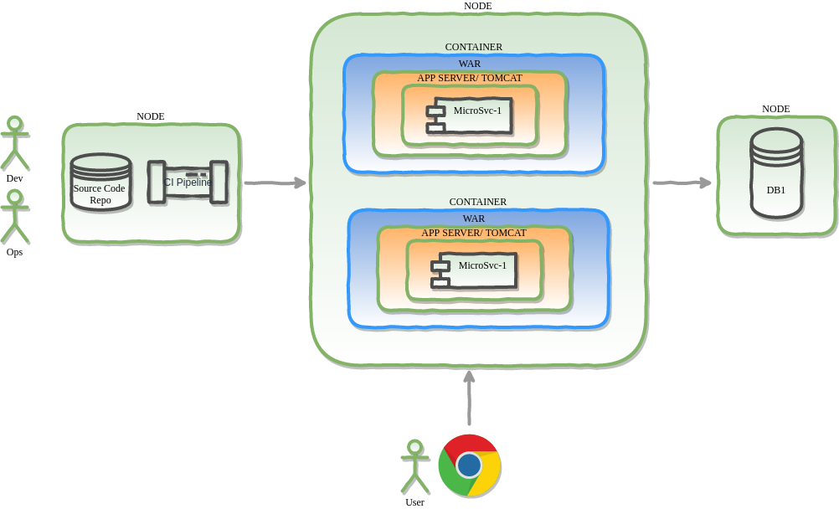
Containerized App Deployment

Slide 4
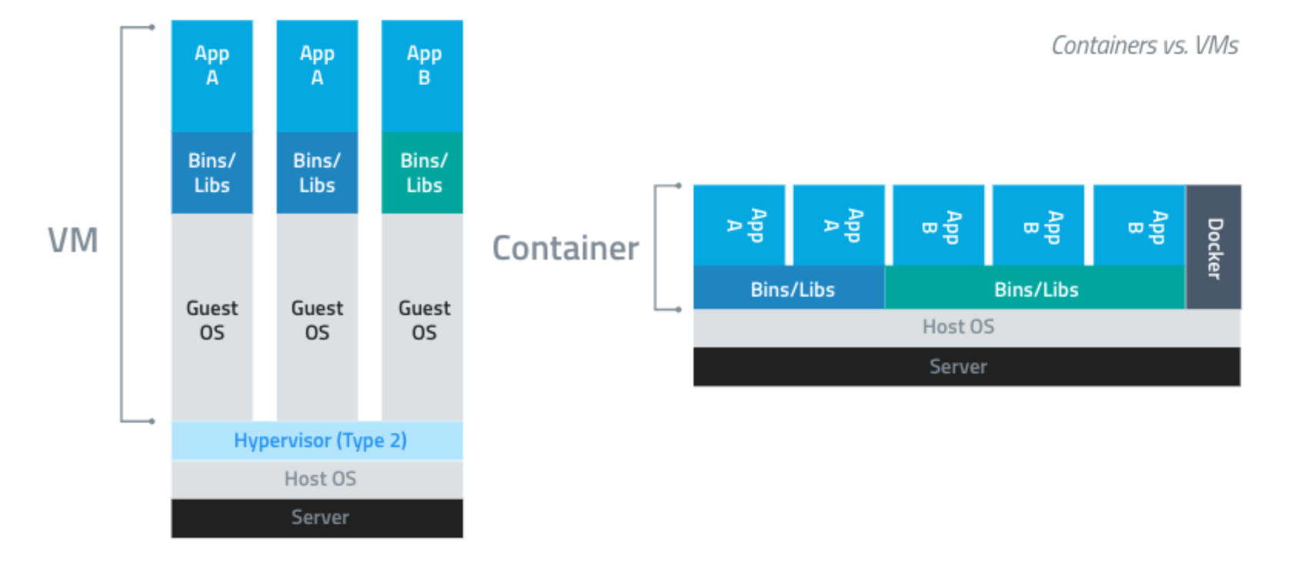
Design Notes

Slide 5
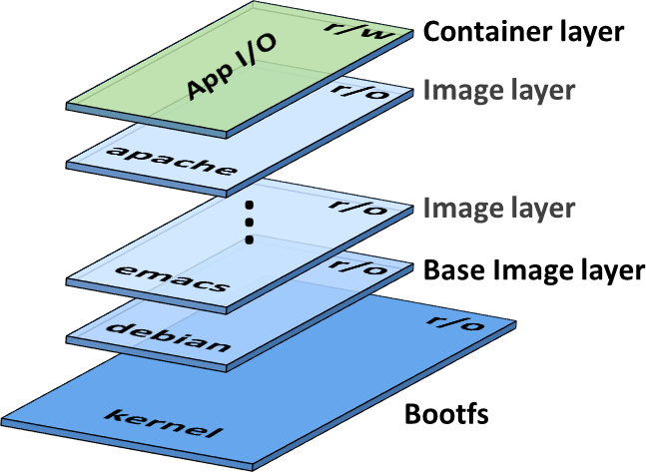
Design Notes
http://neokobo.blogspot.com/2017/03/docker-container.html

Slide 6
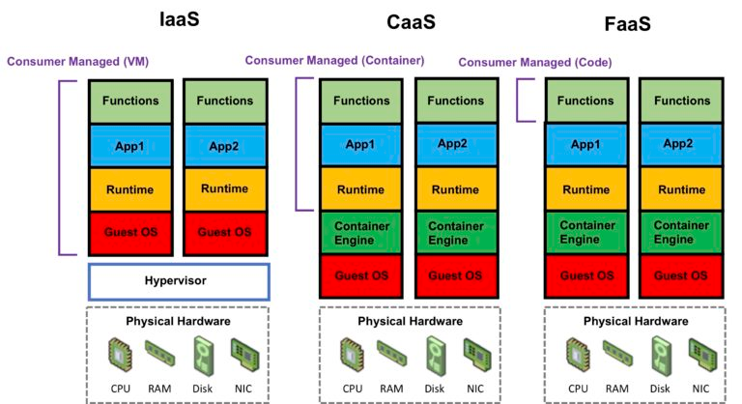
Design Notes
https://digitalcloud.training/2018/12/18/cloud-computing-basics-serverless/

