Slide 1
The Container - Again
Build | Containerize | Deploy

Slide 2
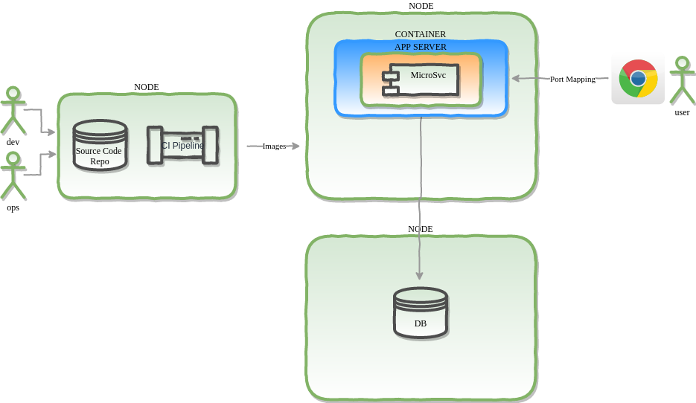
Containerized App -- External DB

Slide 3
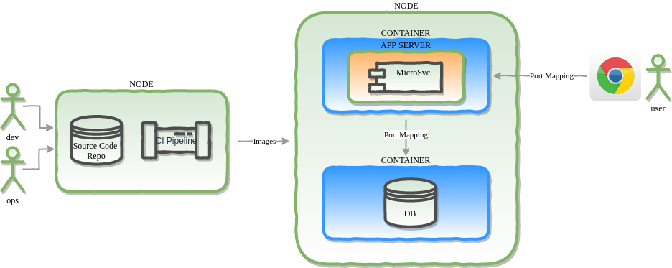
Containerized App & DB
concerns {
auto-scaling;
failover;
storage;
networking;
integration;
infrastructure-provisioning;
instrumentation;
}

Slide 4
Design Notes

