Slide 1


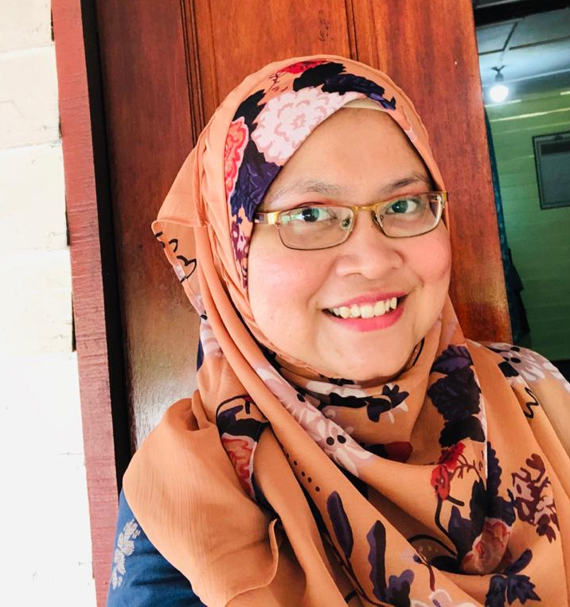
Your Title
Abstract
Results & Discussion
Author may follow the font size.
Introduction
Conclusion
Materials & Method
References
Corresponding Author:
Siti Khadijah is a Senior Lecturer in a Department of Multimedia, UPM. Her research interest lies on Computer Graphics, Physics-based Animation, Control System Engineering and Computer Vision.
Acknowledgement

