Slide 1
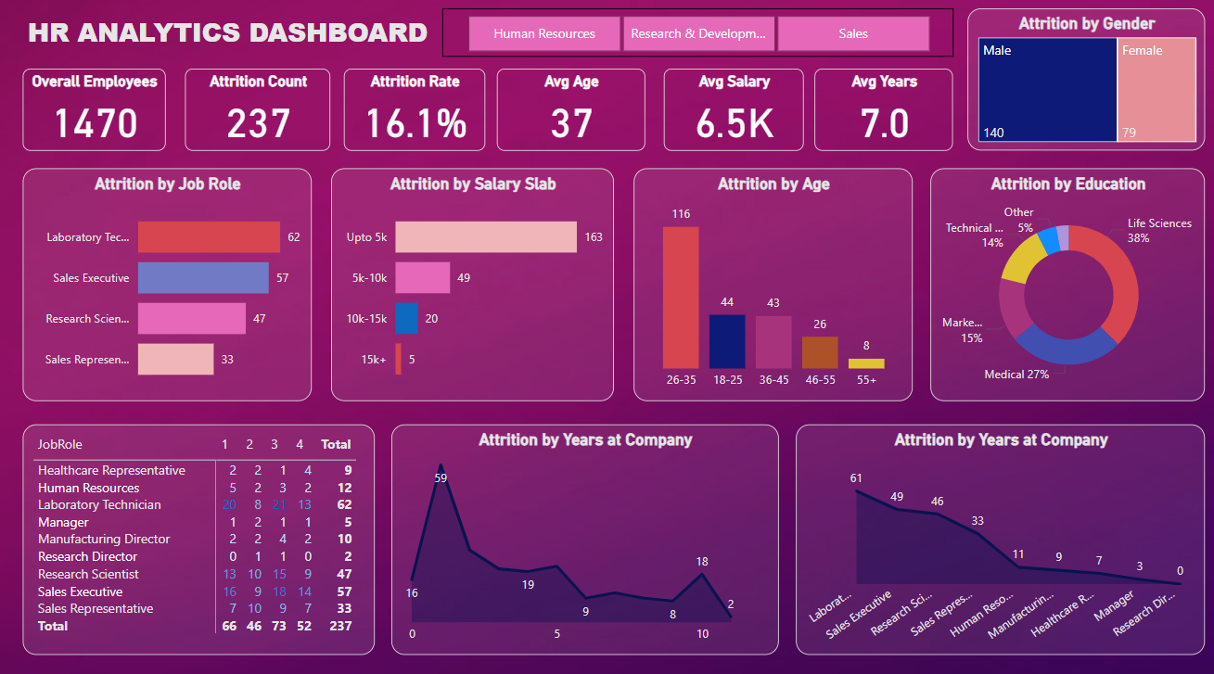

Slide 2
HR Analytics Dashboard By Sufiyan Zamindar 1. Introduction This project focuses on analyzing employee attrition data to uncover patterns and trends that can help an organization improve employee retention. Using IBM’s HR dataset, the dashboard visualizes key factors influencing attrition, such as job satisfaction, work-life balance, department, age group, and more. 2. Objective To build a dynamic Power BI dashboard and use Python for EDA to identify key drivers of employee attrition and recommend data-driven HR strategies

Slide 3
3. Dataset Description The dataset used is IBM’s HR Analytics dataset, which contains employee-level information such as: Age Department Education Gender Job Role Monthly Income Job Satisfaction Work-Life Balance Attrition status 4. Tools and Technologies Used
Power BI – For building interactive dashboards and data visualizations
Python – For data cleaning, preprocessing, and analysis
Libraries Used: Pandas, Seaborn, Matplotlib, Scikit-learn
Jupyter Notebook – For Exploratory Data Analysis (EDA)
Source File: IBM HR Analytics Dataset (CSV)

Slide 4
5. Dashboard Overview (Power BI) The Power BI dashboard was designed to visually communicate key trends and allow interactive filtering: 📌 Key Visuals: Attrition Rate by Department Job Role vs Attrition Monthly Income and Age Distribution Job Satisfaction Heatmap Slicers to filter by gender, department, education, etc. KPI cards showing average income, total attrition, and other high-level metrics. 6. Key Finding
Employees earning below average salary were more likely to quit.
Sales and Human Resources departments had higher attrition rates.

Slide 5
Job satisfaction and work-life balance are major contributors to attrition.
Younger employees with less experience are more vulnerable to leaving.
Gender showed minor influence compared to other factors.
7. Conclusion and Recommendations
Improve work-life balance through flexible work policies.
Address dissatisfaction in key departments, especially Sales.
Offer growth paths and competitive compensation to younger/new employees.
Regular feedback and engagement surveys to monitor employee sentiment.

