Slide 1
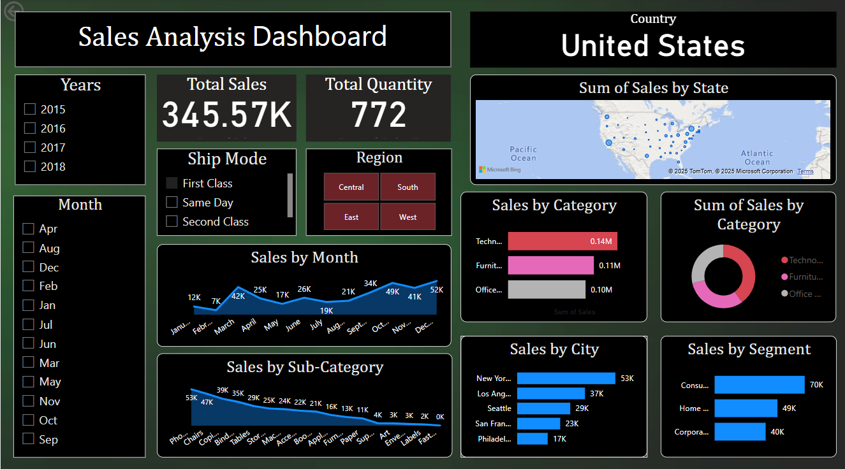

Slide 2
Title:
Simple Analysis of Market Sales Using Power BI
Objective:
To create an interactive dashboard that shows sales performance by product, region, and month using Power BI.
Tools Used:
Power BI (Dashboard creation)
Optional: Python + Pandas (for data cleaning)

Slide 3
Dataset:
File Name: T8_Sales_Data.csv
Columns: Order Date, Region, Category, Sales, Quantity, Sub-Category, Ship Mode, etc.
Steps Followed:
Imported the dataset into Power BI
Converted 'Order Date' to 'Month-Year' format
Added visuals: Line Chart, Bar Chart, Donut Chart
Applied slicers for filters (Year, Month, Region, Ship Mode)
Used color formatting to highlight high-performing segments
Wrote 3–4 key business insights

Slide 4
Key Insights:
📍 Total Sales: $345.57K
📦 Total Quantity Sold: 772 units
🗺 Top Region: West
🖥 Top Category: Technology
🗓 Peak Month: December
🏙 Top City: New York
👥 Top Segment: Consumer

