Slide 1
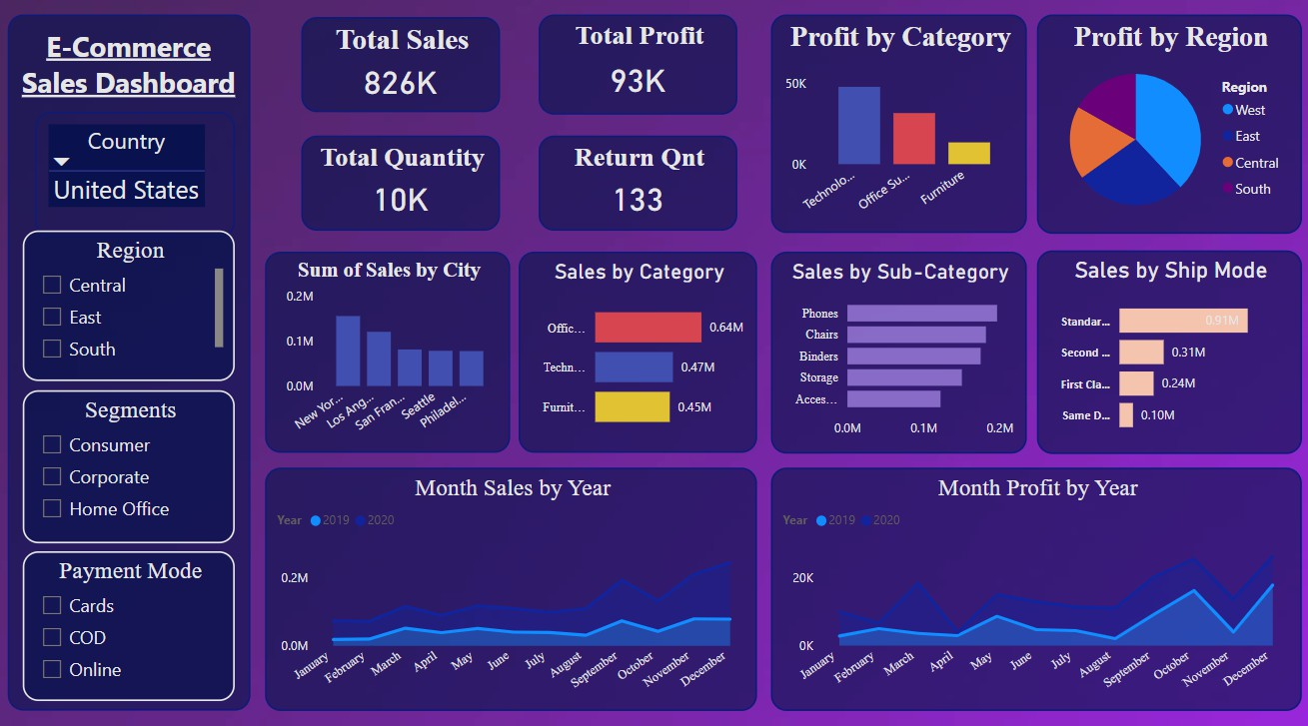
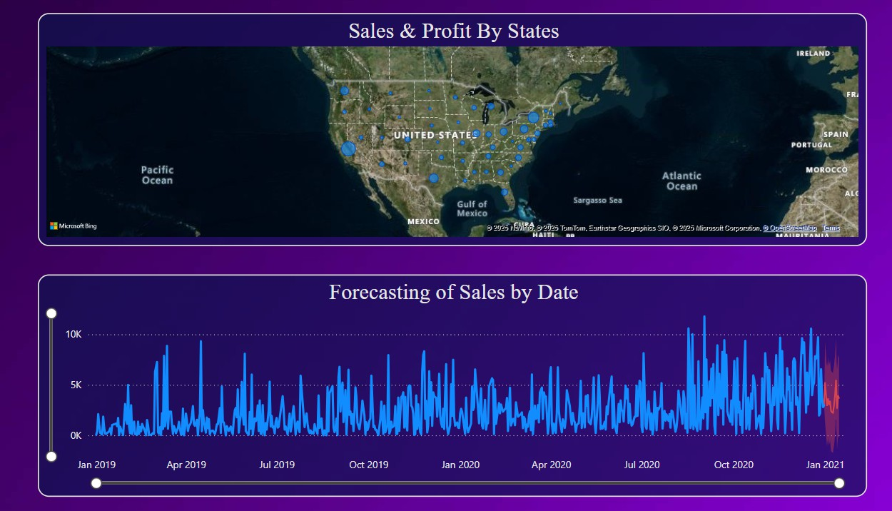
E-Commerce Sales Dashboard Report
Objective
The objective of this dashboard is to analyze e-commerce sales data to monitor key performance metrics such as total sales, profit, and quantity sold, while identifying trends, high-performing segments, and areas of

Slide 2
improvement.
Dataset Overview
Country Focus: United States
Categories: Technology, Office Supplies, Furniture Segments: Consumer, Corporate, Home Office Regions Covered: East, West, Central, South
Key Fields: Sales, Profit, Quantity, Return Quantity, Shipping Mode, Payment Mode, City
Key Performance Indicators (KPIs)
Total Sales: 826K Total Profit: 93K
Total Quantity Sold: 10K Return Quantity: 133
Visuals Information
Profit by Category: Bar chart showing profits across major categories.
Profit by Region: Pie chart illustrating regional profit contribution.
Sum of Sales by City: Bar chart of top cities by sales volume.
Sales by Category and Sub-Category: Horizontal bar charts for detailed product sales.
Sales by Ship Mode: Horizontal bar chart comparing different shipping methods.
Monthly Sales by Year: Line chart tracking monthly sales over 2019 and 2020.
Monthly Profit by Year: Line chart showing monthly profit trends across two years. Sales & Profit by States: Map visualization.
Forecasting of Sales by Date: Line chart showing future trend projection.
Key Focuses
Regional sales and profitability distribution.
Top-performing product categories and sub-categories.
Impact of shipping modes on overall sales.

Slide 3
E-Commerce Sales Dashboard Report
Sales and profit trends across months and years.
Business Insights
Top Categories: Office Supplies led in sales followed by Technology and Furniture.
Regional Profitability: The West region contributed the highest profit share.
City Sales: New York and Los Angeles were among the top cities by sales volume.
Shipping Preference: Standard Class shipping had the highest sales volume.
Seasonality: Sales and profits peaked during the year-end months (November-December).
Recommendations
Focus more marketing efforts in the West region to maximize profits.
Leverage Standard Class shipping promotions as it drives the majority of sales.
Stock and promote Office Supplies aggressively given their high performance.
Develop targeted strategies for underperforming cities and regions.
Monitor return quantities closely to minimize post-sale losses.

