Slide 1


SMART INDIA HACKATHON 2026
AlertX
Problem Statement ID – 10
Problem Statement Title- AI-Based Rockfall Prediction and Alert System for Open-Pit Mines
Theme- Disaster Management
PS Category- Software
Team ID-
Team Name - AlertX

Slide 2
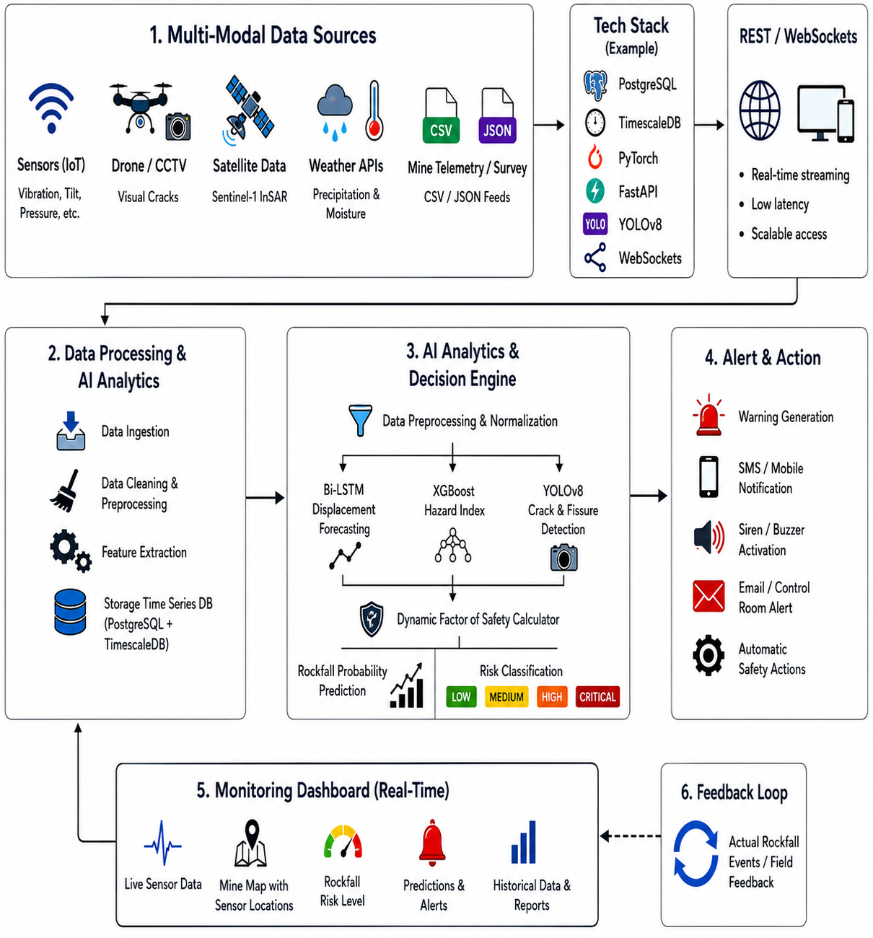
AlertX
Proposed Solution
Multi-Modal Data Ingestion Engine: Aggregates satellite radar (Sentinel-1 InSAR for millimeter-level ground displacement), public meteorological APIs (precipitation, temperature, storm forecasts), and geotechnical mine topography data via REST & WebSockets.
Hybrid AI/ML Predictive Analytics Core: Employs Bi-LSTM neural networks for time-series slope movement forecasting alongside XGBoost for dynamic Factor of Safety (FoS) and Rockfall Hazard Index (RHI) scoring.
Computer Vision Surface Crack Detector: Analyzes mine drone surveys and optical CCTV streams using YOLOv8 to identify fresh rock fractures, tensile fissures, and surface spalling before major collapses occur.
Interactive 3D Geospatial Digital Twin: Renders the open-pit benches in real-time with color-coded safety heatmaps (Green = Stable, Yellow = Watch, Red = Danger Zone) powered by Three.js/MapLibre.
Automated Decision Support & Alert Dispatcher (DSS): Triggers sub-second multi-channel alerts (SMS, WhatsApp, sirens, browser push) and recommends operational actions (e.g., haul truck rerouting, bench evacuation).

Slide 3
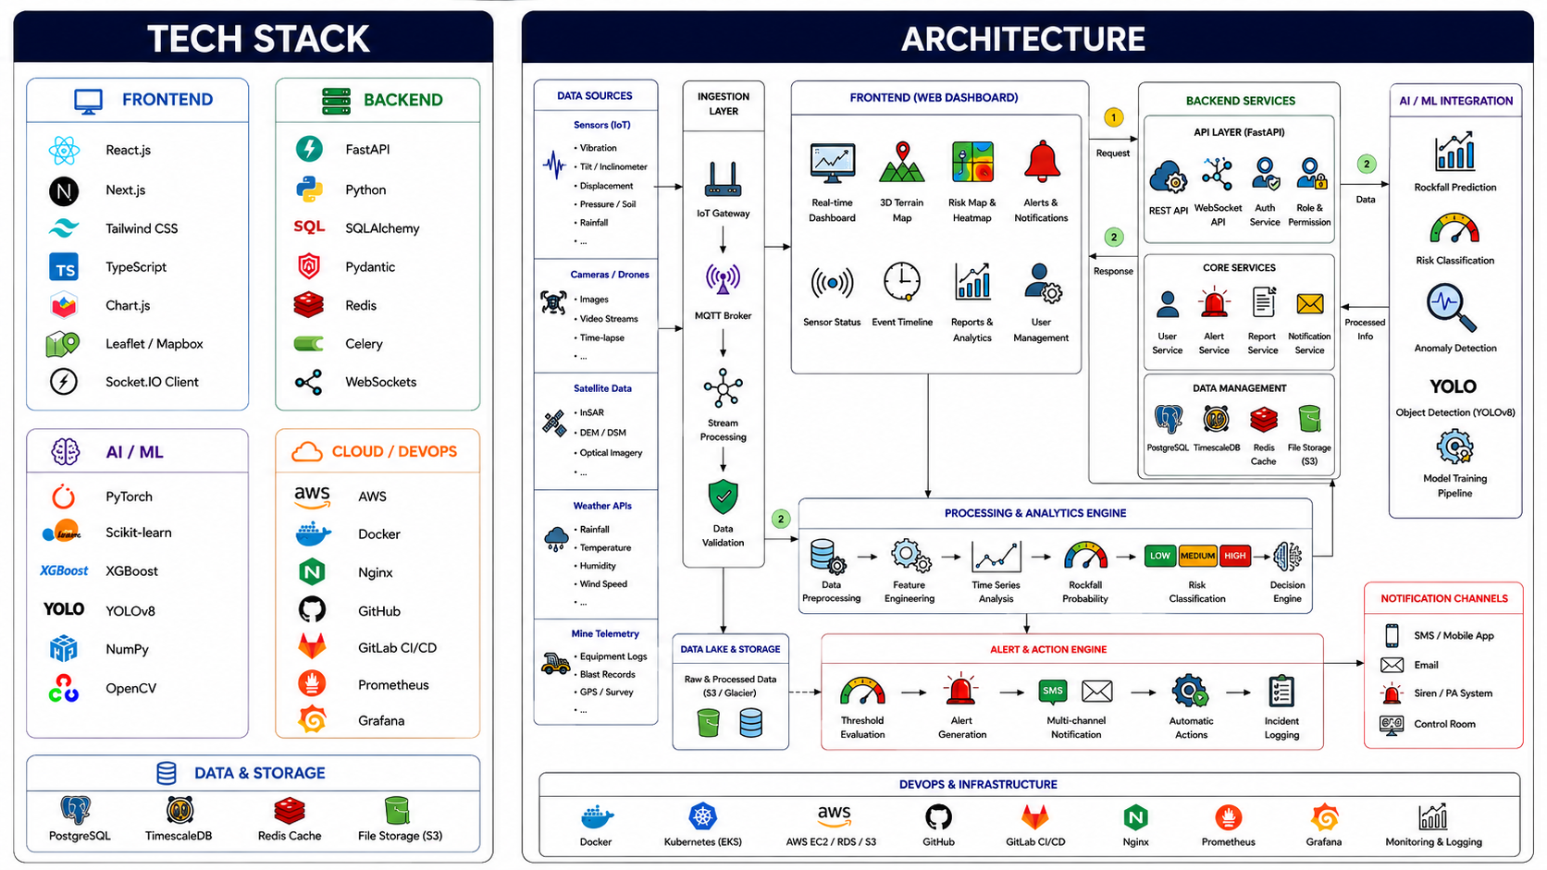
TECHNICAL APPROACH
AlertX

Slide 4
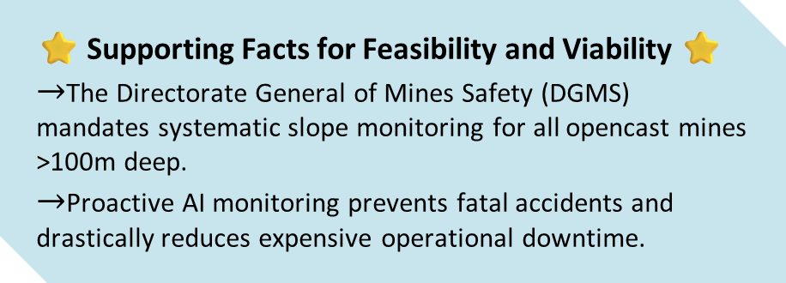
FEASIBILITY AND VIABILITY
AlertX
⚖️ Feasibility
Technical: no custom hardware.
Modular: Microservices allow independent AI, dashboard & alert modules.
Market: Strong demand due to DGMS safety requirements.
Economic: Low-cost using existing mine cameras + free satellite data.
🛡️ Solutions
Edge Processing: Local networks + offline caching.
Vibration Filtering: AI detects and ignores blast vibrations.
API Wrappers: Convert legacy sensor data for easy
integration.
👨‍💻 Use Cases
Safety Officers: Monitor cracks & risk zones in 3D.
Shift In-Charge: Reroute trucks from high-risk areas.
Pit Workers: Get instant alerts before collapses.
💰 Viability & Business Potential
B2B SaaS: Tiered subscriptions based on pits & data frequency.
Large Market: Scalable across global open-pit mines.
Cost Savings: Reduces equipment damage & downtime.
Compliance: Digital audit trails simplify safety inspections.
⭐ Supporting Facts for Feasibility and Viability ⭐
$→$The Directorate General of Mines Safety (DGMS) mandates systematic slope monitoring for all opencast mines >100m deep.
$→$Proactive AI monitoring prevents fatal accidents and drastically reduces expensive operational downtime.
🚧 Challenges
Connectivity: Poor network coverage in remote mine areas.
False Alarms: Blasting vibrations may trigger unnecessary alerts.
Data Integration: Legacy sensor data may be difficult to integrate.

Slide 5
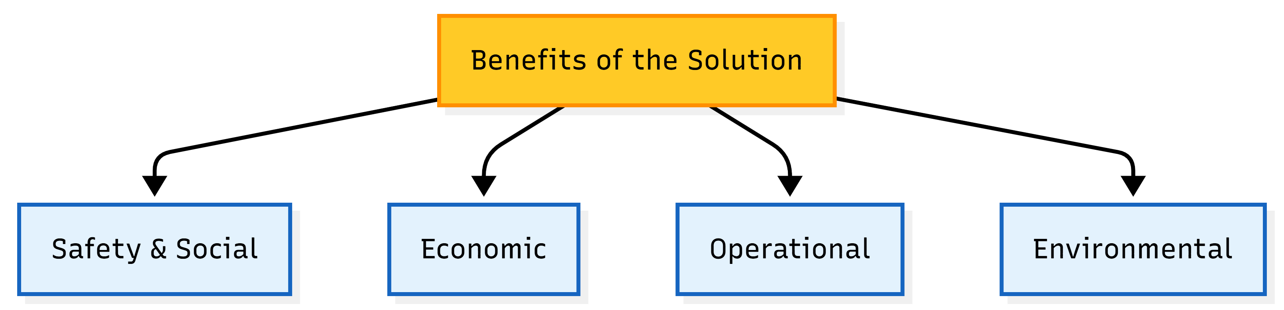
IMPACT AND BENEFITS
AlertX
Benefits of the solution
🛡️ Safety & Social
Zero-Fatality: Early warnings enable timely evacuation.
Worker Confidence: 24/7 monitoring ensures a safer workplace.
💰 Economic
Cost Savings: Prevents costly landslide response, cleanup & downtime.
Lower Insurance: Automated compliance may reduce insurance premiums.
⚙️ Operational & Technological
24/7 All-Weather: Radar & satellite monitoring works through rain and fog.
Digital Transformation: Brings AI, IoT & remote sensing to mining.
🌱 Environmental
Ecosystem Protection: Prevents slope failures and habitat damage.
Lower Carbon Footprint: Optimized slopes reduce waste hauling & diesel emissions.
🦺
💰
⚙️
🌍
Potential impact on the target audience:
Boosted Production: AI monitoring can cut downtime by 30%+.
Fatality Prevention: Early warnings aim to reduce slope-related fatalities to zero.
Cost Optimization: Optimized slopes can reduce waste stripping costs by 10–20%.
Asset Protection: Prevents equipment damage, saving millions per haul truck

Slide 6
RESEARCH AND REFERENCES
AlertX
❖ References
❖ Comparison with Existing Systems
Industry Platforms:
➤ GroundProbe: https://www.groundprobe.com/
➤ IDS GeoRadar: https://idsgeoradar.com/
➤ Hexagon Mining: https://hexagon.com/
Research & Best Practices:
➤ IEEE Xplore – Ground-Based SAR for Slope Monitoring: https://ieeexplore.ieee.org/document/10047045
➤ IEEE Xplore – SAR/InSAR Mining Deformation: https://ieeexplore.ieee.org/document/8977523
➤ Scientific Reports – ML for Slope Failure Prediction: https://www.nature.com/articles/s41598-020-66904-y
➤ Scientific Reports – Deep Learning for Slope Stability: https://www.nature.com/articles/s41598-023-38896-y
Feasibility Facts:
➤ MDPI Open-Pit AI Study
➤ DGMS Safety Reports
Feature | Geoshield(ours) | Existing Systems
Wide-Area 3D Monitoring | ✅ | Limited
AI Prediction | ✅ | ❌
Crack Detection | ✅ | Limited
Automated Alerts & Route Support | ✅ | ❌
Low Deployment Cost | ✅ | ❌
💻 Live Demo :
SIH 2026 • AI Rockfall Early Warning System

