Slide 1
Frito Lay Case study
Sufiyan Mohammed
DDS Analytics

Slide 2
Contents
Introduction
Attrition
Factors for Attrition
Naïve Bayes Model
Monthly Income
Factors for Monthly Income
Linear Regression Model

Slide 3
Introduction
DDS Analytics is a talent management consultant
6 years of experience
Over 15 Fortune 500 companies serviced
Data Science based results
Frito Lay has been having recent struggles with employee retainment
Predictive analysis on preventing employee turnover

Slide 4
DataSet
35 variables
1 response variable (Attrition)
140 yes vs 730 No (16%)
Exluded: (ID, Employee Number, Employee Count, Over 18, Standard Hours)

Slide 5
Attrition
Natural process by which employees leave the workforce
Why do people leave?
Aim for a low rate
Reduction in new trainings
Higher employee satisfaction

Slide 6
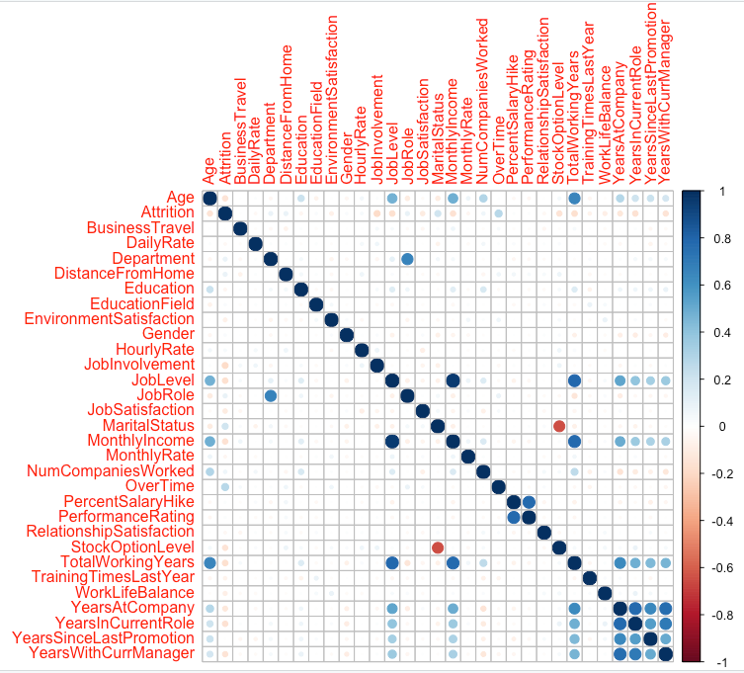
Correlation

Slide 7

Factors leading to attrition
Overtime
Distance from Home
Age

Slide 8
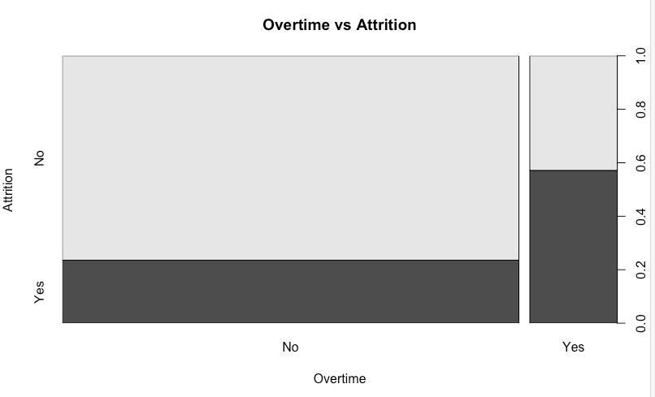
Overtime

Slide 9
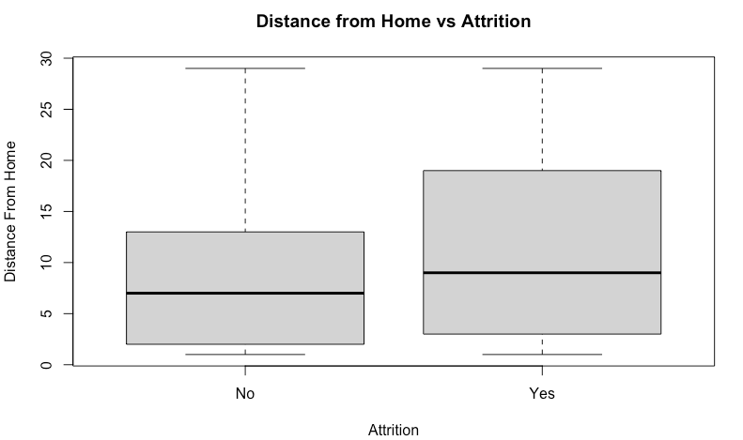
Distance from home
As Distance from Home Increases, Attrition increases

Slide 10
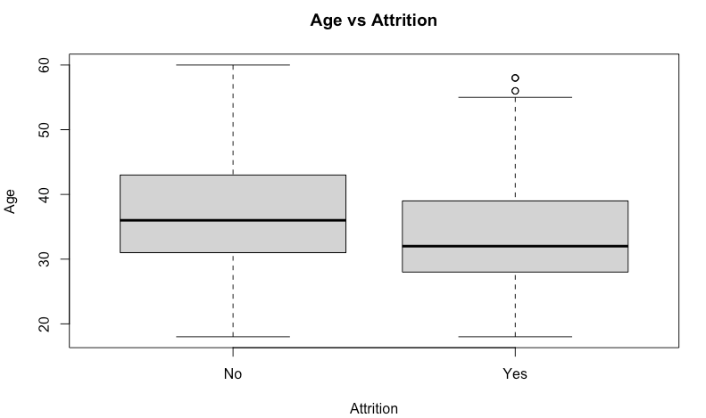
age
As Age Increases, Attrition Decreases

Slide 11
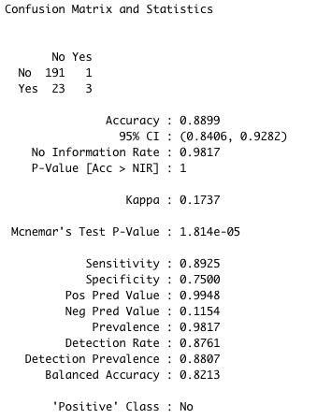
Naïve Bayes Model
Factors of Age, Overtime, Distance from Home

Slide 12

Predicting salaries

Slide 13
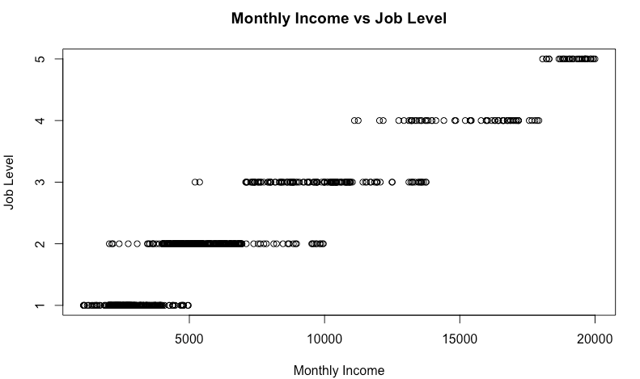
Job Level

Slide 14
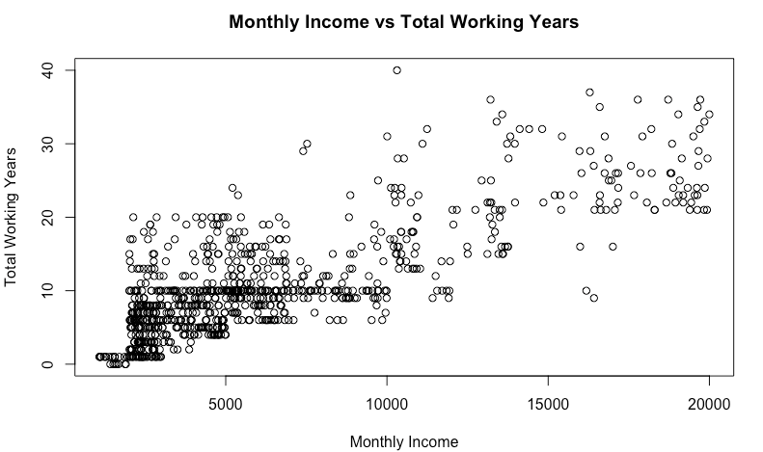
Total Working Years

Slide 15
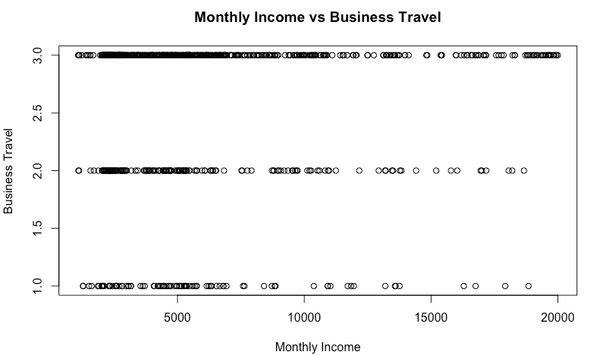
Business Travel

Slide 16
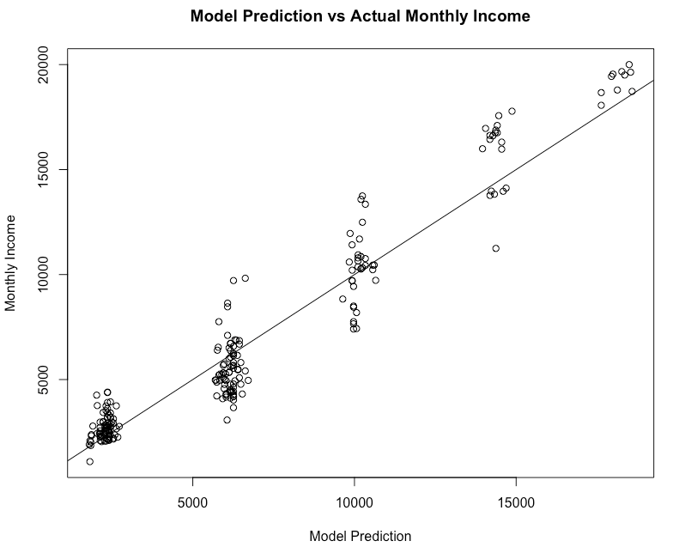
Linear Regression Model RMSE of $1315.06

Slide 17
Concluding Remarks
Work from home can be used to combat work distance
Increase Overtime
Better Promotion options and focus on tenured/key employees

Slide 18
Github
Link will be sent to you company emails shortly

