Slide 1
Atliq Hardware
Power BI Sales Insights

Slide 2
TABLE OF CONTENT
Problem Statement.
2. Customer Sales & Revenue Insights & key metrics.
3. Performance Insights.

Slide 3
PROBLEM STATEMENT
To analyze sales, revenue, and profit margin performance across regions, customer types, and time periods. Challenges include identifying high- and low-performing areas, optimizing revenue by customer type, and addressing profit gaps in underperforming cities like Bengaluru. Insights will guide strategies to enhance growth and profitability.

Slide 4
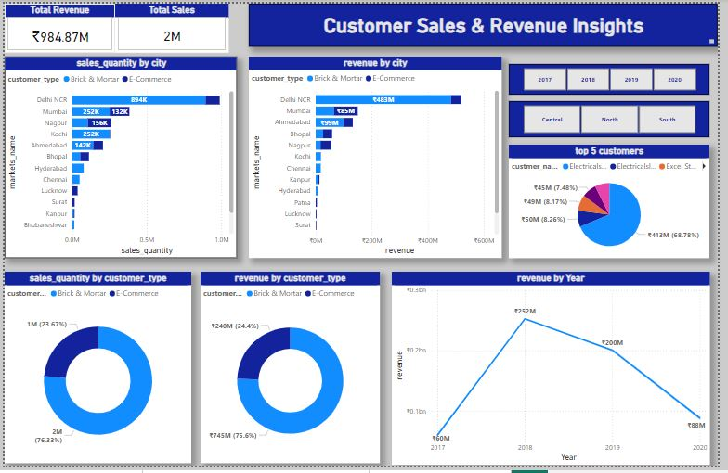
CUSTOMERS SALES & REVENUE INSIGHTS

Slide 5
Key Metrics Overview
Total Revenue:
₹984.87M
Total Sales:
2M units
Sales Quantity by City:
Delhi NCR: 988K units (highest orders).
Mumbai: 384K units.
Nagpur: 262K units.
Bangluro: 413 units. (lowest orders).
Remaining cities have smaller contributions ranging between 6K–255K units.
Revenue by City:
Delhi NCR: ₹519570K (highest revenue).
Mumbai: ₹150085K.
Ahmedabad: ₹132307K.
Bengluru: ₹373K. (lowest revenue).
Other cities contribute less than ₹58610K.
Sales Quantity by Customer Type:
Brick & Mortar: 2M (76.3%).
E-Commerce: 1M (23.7%).
Revenue by Customer Type:
Brick & Mortar: ₹745M (75.6%).
E-Commerce: ₹240M (24.4%).
Top 5 Customers:
Top Contributor: Electrical Sara Store ₹413M (68.78%).
The remaining four contribute a combined 31.22%.
Revenue by Quarter:
Q1: ₹173M (highest).
Q2: ₹145M.
Q3: ₹122M (lowest).
Q4: ₹163M.

Slide 6
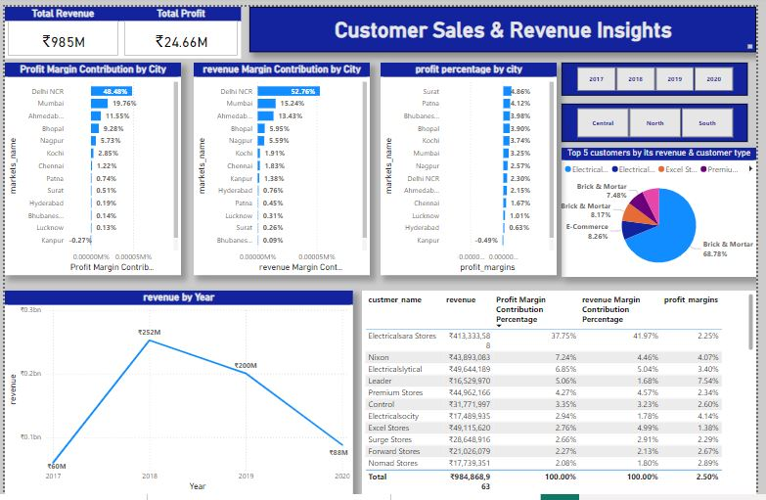
CUSTOMERS SALES & REVENUE INSIGHTS

Slide 7
Key Metrics Overview
Total Revenue:
₹984.87M
Total Profit:
24.66M
Profit Margin Contribution by City:
Delhi NCR: 48.45% (highest contributor).
Mumbai: 19.76%.
Ahmedabad: 11.55%.
Cities like Bangluro and Kanpur show negative contributions, such as Kanpur (-0.27%).
Revenue Margin Contribution by City:
Delhi NCR: 52.76% (dominates revenue margin).
Mumbai: 15.24%.
Ahmedabad: 13.43%.
Profit Percentage by City:
Surat: Highest profit percentage at 4.86%.
Patna: 4.12%.
Cities like Kanpur and Bangaluru show a negative profit percentage.

Slide 8
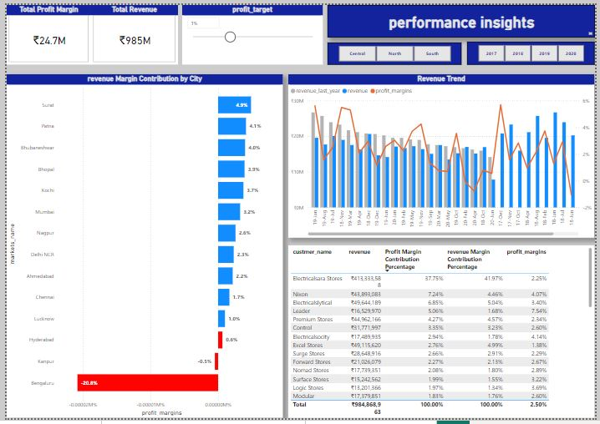
PERFORMANCE INSIGHTS

