Slide 1

Empowering Tomorrow, One Robot at a Time."

Slide 2

CONTENTS
Contents Introduction: ........................................................................................................................................ 3 I-Components of the Robot ...................................................................................................................... 4 A - Motor ............................................................................................................................................ 4 B – Driver ........................................................................................................................................... 5 C – Arduino card ................................................................................................................................. 6 D - Camera used for detection ............................................................................................................. 7 E - . Connection ................................................................................................................................... 7 II - Working of the Robot ........................................................................................................................ 8 Working .............................................................................................................................................. 8 Direction: ............................................................................................................................................ 9 Enable: ................................................................................................................................................ 9 Pulse: ................................................................................................................................................ 10 Speed ................................................................................................................................................. 10 The orientation of the robot with respect to the starting position: ......................................................... 11

Slide 3
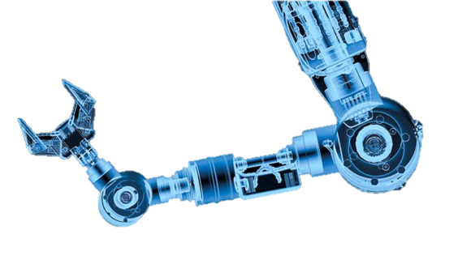
COMPONENT OF ROBOPTICS MOTOR
The M4 42 051 bipolar motor with permanent magnetism is used. The M4 42 051 motor works with at least two spools. It functions in a step by step manner, i.e. with each pulse, it rotates by an angle of 1.8 degrees. We can use a maximum of 4 different steps. Step 1 : A rotation of 1.8 degrees Step 2 : Dividing the rotation by 2 thus obtaining a rotation of 0.9 degrees Step 3 : Dividing the rotation by 4 thus obtaining a rotation of 0.45 degrees Step 4 : Dividing the rotation by 8 thus obtaining a rotation of 0.225 degrees thus with each reduction in the degree of rotation, we increase the precision but reduce the speed by the times the degree of rotation was reduced. The motor needs to a current of 0,6 ampere and 7 ohm resistance

Slide 4
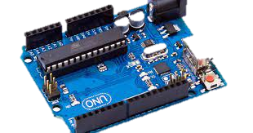
Arduino card
As the Arduino card is easily programmed it is the most viable option. It has an area of 38,5 cm² a of thickness of 1.5cm and is equipped with a micro controller Atmel AVR of 8bits. A micro controller allows the card to carry out different instructions and also has an internal memory. It's an integrated circuit which gathers the essential elements of a computer. It is connected to the computer with the help of a USB connection and needs an external power source. The various software characteristics of the card are: 1. A Code Editor 2. A Compile function 3. A debug and run file function. 4. A simplified language and good bibliographies which improve the capacity of the

Slide 5
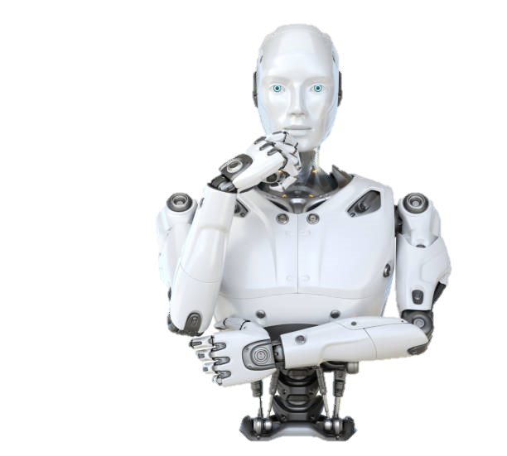
Three laws of robotics
safety and well-being of humans and the environment.
Ethical Behavior: Robots must act in accordance with ethical guidelines, ensuring fairness, transparency, and respect
for privacy in all interactions and operations.
Continuous Improvement: Strive for ongoing advancements in technology and knowledge to enhance the capabilities,
efficiency, and reliability of robotic systems.

Slide 6
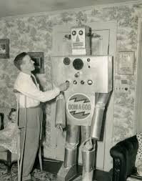
FIRST ROBOT
The term "robot" was first used by Czech writer Karel Čapek in his 1920 play "R.U.R. (Rossum's Universal Robots)." However, the first real robots—mechanical devices designed to perform tasks—emerged in the 20th century. Here are a few notable early examples:
Unimate: Developed in the 1950s by George Devol and Joseph Engelberger, the Unimate was the first industrial robot. It was used in a General Motors assembly line to perform tasks such as welding and handling parts. It marked the beginning of automation in manufacturing.
Shakey the Robot: Created in the late 1960s at the Stanford Research Institute, Shakey was one of the first robots to combine perception, planning, and action. It was an early example of artificial intelligence in robotics.
WABOT-1: Built in 1973 by Waseda University in Japan, WABOT-1 is often cited as the first full-scale humanoid robot. It could walk, grasp objects, and even communicate using simple Japanese phrases.
These early robots laid the foundation for the sophisticated robots we use today, from industrial machines to advanced AI-driven systems.

Slide 7
ROBOTICS TECHNOLOGY
Robotics technology involves the design, construction, operation, and use of robots. It encompasses a variety of disciplines, including mechanical engineering, electrical engineering, computer science, and more. Here are some key aspects:
Types of Robots:
Industrial Robots: Used in manufacturing and production processes, like assembly lines and welding.
Service Robots: Designed for tasks outside of industrial settings, such as home cleaning robots or medical robots.
Exploration Robots: Used in environments that are difficult for humans to access, like Mars rovers or underwater drones.

