Slide 1
Assignment 3 - Sentiment Analysis of Canadian Election 2019 data
MIE1624 - Introduction to Data Science & Analytics
Sugumar Prabhakaran (id: 994126815)
29 Mar 2021

Slide 2
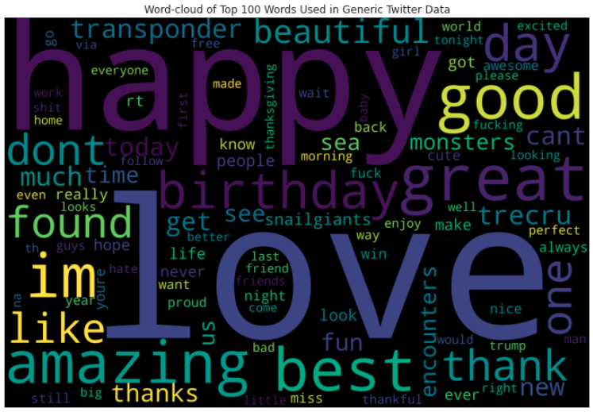
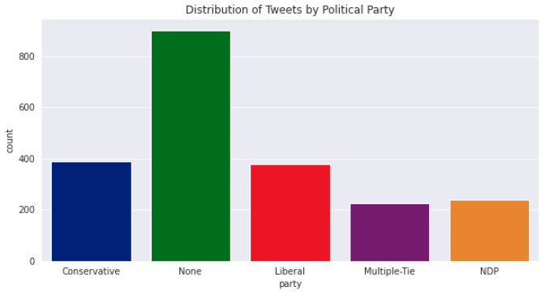
Exploratory Data Analysis
Tweet Party Affiliation: My procedure to predict party works by counting # of words in a tweet that belong to each party. The tweet belongs to the party with the highest count. The above graph shows the resulting distribution of this procedure.
Word-Cloud: This image depicts the top 100 words with highest word count in the sentiment analysis data.

Slide 3
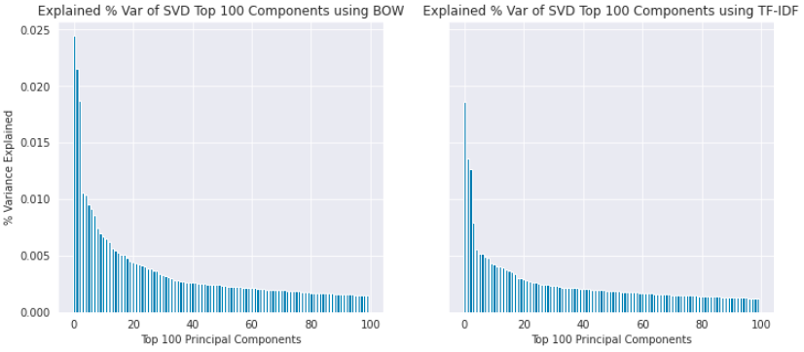
First Model Feature Importance
Feature Importance: After vectorizing with bag-of-words (BOW) or TF-IDF, we obtain 4700+ features, which made computation challenging. Using sklearn TruncatedSVD(), I reduced the # of principal components to 100, while retaining a significant % of the overall variance: BOW: 37%, TF-IDF: 26%. The plot shows the % of variance from each of the top 100 components in order of importance.

Slide 4
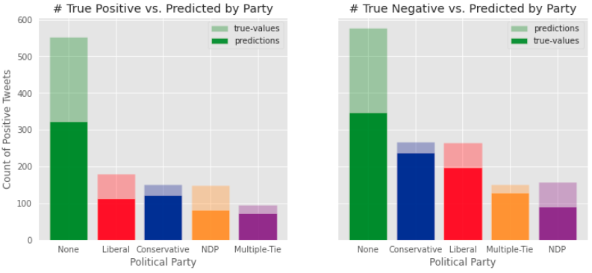
First Model Results: Predict Canadian Election Sentiment
Best Model Results (training: 94%, test: 53%): These results were obtained using Random Forest.

Slide 5
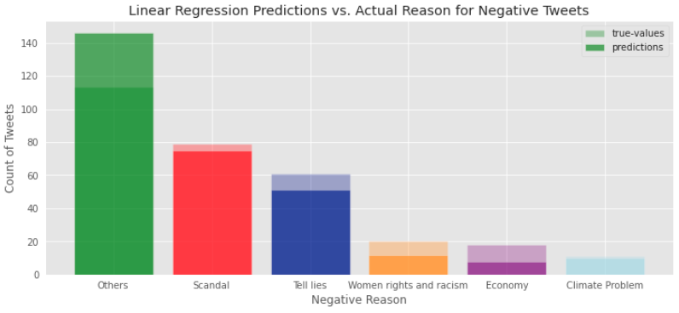
2nd Model Results: Predict Negative Reasons
Best Model Results (training: 57%, test: 58%): These results were obtained using Logistics Regression.

