Slide 1
IDENTIFICATION OF FAKE DRIVING LICENSES AND VEHICLE SMUGGLERS THROUGH BLOCKCHAIN PROTOCOL by Vijay Sugali

Slide 2
OVERVIEW
Abstract
Introduction
Identification of problem
Pre-Analysis
Methods
Tasks
Working description
Result
Future work
References

Slide 3
ABSTRACT
Centralized databases are vulnerable.
If the authority is centralized, tampering of the data takes place in some conditions.
If the authority is decentralized, non – tamperable permanent ledger protects the data.
Blockchain technology is suitable for establishing decentralized network.
We had chosen one of the problems of government organizations which uses centralized servers to solve.

Slide 4
INTRODUCTION
About Blockchain Technology
Decentralized server
Distributed network
Permanent ledger
Two-way encryption
Smart contracts
Cryptography
Hashing techniques
Digital signatures
RSA and SHA256 hashing algorithms

Slide 5
INTRODUCTION continued
How relevant the technology is for practical field?
Ethereum Blockchain
Main network
Test networks
Ropsten test network
Rinkeby test network
Koven test network
Decentralized applications
Solidity programming language
Remix – ide

Slide 6
INTRODUCTION continued
Importance of Blockchain technology
Industry flows
Asset management
Smart contracts
Identity management
Eligibility for social tariffs
Safety authorizations and permit to work
Fraud detection
Loyalty schemes

Slide 7
IDENTIFICATION OF PROBLEM
Basic background of the problem
Creating fake identity cards
Driving licenses
PAN cards
Voter cards
Consequences of such problems
Fake passports
Bank loans
Smuggling of luxury vehicles

Slide 8
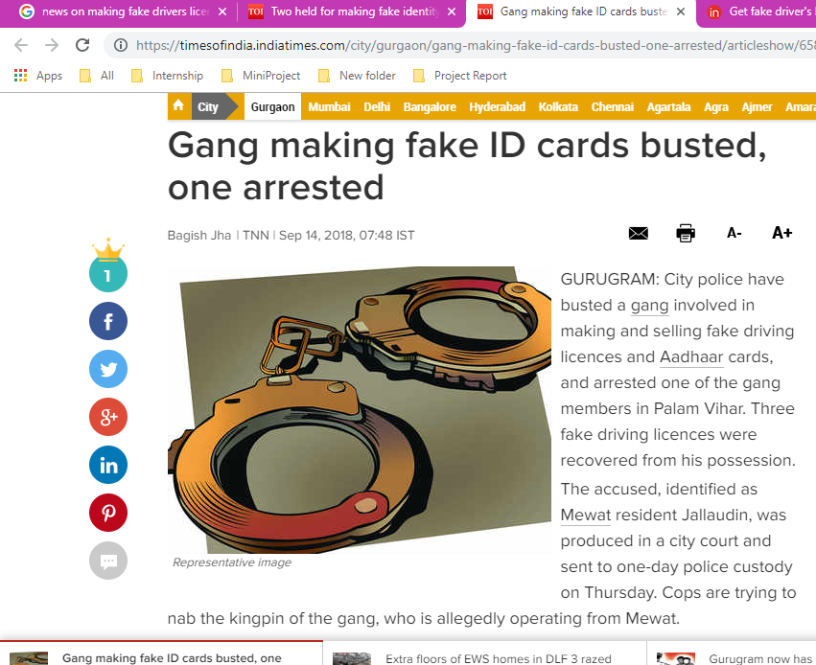
IDENTIFICATION OF PROBLEM continued
Click image to get into original site
Fig. 1: News of Times of India showing Gang arrested in making fake ID Cards

Slide 9
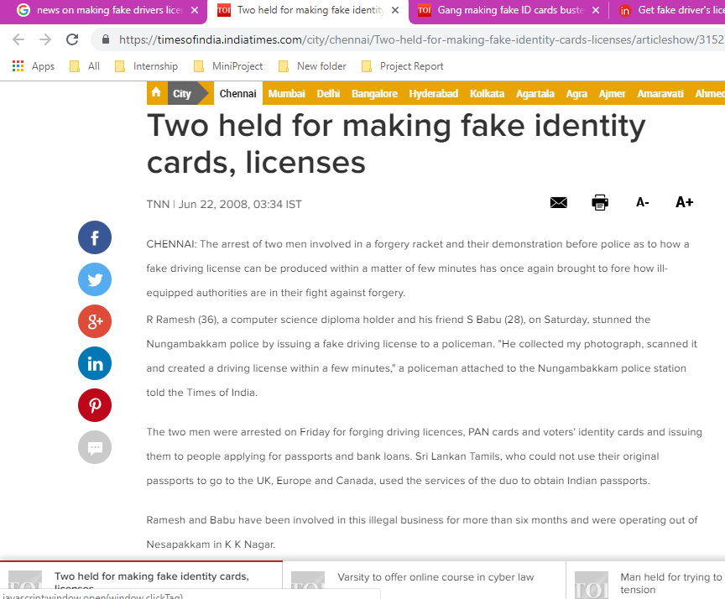
IDENTIFICATION OF PROBLEM continued
Click image to get into original site
Fig. 2: News on Times of India showing two members caught on making fake identity cards

Slide 10
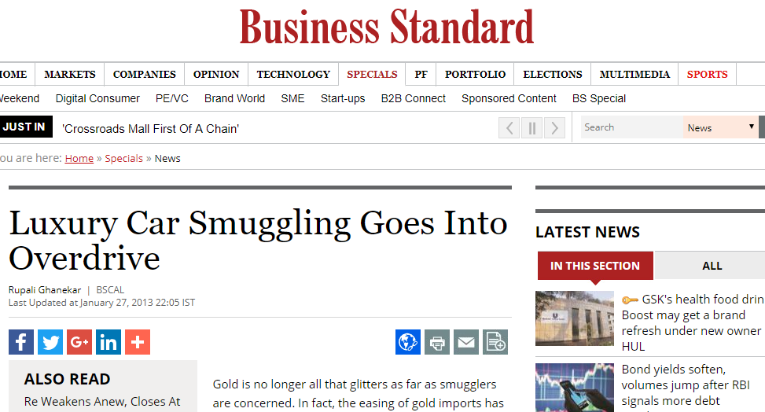
IDENTIFICATION OF PROBLEM continued
Click image to get into original site
Fig. 3: News showing that smuggling luxury vehicles become trend now overwhelming gold

Slide 11
IDENTIFICATION OF PROBLEM continued
Definition of the problem:
From the above studies, we considered the problem of fake driving license cards and identification of smuggled vehicles. The flaws and vulnerable methods using to maintain the data which are there in the existing system are considered as a problem statement.
Whereas we are taking less secured examples like driving licenses but not highly secured systems such as aadhar.

Slide 12
PRE – ANALYSIS
Structure of existing system
Forgery
Giving bribes or frightened to modify details for fake identities
There is no trustful data of vehicles
Sources of data storage used in existing system
Meeseva portal uses SQL server, view here.
RTO portal uses Tomcat application server, view here.

Slide 13
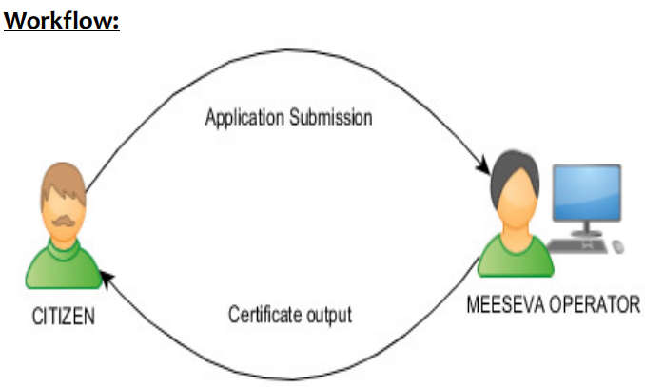
PRE – ANALYSIS continued
Accessibility and permissions
Fig. 4: Data accessibility in Meeseva portal

Slide 14
PRE – ANALYSIS continued
RTO portal authorization to control driving license data:
Road transport office receives the request from Meeseva operator.
Respective officer checks and approves or disapproves
Loop holes in above discussed existing systems:
Meeseva operator can enter the fake details in support of the applicant.
RTO or officers who approve the original documents of application can change in favor of the applicant in their respective databases.

Slide 15
PRE – ANALYSIS continued
Suitable solutions:
Maintaining a permanent ledger
Creating a decentralized authorization
Building trust factor
Using encryption techniques
Distributed network
Collaborating with governmental bodies

Slide 16
METHODS
Creation of decentralized eco-system
Deploying smart contracts in Blockchain
Head Governing Body
Road Transport Authority
Imports & Exports department
Traffic management department
Aadhar department
Fig. 5: Formation of decentralized governing bodies

Slide 17
TASKS
Write a smart contract to achieve the above-mentioned method in solidity programming language.
Choose a Blockchain network to deploy smart contract.
Get a Metamask wallet to make use of chosen Blockchain network.
Create sample accounts and request for ethers in Faucet if network is test network.
Deploy the contract.
Form governing bodies.
Create users and enter sample vehicles data.
Verify and validate smart contract in Etherscan.io.
Connect Etherscan.io with Metamask and check for execution of the smart contract.
Test the smart contract using Truffle and Ganache-cli.
Prepare a Decentralized application for user friendly application if needed.

Slide 18
WORKING DESCRIPTION
Softwares, tools and dependencies used:
Node.js,
Microsoft Visual Studio dependencies,
Solidity Compiler,
Visual Studio Code,
Remix ide,
Metamask chrome extension,
Ganache-cli,
Truffle.

Slide 19
WORKING DESCRIPTION continued
Technologies involved:
Blockchain fundamentals,
Solidity, contract-oriented programming language,
Web3.js,
JavaScript,
Dapps, Decentralized applications.
Smart contract details:
Blockchain network: Ropsten test network,
Contract hash: 0xf1fca2a9eb9202351d5aa8b5b7da12306ba6be2a,
Source code: click here or explore Etherscan.io

Slide 20
RESULT
Successfully smart contract is created, deployed and verified. The whole implementation is done to solve the identified problem statement. By this, we get the details of every citizen who owns vehicles along with their vehicles data.

Slide 21
INTERPRETATION OF RESULT
The data we have is used to sell for governments or other authorized organizations.
The tax payment is achieved accurately.
No fraudulent activities are entertained with driving license cards.
No smuggled vehicles are imported.
The country economy rate increases slightly by adopting this system.

Slide 22
FUTURE WORK
We can even create a better user-friendly application by creating Dapp. Unlike the benefits to government, private organizations can also make use of this Blockchain technology. The companies of Cab services like Uber, Ola and other private taxi services can adopt this technology for its permanent ledger feature and it’s distributed nature. One of the applications is that live tracking the vehicles location with perfect timestamp.

Slide 23
REFERENCES
Satoshi Nakamoto, Bitcoin: A peer-to-peer electronic cash system, a white paper in 2008.
Edureka, https://www.edureka.co/blockchain-training?gclid=EAIaIQobChMIupS5ztSN3wIVVg4rCh1UAgk8EAAYASAAEgJ18_D_BwE, online certification course taken in 2017.
Times of India, https://timesofindia.indiatimes.com/city/gurgaon/gang-making-fake-id-cards-busted-one-arrested/articleshow/65801892.cms, online news sited in 2018.
Times of India, https://timesofindia.indiatimes.com/city/chennai/Two-held-for-making-fake-identity-cards-licenses/articleshow/3152797.cms, online news sited in 2008.
Business standard, https://www.business-standard.com/article/specials/luxury-car-smuggling-goes-into-overdrive-197111501025_1.html, online news sited in 2013.
National Informatics Centre, Government of India, http://apps.nic.in/apps/government/mee-seva-rapid-roll-out.
National Informatics Centre, Government of India, http://apps.nic.in/apps/government/vahan.
Meeseva Handbook, Government of Andhra Pradesh, https://ap.meeseva.gov.in/DeptPortal/Downloads/Mee%20Seva%20Hand%20book%20Final.pdf.
Citizen Charter, Government of Andhra Pradesh, http://www.aptransport.org/html/pdf/citizen-charter-transport-2013.pdf.
Solidity Open Source, https://solidity.readthedocs.io/en/v0.4.25/.

Slide 24
REFERENCES continued
Ethereum Community, https://readthedocs.org/projects/ethereum-homestead/.
Dapps, Ethereum community, http://ethdocs.org/en/latest/contracts-and-transactions/developer-tools.html.
Truffle framework, https://truffleframework.com/.
Gavin Wood, Ethereum yellow paper, https://ethereum.github.io/yellowpaper/paper.pdf sited in 2018.
Ethereum Community, Remix browser, https://remix.readthedocs.io/en/latest/.
Etherscan, https://etherscan.io/.
Metamask, https://metamask.io/.
Web3.js, Open docs, https://web3js.readthedocs.io/en/1.0/.
Coursera Buffalo University, Specialization on Blockchain, https://www.coursera.org/specializations/blockchain, taken in 2018.
New Zealand Transport Agency, https://vehicleinspection.nzta.govt.nz/virms/entry-certification/pre-reg-and-vin/vehicle-attributes/recording-vehicle-attributes, sited in 2013.
Post capes, https://www.postscapes.com/blockchains-and-the-internet-of-things/.
Xalentis, https://gideonvos.wordpress.com/2017/12/20/gps-iot-blockchain-integration-to-erp/.

Slide 25
THANK YOU

