Slide 1
previousSibling
The previousSibling property returns the previous node on the same tree level.
The previousSibling property returns a node object.
The previousSibling property is read-only.

Slide 2
HTML
<body>
<h1>Element Traversal</h1>
<h3>Previous Sibling Property</h3>
<ul>
<li id="first">Apple (First Item)</li>
<li id="second">Banana (Second Item)</li>
</ul>
<p>The HTML content of the previous sibling of the second list item is:</p>
<script src="index.js"></script>
</body>

Slide 3
JS
let text = document.getElementById("second").previousSibling.previousSibling.innerHTML;
console.log(text);
console.dir(text);
document.write(text);

Slide 4
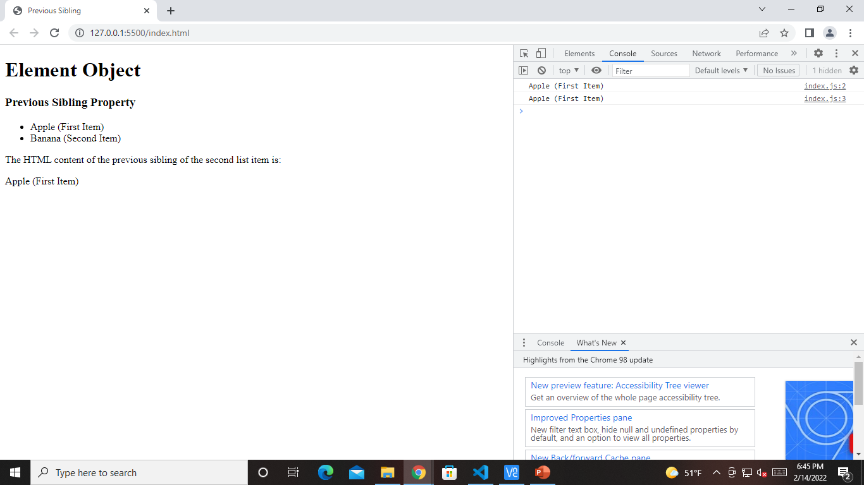
Output

Slide 5
let text = document.getElementById("second").previousSibling.innerHTML;
console.log(text);
console.dir(text);
document.write(text);

Slide 6


Slide 7
previousElementSibling
let text = document.getElementById("second").previousElementSibling.innerHTML;
console.log(text);
console.dir(text);
document.write(text);

Slide 8


